Slide 1
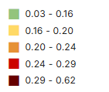
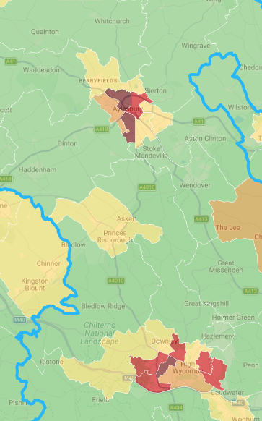

No or low qualifications
Having no or low qualifications, or poor English language proficiency, can be a barrier to work.
In total, 18% of working-age adults* (51,700 people) living in Buckinghamshire either have:
no qualifications (25,050 or 8.6%)
low qualifications** (25,400 or 8.8%)
have higher level qualifications but cannot speak English / cannot speak English well (1,250 or 0.4%
As shown on the map (dark red areas), wards in Aylesbury and High Wycombe have the highest proportion of adults with no or low skills.
  XXXXX
*aged 25 to 64
**level 1 or entry level
Source: Census 2021, ONS and the Index of Deprivation (via Local Insight)
Notes:
---
This slide references information from the following file: https://buckscc-my.sharepoint.com/personal/elizabeth_north_buckscc_gov_uk/Documents/Microsoft%20Copilot%20Chat%20Files/Buckinghamshire_Works_-_First_Edition_FINAL.pdf
Caring responsibilities are a significant and often hidden barrier to employment in Buckinghamshire. The report estimates that around 10% of residents provide unpaid care, many of whom are of working age. Caring roles can include looking after young children, older relatives, or individuals with long-term illness or disability. These responsibilities often limit the hours people can work, the distance they are willing to travel, and the types of jobs they can accept. Carers are more likely to experience stress, poor mental health, and economic inactivity, with women disproportionately affected. The cost, availability, and flexibility of childcare are particular challenges, especially in Opportunity Bucks wards. From a health perspective, carers frequently present with fatigue, anxiety, and long-term conditions that are exacerbated by financial and time pressures. The report highlights the need for flexible employment support, better integration with carers’ services, and improved awareness of available help. Health professionals are well placed to identify carers, understand the impact of caring on health and employment, and signpost individuals to tailored support that can help them balance caring responsibilities with work or training.

