Slide 1
The Buckinghamshire Economy - 2026
May 2026
Business Intelligence – PGS and Communities

Slide 2
Executive Summary

Slide 3
Executive Summary
At a macro level, economic growth stalled across the county between 2021 and 2023. Over the longer term, Buckinghamshire’s business population has grown more slowly than both regional and national averages - albeit from a high base.
Buckinghamshire’s high-value economy (e.g. tradable industries, knowledge-intensive sectors etc) has similarly experienced comparatively modest growth over the past decade. However, the county retains significant structural strengths. It has a strong presence in four of the eight growth-driving sectors (IS-8) identified by the UK Government and is home to three world-class clusters: high-performance engineering at Silverstone, film and high-end television production at Pinewood and surrounding areas, and space at Westcott. The trajectory and outlook for these clusters remains positive.
There are also encouraging signs at both ends of the business maturity spectrum. Over the past two years, Buckinghamshire has performed strongly in terms of business ‘births’ per resident, suggesting high levels of entrepreneurial activity. At the other end of the spectrum, the county is now home to 100 large employers (employing more than 250 people), up from 90 in 2024. This increase likely reflects a combination of existing firms expanding into a larger size bracket and the relocation of new large enterprises into the area.

Slide 4
Background

Slide 5
Background
This report provides analysis of the performance, size and structure of the Buckinghamshire economy. It is organised into four sections:
Economic performance
Business population
Business dynamism
Industry structure and specialisms
Each section includes an explainer to help readers understand what is being measured and how, providing context for the analysis.
All data presented within this report is the latest available at the time of writing.
Further details of the datasets and geographies used can be found in the Annex.

Slide 6

Buckinghamshire’s economy evidence base
This report is part of a suite of evidence reports and dashboards produced by Buckinghamshire Council’s economic research team and published on the Buckinghamshire Local Economic Intelligence Observatory .
Other reports and dashboards in the suite that have been published within the last two years include:
Performance of the Buckinghamshire Economy Dashboard
Buckinghamshire’s Labour Market and Skills Analysis 2025
Buckinghamshire Works Plan Evidence Base 2025
The Buckinghamshire Economy – Industry, Cluster and Innovation Strengths 2025
10 things you need to know about the Buckinghamshire economy 2025
The Buckinghamshire Productivity Review 2024

Slide 7
Economic performance

Slide 8

Measuring Economic Performance – Explainer
There are two main ways of estimating how well a local economy is performing
  The level of economic output
  The growth of economic output (e.g. change in output over time)
The main measures of economic output are Gross Domestic Product (GDP) and Gross Value Added (GVA).
GDP = GVA plus taxes, minus subsidies.
GVA is often used as a proxy for GDP.
GVA can be measured at county level, sub-county level, industry level and (to some extent) at company level.
Local level GDP and GVA data has a long lag time. For example, data for 2024 is published in mid 2026.
Local economic output (e.g. GDP/GVA) is driven by:
  The size of the population
  The proportion of the population in employment
  The productivity of workers
Productivity measures how efficiently inputs (e.g. labour, skills, physical capital and intangible capital) are converted into outputs (goods and services).
The productivity of a local economy is most commonly measured by dividing economic output (GVA) by the number of hours worked by those working within the geographic area in question.

Slide 9
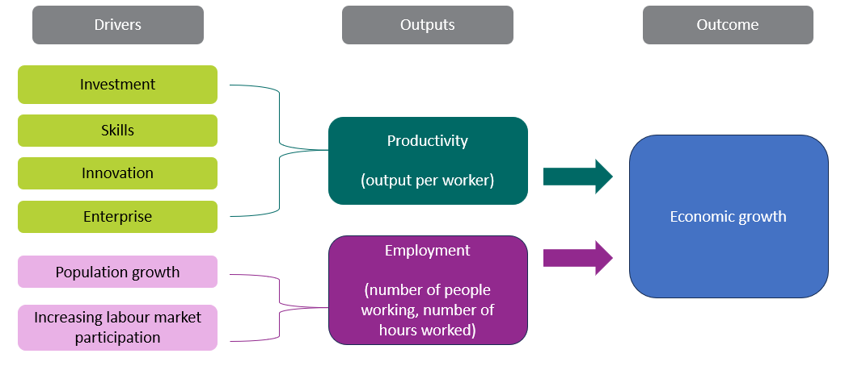
Economic Performance – Explainer
Economic growth can be achieved by increasing productivity and / or increasing employment
In developed economies with high levels of employment, raising productivity will be the most effective and sustainable way of achieving economic growth.
Simply adding more workers without improvements in productivity may not lead to long-term economic growth and can put a strain on local resources and infrastructure.

Slide 10
Economic Performance – context
The UK has experienced slow productivity growth in recent years, largely due to economic shocks (the 2007/2008 Global Financial Crisis and the Covid-19 pandemic) and geo-political uncertainty.
Despite persistently weak productivity growth since 2007, employment rates have remained relatively high by historic standards. However, the labour market has softened in recent years, with unemployment rising modestly. For individuals, the most significant impact of weak productivity growth has been a prolonged period of weak wage growth, with a limited recovery over the last few years.
Improving productivity at the local level is complex and requires a multidimensional approach. Strong productivity growth requires good performance in the key drivers of productivity - investment, skills, innovation and enterprise.
There are limited policy levers available at a local level to significantly affect local economic performance. National policy and external factors have the greatest influence. Constraints on local policy levers include: regulation, funding and political appetite.
In 2025, the Buckinghamshire Growth Board published the Buckinghamshire Economic Growth Plan. This sets out a vision and actions for securing strong productivity growth for the county over the next 10 years.
National context
Local policy levers

Slide 11
Buckinghamshire has experienced slow growth in economic output (GVA) over the last 20 years
Buckinghamshire’s GVA (£m – in 2022 prices) 2003 to 2023
Over the last two decades, Buckinghamshire’s GVA (in 2022 prices) has generally risen year-on-year, with the notable exceptions of:
  2009 (Global Financial Crisis)
  2020 (Onset of Covid-19 pandemic)
Buckinghamshire’s economic output in 2023 remains slightly below the pre-Covid level.
In 2023, Buckinghamshire’s GVA was 19% higher (in 2022 prices) than in 2003. This places Buckinghamshire in 101st position of 141 ITL3* areas in England in terms of economic growth. Across England as a whole, GVA was 32% higher in 2023 than in 2003.
Source: ONS, 2025
Note: Chained Volume Measure (CVM) of Gross Value Added (GVA) in 2022 money value (£m)
*See Annex for definition

Slide 12
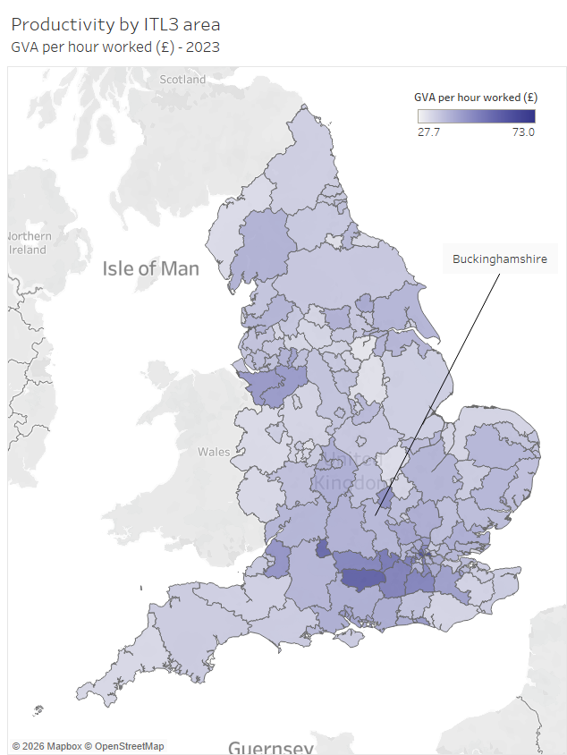
Buckinghamshire has a more productive economy than much of the rest of the country, but is outperformed by most neighbouring areas
In 2023 Buckinghamshire was ranked 57th out of 141 ITL3* areas in England in terms of productivity
Productivity (GVA per hour worked - £) - 2023
Source: ONS, 2025
Click here for interactive map
*See Annex for definition

Slide 13
Buckinghamshire’s productivity is lower than the national (England) average, however, the national average is skewed by some very high performing areas within London and the South East
Productivity (GVA per hour worked) - 2023
Buckinghamshire’s productivity sits below the national (England) average. However, the national average reflects the influence of a small number of exceptionally high-performing areas, particularly in London and parts of the South East. In fact, only 33 of England’s 141 ITL3* areas exceed the national average. Buckinghamshire performs above the median of all ITL3 areas, placing it in the stronger half of areas nationally.
£42.39
£40.15
£38.62
England
Buckinghamshire
Median of 141 ITL3 areas
Source: ONS, 2025
*See Annex for definition

Slide 14
Buckinghamshire’s comparative performance on productivity has weakened over the last decade or so
Productivity over time, Buckinghamshire v England (England = 100)
Buckinghamshire’s productivity rank – out of 141 ITL3 areas
From a relatively strong position between 2007 and 2011, Buckinghamshire’s economy experienced slower than average productivity growth between 2011/12 and 2016. Productivity rates (GVA per hour worked) have been similar to, or slightly below, the England average since 2016.
In ranking terms, Buckinghamshire had the 25th highest productivity rate of the 141 ITL3* areas of England in 2011, falling to 51st position in 2017. The county rose back up the rankings to 34th in 2020, before falling down to 57th position in 2023.
Source: ONS, 2025
*See Annex for definition

Slide 15
Buckinghamshire has high levels of gross disposable household income (GDHI) per head of population, ranking 15th of the 141 ITL3 areas
GDHI per head of population (£) by ITL3 area (2023)
Whilst Buckinghamshire’s productivity is similar to the national average, Buckinghamshire households have much higher levels of gross disposable income. GDHI per head of population is 29% higher in Buckinghamshire than the England average, and Buckinghamshire is ranked 15th of 141 ITL3* areas on this measure.
Analysis conducted by ONS in 2021 found that areas with higher GDHI than productivity tend to be more rural but within commuting distance of large cities.
High levels of disposable income in Buckinghamshire are therefore likely linked to a high proportion of residents working in highly paid roles in London-based organisations. Higher levels of GDHI are also likely to reflect greater levels of wealth (on average) within the local retiree population than nationally.
Source: ONS, 2025
Note - GDHI is calculated before housing costs such as rental and mortgage capital repayments.
*See Annex for definition

Slide 16
Business Population

Slide 17
Business Population Statistics - Explainer
The majority of business statistics measure enterprises or units operating above defined thresholds, usually those registered for VAT and/or PAYE.
Businesses with a VAT taxable turnover of over £90,000 must register for VAT.
Businesses with one or more employee (who are paid £96 or more a week) must register for PAYE. This includes sole directors who take a salary from the company.
Businesses not registered for VAT or PAYE are referred to as being ‘unregistered.’
A business enterprise is the smallest combination of legal units which has a certain degree of autonomy within an enterprise group.
A business unit is a branch, factory or office (etc) of a business enterprise.

Slide 18
There were approximately 67,500 private sector businesses operating in Buckinghamshire in 2025
At the beginning of 2025, we estimate that there were approximately 67,500 private sector (including non-profit) businesses in Buckinghamshire.
Just over half of these businesses (approximately 37,100) had no employees and were not registered for VAT / PAYE.
There were 30,400 private sector VAT / PAYE registered enterprises in Buckinghamshire in 2025.
Overall, the total number of private sector businesses operating in Buckinghamshire has been stable over the last few years. However, there has been a slight drop in the number of VAT / PAYE registered firms, and a slight increase in the number of unregistered firms.
We have very limited information on the economic contribution of Buckinghamshire’s unregistered businesses.
67,500 private sector businesses (estimate)
37,100
unregistered (estimate)
30,400
registered
Source: UK Business Count 2025, ONS and Business Population Estimates, Department for Business and Trade, 2025

Slide 19
Buckinghamshire has a much larger VAT / PAYE business base (on a per head of population basis) than the national average
57
businesses per 1,000 residents
45 businesses per 1,000 residents
43 businesses per 1,000 residents
Buckinghamshire
South East
England
In 2024, there were 57 VAT / PAYE registered businesses in Buckinghamshire per 1,000 residents, much higher than the regional average of 45 and the national average of 43.
Source: Business Demography 2024, ONS and ONS mid-year population estimates (2024)

Slide 20
Buckinghamshire has experienced slower growth in the number of VAT / PAYE registered businesses than the regional and national averages over the last decade
The number of VAT / PAYE businesses operating in Buckinghamshire was relatively stable between 2019 and 2024, with a decline between 2024 and 2025.
In 2025, there were 5% more VAT / PAYE businesses in Buckinghamshire than in 2015. Nationally there were 12% more businesses and regionally there were 7% more businesses.
Change in number of VAT / PAYE registered businesses – 2015 to 2025
Number of VAT / PAYE businesses in Buckinghamshire over time
Note – non-zero y axis
Source: UK Business Count 2025, ONS

Slide 21
Micro firms are more dominant in the Buckinghamshire economy than the national average, but a small number of large organisations provide a substantial proportion of the county’s jobs.
Businesses and employment by size of firm (Buckinghamshire)
Employees by size of firm (Buckinghamshire versus England)
The vast majority of VAT/PAYE enterprises in Buckinghamshire are micro in size (employing fewer than 10 people).
Buckinghamshire is home to 100 large enterprises (with more than 250 employees). Whilst they only account for 0.3% of all VAT/PAYE registered enterprises in Buckinghamshire, they provide 47% of all employee jobs.
Micro, small and medium-sized firms provide more employee jobs in Buckinghamshire than the national (England) average. Around 20% of employee jobs in Buckinghamshire are in firms employing fewer than 10 people, compared with 15% nationally.
Source: ONS, 2025

Slide 22




























A selection of Buckinghamshire’s largest employers (operating within the private, public and not-for-profit sectors) are set out below.

Slide 23
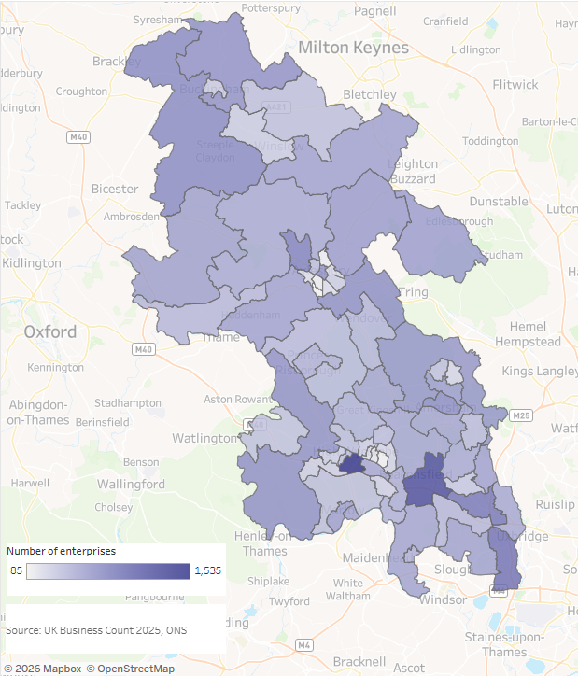
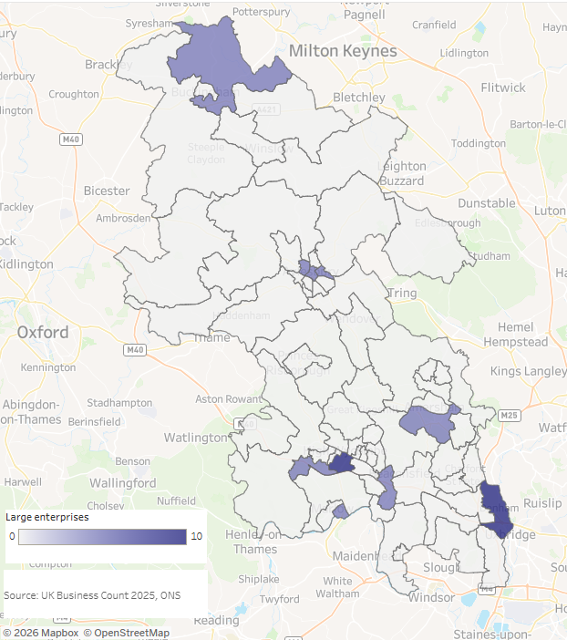
Where VAT/PAYE registered businesses (enterprises) are concentrated in Buckinghamshire - 2025
Where large employers (employing 250+ people) are concentrated in Buckinghamshire - 2025
There are particularly high concentrations of businesses along the M40 corridor (High Wycombe, Beaconsfield, Marlow, Wooburn Green, west of Uxbridge).
Buckinghamshire’s largest employers (employing more than 250 people) are mainly located in: the south of the county; in Aylesbury; and in the far north of the county (in the area which includes Silverstone Park business park).
Click here for interactive map

Slide 24
Business Dynamism

Slide 25
Business Dynamism Statistics - Explainer
Business dynamism is a vital driver of productivity and economic growth.
Typically, it is measured by the rate at which firms enter the market, grow, shrink, and leave the market. I.e. start-up, grow and close.
A steady rate of business creation and closure is necessary for an economy to grow in the long-run, because it allows new ideas to flourish.
It is argued by some that reduced business dynamism in recent years has contributed to weak productivity growth¹.
High business survival rates in an area tend to be an indicator of a stable economic environment where businesses can thrive, and residents benefit from a stable job market. However, high survival rates that are due to lack of competition may not be beneficial in the long term.
¹ Ready for Change, the Resolution Foundation, 2023

Slide 26
Buckinghamshire’s ‘new businesses’ have higher survival rates than the national and regional averages
Business survival rates for firms ‘born’ between 2019 and 2023
Data on business survival is published for businesses that are VAT and/or PAYE registered.
For the last five years, ‘new businesses’ (i.e. those becoming VAT or PAYE registered) in Buckinghamshire have been more likely to survive for two, three, four and five years than is the case nationally and regionally.
This was particularly the case in 2020 (the year of the onset of the Covid-19 pandemic). 50.7% of Buckinghamshire firms ‘born’ in this year have survived for four years, compared with the regional and national averages of 45.2% and 43.8% respectively.
Generally speaking, high business survival rates indicate a stable and supportive economic environment where businesses can thrive. On the flip side, they could indicate a lack of competition that may not be beneficial to the economy in the long term.
Source: Business Demography 2025, ONS

Slide 27
Buckinghamshire has a higher number of business births per resident than the national average, suggesting higher levels of entrepreneurialism. Buckinghamshire has lower business births as a proportion of exiting the business stock than the national average, suggesting lower levels of churn within the business base
Total number of business births
Business births per 10,000 residents
Business births as percentage of business stock
The total number of business births (businesses becoming VAT / PAYE registered) in Buckinghamshire has been relatively stable over the last three years. Annual figures for the last five years have not surpassed the pre-Covid figure of 3,375 in 2019.
Assessing business births as a proportion of the resident population helps us ascertain levels of entrepreneurialism. Buckinghamshire has a higher rate of business births per resident than the national average, suggesting higher levels of entrepreneurialism.
Assessing business births as a proportion of business stock, helps us measure the level of churn within the business base. Buckinghamshire has a lower rate of business births per active business, suggesting lower levels of churn and a more stable business base than the national average.
Source: Business Demography 2024, ONS
Notes:
Look at net change in active

Slide 28
Buckinghamshire tends to have a lower business death rate (number of deaths as a proportion of business stock) than the national average. Again, reflecting less churn within the business base.
Business deaths as percentage of business stock
Business death rates in Buckinghamshire rose following the Covid-19 pandemic, as was the case nationally, peaking in 2022 when most Covid-related business support measures had been phased out.
The latest data suggests that Buckinghamshire had a higher business death rate than the national average in 2024. However, ONS have flagged anomalies within the data (i.e. the loss of multiple firms registered at one address). Therefore Buckinghamshire’s 2024 data should be treated with caution.
Source: Business Demography 2024, ONS

Slide 29
Buckinghamshire’s high growth firm rate is fairly similar to England’s. 2023 was a strong year for high growth firms in Buckinghamshire, with 135 firms classified as high growth in terms of employment
Number of high growth firms* in Buckinghamshire
High growth firm rate**
*enterprises with more than 10 employees that have average annualised growth in the number of employees greater than 20% per annum, over a three-year period.
** high growth firms as a proportion of all firms employing more than 10 people (VAT / PAYE registered)
Source: Business Demography 2024, ONS

Slide 30
In May 2026 there were approximately 500 firms exhibiting ‘growth signals’* in Buckinghamshire being tracked by high growth firm specialists Beauhurst. Just under half were classified as ‘established’. Nationally, a greater proportion are at ‘seed’ stage.
Buckinghamshire’s high growth firms’ stage of evolution*
England’s high growth firms’ stage of evolution*
Source: Beauhurst, May 2025
*see Annex for definitions

Slide 31
Industrial structure and specialisms

Slide 32
Industrial Structure and Specialisms Statistics – Explainer (1)
Industrial structure describes the composition of an area's economic activity.
We can understand the industrial structure of an area by considering
  The number of people employed in different industries
  The amount of economic output (GVA) generated by different industries
  The number of businesses operating in different industries
In the UK, industries are officially classified using Standard Industrial Classification (SIC) codes. These better describe traditional production industries than they do more modern service industries, or emerging industries such as ‘space’.
Alternative industry classification systems have been developed by companies such as the Data City and Beauhurst, that better define new and emerging industries.

Slide 33
Industrial Structure and Specialisms Statistics – Explainer (2)
Tradeable sectors tend to drive productivity growth.
Tradable goods and services can be sold and consumed outside of the region in which they are produced. In contrast, non-tradable goods and services can only be bought and consumed where they are produced. They form the foundational economy.
Cars and computer software are tradable. A meal at a restaurant is not.
Local public services (e.g. school, GP surgeries, local government) operate within the foundational economy,
The traded sector benefits local economies in other ways. The traded sector generates income which can be spent locally. This results in the multiplier effect. Put simply, the multiplier effect is the number of additional jobs one additional job creates. Non-tradable sectors also have a multiplier effect, but studies show that it’s much lower.
Tradable sectors serve a market that reaches beyond the local economy. This means that they are much less likely to be in direct competition with other local businesses, reducing the risk of displacement.
Source: the What Works Centre for Local Economic Growth

Slide 34
Industrial Structure and Specialisms Statistics – Explainer (3)
The knowledge economy is the element of an economy that is based on intellectual capabilities rather than natural resources or physical contributions. Products and services that are based on intellectual expertise advance technical and scientific fields, encouraging innovation in the economy as a whole*.
According to the OECD, “ageing populations and dwindling natural resources mean that growth in advanced economies will increasingly depend on knowledge-based increases in productivity. Unlike labour, natural resources and physical capital, knowledge-based capital is the only factor of production that will not suffer from scarcity”.
Three Standard Industrial Classification (SIC) code sectors are generally used** to statistically analyse the knowledge economy at a local level. These are:
  Telecommunications; information technology
  Research and development; advertising and market research
  Other professional, scientific and technical activities
*Investopedia, accessed 22 August 2023
**E.g. Oxfordshire’s Innovation Engine, 2023, Advanced Oxford

Slide 35
Buckinghamshire’s economy is dominated by the service sector. Buckinghamshire’s service sector has experienced weaker growth since 2007 than the national average.
GVA generated by Buckinghamshire’s service and production sectors (2007 to 2023)
In 2023 (latest available data) approximately 82% of Buckinghamshire’s economic output was generated by the service sector. This is similar to the national picture.
However, whilst the growth of Buckinghamshire’s production sector since 2007 has been just below the national average (5% versus 7%), the growth of the county’s service sector has been substantially weaker (13% versus 26%). In 2023, the output in both the county’s production and service sectors remained slightly below pre-pandemic levels.
Production sector: Manufacturing, construction, agriculture, mining and utilities
Service sector: Wholesale; retail; transport; storage; hospitality; financial services; real estate; information & communication; professional, scientific & technical; admin & support services; public administration; health; education; the arts and recreation
Source: ONS, 2025
Note: Chained Volume Measure (CVM) of Gross Value Added (GVA) in 2022 money value (£m)

Slide 36
Buckinghamshire has a smaller tradeable sector (particularly in output terms) than the national average
Buckinghamshire
60% of Buckinghamshire’s economic output (GVA) is generated by the foundational sector (i.e. firms and organisations serving the local population). This is higher than the national average of 51%.
The foundational sector provides 64% of jobs in the county, which is in line with the national average.
The size of Buckinghamshire’s foundational economy could, in part, be driven by high employment rates and high wages, which enable residents to spend more on local services (such as cleaning, health and fitness, hair and beauty, and animal care) than in other parts of the country.
England
Source: Lightcast 2024

Slide 37
Buckinghamshire’s knowledge economy has experienced slow growth since the Global Financial Crisis
Economic output of Buckinghamshire and England’s knowledge economy over time
Buckinghamshire’s knowledge economy (see explainer) generated 7.4% of the county’s economic output in 2023.
GVA generated by Buckinghamshire’s knowledge economy grew rapidly from 1998 to 2006 (just before the Global Financial Crisis).
Since 2006, GVA generated by Buckinghamshire’s knowledge economy has plateaued. In 2023, output generated by Buckinghamshire’s knowledge economy was 10% lower than in 2007. Nationally, output was 53% higher in 2023 than in 2007.
Global Financial Crisis
Source: ONS, 2025
Note: Chained Volume Measure (CVM) of Gross Value Added (GVA) in 2022 money value (£m)

Slide 38
The sub-sectors that make up the knowledge economy have experienced mixed success since 2007
Economic output of the constituent elements of Buckinghamshire’s knowledge economy over time
Within Buckinghamshire’s knowledge economy, growth has been greatest in the telecommunications / IT sub-sector - although output has dropped sharply over the last two years. A trend not observed to this extent nationally.
The amount of GVA generated by the research & development; advertising and market research sub-sector fell between 2007 and 2019 and has since plateaued. Cross-referencing this with employment data, we believe that most of the fall in output was in the market research element of the sub-sector, rather than R&D.
Source: ONS, 2025
Note: Chained Volume Measure (CVM) of Gross Value Added (GVA) in 2022 money value (£m)

Slide 39
In 2023, Buckinghamshire’s economic output was driven by the wholesale, construction and manufacturing sectors
Economic output (GVA) by sector, 2023
The wholesale, construction and manufacturing and sectors generated the most economic output (GVA) for Buckinghamshire in 2023.
The wholesale sector contributes more than twice as much to local GVA as it does to national GVA, and the construction sector 1.6 times more. Buckinghamshire’s wholesale specialisms are the wholesale of office machinery and equipment, pharmaceuticals and computers / software.
Two high productivity / high value sectors: professional, scientific & technical; and financial & insurance; generate a smaller proportion of Buckinghamshire’s total economic output than the national average. Whilst the contribution of the highly productive information & communication and manufacturing sectors is in line with the national average.
Source: ONS, 2025
Note: Real estate industry data excludes owner occupiers imputed rental values

Slide 40
The health & social work sector provides the most employee jobs within Buckinghamshire
Share of employees by sector, 2024
The health & social work sector provides the most employee jobs within Buckinghamshire, many of which are part-time roles.
More than twice as many people work within the wholesale sector in Buckinghamshire than the national average.
Other sectors employing a higher proportion of the employee workforce locally than nationally include: construction and information & communication.
Note: this analysis excludes those who are self-employed. Self-employment is more prevalent in certain sectors and occupations, including: construction, hairdressing, sport, TV and film, taxi driving and animal care.
Source: BRES, 2024

Slide 41
Buckinghamshire has a higher proportion of businesses operating within the professional, scientific & technical and the information & communication sectors than the national average.
Share of businesses (enterprises) by sector, 2025
Just under a fifth of businesses* in Buckinghamshire operate within the professional, scientific and technical sector (which includes law firms, accounting firms, and engineering companies), a higher proportion than nationally. Despite this, the sector produces less economic output for the local economy than the national average.
Buckinghamshire also has a higher proportion of firms within the information & communication sector than the national average. This sector includes computer programming and consultancy firms, and motion picture, video and TV companies. The economic output created by this sector in Buckinghamshire is similar to the national average.
A higher proportion of firms operating within these two sectors are micro in size (employing fewer than 10 people) than the national average, and a higher proportion of these firms categorise themselves as providing ‘consultancy.’
In total, 18% of firms in Buckinghamshire are consultancies, compared with 13% nationally.
Source: UK Business Count, 2025
*Analysis relates to VAT / PAYE registered businesses

Slide 42
Three sectors which typically drive productivity growth (professional, scientific & technical, information & communication, and financial & insurance) have experienced negative GVA and employment growth in Buckinghamshire over the last 10 years
High GVA & high employee growth
High employee growth & negative GVA growth
Three sectors have experienced particularly high growth in both GVA and employment in Buckinghamshire over the last 10 years – construction; public administration & defence; and utilities. The latter two employ comparatively few people.
Three high productivity sectors (professional, scientific & technical, information & communication, and financial & insurance) have experienced negative growth in both GVA and employment over the period.
Chart details
Size of circle = number of employees in 2024
Orange circles are sectors with higher-than-average productivity rates
Sources: ONS 2025 and BRES 2024
Negative employee growth & negative GVA growth
High GVA growth & negative employee growth

Slide 43
Industrial Strategy Growth Driving Sectors (the ‘IS-8’) & their ‘frontier’ industries
Employment in the IS-8 sectors and their frontier industries in Buckinghamshire
Employment in the foundational industries that provide inputs and infrastructure for the IS-8 sectors
 | Number of employees in Buckinghamshire (2024) | Location Quotient
Advanced Manufacturing | 6,250 | 1.1
Aerospace manufacturing | 1,950 | 2.7
Automotive manufacturing | 300 | 0.2
Clean Energy Industries | n/a | n/a
Creative Industries | 15,950 | 1.4
Adverstising & marketing | 1,400 | 0.8
Film & TV | 3,600 | 3.2
Music, performing, & visual arts | 1,225 | 1.7
Defence | n/a | n/a
Digital and Technologies | 23,265 | 1.3
Financial Services | 3,475 | 0.4
Asset management & wholesale services | 320 | 0.3
Capital markets & retail investment | 960 | 0.3
Insurance & reinsurance markets | 685 | 0.4
Life Sciences | 980 | 1.3
Professional & Business Services | 28,250 | 0.8
Accounting, audit, & tax consultancy | 2,500 | 0.6
Legal services | 1,750 | 0.7
Managament consultancy | 5,000 | 1.2
 | Number of employees in Buckinghamshire (2024) | Location Quotient
Foundational industries & inputs
Chemicals | 600 | 1.0
Construction | 15,000 | 1.3
In June 2025, the UK Government published its Industrial Strategy – a 10-year plan to increase business investment and grow the industries of the future in the UK.
The Strategy focuses on backing eight sectors (the IS-8) with the highest growth-driving potential, and the frontier industries at their leading edge.
The data in the tables on this page set out ‘best estimates’ of the number of people the IS-8 sectors and their frontier industries (where official data is available) employ in Buckinghamshire.
The Location Quotients (LQs) presented in the tables indicate the extent to which Buckinghamshire has a specialism in each sector / industry. A LQ of 2, for example, shows that Buckinghamshire has twice as many employees in that sector / industry than the national average.
Buckinghamshire has higher than national average employment in four IS-8 sectors (see dark green cells): creative industries; life sciences; digital & technologies and advanced manufacturing. And has higher than national average employment in four ‘frontier industries’ (light green cells): film and TV; aerospace manufacturing; music, performing, and visual arts; management consulting.
Please note, frontier industries for which Buckinghamshire data is not available are excluded from the tables
Source: BRES, 2024

Slide 44
Buckinghamshire is home to three world-class clusters, and sits within the Oxford-Cambridge-London life sciences golden triangle
Sector | Cluster | Asset/s | Maturity | Fortunes over last 5 years
Film and high-end television | West of London Screen Cluster | Pinewood National Film and Television School CoStar National Lab Marlow Studios (forthcoming) Buckinghamshire Film Office | Mature | The sector has had a bumpy few years. Demand for studio space and a skilled workforce has boomed, but significant disruption was caused by Covid-19 and the US writer and actor strikes. The sector currently appears more stable.
High performance engineering | Silverstone Technology Cluster | Silverstone Technology Park Silverstone Sports Engineering Hub Digital Manufacturing Centre Applus+3C Test The National College for Motorsport Silverstone University Technology College | Mature / evolving | The last five years have seen further expansion of the Silverstone Park site and diversification of advanced engineering activity exemplified by the establishment of the Digital Manufacturing Centre and the Silverstone Sports Engineering Hub.
Space | Westcott Space Cluster | National Space Propulsion Test Facility In-Orbit Servicing and Manufacturing facility Drone Test and Development centre Future Networks Development Centre Innovation Centre Centre for Excellence for Rocket Engineer and Flow Tests facility Skylark Conference Centre | Growth | The Westcott Space Cluster has evolved significantly over the last five years, largely as a result of investment and partnership working between the Westcott Venture Park landowner (PATRIZIA), national agencies (the UK Space Agency and the Satellite Applications Catapult), local organisations (Buckinghamshire Local Enterprise Partnership – now part of Buckinghamshire Council), and the space-related firms operating at the park.
Life Sciences | Oxford-Cambridge-London golden triangle | National Spinal Injuries Centre (Stoke Mandeville) Health Research and Innovation Centre Health and Social Care Partnership Epilepsy Society Global life science firms | Mature / evolving | The sector is growing, with employment increasing by 12% between 2017 and 2022. The Health Research and Innovation Centre at Stoke Mandeville opened in 2021 and has attracted national innovation funding.
Further details on each of the four specialisms can be found in The Buckinghamshire Economy: Industry, cluster and innovation strengths report (pages 74 to 119) (Buckinghamshire Council, 2025)

Slide 45
Annex

Slide 46
Data sources
The analysis presented within this report draws on the following Office for National Statistics (ONS) data sources:
  Sub-regional GVA 2023
  Sub-regional Productivity 2023
  UK Business Population: Size, activity, and location 2025 (see next slide for further details)
  Business Demography 2024 (see next slide for further details)
  Business Register and Employment Survey 2024
Plus, information from data providers Beauhurst (on high growth firms), along with locally generated intelligence.

Slide 47
Business Demography – 2024
Data sources
UK Business Population: Size, activity and location 2025
This dataset presents annual data on the number of businesses (enterprises) registered for Value Added Tax (VAT) and/or Pay As You Earn (PAYE)
Low turnover non-employing (unregistered) businesses are not covered by this data
The data is produced by the Office for National Statistics from the Inter-Departmental Business Register (IDBR)
The 2024 data measures businesses that were active between December 2022 and December 2023
Being ‘active’ means that they either had turnover of employment at any time in the reference year
The full dataset can be accessed here
This dataset presents annual data on the number of businesses (enterprises) registered for Value Added Tax (VAT) and/or Pay As You Earn (PAYE)
Low turnover non-employing (unregistered) businesses are not covered by this data
The data is produced by the Office for National Statistics from the Inter-Departmental Business Register (IDBR)
The 2025 data measures businesses that were active on 11 March 2025
Being ‘active’ means that they had turnover of employment at any time in the reference year.
The full dataset can be accessed here

Slide 48
Measuring productivity
The Office for National Statistics (ONS) publish sub-regional estimates of labour productivity on an annual basis. Three things to bear in mind with the data are:
The data has a long lag time of 2 years
It is subject to on-going methodological revisions. These revisions can be big. For example, revisions adopted in 2018 resulted in Buckinghamshire’s productivity performance being significantly downgraded.
A handful of areas of the country have very high levels of productivity (in particular London and Berkshire) and therefore skew the national and regional (South East) averages.
A quirk in the way productivity data is calculated (the inclusion of estimates of the value of home ownership) artificially inflates Buckinghamshire’s productivity figures to a greater extent than in many other parts of the country.
The chained volume measure (CVM) of productivity is a way of measuring productivity in real (inflation-adjusted) terms over time, using a method that keeps prices constant.

Slide 49
Firms exhibiting growth signals
High growth firm specialists, Beauhurst, identify high growth / high potential firms on the basis of whether or not meet any of the following growth signals:
Equity fundraising (the issuance and sale of new shares by a company to fund its growth)
Debt fundraising (venture debt comprises mezzanine debt, convertible debt and debt provided by angel networks or venture capital firms)
Management buy-outs / buy-ins
Attendance on accelerator programmes (programmes that validate the ambition and growth prospects of participating companies)
10% scaleup & 20% scaleups (annualised average growth rate of at least x% in turnover over 3 accounting years AND it had at least £200k in revenue in its base year or annualised average growth rate of at least x% in headcount over 3 accounting years AND it had at least 20 employees in its base year)
Acquired / made acquisition
IPO (an Initial Public Offering, where a company lists on a public stock exchange)
High growth list (lists that validate the ambition and growth prospects of featured companies)
Source: Beauhurst, 2026

Slide 50
Stages of business evolution
Stages of evolution | Applicability criteria
Seed | A youngish company with a small team, low valuation and funding received (low for its sector), uncertain product-market fit or just getting started with the process of getting regulatory approval. Funding likely to come from grant-awarding bodies, equity crowdfunding and business angels.
Venture | A company that has been around for a few years, has either got significant traction, technology or regulatory approval progression and funding received and valuation both in the millions. Funding likely to come from venture capital firms.
Growth | A company that has been around for 5+ years, has multiple offices or branches (often across the world), has either got substantial revenues, some profit, highly valuable technology or secured regulatory approval significant traction, technology or regulatory approval progression, funding received and valuation both in the millions. Funding likely to come from venture capital firms, corporates, asset management firms, mezzanine lenders.
Stages of evolution | Applicability criteria
Established | A company that has been around for 15+ years, or 5-15 years with a 3 year consecutive profit of £5m+ or turnover of £20m+. It is likely to have multiple (often worldwide) offices, be a household name, and have a lot of traction. Funding received, if any, is likely to come from corporates, private equity, banks, specialist debt funds and major international funds.
Zombie | The company has met one or more of these conditions: website and/or social media presence show prolonged neglect. key people have all left the company and it appears to have no employees. has appointed administrators or liquidators. status in Companies House is dissolved but the company still appears to be active.
Source: Beauhurst, 2026

Slide 51
Geographic areas
Area | Definition
International Territorial Level (ITL) areas | Europe-wide geographic units that exist at three levels. Within England, ITL1 relates to regions (e.g. the South East), ITL2 is the next level down (e.g. Berkshire, Buckinghamshire and Oxfordshire) and ITL3 is the smallest geographic level (e.g. Buckinghamshire).
Upper tier local authority areas | County or unitary authorities

