Slide 1
Buckinghamshire:
Labour Market and Skills Analysis
August 2025

Slide 2
Contents
About
Key findings
Quick links
Section 1: The economy
Section 2: Industries and occupations
Section 3: Demand for labour
Section 4: Labour market participation
Section 5: Skills supply
Section 6: Meeting current and future demand for skills
Key stats
Acronyms and abbreviations
Definitions
Further reading

Slide 3
About
This slide-deck provides a comprehensive overview of the current state of the Buckinghamshire labour market, in particular, the demand for and the supply of skills.
It is a reference document that has been designed to help inform strategic decision making.
All data presented within the slide-deck is the latest available at the time of writing (July 2025).
If you have any questions, please get in touch via the e-mail address below:
pgsandcommunitiesbi@buckinghamshire.gov.uk

Slide 4
Key findings – the nature of jobs within the Buckinghamshire economy
Buckinghamshire has a mixed economy that is not dominated by a single industry.
Buckinghamshire’s health sector employs the most people within the county, whilst twice as many people work in Buckinghamshire’s wholesale sector than the national average.
A slightly greater proportion of Buckinghamshire-economy employees work in the ‘education’, ‘information & communication’, ‘construction’ and ‘arts, entertainment, recreation & other services’ sectors than the national average.
The prevalence of part-time work varies considerably by sector with the county’s health, retail, hospitality and education sectors employing the largest number of people on a part-time (less than 30 hours per week) basis.
A comparatively small proportion of all employee jobs in Buckinghamshire are within the public sector.
(With some exceptions) there has been stronger employee growth in Buckinghamshire’s lower-productivity / foundation economy sectors and than in higher-productivity / tradeable economy sectors since 2015.
Buckinghamshire has particular specialisms (i.e. higher than national average levels of employment) in the following supply chain clusters:
  Downstream chemical
  Appliances and personal goods
  Production technology
  Local environmental services
  Creative
  Precision technology
It is estimated that 7% of all jobs in Buckinghamshire sit within Buckinghamshire’s four areas of economic and innovation specialism or strength: film and high-end television; high performance engineering; space; and life sciences.
A greater proportion of Buckinghamshire’s working residents work in managerial and professional occupations than the national average.
The two largest occupations that are more highly concentrated in Buckinghamshire than nationally are both marketing related - ‘marketing and sales directors’ and ‘marketing and commercial managers’.

Slide 5
Key findings – recruitment difficulties
Buckinghamshire employers are more likely to report recruitment difficulties than average.
Vacancies are hard to fill for a mixture of reasons – including skills shortages, labour shortages, unattractive job conditions and the ease by which people can access employment sites by public transport.
Buckinghamshire’s labour and skills shortages are exacerbated by high levels of out-commuting, high employment rates, high housing costs (making it difficult for people to move to the area to take up job opportunities) and local employers being unable to match London-wages.
In comparison to the national average, vacancies in Buckinghamshire are more prevalent for middle-skill and service-intensive occupations, whilst skills shortage vacancies are more prevalent for high and middle-skill occupations.
Skills shortage vacancies are particularly prevalent for associate professional and skilled trade roles.
Local job vacancies in occupations concentrated in the manufacturing; health; professional, scientific & technical and construction sectors tend to take the longest time to fill – indicating labour or skills supply shortages.
Labour and skills shortages are a barrier to economic growth. They can result in: increased workload for existing staff, increased costs, delays in innovation, difficulties meeting customer service objectives and firms having to outsource work.
For Buckinghamshire’s economic and innovation specialisms, labour and skills shortages are a barrier to firms’ ability to undertake and commercialise cutting edge innovation, and therefore ultimately to the UK’s ability to capture global market share, which in turn drives national economic growth.

Slide 6
Key findings – labour market participation
There has been little change in the labour market participation rates of Buckinghamshire residents over the last 20 years. Overall economic activity and inactivity rates in 2021 were very similar to those of 2001.
Over the last 20 years has been the reduction in the proportion of residents who are economically inactive because they are ‘looking after home or family’.
Buckinghamshire residents are more likely to be economically active and in employment than the national average and are less likely to be economically inactive or unemployed.
Employment rates are lowest amongst those with a disability, those who do not speak English well and those providing 50 hours plus a week undertaking unpaid care.
Approximately 22,800 (or 7% of) Buckinghamshire’s working age residents are not working but would like to.
A higher proportion of Buckinghamshire’s economically inactive population are students than the national average, whilst a lower proportion are long-term sick or disabled.
Economic inactivity due to long term sickness is more prevalent in urban areas and to the north of the county, whilst inactivity due to early retirement is more common in rural areas.
Buckinghamshire residents are less likely to be claiming benefits due to being out-of-work or having low earnings than the national average.
Whilst there are limitations with datasets, it is estimated that Buckinghamshire’s unemployment rate and claimant count rate (residents claiming benefits due to being out of work or having low earnings) have crept up in the 12 months to June 2025.
Across the county, the claimant count rate is highest in the Wycombe and Aylesbury parliamentary constituency areas.
Buckinghamshire’s working residents are more likely to be employed than the national average.
Buckinghamshire has higher self-employment rates than the national average.
Buckinghamshire is a net exporter of workers, with 29,200 more residents leaving the county for work than non-residents commuting in.
London is a key destination for those leaving the county for work, with 17% of all working residents working in central or greater London.
Employees jobs within the Buckinghamshire economy are most densely concentrated in the south of the county, particularly in locations within easy-reach of the M40.

Slide 7
Key findings – labour and skills supply
Buckinghamshire has a smaller proportion of residents aged 19 to 37 than the England average, particularly in the 19- to 22-year-old age group. This is common in predominantly rural English counties.
Within the county, Wycombe and Aylesbury parliamentary constituency areas have younger age profiles.
On an annual basis, around 2,000 more 19-year-olds move out of Buckinghamshire than move in. The majority of them doing so to attend out-of-county universities.
Buckinghamshire has a higher old age dependency ratio than the national average. The ratio is projected to continue to rise over the next 25 years.
Buckinghamshire’s working age residents are more likely to have degree-level qualifications than the regional and national averages.
Areas within Buckinghamshire’s main towns (Wycombe, Aylesbury and Chesham) have the highest proportion of residents with no or low-level qualifications. Whilst residents in the south of the county are most likely to have a degree-level or higher qualification.
Buckinghamshire is home to one general Further Education college (the Buckinghamshire College Group), and three higher education institutions (Buckinghamshire New University, the University of Buckingham, and the National Film and Television School).
A comparatively high proportion of young people in Buckinghamshire enter ‘sustained destinations’ following Key Stage 4 and Key Stage 5.
Year 11 leavers are more likely to remain in a sustained destination (mainly education) than the national average and are more likely to go on to study at a school sixth form.
On completion of 16–18-year-old study, a much higher proportion of young people from Buckinghamshire go on to study at university than the national average.
Buckinghamshire has lower Apprenticeship start rates than the national average, and some of the lowest rates of neighbouring areas.
Over the last eight years, there has been a sharp increase in the proportion of Apprenticeship starts at Level 4, and a sharp decrease in the proportion of starts at Level 2.
Aside from ‘preparation for life and work’ related subjects, the further education subjects most commonly studied in Buckinghamshire are ‘health, public service and care’, ‘business, administration and law’ and ‘retail and commercial enterprise’.
The top three subject areas studied by those completing higher education courses at Buckinghamshire institutions are: ‘business and management’; ‘education and teaching’; and ‘subjects allied to medicine’.
Buckinghamshire employers are slightly less likely than average to offer training to employees.

Slide 8
Key findings – skills priorities
The evidence presented within this report suggests the continuing need for Buckinghamshire’s current and future workforce to develop and upskill in the following areas:
Cross-cutting skills
  Management
  Digital (including Generative AI)
  Employability
Skills to support the growth of Buckinghamshire’s economy
  Skills required by Buckinghamshire’s three economic and innovation specialisms (film and high-end television, high performance engineering and space)
  Skills required of Buckinghamshire’s life sciences sector
  Skills required of Buckinghamshire’s remaining high value sectors (e.g. digital technologies, professional services)
  Entrepreneurialism
Occupations potentially warranting focus to ensure the required local supply of skills
  Health and care related
  Engineering*
  Associate professional / technician level roles
  Skilled trades
  Teaching
*please note, new engineering course have been established by Buckinghamshire New University and Buckinghamshire College Group within the last two years. It is too early to assess the extent to which these will help ease skills shortages.

Slide 9
Quick links
Industry structure
Recruitment difficulties
Labour market participation overview
School leaver destinations
Occupation structure
Reasons for hard-to-fill vacancies
Economic inactivity and unemployment
Education and training providers
Large employers
Skills shortages
Claimant count
Apprenticeships
Innovation clusters
Skills shortages by occupation
Commuting
Focus on AI

Slide 10
Section 1: The economy
Please note – the slides in this section are an updated version of slides that were published on the Buckinghamshire Economic Intelligence Observatory website in February 2025

Slide 11
10 things you should know about the Buckinghamshire economy
It’s not performing as well as it used to
The county’s high-value (tradeable) economy is small
Low-productivity sectors are becoming increasingly dominant
A lack of large, productive firms is affecting performance
The departure of major financial and insurance companies from Aylesbury has dented productivity
The county exports more workers than it imports
Investment in the economy over the last 15 years has been weak
Firms highlight property costs, recruitment difficulties, transport challenges and housing costs as key barriers to growth
The county has three unique economic and innovation specialisms: film and high-end TV, high performance technology and space. The county also has strengths in the life sciences and MedTech sector
Buckinghamshire’s SME business base is relatively stable and resilient

Slide 12
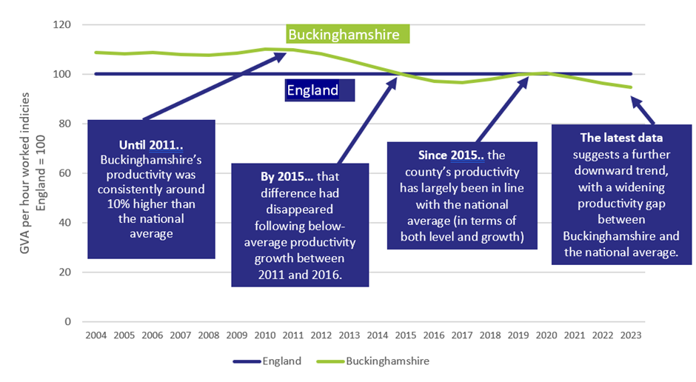
1. The economy is not performing as well as it used to
Why?
Structural change within the economy
Low productivity sectors growing more quickly than high productivity sectors
High productivity sectors growing more slowly than the national average
(public sector productivity performance has been about average)
Why have we seen structural change?
Loss of some high-value firms (closures, relocations)
Few high-value firms growing within / moving into the county
Growth of the local consumer economy
Skills and productivity
Studies by the OECD, ONS and McKinsey suggest that improving management, higher-order cognitive and digital skills, yield the highest productivity returns.
Productivity (GVA per hour worked) indices – Buckinghamshire versus England
Source: Current price (smoothed) GVA per hour worked, ONS, 2025

Slide 13
2. The county’s high value (tradeable) economy is small (which is not a good thing)
Tradable goods and services can be sold and consumed outside of the region in which they are produced. Cars and computer software are tradable. A meal at a restaurant is not.
Firms operating in tradable sectors:
drive productivity growth
have strong multiplier effects (i.e. they create more additional jobs than firms in foundation / everyday sectors)
are less likely to be in direct competition with other local businesses, thus reducing the risk of displacement
Share of Gross Value Added (GVA) generated by tradeable sectors 2019 – Buckinghamshire and neighbouring areas
Tradeable sectors do not solely employ people in highly skilled roles; they provide a wide range of entry-level jobs and career progression opportunities for individuals.
Tradeable sectors are also not solely made up of large companies. The majority of firms operating in tradable sectors are Small and Medium-sized Enterprises (SMEs).
Source: Lightcast, 2025

Slide 14
3. Low-productivity sectors are becoming increasingly dominant in the Buckinghamshire economy
Over the last five years the county has seen a..
21% increase in jobs in the arts, entertainment and recreation industry
21% increase in jobs in the transport and storage industry
13% increase in jobs in the hospitality industry
All of which are low-productivity sectors.
In 2022 there were…
700 more warehouse operators
500 more gardeners
400 more cleaners
400 more LGV drivers
350 more kitchen assistants
..working in Buckinghamshire than in 2017
Some of this growth is linked to Buckinghamshire’s strong consumer economy – driven by the relatively high proportion of cash-rich / time-poor residents
Source: Lightcast, 2025

Slide 15
4. A lack of large, productive firms affects performance
Buckinghamshire has a higher proportion of Small and Medium Sized firms (particularly micro firms) than the national average, and more people working in SMEs.
Since larger firms tend to be more productive and can contribute to the economy in ways smaller firms cannot, the relative lack of large firms can limit growth and innovation.
Buckinghamshire has lost some large firms in recent years through closures (Buckingham Group) and relocations (Hyundai, Johnson & Johnson*)
Buckinghamshire’s existing large firms are most highly concentrated in the south of the county, particularly along the M40 corridor, where there is currently a lack of affordable, Grade A office premises.
In 2024, 47% of all turnover generated by Buckinghamshire firms and institutions was generated by the 90 county employers with more than 250 employees. They also provide 44% of all Buckinghamshire-based employee jobs.
Proportion of turnover in Buckinghamshire generated by large employers and SMEs
Source: ONS 2024
*Relocating out of Buckinghamshire within the next few years
*move anticipated to be completed in 2026

Slide 16
5. The departure of major financial and insurance companies from Aylesbury has dented productivity
Productivity in Aylesbury town has been declining for the last decade.
This is likely largely due to large scale job cuts made by Lloyds Group and Equitable Life in 2009. Lloyds Group was by far the biggest private sector employer in Aylesbury. This had knock-on supply chain implications for SMEs who supplied goods and services to the company or relied on custom from Lloyds employees. More recently, 250 financial services jobs were lost from the town in 2020 with the closure of The Share Centre.
Other areas (e.g. Berkshire) were also hit by financial services job losses during the financial crisis but developed or maintained other high-value industries (such as IT). Aylesbury has not attracted alternative employers in high-value industries.
The loss of Johnson & Johnson from High Wycombe (due to relocate to Maidenhead in 2026) could have a similarly significant effect on the Wycombe economy. The company is estimated to currently employ around 800 people locally.
Financial and insurance employees – Aylesbury Vale
Lloyds Banking Group / Equitable Life – 700 job losses 2009 to 2011
The Share Centre - 250 job losses 2020
Source: Productivity data ONS 2024 and BRES 2023, ONS

Slide 17
6. The county exports more workers than it imports
In contrast to neighbouring areas, more Buckinghamshire residents leave the county for work than non-residents come in. A comparatively high proportion of Buckinghamshire’s working residents work in London.
Buckinghamshire residents earn more (on average) than those working within the Buckinghamshire economy (whether they live in the county or not).
In addition to being a net-exporter of workers, Buckinghamshire is a net-exporter of young adults.
Source: Census 2021

Slide 18
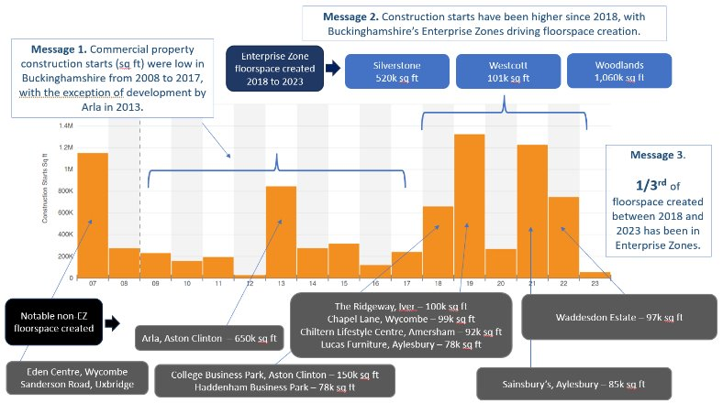
7. Investment in the local economy has been weak over the last 15 years*
Commercial property construction starts, 2007 to 2023
Between 2008 and 2017 very little new commercial property was built in Buckinghamshire (see chart).
Relative to business population size, Buckinghamshire has attracted less Innovate UK funding than the national average in recent years.
In addition, there has been below-average ICT investment (per job) and declining investment (per job) in intangible assets and all capital assets combined. Equity investment in Buckinghamshire is largely very early stage and in low value sectors.
As successive governments have tried to reduce regional inequalities, Buckinghamshire has received less central government investment for regeneration / economic growth in recent years than areas facing greater structural challenges.
Sources: CoStar, Innovate UK, ONS and Beauhurst
*See Buckinghamshire Productivity Review 2024 for further details.

Slide 19
8. Firms highlight property costs, recruitment difficulties, transport challenges and housing costs as key barriers to growth
Barriers to growth
Housing affordability
Housing affordability has worsened over the last few decades. Housing is less affordable in Buckinghamshire than in neighbouring areas with average house prices 11.4 times average earnings
Hard to fill vacancies
Job vacancies tend to be more difficult to fill in Buckinghamshire than nationally, with 61% of vacancies identified as being hard-to-fill in 2022 compared with 57% nationally
Firms have faced a range of barriers to growth in recent years. From uncertainty around Brexit to the Covid-19 pandemic and high energy costs. Additional local barriers to growth frequently cited by surveyed firms include: property costs and availability; recruitment difficulties; road congestion; limited local public transport and the planning application process.
Sources: Bucks Council, ONS and DfE (2022 ESS)

Slide 20
9. The county has three unique economic and innovation specialisms: film and high-end TV, high performance technology and space. The county also has strengths in the life sciences and MedTech sector
Buckinghamshire has three unique economic and innovation specialisms:
Pinewood Studios, the National Film and Television School and the wider West of London film and high-end television cluster;
Silverstone Circuit and its associated high-performance technology cluster;
The Westcott space cluster
Each is significant nationally and internationally and is firmly rooted in their location, with histories and evolutions that can be traced back 80 years. Technological advancements in space and high-performance technology can significantly reduce carbon emissions, whilst the film industry is a major service exporter, attracting international investment and offering diverse job opportunities.
Many of the firms operating in these three areas are highly innovative SMEs undertaking cutting edge R&D.
Buckinghamshire also has strengths in the life sciences and MedTech sector, with assets including the National Centre for Spinal Injuries Unit (the birthplace of the Paralympics) at Stoke Mandeville Hospital, the world-leading Epilepsy Society and major global life science firms. This sector has significant growth potential in Buckinghamshire given the county’s locational advantages (within the Oxford-Cambridge-London golden triangle, close to Heathrow Airport and close to London).

Slide 21
10. Buckinghamshire’s SME business base is stable and resilient
Proportion of workforce employed in different sized firms
Small and Medium-Sized companies (SMEs) are more dominant in the Buckinghamshire economy than nationally, particularly micro firms (employing fewer than 10 people).
Micro firms (VAT/PAYE registered) provide 23% of jobs in Buckinghamshire, compared with 16% nationally.
Around 40% of all Buckinghamshire’s (VAT/PAYE registered) SMEs operate in high-value / tradable industries
Despite facing significant challenges over recent years, Buckinghamshire’s SMEs are resilient with higher business survival rates than the national and regional averages, and neighbouring areas.
Business survival
Source: ONS, 2024

Slide 22
Section 2: Industries and occupations

Slide 23
Buckinghamshire’s health sector employs the most people whilst twice as many people work in Buckinghamshire’s wholesale sector than the national average.
Employees by industry (Buckinghamshire workplaces and England average) - 2023
1 in 8 jobs within the Buckinghamshire economy is in the health and social care sector. This is similar to the England average.
The wholesale sector employs twice as many people in Buckinghamshire than the national average.
A slightly greater proportion of Buckinghamshire-economy employees work in the ‘education’, ‘information & communication’, ‘construction’ and ‘arts, entertainment, recreation & other services’ sectors than the national average
Source: Business Register and Employment Survey, 2023, ONS
Note: Authors have adjusted the published data to remove what is believed to be erroneous data linked to one company within the business admin and support services industry

Slide 24
The prevalence of part-time work varies considerably by sector
Full and part-time employees by sector (Buckinghamshire workplaces) - 2023
Buckinghamshire’s health, retail, hospitality and education sectors employ the largest number of people on a part-time (less than 30 hours per week) basis.
Buckinghamshire’s health, wholesale, manufacturing and professional, scientific & technical sectors employ the largest number of people on a full-time basis.
Source: Business Register and Employment Survey, 2023, ONS

Slide 25
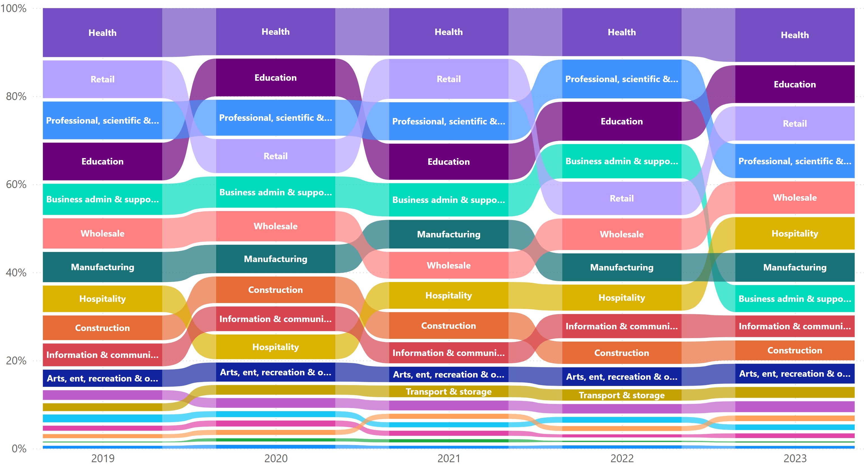
The health sector has been Buckinghamshire largest sector (in terms of employee jobs) over the last five years.
Share of employees by sector in Buckinghamshire, 2019 to 2023
Over the last five years, the proportion of the Buckinghamshire workforce employed in different sectors has remained relatively stable. The health sector has consistently been the largest employer each year, whilst the education, retail and professional, scientific & technical sectors have consistently occupied the remaining top four positions, with the exception of retail in 2022.
The biggest change in recent years has been the decrease in the number of employees working in the business admin & support sector between 2022 and 2023. With the data suggesting a drop of 3,500 employees. The drop appears to be associated with a handful of large outsourcing firms based in Wycombe and Aylesbury.
Source: Business Register and Employment Survey, 2023, ONS

Slide 26
A comparatively small proportion of all employee jobs in Buckinghamshire are within the public sector
Public and private sector employee jobs, 2023 (%)
% employee jobs in public sector – 2015 to 2023
Public sector
(proxy)
Private sector
A smaller proportion of all employee jobs in Buckinghamshire are within the public sector (13%) than the regional (16%) and national (18%) averages. The share of jobs in the public sector has been relatively stable over the last eight years, with a slight uptick between 2022 and 2023. Across England as a whole, the share of jobs in the public sector has crept up since 2019, with a slight dip in 2022.
Source: BRES, ONS, 2025

Slide 27
(With some exceptions) there has been stronger employee growth in Buckinghamshire’s lower-productivity / foundation economy sectors and than in higher-productivity / tradeable economy sectors since 2015
Number of employees by industry in Buckinghamshire, 2015 to 2023
The transport & storage, hospitality and public admin & defence industries have experienced the strongest average annual growth in employees since 2015, and agriculture, information & communication, and professional, scientific & technical sectors the greatest contractions.
Source: Business Register and Employment Survey, 2023, ONS
Note 1: Authors have adjusted the published data to remove what is believed to be erroneous data linked to one company within the business admin and support services industry
Note 2: CAGR = Cumulative Annual Growth Rate

Slide 28
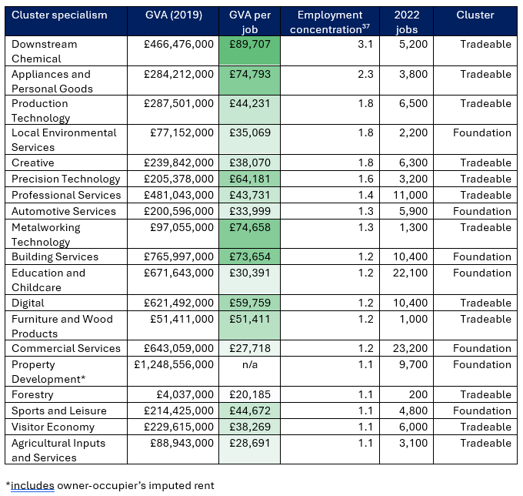
Buckinghamshire’s supply-chain cluster specialisms (1)
Buckinghamshire’s tradeable and foundation cluster specialisms
Lightcast, a provider of economic and labour market intelligence, group industries into supply-chain ‘clusters’ based on a number of criteria that link them together economically. These include:
Industries which tend to co-locate in the same areas
Industries that share a similar workforce
Industries which tend to have supply chain connections
They divide their 49 ‘coherent’ industry clusters into two distinct groups, those that are tradeable and those that primarily serve the local population (i.e the foundation economy).
At county level, Lightcast data suggests that Buckinghamshire has specialisms (i.e. higher than national average levels of employment) in 12 tradable supply chain clusters and 10 foundation economy supply chain clusters. Six clusters stand out:
Downstream chemical
Appliances and personal goods
Production technology
Local environmental services
Creative
Precision technology
Further details of which are provided on the following slide.

Slide 29
Buckinghamshire’s supply-chain cluster specialisms (2)
The ‘downstream chemical’ cluster has three times the concentration of employment locally as nationally. This ‘cluster’ supports over 5,000 local jobs and generates high economic output per job. Buckinghamshire’s particular specialism within this ‘cluster’ is the ‘wholesale of pharmaceutical goods’. Significant companies based in Buckinghamshire operating in this cluster include: Johnson & Johnson*, Bristol Myers Squibb, Global Life Science Solutions and Abbvie.
The ‘appliances and personal goods’ cluster employs more than twice as many people locally than nationally. This ‘cluster’ also generates high economic output per job. Within this ‘cluster’, Buckinghamshire’s particular specialism is the ‘wholesale of computers, computer peripheral equipment and software’. Significant companies based in Buckinghamshire operating in the ‘cluster’ include: Softcat and Zebra Technologies.
Three ‘clusters’ employ 1.8 times as many people locally than nationally:
production technology, in which Buckinghamshire has a particular specialism in the ‘manufacture of instruments and appliances for measuring, testing and navigation’. Companies based in Buckinghamshire operating in this cluster include: Instron and Dage Precision Industries.
local environmental services, the most significant local employer being Biffa
creative, in which Buckinghamshire has a particular specialism in film and high-end television. Companies based in Buckinghamshire operating in this cluster include: Pinewood Studios, SDTA Productions and EMG UK Live.
Finally, the precision technology cluster, in which 1.6 times as many people are employed locally than nationally. Companies based in Buckinghamshire operating in this cluster include: Danecca and GE Healthcare.
*Relocating out of Buckinghamshire within the next few years
Source: The Buckinghamshire Economy: Industry, Cluster and Innovation Strengths, 2024

Slide 30
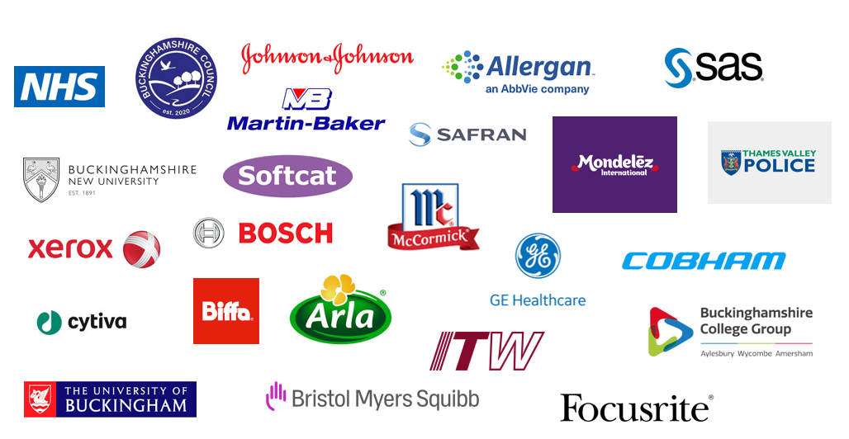
Buckinghamshire is home to approximately 90 large (250+ employees) employers. Some of the largest being those featured below.

Slide 31
It is estimated that 7% of all jobs in Buckinghamshire sit within Buckinghamshire’s four areas of economic and innovation specialism or strength
Buckinghamshire’s specialisms mapped to the Industrial Strategy Growth Sectors
As highlighted in section 1, Buckinghamshire’s has three unique economic and innovation specialisms:
Pinewood Studios, the National Film and Television School and the wider West of London film and high-end television cluster;
Silverstone Circuit and its associated high-performance technology cluster;
The Westcott space cluster
Many of the firms operating in these three areas are highly innovative SMEs undertaking cutting edge R&D.
Buckinghamshire also has strengths in the life sciences and MedTech sector. This sector has significant growth potential in Buckinghamshire given the county’s locational advantages (within the Oxford-Cambridge-London golden triangle, close to Heathrow Airport and close to London).
Buckinghamshire specialism |  | National Industrial Strategy
Specialism / strength | Estimated number of employees | Sector | Frontier Industry
Film and high-end television | 10,000 (employees and freelancers) | Creative Industries | Film and TV
High-performance technology | Approx. 750 at the Silverstone Enterprise Zone and with at least 3,000 within the wider cluster | Advanced manufacturing
 |  | Defence
 |  | Digital and technologies
Space | Approx. 200 at Westcott, with the expectation that this will increase substantially over the next 10 years | Advanced manufacturing | Aerospace manufacturing
 |  | Defence | Drone and autonomous systems
Life science and MedTech | 5,300* | Life sciences
It is estimated that around 7% of all jobs in Buckinghamshire’s economy sit within the four areas of specialism or strength. With additional people being employed within their supply chains.
*includes wholesale of pharma goods, which is not included in the national Industrial Strategy definition.

Slide 32
A greater proportion of Buckinghamshire’s working residents work in managerial and professional occupations than the national average
Occupational profile – Buckinghamshire and England
This chart shows how the broad occupational profile of Buckinghamshire’s working residents compares with the occupational profile of England’s workforce as a whole.
The largest occupational group in which Buckinghamshire residents work is ‘professional occupations’. A similar proportion of residents work in professional roles as nationally.
The second largest occupational group in which Buckinghamshire residents work is ‘managers, directors and senior officials’. With a larger proportion of residents working in this occupational group than the national average (19% versus 13%).
Fewer residents work in ‘process, plant and machine operative’ and in ‘elementary’ roles than nationally
Note – this analysis includes those working as employees plus those who are self-employed
Source: Census 2021

Slide 33
In 2021, the occupational profile of Buckinghamshire’s residents and those working in the Buckinghamshire economy was very similar
Occupational profile – Buckinghamshire workforce and Buckinghamshire residents
Buckinghamshire’s residents are slightly more likely to work in managerial and professional roles than those working within the Buckinghamshire economy, and slightly less likely to work in elementary, skilled trade and caring / other service occupations.
This data includes those working as employees and those working on a self-employed basis.
Source: Census 2021
Source: Annual Population Survey (workplace and resident analysis) – Jan to Dec 2022

Slide 34
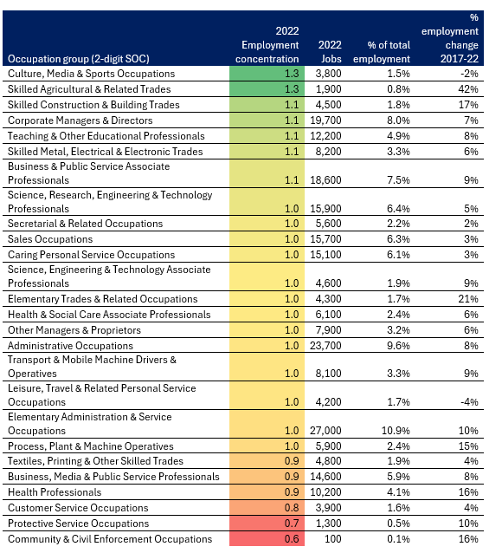
Occupation specialisms within the Buckinghamshire economy
Data from Lightcast allows us to analyse workplace occupation specialisms in Buckinghamshire at various levels of detail. It is important to note that self-employment is not well represented in the data. Self-employment is particularly prevalent within Buckinghamshire’s film and TV, construction and personal services industries.
The table to the right groups occupations into relatively broad groups using Standard Occupational Classification (SOC) codes. This shows that in 2022, the two broad occupations that were most concentrated in Buckinghamshire were: ‘culture, media and sports’ occupations and ‘skilled agriculture and related trades’ occupations. Both employing 1.3 times as many people in the local economy than in the national economy as a whole.
The three occupational groups of ‘corporate managers and directors’, ‘teaching & other educational professionals’ and ‘business & public service associate professionals’ are slightly more highly concentrated in Buckinghamshire than nationally, and each employ a high number of people.
Source: Lightcast 2024

Slide 35
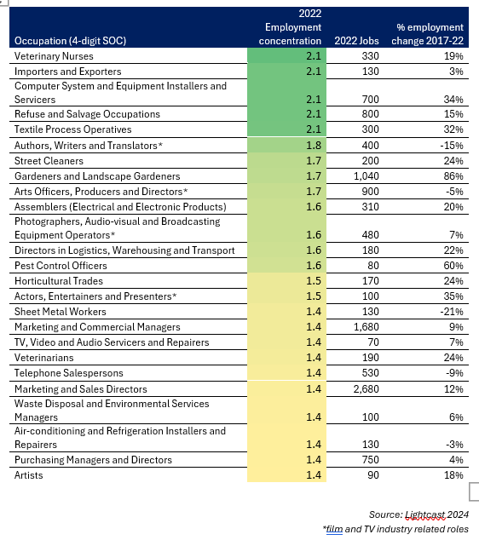
Occupation specialisms within the Buckinghamshire economy
The table to the right presents occupational data at a more granular 4-digit Standard Occupational Classification (SOC) code level. This shows that many of Buckinghamshire's specialised media roles are likely connected to its large film and TV industry (see occupations marked with an asterisk).
Top of the list of specific occupational specialisms in the Buckinghamshire economy is ‘veterinary nurses’, possibly reflecting high levels of pet ownership amongst residents. Followed by ‘importers and exporters’, an occupation in which relatively few people work (130) but which employs more than twice as many people locally than nationally.
Other occupational groups linked to logistics / supply-chain activity also have a relatively high employment concentration in Buckinghamshire, e.g. ‘directors in logistics, warehousing & transport’ and ‘purchasing managers & directors’. Potentially linked to economic activity driven by Buckinghamshire’s close proximity to Heathrow Airport.
The two largest occupations that are more highly concentrated in Buckinghamshire than nationally are both marketing related - ‘marketing and sales directors’ and ‘marketing and commercial managers’ (employing 4,630 people in total). Followed by ‘gardeners and landscape gardeners’ (in which 1,040 people work as employees).

Slide 36
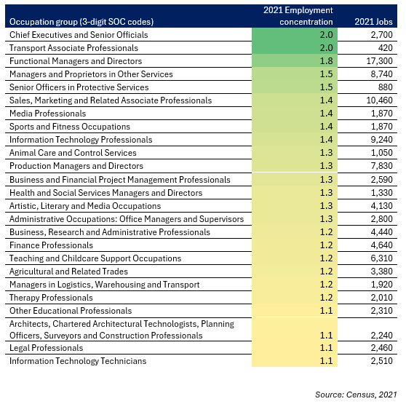
Occupation specialisms of Buckinghamshire residents
The 2021 Census provides details of the jobs held by Buckinghamshire residents. The data includes all employed residents, irrespective of where they work, and irrespective of whether they are employees or self-employed.
The table to the right shows that Buckinghamshire’s residents are more likely to work in higher level managerial roles than the national average. For instance, twice as many residents work in ‘chief executives and senior official’ occupations than the national average, and 1.8 times as many people work in ‘functional manager and director’ occupations than nationally (a sizable group of 17,300 people).
Other occupations in which more residents work than the national average include a variety of professional roles (transport associate professionals, sales and marketing professionals, media professionals, IT professionals, business and finance professionals) and a variety of managerial roles (service sector managers, production managers, health and social services managers).

Slide 37
Section 3: Demand for labour

Slide 38
Buckinghamshire residents earn more than those working within the Buckinghamshire economy
Median Earnings – Residence Based
Unified County | 2020 | 2021 | 2022 | 2023 | 2024 | CAGR - 4 Yr
Buckinghamshire | £36,349 | £35,302 | £38,862 | £39,505 | £43,318 | 4.48%
Bedfordshire | £33,421 | £31,644 | £34,727 | £36,303 | £38,357 | 3.50%
Berkshire | £36,191 | £36,444 | £38,344 | £39,589 | £42,867 | 4.32%
Hertfordshire | £37,339 | £35,119 | £38,421 | £40,664 | £44,054 | 4.22%
Milton Keynes | £33,256 | £33,967 | £36,049 | £36,905 | £40,125 | 4.81%
Northamptonshire | £29,954 | £29,985 | £32,545 | £33,076 | £36,891 | 5.35%
Oxfordshire | £35,433 | £34,645 | £36,939 | £38,492 | £42,342 | 4.55%
South East | £34,193 | £33,939 | £35,734 | £37,434 | £40,339 | 4.22%
Rank out of 7
Buckinghamshire | 2 | 2 | 1 | 3 | 2 | 4
Median Earnings – Workplace Based
Unified County | 2020 | 2021 | 2022 | 2023 | 2024 | CAGR - 4 Yr
Buckinghamshire | £35,000 | £35,331 | £38,798 | £38,551 | £39,847 | 3.30%
Bedfordshire | £32,045 | £30,951 | £32,844 | £33,978 | £36,105 | 3.03%
Berkshire | £36,560 | £37,533 | £39,224 | £41,379 | £44,365 | 4.96%
Hertfordshire | £32,786 | £33,928 | £35,482 | £38,166 | £40,244 | 5.26%
Milton Keynes | £34,277 | £32,661 | £35,248 | £39,633 | £40,974 | 4.56%
Northamptonshire | £29,533 | £28,648 | £31,673 | £32,431 | £35,954 | 5.04%
Oxfordshire | £34,217 | £33,785 | £36,700 | £38,518 | £40,958 | 4.60%
South East | £32,980 | £32,827 | £34,500 | £36,527 | £39,038 | 4.31%
Rank out of 7
Buckinghamshire | 2 | 2 | 2 | 3 | 5 | 7
Buckinghamshire residents earn more than the national and regional averages, and more than in most neighbouring areas. Earnings of those working within the Buckinghamshire economy are also higher than national and regional averages. But are lower than in many neighbouring areas.
Buckinghamshire residents earn more than those working within the Buckinghamshire economy. Many residents travel to higher-paying jobs outside the county, particularly in London. The gap between residence-based and workplace-based income in Buckinghamshire has widened in recent years, reaching 8.7% in 2024. This could further exacerbate recruitment difficulties for local employers.
Source: Annual Survey of Hours and Earnings 2024, ONS

Slide 39
The NHS generates by far the greatest number of job vacancies in Buckinghamshire
Unique job postings – by employer, 2024
Estimates suggest that an average of 4,400 Buckinghamshire-based job vacancies were advertised online per month during 2024.
Whilst not all job postings can be attributed to a specific employer (many firms do not include their name on job adverts), of those who do, employers posting the most jobs in 2024 were the NHS (by far) and Buckinghamshire Council.
Identifiable private sector employers posting a relatively large number of jobs included Johnson & Johnson (life sciences), Sodexo (contracted services), Tesco (supermarket) and Danaher (life sciences).
Source: Lightcast, 2025

Slide 40
Teaching and early education roles feature heavily in the top 25 most advertised roles in Buckinghamshire
Unique job postings – by occupation, 2024
The top three occupations for which the most job vacancies were posted online during 2024 were ‘sales related occupations’, ‘care workers and home carers’ and ‘cleaners and domestics’.
Across the top 25 most advertised roles , teaching and early education roles feature heavily.
Jobs at all levels feature within the top 25 most advertised roles. From those requiring high levels of qualifications / technical skills (such as solicitors and software developers) to those requiring skills that can be taught in a short space of time (e.g. cleaners and kitchen assistants)
Source: Lightcast, 2025

Slide 41
Buckinghamshire firms find it harder to recruit than the national average
Hard to fill vacancies – employer base
Hard to fill vacancies – vacancy base
 | Buckinghamshire | England
Have at least one vacancy | 26% | 23%
Have at least one vacancy that is hard-to-fill | 18% | 15%
Have a skill-shortage vacancy | 12% | 10%
Average vacancies per establishment with vacancies | 2.8 | 2.8
Examining vacancies at employer level (table) we see that Buckinghamshire employers are more likely to have vacancies, to have a hard-to-fill vacancy and to have a skills shortage vacancy* than the national average. The overall average number of vacancies per establishment with vacancies is in line with the national average at 2.8.
At vacancy level, just over a third (35%) of vacancies in Buckinghamshire were skills shortage vacancies in 2022. This is slightly lower than the national average (36%). 26% of vacancies were hard-to-fill for other reasons**, higher than the national average of 21%.
Source: Employer Skills Survey 2022, DfE
*a skills shortage vacancy is a vacancy that is proving hard-to-fill due to a lack of applicants with the required skills or qualifications.
**other reasons for vacancies proving difficult to fill include: job conditions (e.g. hours, pay), remote or difficult to reach location, nature of the job
Source: Employer Skills Survey 2022, DfE

Slide 42
70% of respondents to a local business survey conducted in 2024 identified finding staff with the required skills to be a barrier to growth, with respondents not anticipating the ease of filling vacancies to improve in the near future.
Barriers to growth
Source: Buckinghamshire Business Survey 2024, Buckinghamshire Council
*Self-selecting survey of 123 Buckinghamshire firms. Results are indicative only.

Slide 43
Vacancies (as a proportion of employment) are most common for ‘skilled trade’, ‘associate professional’ and ‘caring, leisure and other service’ occupations, whilst skill shortages (as a proportion of vacancies) are most common for ‘associate professional’ and ‘skilled trade’ occupations.
Associate professionals occupations include: teaching assistants, IT technicians, engineering technicians and childcare practitioners.
Skilled trade occupations include: chefs, electricians, vehicle technicians, plumbers and carpenters.
Source: Employer Skills Survey 2022, DfE

Slide 44
In comparison to the national average, vacancies in Buckinghamshire are more prevalent in middle-skill and service-intensive occupations, whilst skills shortage vacancies are more prevalent for high and middle-skill occupations
Vacancy density
Skills shortage vacancy density
In 2022, an estimated 7% of middle-skill roles and 8% of service-intensive roles in Buckinghamshire were vacant, compared with 5% and 6% nationally.
Buckinghamshire employers are more likely to report skills shortage vacancies (as a proportion of all vacancies) for high-skill and middle-skill roles than employers across England as a whole (right hand chart)
High-skill = managerial, professional and associate professional roles
Middle-skill = admin / secretarial and skilled trade roles
Service-intensive = caring, leisure, service, sales and customer service roles
Labour-intensive = process, plant & machine operatives and elementary roles
Source: Employer Skills Survey 2022, DfE

Slide 45
Job vacancies for occupations concentrated in the manufacturing; health; professional, scientific & technical and construction sectors tend to take the longest time to fill – indicating labour or skills supply shortages
Occupations for which Buckinghamshire jobs advertised online are advertised for the longest duration (days)
Occupation | Main industry occupation is found in | Sits in one main industry (50% or more) or dispersed | Unique Postings from Jan 2024 - Dec 2024 | Median Posting Duration from Jan 2024 - Dec 2024 Bucks | Difference in median posting duration - Bucks and England | Median Annual Advertised Salary Bucks | Difference in median Annual Advertised Salary- Bucks and England) | Avg. Posting Intensity* (Jan 2024 - Dec 2024)
Elementary Agricultural Occupations | Agriculture, Forestry and Fishing (67% of jobs) | Concentrated | 45 | 32 | 5 | £25,536 | (£512) | 1 : 1
Artistic, Literary and Media Occupations | Information and Communication (50%) | Concentrated | 281 | 31 | 2 | £30,144 | (£1,024) | 2 : 1
Hairdressers and Related Services | Other service activities (93%) | Concentrated | 96 | 31 | 1 | £27,968 | £1,920 | 1 : 1
Process Operatives | Manufacturing (47%) | Dispersed | 75 | 31 | 5 | £27,392 | £960 | 2 : 1
Web and Multimedia Design Professionals | Professional, scientific and technical (40%) | Dispersed | 61 | 31 | 7 | £27,904 | (£4,160) | 2 : 1
Design Occupations | Professional, scientific and technical (39%) | Dispersed | 69 | 30 | 4 | £26,560 | (£5,888) | 2 : 1
Animal Care and Control Services | Other service activities (37%) | Dispersed | 65 | 30 | 6 | £24,768 | (£256) | 1 : 1
Conservation and Environment Professionals | Professional, scientific and technical (34%) | Dispersed | 30 | 30 | 7 | £24,896 | (£4,864) | 2 : 1
Caring Personal Services | Human health and social work (90%) | Concentrated | 1,687 | 29 | 1 | £26,176 | £640 | 3 : 1
Teaching and Childcare Associate Professionals | Education (84%) | Concentrated | 708 | 29 | 1 | £25,280 | £896 | 2 : 1
Health and Social Services Managers and Directors | Human health and social work (80%) | Concentrated | 226 | 29 | 5 | £46,976 | (£64) | 3 : 1
Plant and Machine Operatives | Manufacturing (51%) | Dispersed | 136 | 29 | 2 | £34,432 | £4,416 | 2 : 1
Skilled Metal, Electrical and Electronic Trades Supervisors | Manufacturing (29%) | Dispersed | 75 | 29 | 4 | £35,712 | (£3,392) | 2 : 1
Production Managers and Directors | Manufacturing (33%) | Dispersed | 71 | 29 | 6 | £54,784 | £1,344 | 2 : 1
Textiles and Garments Trades | Manufacturing (40%) | Dispersed | 27 | 29 | 1 | £29,056 | £1,984 | 2 : 1
Sales, Marketing and Related Associate Professionals | Wholesale, retail and motor trades (35%) | Dispersed | 996 | 28 | 4 | £27,712 | (£1,280) | 2 : 1
Finance Professionals | Professional, scientific and technical (39%) | Dispersed | 378 | 28 | 5 | £47,488 | £4,800 | 2 : 1
Other Health Professionals | Human health and social work (90%) | Concentrated | 376 | 28 | 3 | £46,976 | (£64) | 3 : 1
HR, Training & Other Vocational Associate Guidance Professionals | Administrative and support services (19%) | Dispersed | 279 | 28 | 4 | £34,944 | £3,904 | 2 : 1
Vehicle Trades | Wholesale, retail and motor trades (64%) | Concentrated | 182 | 28 | 1 | £35,520 | £512 | 2 : 1
Managers in Logistics, Warehousing and Transport | Wholesale, retail and motor trades (36%) | Dispersed | 134 | 28 | 6 | £28,992 | (£2,816) | 2 : 1
Administrative Occupations: Government & Related Organisations | Public administration and defence (54%) | Concentrated | 85 | 28 | 3 | £26,368 | £1,216 | 2 : 1
On average, jobs advertised on-line in Buckinghamshire are advertised for 27 days, this is higher than the national average of 26 days, suggesting that employers in Buckinghamshire take longer to recruit. Occupations for which jobs are advertised for the most days are listed in the table above. Jobs in the manufacturing; health; professional, scientific and technical and construction sectors feature most heavily. For about half of the jobs listed, Buckinghamshire employers are estimated to be offering lower than national average salaries.
*Posting Intensity is the ratio of total to unique (deduplicated) job postings. A higher-than-average posting intensity can mean that employers are putting more effort than normal into hiring that position.

Slide 46
The main skill area lacking amongst job applicants is the ‘technical and practical skills needed to perform the role’, followed by ‘people and personal skills’
Skills difficult to obtain from applicants | Bucks | England
ANY TECHNICAL OR PRACTICAL SKILLS | 83% | 88%
ANY PEOPLE AND PERSONAL SKILLS | 62% | 71%
OPERATIONAL SKILLS | 50% | 48%
SELF-MANAGEMENT SKILLS | 47% | 56%
COMPLEX ANALYTICAL SKILLS | 31% | 43%
MANAGEMENT AND LEADERSHIP SKILLS | 30% | 45%
DIGITAL SKILLS | 28% | 32%
BASIC SKILLS | 28% | 40%
SALES AND CUSTOMER SKILLS | 27% | 40%
‘Specialist skills needed for role’, ‘adapting to new materials and equipment’, ‘knowledge of products & services’ and ‘manual dexterity’ are skills more likely to be reported to be in short supply in Buckinghamshire than nationally. Whereas ‘managing staff’, ‘basic numeracy’ and ‘customer handling skills’ are much less likely to be in short supply locally than nationally
Source: Employer Skills Survey 2022, DfE
(base – all skills shortages vacancies)

Slide 47
Skills that are commonly mentioned in job postings in Buckinghamshire that are less commonly mentioned in individual’s CVs (suggesting a potential undersupply) include: communication skills; detail orientated; teaching; English language and problem solving.
Specialist skills sought
Common skills sought
IT skills sought
Source: Lightcast, 2025

Slide 48
Many of the reasons employers give for experiencing hard-to-fill vacancies are place-related. For example, proximity to London and related factors (such as high London wages and high local house prices) and in the case of construction, the impact of the HS2 project. Others highlight issues regarding the work-readiness of school leavers. In the summer of 2024, engineering remained the occupation most frequently highlighted by employers as suffering from skills shortages.
We struggle to attract technicians into the industry and I have felt the process to take on an apprentice in order to have them grow with us to be very arduous.
An affluent area & aging population makes filling of vacancies challenging.
We need highly skilled engineering contractors in the defence and aerospace sectors. There are shortages of skilled staff. If pay rates do not increase, contractors will move to different sectors.
Finding younger people with the right skills and a professional, focused mindset is difficult.
Filling factory positions has been very easy, however over the next 12 months we will be recruiting senior leadership positions which I feel may be harder. I will extend my search beyond the county.
High pay expectations of local candidates, failure of local education to prepare school leavers for work.
HS2 soaks up much of the available talent pool in the area, especially suitably qualified engineers.
It can be difficult to attract employees in our sector because many of them want to work in London and get London level salaries, especially now with hybrid/remote working. Cost of housing (buying or renting) makes it difficult for young people to work for us unless they can live with their parents. Traveling to our premises is also difficult unless they have a car.
[There is a] lack of skilled HVAC engineers in the area. This has .. driven up the cost to employ them to an unsustainable level.
Sources: Buckinghamshire Business Survey 2024, Buckinghamshire Council and Buckinghamshire Business Barometer surveys, Buckinghamshire Business First

Slide 49
Recruitment and retention challenges, along with skills shortages, are barriers to growth for all three of Buckinghamshire’s economic and innovation specialisms.
Labour market and skills challenges
Firms in Buckinghamshire’s three economic and innovations specialist clusters (space, high performance engineering and film & TV) all identify labour and skills challenges as a barrier to growth. Key challenges across all three being:
Recruitment and retention – often linked by firms to a lack of affordable housing, insufficient public transport links and competition from higher-paying employers and industries within commuting distance of the county.
Skills shortages – at a variety of levels, particularly for engineers
Labour market and skills opportunities
There are opportunities within all three clusters to further develop ‘centres of excellence’ to drive future innovation and local economic growth, and to help the UK maintain and gain global market share in new technologies and their application. Such specialist training and knowledge transfer opportunities include:
Growth of the National Film and Television School
Roll out of the CoSTAR National Lab
New training and knowledge exchange activity linked to Westcott’s propulsion, drone and ISAM* specialisms
Development of a globally recognised research institute at Silverstone
*In-Orbit Servicing, Assembly, and Manufacturing

Slide 50
Firms in the Westcott Space Cluster attribute recruitment difficulties to insufficient public transport links, a lack of affordable house and skills supply shortages
Recruitment difficulties are a key challenge for Westcott Space cluster firms. Many firms attribute this to a lack of affordable housing in the area and insufficient public transport links to Westcott Venture Park.
Recruitment difficulties are also attributed to a general lack of applicants with the required technical skills. This can lead firms down the time consuming and costly path of trying to bring in talent from overseas via work-visas.
The UK Space Agency is seeking to address skills shortages across the UK by increasing in the provision of space-related skills training. This includes funding some Westcott-based space firms to develop and deliver specialist training provision.
In addition to recruitment difficulties, some firms also suffer from retention challenges. This is partly attributed to staff being attracted to work for larger companies in nearby clusters that can offer higher wages.
“There isn't a good enough bus service between Bicester, Oxford or Aylesbury, and you've got to run a car. [When you’ve] got engineers who are earning 40k, they have to live in shared houses because they can't afford to do anything else. So that for me is a huge problem in terms of growing .. my business, finding employees”. (Space-industry interviewee, 2024)
“We've lost three or four staff to them [larger firms at Harwell] now. They're coming in, offering between 40 and 60% pay rises to staff to go over there. We have well qualified, good quality staff who are attractive to larger, bigger output outfits, and we can't pay those kind of wages”. (Space-industry interviewee, 2024)

Slide 51
Firms operating within the Silverstone High Performance Technology Cluster identify a shortage of skilled engineers, limited public transport and a lack of affordable housing as the reasons why they find it difficult to fill vacancies
Silverstone’s engineering talent pool is world-leading and highly valued. However, attracting skilled staff is a key challenge cited by firms on Silverstone Park.
This is attributed to:
a lack of skilled engineers in the UK generally;
potential engineers being attracted to higher paying roles in the tech industry
a lack of awareness amongst young people about what being a modern-day engineer entails.
Firms cite limited public transport serving Silverstone Park as contributing to recruitment challenges. Whilst a lack of affordable housing for early-career employees is cited as an issue by some employers.
“Transport options to Silverstone Park can sometimes be a barrier for recruitment.” (2024 Buckinghamshire Business Consultation respondent)
“University placement year students often struggle to find affordable housing for 12 months while also paying for university accommodation etc” (2024 Buckinghamshire Business Consultation respondent)

Slide 52
Silverstone High Performance Technology Cluster stakeholders believe that efforts to attract inward investment and greater partnership working could help overcome recruitment and skills challenges
Opportunities for addressing recruitment and skills challenges and accelerating future cluster growth include:
Leveraging the Silverstone brand to raise the profile of the cluster nationally and internationally to attract new inward investment and talent.
Attracting / establishing a globally recognised research institute at Silverstone Park that brings together academia and R&D focused companies on site.
Promoting and developing opportunities for those from disadvantages groups to improve social mobility and help address recruitment difficulties.

Slide 53
There are opportunities to further strength knowledge transfer within Buckinghamshire’s Film and High End Television Cluster to help maintain and grow the skills of the workforce
The cluster faces difficulties attracting and maintaining a skilled workforce due in part to the recent boom / bust nature of film production, the insecurity of freelance work and comparatively weak wage growth over the last decade.
There is also a perceived lack of lower-level / practical training provision (particularly short courses to upskill people from one discipline to another) and a perceived lack of awareness amongst residents of the career opportunities available within the industry
A number of national film and high-end television innovation initiatives have been based in and near Buckinghamshire in recent years, however, more could be done to ensure knowledge transfer into the local business base and workforce, thus raising productivity.
“[We need to] make sure that the colleges and universities are providing adequate provision at the more practical and lower end level, so that more people come from local schools, colleges and universities straight into production” (Film and High End Television industry interviewee, 2024)
“We need to make sure that locally in Buckinghamshire there's real impact in terms of research and development. How can we actually turn it into skills and practical opportunity on the ground, [to address] the skills gaps that we have in the local area”. (Film and High End Television industry interviewee, 2024)

Slide 54
There are opportunities to further strength knowledge transfer within Buckinghamshire’s Film and High End Television Cluster to help maintain and grow the skills of the workforce
It is anticipated that the CoSTAR National Lab, which is being established at Pinewood Studios, will contribute to the growth and success of the UK’s film and high end television industry by:
Delivering the skills and infrastructure required for the UK to stay at the cutting-edge of new virtual production techniques
Stimulating knowledge exchange
Helping SMEs to innovate, commercialise and scale-up.
The new facilities will build on the area’s specialism of immersive storytelling and help develop new specialisms in virtual production, creative Artificial Intelligence (AI) and creative technology R&D.
The establishment of Screen Buckinghamshire, a partnership of local film and TV-related organisations (including the Buckinghamshire Film Office) could help facilitate greater linkages between studios and education and training providers to help reduce skills shortages and increase investment.
There are also opportunities to increase collaboration more broadly across the West of London Screen Cluster, particularly in terms of skills initiatives and support for the freelance workforce, who often move between film locations within this sub-region.

Slide 55
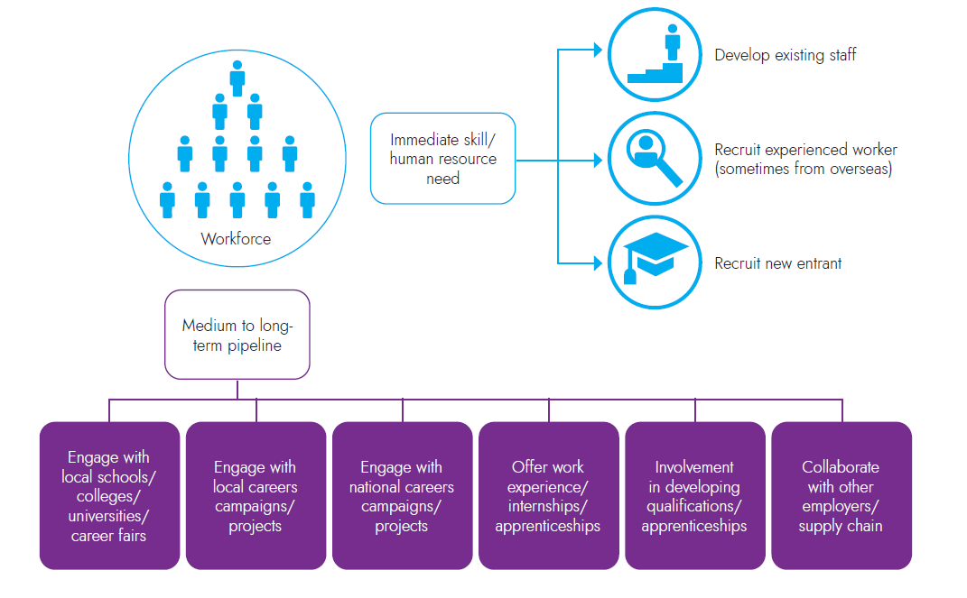
How employers fill vacancies and develop talent pipelines
This diagram shows some of the ways in which employers address their skills needs

Slide 56
The proportion of staff Buckinghamshire employers report to have skills gaps (i.e. they are not fully proficient) rose between 2019 and 2022, although remains below the national average
% of staff not fully proficient
Skills lacking amongst existing employees
Basic skills are more likely to be reported as being deficient within the Buckinghamshire workforce than nationally.
Source: Employer Skills Survey 2022, DfE

Slide 57
Buckinghamshire employers are slightly less likely than average to offer training to staff
Percentage of employers offering training to staff
65% of Buckinghamshire businesses not providing training hadn’t done so because staff were already proficient
Buckinghamshire employers are slightly less likely to offer training to staff than the national average.
Nationally, training provision fell between 2019 and 2022, from 66% of employers to 60%. This may reflect impacts of high inflation on training budgets. Indeed, 8% of non-training employers in Bucks report a lack of money for training.
In 2022, only 3% of Buckinghamshire employers not providing training could not find training available in the relevant subject area, down from 7% in 2019
Source: Employer Skills Survey, 2022

Slide 58
A quarter of respondents to the 2024 Buckinghamshire Business Survey from production sectors cited the ‘relevance of local education and training provision’ to be a barrier to success / growth
The extent to which the relevance of local education and training provision is deemed to be a barrier to success / growth
​Respondents from the production sectors were most likely to cite the ‘relevance of local education and training provision’ to be a barrier to success / growth, followed by respondents from the professional services sectors.
Production includes sectors such as manufacturing, construction, utilities and agriculture.
Professional services includes sectors such as IT, life sciences and marketing.
Consumer services includes sectors such as retail and hospitality.
Foundation services includes sectors such as healthcare and education.
Source: Buckinghamshire Business Survey 2024, Buckinghamshire Council
*Self-selecting survey of 123 Buckinghamshire firms. Results are indicative only.

Slide 59
Section 4: Labour market participation
Please note – definitions of the terms used in this section are at the end of the document

Slide 60
Labour market participation of Buckinghamshire’s working age residents – 2024*
Working age population (aged 16-64) (330,300)
Economically active (278,700 – 84%)
Economically inactive
(51,600 – 16%)
Employed (265,900 – 81%)
Unemployed (9,900 – 3%)
Want a job (12,900 – 4%)
Don’t want a job (38,700 – 12%)
Employees (229,100 – 69%)
Self-employed (36,400 – 11%)
Reason economically inactive
Source: Annual Population Survey, 12 months to December 2024, ONS and ONS modelled unemployment data for Buckinghamshire local authority geography
*Note 1: The sample of Buckinghamshire residents participating in the Annual Population Survey is relatively small and therefore data should be treated as estimates only. Data on the reasons for being economically inactive should be treated with a large degree of caution.
Note 2: students aged 16+ who are in full-time education (school / college / university) are classified as being economically active if they also have a job (e.g. part-time work) or are actively seeking work. They will be classified as economically inactive if they are not working and are not actively seeking work.
Note 3: Numbers and percentages may not add to totals due to rounding.
In April 2025, 11,285 people were claiming unemployment related benefits (80% were estimated to be unemployed and 20% working some hours / having low earnings) (source: DWP StatXplore)s

Slide 61
When examined across 10-year periods, there has been little change the labour market participation of Buckinghamshire residents over the last 20 years
It is difficult to ascertain labour market participation trends over time Buckinghamshire using the UK’s primary source of up-to-date local labour participation data (the Annual Population Survey), as the survey sample size for the county is small, resulting in relatively large margins of error. We can however use the Census to give us a sense of change over time. Whilst data from the Census is not timely (as it’s conducted every 10 years), and 2021 Census data is influenced by the labour market implications of the Covid-19 pandemic, we can broadly conclude that:
overall economic activity and inactivity rates in 2021 were very similar to those in 2001
there was a drop in students who were economically active in 2021, likely due to reduced job opportunities at the height of the Covid-19 pandemic
there has been a reduction in the number of people who are economically inactive because they are ‘looking after home or family’ over the last 20 years
Nationally, we know from the more timely Labour Force Survey that unemployment rose following the 2008/09 financial crisis then fell and remains relatively low. And following the onset of the Covid-19 pandemic, there has been an increase in the proportion of working age adults who are economically inactive due to long-term health conditions. Although we are unable to say for sure due to the limitations of the surveys, it is likely that both these trends are also true of Buckinghamshire.
Labour market participation of Buckinghamshire residents over time
 | 2001 | 2011 | 2021
Economically active | 71.8% | 73.6% | 72.0%
Economically active: In employment | 67.3% | 67.7% | 68.9%
Economically active: Unemployed | 2.0% | 3.0% | 3.1%
Economically active: Full-time student | 2.5% | 2.9% | 1.9%
Economically Inactive | 28.2% | 26.4% | 28.0%
Economically inactive: Retired | 12.5% | 13.3% | 12.8%
Economically inactive: Student (including full-time students) | 3.7% | 4.5% | 4.9%
Economically inactive: Looking after home or family | 7.1% | 4.7% | 5.2%
Economically inactive: Long-term sick or disabled | 2.5% | 2.0% | 2.2%
Economically inactive: Other | 2.5% | 1.8% | 2.8%
All usual residents aged 16 to 74 | 346,945 | 363,773 | 393,578
Source: Census 2001, 2011 and 2021, ONS
Note: this data is not comparable with labour market participation data from the Annual Population Survey as definitions and age groups differ

Slide 62
Disabled working age residents, those who can’t speak English well or at all, and those providing 50 hours or more a week of unpaid care, are least likely to be employed
Labour market participation of different groups of Buckinghamshire residents
 | Employed | Unemployed | Economically inactive | Number of residents
Female | 72% | 3% | 25% | 172,785
Male | 81% | 4% | 15% | 166,898
Asian, Asian British or Asian Welsh | 69% | 4% | 27% | 45,107
Black, Black British, Black Welsh, Caribbean or African | 72% | 6% | 22% | 10,123
Mixed or Multiple ethnic groups | 68% | 6% | 26% | 9,250
Other ethnic group | 69% | 5% | 25% | 5,983
White | 78% | 3% | 19% | 269,219
Disabled* | 51% | 4% | 44% | 38,141
Not disabled | 80% | 3% | 17% | 301,541
Main language is English | 77% | 4% | 20% | 308,105
Main language is not English | 78% | 4% | 19% | 27,393
Main language is not English: Cannot speak English | 33% | 4% | 63% | 418
Main language is not English: Cannot speak English well | 54% | 5% | 41% | 3,767
Provides 19 or less hours unpaid care a week | 78% | 3% | 18% | 18,846
Provides 20 to 49 hours unpaid care a week | 68% | 3% | 29% | 5,912
Provides 50 or more hours unpaid care a week | 52% | 2% | 46% | 6,652
Provides no unpaid care | 77% | 4% | 20% | 308,274
This table compares the labour market participation of different groups of Buckinghamshire residents. We see that men are more likely to be employed and unemployed than women, who are more likely to be economically inactive.
Unemployment is highest amongst those of Black and Mixed ethnicity.
Economic inactivity is highest amongst those who cannot speak English well or at all, those who are disabled and those providing 50 or more hours of unpaid care.
Source: Census 2021
*Disabled under the Equalities Act

Slide 63
Working age residents in Booker, Cressex and Castlefield ward are least likely to be in employment
Buckinghamshire wards with lowest employment rates
Across the county, the proportion of the working age population who are employed ranges from 81% in Stone and Waddesdon to 66% in Booker, Cressex and Castlefield ward.
The four wards in which the highest proportion of working age residents are classified as unemployed are: Abbey; Booker, Cressex and Castlefield; Totteridge and Bowerdean; and Downley.
The four wards in which the highest proportion of working age people are classified as economically inactive are: Booker, Cressex and Castlefield; Buckingham East; Downley and Abbey. In the case of the latter three, this is likely being driven by the high number of students living in these wards whilst studying at the University of Buckingham and Buckinghamshire New University.
 | % of working age population (16 – 64)
Ward name (2022) | Employed | Economically inactive | Unemployed
Booker, Cressex and Castlefield | 66% | 29% | 5%
Abbey | 71% | 24% | 5%
Downley | 71% | 24% | 5%
Totteridge and Bowerdean | 71% | 23% | 5%
Aylesbury South West | 72% | 23% | 4%
Buckingham East | 72% | 24% | 3%
Aylesbury North West | 73% | 23% | 4%
Buckinghamshire | 76% | 20% | 4%
Source: Census 2021

Slide 64
Buckinghamshire residents are more likely to be economically active and in employment than the national average and are less likely to be economically inactive or unemployed
Labour market participation – Buckinghamshire and England
Unemployment rate estimates
The majority (approximately 84.4%) of Buckinghamshire’s working age residents are economically active (i.e. they are either in work or are not currently working but are actively seeking work*).
Whilst Buckinghamshire-level estimates are not precise, we can say with a good degree of confidence that Buckinghamshire’s economic activity rate is higher than the national (England) average (of 78.9%).
Buckinghamshire also has a higher employment rate (proportion of working age residents who are in employment) than the national average (approximately 80.5% versus 75.7%).
Conversely, Buckinghamshire has a lower economic inactivity rate than the national average (approximately 15.6% versus 21.1%). And, although small sample sizes make precise estimates difficult, fewer people who are economically inactive for potentially negative reasons (e.g. long-term sick) than for potentially positive reasons (studying, early retirement, looking after family / home).
There are currently data quality concerns with the UK’s unemployment data, particularly at local level. This has been partly addressed by ONS combining survey data with administrative data on people claiming unemployment-related benefits. The resulting data suggests that Buckinghamshire’s unemployment rate is below the national average, and just under the regional average.
Source: Annual Population Survey, year to December 2024, ONS
*Data displayed is the labour market participation of the 16–64-year-old population
**Confidence intervals shown for Buckinghamshire
Source: Modelled estimates for Buckinghamshire (ONS) and Annual Population Survey, year to December 2024 for the South East and England.

Slide 65
Approximately 7% of Buckinghamshire’s working age residents are not working but would like to
Whilst Buckinghamshire has lower economic inactivity and unemployment rates than many other parts of the country, a sizeable minority of residents are currently not working but would like to. We estimate the figure to be in the region of 22,800 residents, or 7% of the working age population.
Just over half of this group are economically inactive. This means they are not working, are not actively seeking work, but would like to work. It could be that caring responsibilities or transport limitations make finding work difficult.
Just under half of this group are unemployed. This means that they are not working but have actively sought work in the last four week and are available to start work. Using modelled data, we estimate that just under 10,000 residents fall into this category.
The majority of those who are unemployed will claim out-of-work related benefits via Universal Credit, but not all.
22,800 residents – not working but would like to
12,900 = economically inactive
9,900 = unemployed
Source: Annual Population Survey, year to December 2024, ONS and modelled unemployment data for Buckinghamshire unitary authority

Slide 66
Buckinghamshire’s economically inactive residents are more likely to be students and less likely to be long-term sick or disabled than the national average
Due to the previously mentioned limitations of the Annual Population Survey, it is difficult to compare the reasons for Buckinghamshire residents being economically inactive with the national average.
However, we can draw two conclusions:
A higher proportion of Buckinghamshire’s economically inactive population are students than the national average¹
A lower proportion of Buckinghamshire’s economically inactive population are long-term sick or disabled².
The first could be linked to Buckinghamshire households, on average, having higher levels of income than the national average, meaning that parents are more able to financially support their (16-year-old plus) children whilst they study.
¹In 2024, 31.1.% to 48.3%* of economic inactivity in Buckinghamshire was due to being a student, significantly higher than the national level of 27.5%
²In 2024, some 9.2% to 22%* of economic inactivity was explained by long term sickness, below the national rate of 27%.
*95% confidence interval
Buckinghamshire’s economically inactive residents
Higher proportion are students
Lower proportion are long-term sick or disabled
Source: Annual Population Survey, year to December 2024, ONS

Slide 67
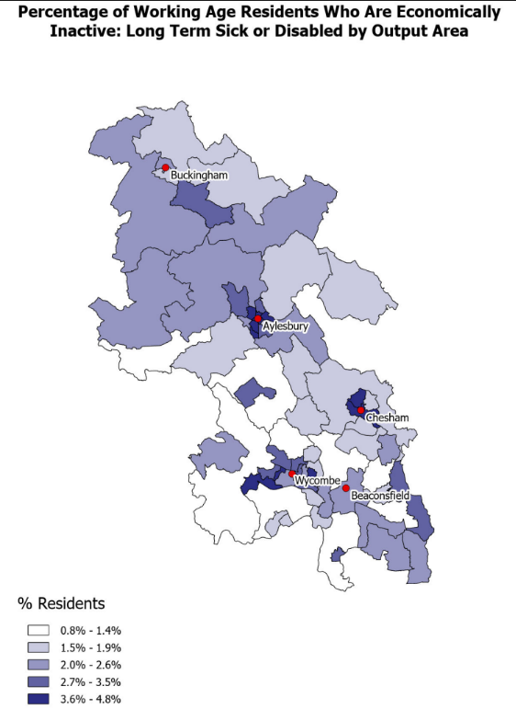
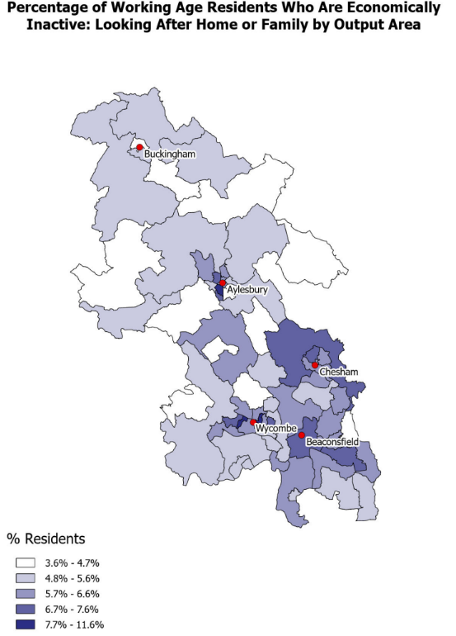
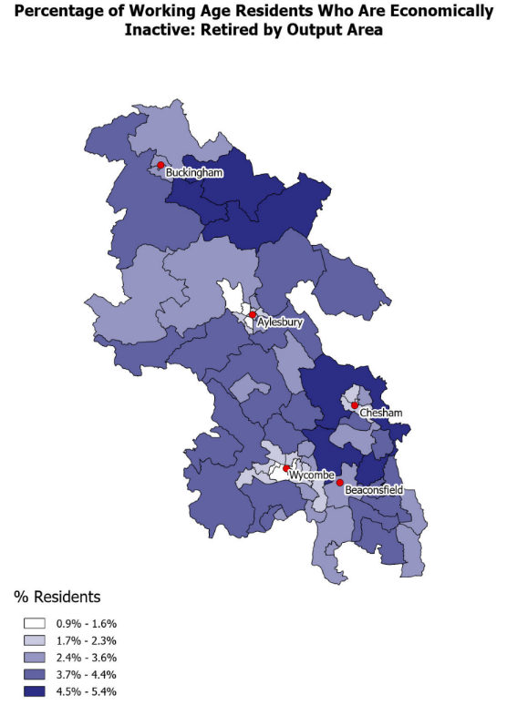
Economic inactivity due to long term sickness is more prevalent in urban areas and to the north of the county, whilst inactivity due to early retirement is more common in rural areas
% of working age residents who are economically inactive due to long term sickness or disability
% of working age residents who are economically inactive due to looking after home or family
% of working age residents who are economically inactive due to being (early) retired
Source: Census 2021, ONS

Slide 68
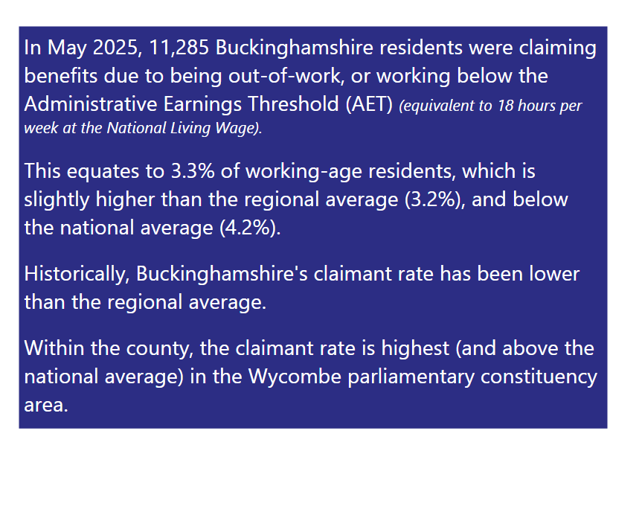
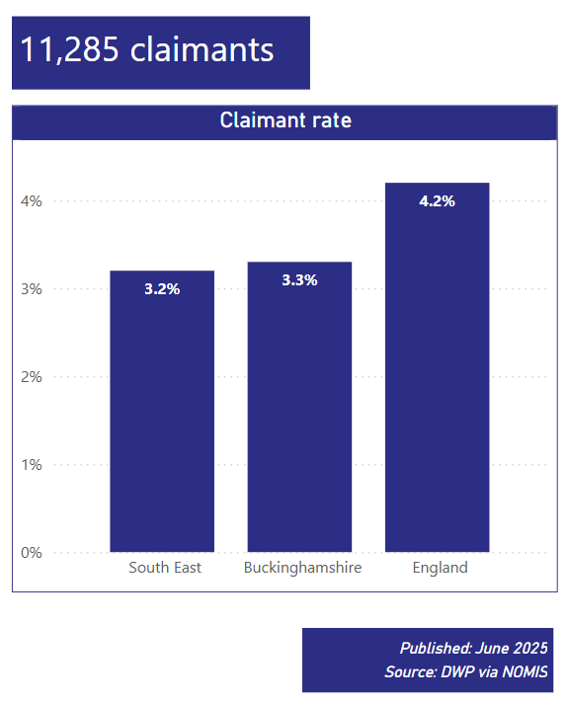
Buckinghamshire residents are less likely to be claiming benefits due to being out-of-work or having low earnings than the national average
For the latest data see the Buckinghamshire Claimant Count interactive dashboard

Slide 69
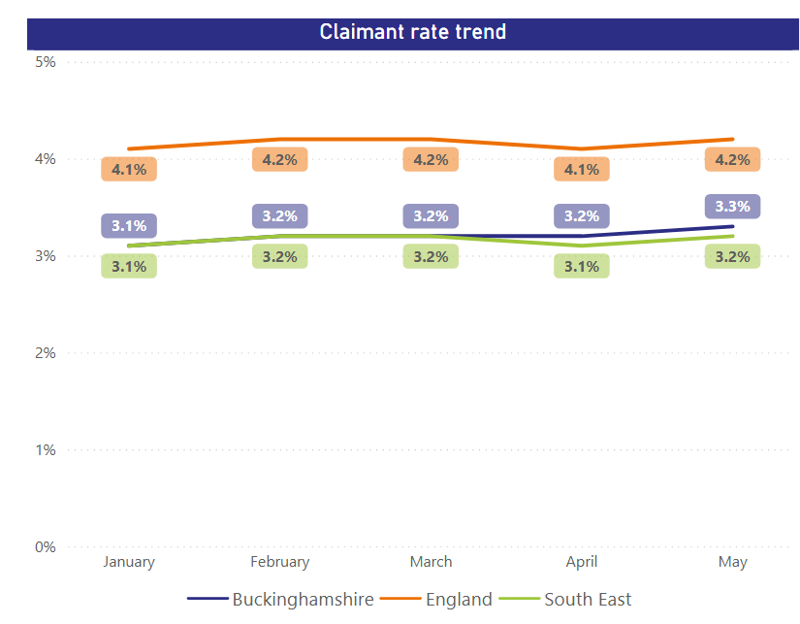
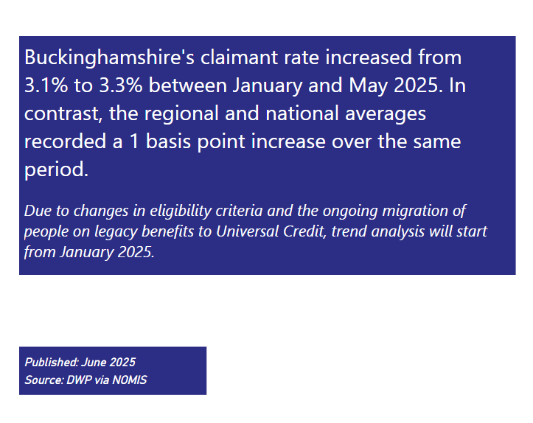
In line with national trends, Buckinghamshire's claimant rate increased slightly during the first half of 2025
For the latest data see the Buckinghamshire Claimant Count interactive dashboard

Slide 70
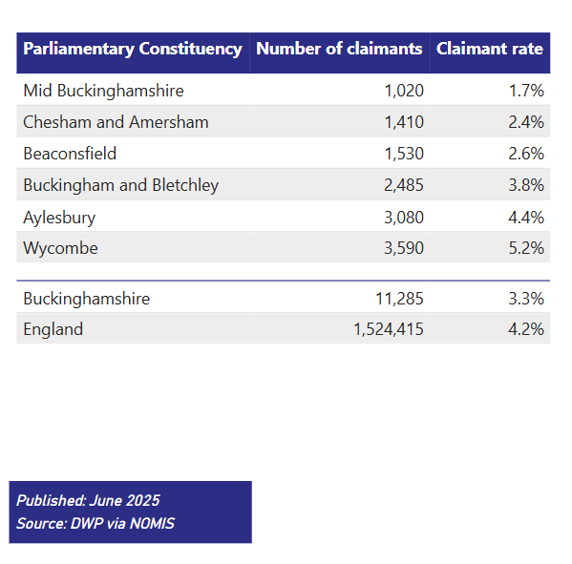
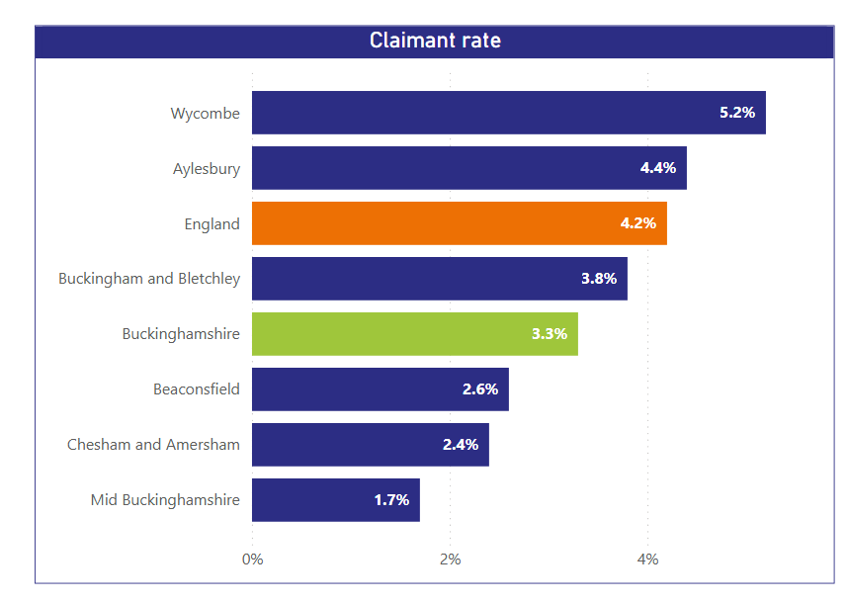
Across the county, the claimant rate is highest in the Wycombe and Aylesbury parliamentary constituency areas
Data is for May 2025
For the latest data see the Buckinghamshire Claimant Count interactive dashboard

Slide 71
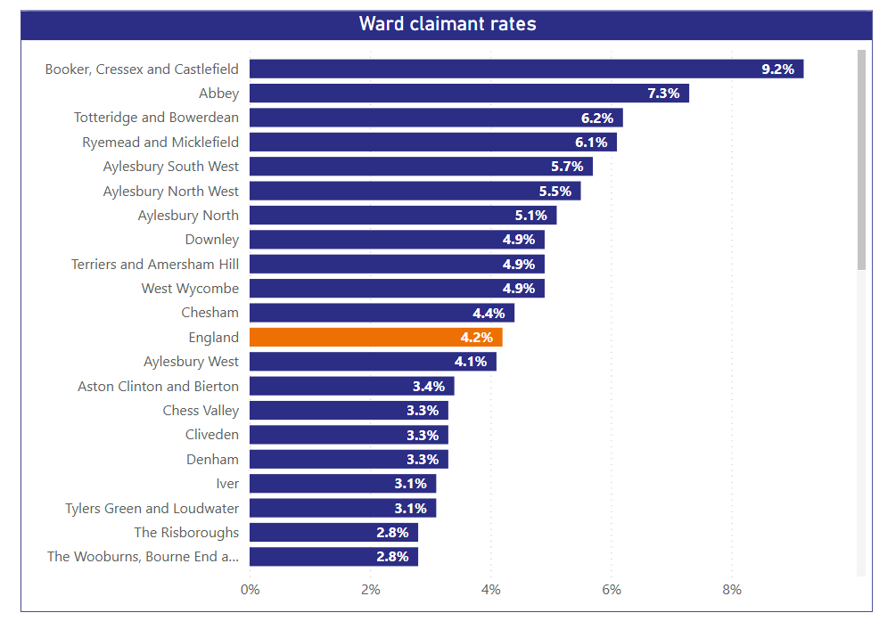
At ward level, the claimant rate is higher than the national average in the 10 Opportunity Bucks wards, plus Downley
Data relates to May 2025 and 2022 ward definitions
For the latest data see the Buckinghamshire Claimant Count interactive dashboard

Slide 72
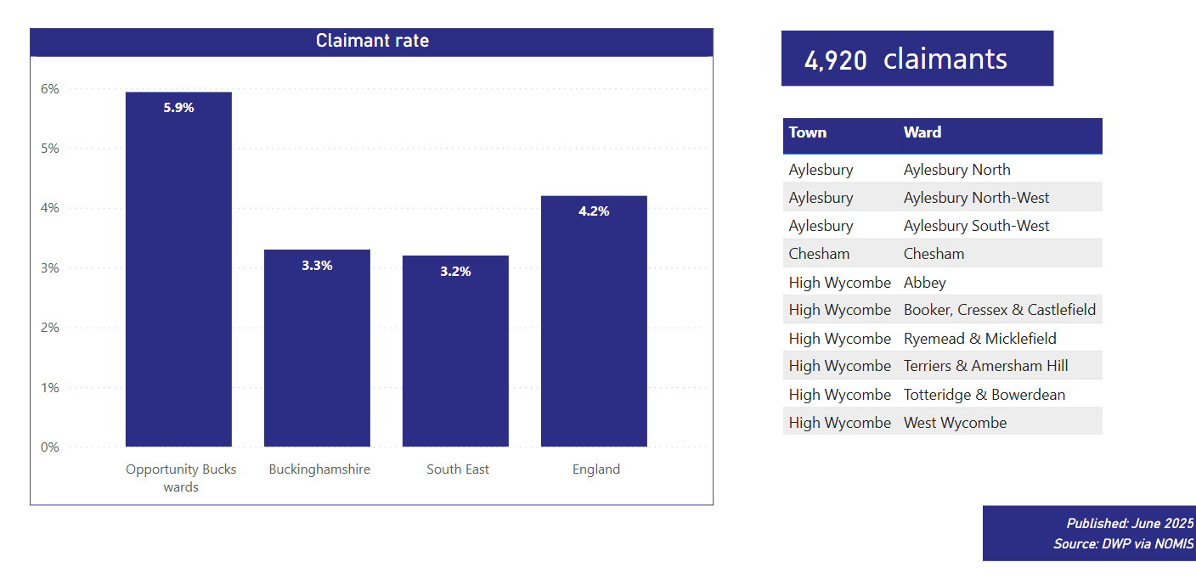
The claimant rate within the Opportunity Bucks wards (combined) is nearly twice that of the Buckinghamshire average
Data is for May 2025
For the latest data see the Buckinghamshire Claimant Count interactive dashboard

Slide 73
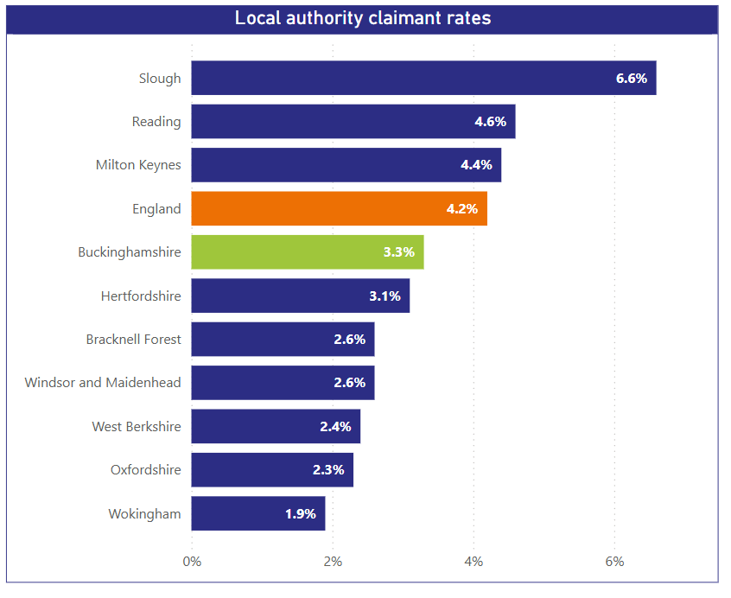
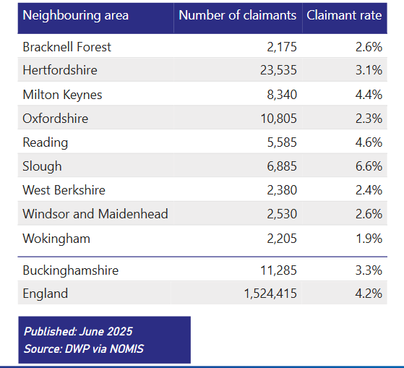
Buckinghamshire’s claimant rate is mid-table of neighbouring areas. Slough has the highest rate (6.6% and Wokingham the lowest 1.9%)
Data is for May 2025
For the latest data see the Buckinghamshire Claimant Count interactive dashboard

Slide 74
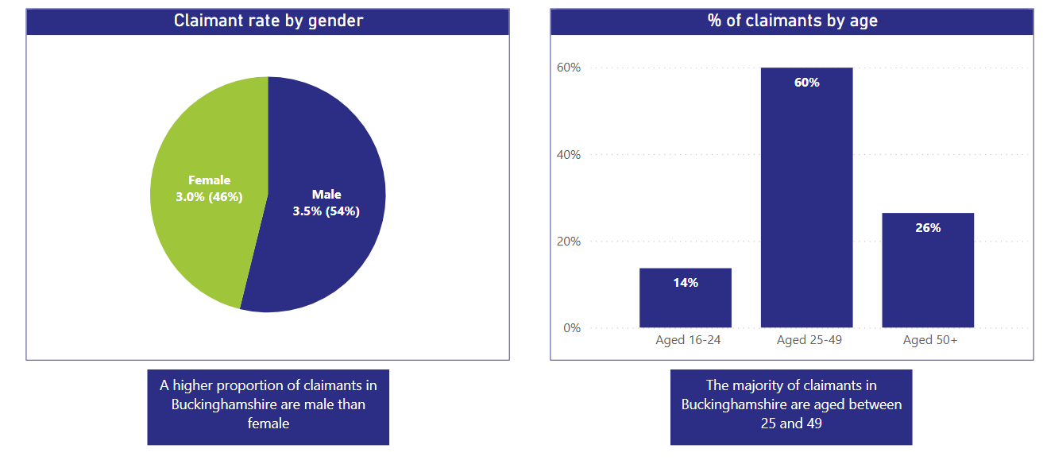
In line with national trends, claimants are slightly more likely to be male than female, and the majority are aged 25 to 49
For the latest data see the Buckinghamshire Claimant Count interactive dashboard
Data is for May 2025

Slide 75
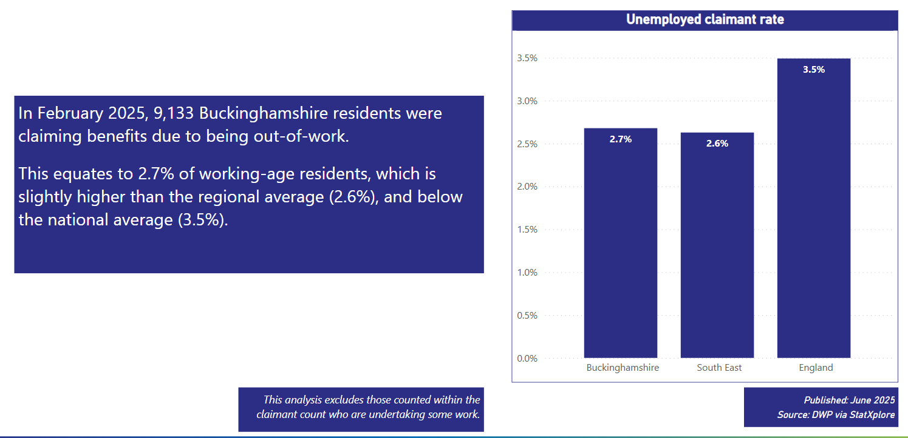
Around 80% of those included in the claimant count are out of work. Buckinghamshire’s ‘unemployed’ claimant rate is 2.7%, lower than the national average and slightly about the south east average
For the latest data see the Buckinghamshire Claimant Count interactive dashboard

Slide 76
The number of payrolled employees who reside in Buckinghamshire has increased at a greater rate than the national average over the last eight years.
Payrolled employees (resident-based) 2015 to 2023 (January 2015 = 100)
Covid-19 lockdowns
Central Bedfordshire
Buckinghamshire
England
Hertfordshire
The number of payrolled employees residing in Buckinghamshire rose steadily following the Covid-19 lockdown period. Since November 2024 numbers have been falling. This is possibly linked to the announcement in the autumn Budget that employer National Insurance Contributions would be increasing from April 2025, making it more expensive for employers to employ people, particularly affecting labour-intensive industries.
Source: HMRC

Slide 77
Buckinghamshire’s working residents are more likely to be self-employed than the national average. Self-employed residents without employees are slightly more likely to be working on a part-time basis than the national average.
Proportion of working residents who are self-employed
Status of self-employed residents
Working patterns of self-employed residents with no employees
Buckinghamshire residents are more likely to be self-employed than the national average. Historically, this has been attributed to a number of factors. Firstly, a relatively high proportion of consultants working on a freelance basis following careers in London-based corporates and secondly, Buckinghamshire having a relatively large construction and film & television sectors, in which many people work on a self-employed basis. It could also be linked to Buckinghamshire having a strong consumer economy with a relatively high proportion of cash-rich / time-poor residents, creating markets for services such as cleaning, childcare, fitness coaching and pet care, all of which are occupations in which people can work on a self-employed basis.
16% of Buckinghamshire residents working on a self-employed basis have employees, the same proportion as the national average. 46% of self-employed workers without employees work on a part-time basis, slightly higher than the national average of 43%.
Source: Census 2021

Slide 78
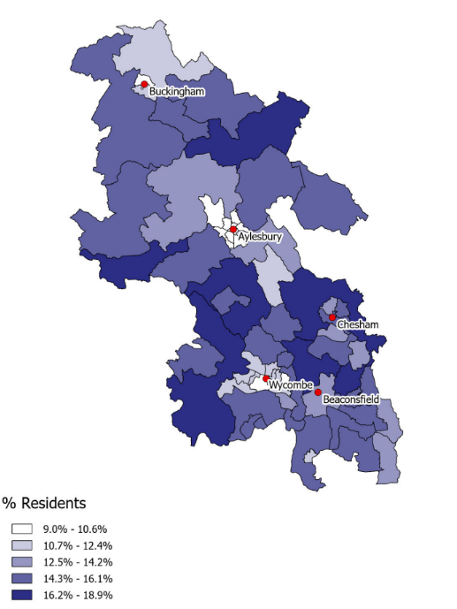
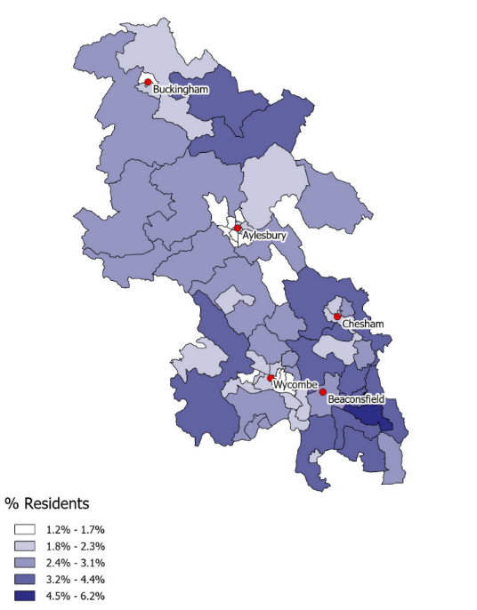
Buckinghamshire’s self-employed residents without employees tend to live in rural Buckinghamshire, whilst those with employees also live outside of the urban areas but are more highly concentrated in the south of the county
Self-employed residents without employees
Self-employed residents with employees
Source: Census 2021, ONS

Slide 79
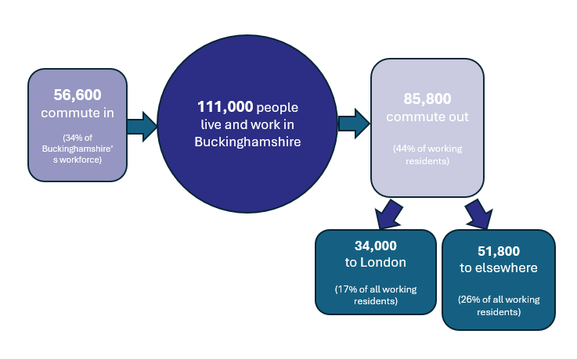
Buckinghamshire is a net exporter of workers, with 29,200 more residents leaving the county for work than non-residents commuting in.
Buckinghamshire’s labour market is ‘leaky’, with 44% of working residents leaving the county for work and 34% of those working in the Buckinghamshire economy travelling in from elsewhere.
London is a key destination for those leaving the county for work, with 17% of all working residents working in central or greater London.
There are some sector specific commuting patterns. Within the film and TV sector for example (which is concentrated in the south of the county), film crews of up to 1,000 per large production, primarily freelancers, move between studios.
Source: Census 2011, ONS
*Commuting patterns matter when undertaking local labour market and skills analysis, particularly when trying to compare data on the demand for, and supply of, skills. For example, whilst Buckinghamshire may have a large number of highly qualified residents, high levels of out-commuting, often for high paid jobs, means that the skills of many of these residents are not available to Buckinghamshire employers, nor are these individuals directly contributing to the output and productivity of the local economy*.
Note 1: We continue to present commuting patterns using 2011 Census data as 2021 data was heavily influenced by the Covid-19 pandemic.
Note 2: An error was found in the calculation of this data in the 2023 version of this report, please use the figures presented here
Note 3: Hybrid workers who work for an out-of-county employer are recorded as out-commuters. The value that they create for their employer is allocated to the area in which the employer is located.

Slide 80
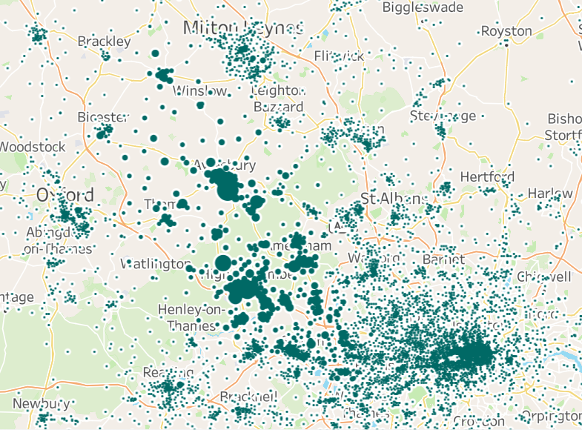
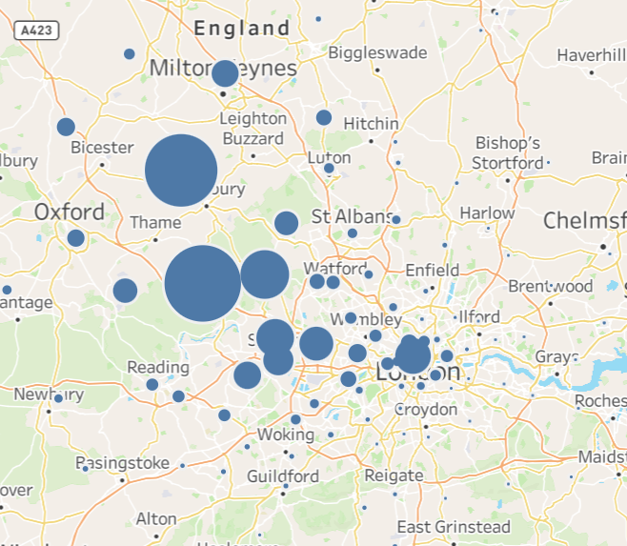
The top work locations for Buckinghamshire residents are High Wycombe, Aylesbury and London.
Where Buckinghamshire residents work (local authority districts (current and former) and London Boroughs
Where Buckinghamshire residents work (workplace zones)
Source: 2011 Census, ONS
Bubble size indicates number of working residents

Slide 81
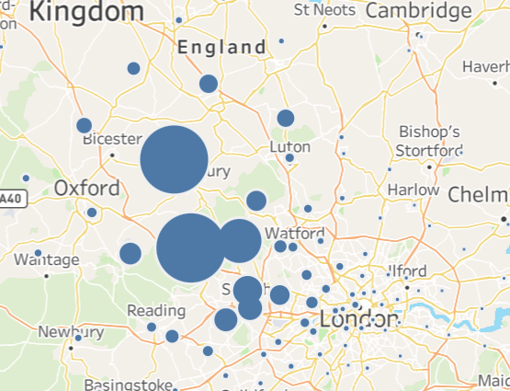
Those commuting into Buckinghamshire to work are most likely to do so from areas to the south east of the county
Where Buckinghamshire workers reside (local authority districts (current and former) and London Boroughs
The majority of those working within the Buckinghamshire economy are Buckinghamshire residents, out-of-county workers who commute in are most likely to do so from Slough, Windsor & Maidenhead, Hillingdon and Milton Keynes.
Source: 2011 Census, ONS
Bubble size indicates number of workers

Slide 82
The number of employees working in Buckinghamshire has increased in recent years, but at a slower rate than nationally and at a slower rate than in most neighbouring areas.
Number of employees in the Buckinghamshire economy and the working age population 2015 to 2023
The number of employees working in the Buckinghamshire economy has risen slowly over the last eight year, by an average annual rate of 1%.
Buckinghamshire’s average annual growth in employees between 2015 and 2023 was lower than the national average (1.0% versus 1.2%) and the second slowest of neighbouring areas, with the greatest growth occurring in Central Bedfordshire and Berkshire West.
Whilst growth in employees is below neighbouring areas, the working age population is increasing at a similar rate, leading to a broadly constant employment rate.
Average annual growth in employees – 2015 to 2023
England average
Source: BRES, 2023

Slide 83
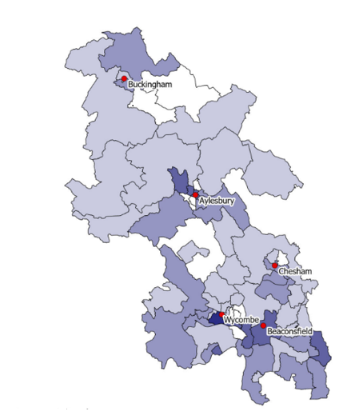
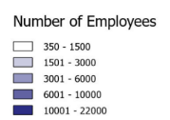
Employees jobs are most concentrated in the south of the county, particularly in locations within easy-reach of the M40.
Areas with particularly high concentrations of employee jobs include Wycombe, Marlow, Beaconsfield, west of Uxbridge and Aylesbury. There are few employee jobs in the rural areas to the south-east of Buckingham and between Aylesbury and Wycombe.
Source: BRES 2023

Slide 84
Section 5: Labour and skills supply

Slide 85
Buckinghamshire has fewer young adults than the national average
Aged 0 -18
Aged 38 – 67
Aged 75 plus
England = 100
Aged 68 - 74
Aged 23 - 37
3% of Buckinghamshire residents are aged 19 to 22, compared with 5% nationally
Aged 19 - 22
21% of Buckinghamshire residents are aged 19 to 37, compared with 25% nationally
Buckinghamshire has a smaller proportion of residents aged 19 to 37 than the England average, particularly in the 19 to 22 age group. This is also the case in other rural English counties.
Buckinghamshire
England
Source: Population estimates 2022-based, ONS

Slide 86
Within the county, Wycombe and Aylesbury parliamentary constituency areas have younger age profiles.
This chart illustrates how the age profile of residents varies across the county.
The two parliamentary constituencies containing Buckinghamshire’s main towns (Aylesbury and High Wycombe) have much younger age profiles than the rest of the county. The Beaconsfield and Chesham and Amersham parliamentary constituency areas have a much older age profile than the county average.
Source: Population estimates 2022-based, ONS

Slide 87
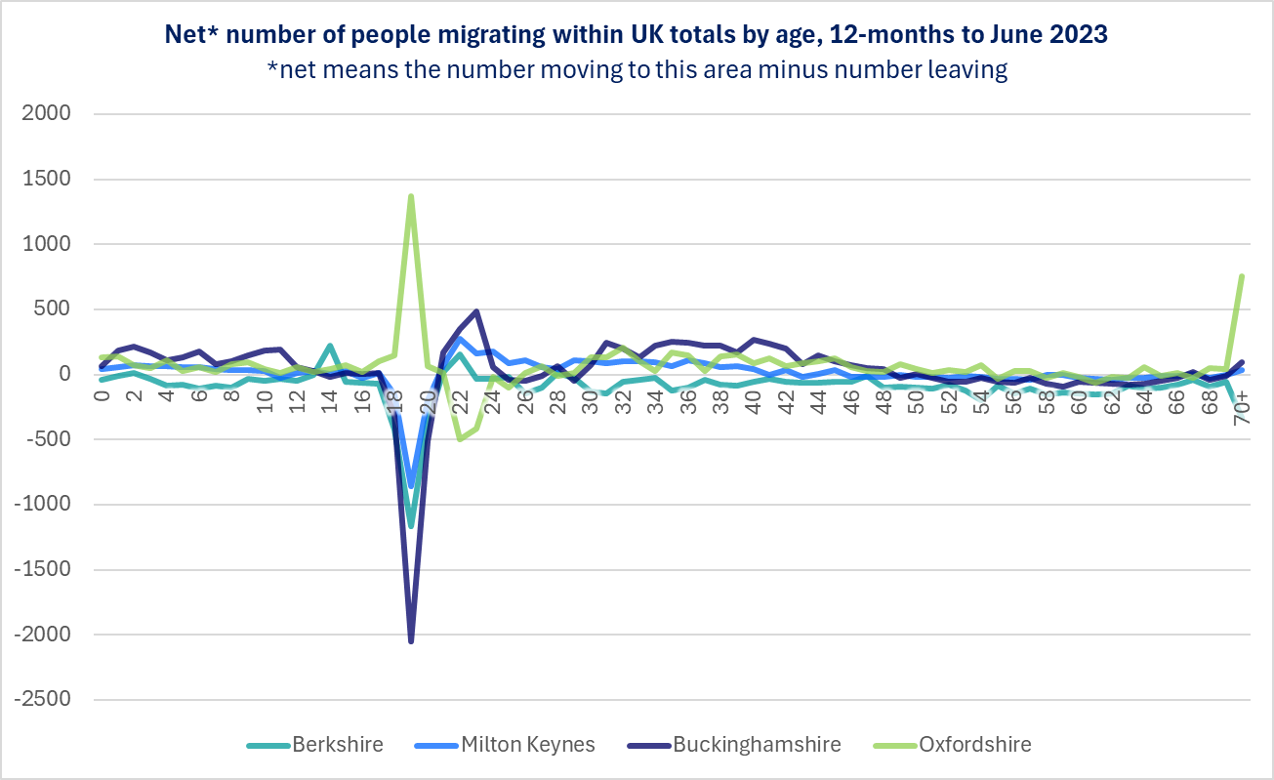
On an annual basis, around 2,000 more 19 year-olds move out of Buckinghamshire than move in
Data on the movement of people within the UK shows that:
Young people are more likely to leave Buckinghamshire in their late teens than in comparator areas
Buckinghamshire has more people moving into the county in their 30s and early 40s than in comparator areas
Likely drivers of these trends include: the high proportion of young residents going to university, the lack of a city in Buckinghamshire; the lure of London for young people; the cost of housing (particularly for those in their mid to late 20s) and the desire to move out of London for a ‘quieter life’ or to bring up children (for those in their 30s and 40s).
Bucks attracts more families with young children than its neighbours
Oxfordshire’s migration flows for young people are the opposite to Buckinghamshire’s
Bucks attracts people in their 30s and early 40s (including families), more so than its neighbours
Each year, Bucks ‘loses’ far more 19 year-olds than it gains – more so than its neighbours
Source: ONS Analysis of population estimates tool for UK, July 2024 release

Slide 88
Buckinghamshire has a higher old age dependency ratio than the national average
Old age dependency ratio
Over the next 25 years, Buckinghamshire’s old age dependency ratio (the number of people of state pension age for every 1,000 people of working age) is projected to rise from 290 to 304 and then 320.
Buckinghamshire’s old age dependency ratio is, and is projected to remain, above the England average. Nationally, a high old age dependency ratio means that more older people are financially reliant on the working age population to pay for pensions.
By 2047, a smaller proportion of Buckinghamshire’s working age population will be under 35 (decreasing from 29% in 2022 to 26% in 2047).
Profile of Buckinghamshire’s working age population, 2022 and 2047
Source: National and Subregional Population Projections, 2022-based, ONS

Slide 89
Buckinghamshire’s working age residents are more likely to have degree-level qualifications than the regional and national averages
Highest level of qualifications held by working age residents
Buckinghamshire’s working age residents are much more likely to hold higher level qualifications (degree level and higher) than the national average (44% versus 37%). At the other end of the spectrum, residents are less likely to have no (9% versus 12%) or low (level 1 or entry level) qualifications (9% versus 10%).
The proportion of residents whose highest qualification is at level 2 is the same as the national average, and a slightly lower proportion have a highest qualification at level 3.
Level | Description
Level 1 | Fewer than 5+ GCSEs / NVQ 1
Level 2 | 5+ GCSEs / NVQ 2 or equivalent
Level 3 | 2+ A-levels / NVQ 3 or equivalent
Level 4+ | HNC, HND, NVQ 4 and 5, degree or higher
Other | Includes apprenticeships and qualifications gained overseas
Source: Census 2021, ONS

Slide 90
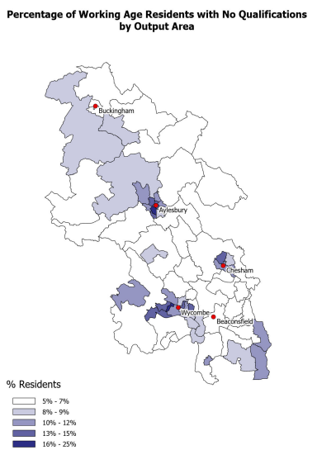
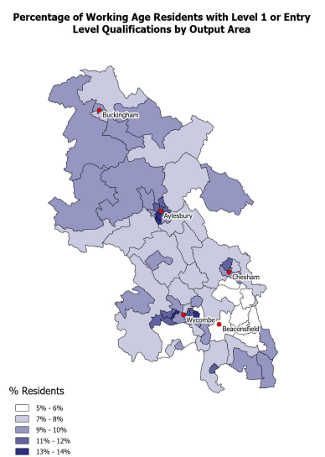
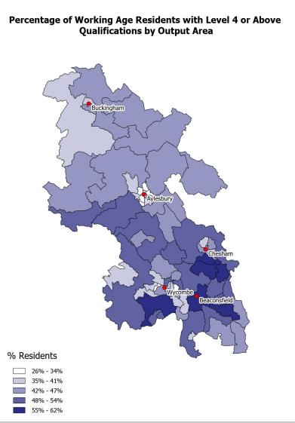
Areas within Buckinghamshire’s main towns (Wycombe, Aylesbury and Chesham) have the highest proportion of residents with no or low-level qualifications. Whilst residents in the south of the county are most likely to have a degree-level or higher qualification
Source: Census 2021, ONS

Slide 91
Buckinghamshire’s education and training provision
Higher Education (HE)
Buckinghamshire has three Higher Education Institutions:
Buckinghamshire New University
University of Buckingham
National Film and Television School (primarily post-graduate courses)
The University of Bedfordshire also has a presence in the County, delivering nursing and midwifery qualifications from its Stoke Mandeville campus.
Secondary schools
Buckinghamshire is one of a handful of counties in England where secondary education is selective. There are 13 grammar schools and 21 upper schools in the County. The County also has one Free School and one University Technical College (Aylesbury UTC - which focuses on construction and digital provision)
Further Education (FE)
Buckinghamshire College Group (Aylesbury College) is the largest provider of full-time education and training for 16-18 year olds in Buckinghamshire, with 30% of the county’s 16–18-year-olds studying at the college.
The college also caters for adult (19+) learners.
Adult Education
Buckinghamshire has a county-wide adult education service - Buckinghamshire Adult Learning.
Pinewood Studios
There are a dozen private training companies serving the creative industries and its supply chain, many of whom are located at Pinewood Studios. One of the largest being the Creative Media Skills Institute.
Apprenticeships
Buckinghamshire College Group and Buckinghamshire New University are the largest providers of apprenticeship training within Buckinghamshire. A significant proportion of apprenticeship provision in Buckinghamshire is delivered by out-of-area providers.
Bordering Bucks
The Silverstone UTC, the South Central Institute of Technology and Henley Business School are all situated on the Buckinghamshire border.

Slide 92
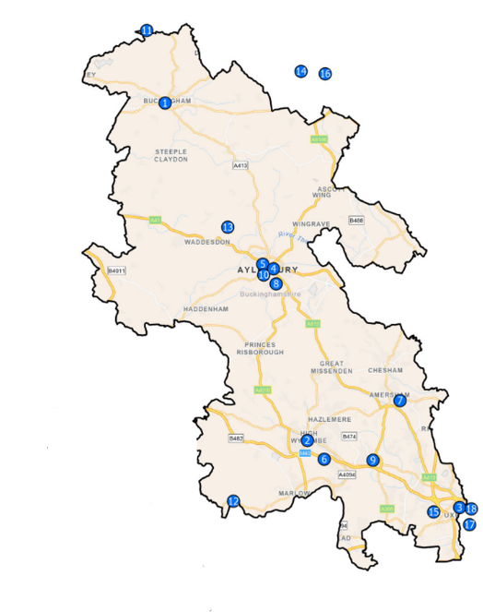
Buckinghamshire’s main post-16 education and training providers (excluding schools) are shown on the map to the right.
No. | Training Provider Campus
1 | The University of Buckingham
2 | Bucks New University (High Wycombe campus)
3 | Bucks New University (Uxbridge campus)
4 | Bucks New University (Aylesbury campus)
5 | Bucks College Group (Aylesbury campus)
6 | Bucks College Group (High Wycombe campus)
7 | Bucks College Group (Amersham campus)
8 | University of Bedfordshire (Aylesbury campus)
9 | National Film and Television School
10 | Aylesbury University Technical College (UTC)
11 | Silverstone University Technical College (UTC)
12 | Henley Business School (Greenlands Campus)
13 | Bucks Training Academy
14 | South Central Institute of Technology (MK College)
15 | Creative Media Skills Institute
16 | Open University
17 | Brunel University
18 | West London Institute of Technology (Uxbridge campus)

Slide 93
Buckinghamshire performs well on the proportion of young people entering sustained destinations following KS4 and KS5, ranking 8th out of 151 local authorities for the former and 25th for the latter
 | KS4 (Y11) [State-funded schools] - Bucks |  | National |  | KS5 (Y12 / Y13) [State-funded schools & colleges] - Bucks |  | National
 | No. pupils | % | % |  | No. pupils | % | %
Cohort | 5,977 |  |  |  | 5,240
Sustained education, apprenticeship or employment | 5,724 | 96% | 93% |  | 4,446 | 85% | 80%
Sustained education | 5,442 | 91% | 86% |  | 2,924 | 56% | 45%
Higher Education | - | - | - |  | 2,763 | 53% | 38%
Further Education | 1,370 | 23% | 35% |  | 148 | 3% | 6%
School Sixth Form | 3,940 | 67% | 39% |  | - | - | -
Sixth Form College | 242 | 4% | 13% |  | - | - | -
Other education (includes independent schools) | 82 | 1% | 1% |  | - | - | -
Apprenticeship | 127 | 2% | 3% |  | 254 | 5% | 7%
Employment | 155 | 3% | 4% |  | 1,268 | 24% | 28%
Not a sustained destination | 182 | 3% | 6% |  | 543 | 10% | 15%
Unknown | 71 | 1% | 1% |  | 251 | 5% | 5%
Key Stage 4 and Key Stage 5 destinations – 2022/23
Source: DfE, 2025

Slide 94
Year 11 leavers are more likely to remain in a sustained destination (mainly education) than the national average and are more likely to do so at a school sixth form.
In 2022/23, following Year 11 (Key Stage 4), most young people (63%) in Buckinghamshire’s state-funded mainstream schools continued in education at a school sixth form. This is much higher than the national average of 37%. Nationally, more young people entered Further Education (35% compared with 23% in Buckinghamshire) and Sixth Form Colleges (13% compared with 4% in Buckinghamshire).
Overall, 91% of Buckinghamshire’s Y11 leavers entered sustained education, compared with 86% nationally.
Moving into apprenticeships and employment are slightly less common routes in Buckinghamshire than nationally.
The proportion of Buckinghamshire’s Y11 leavers entering all sustained destinations was three percentage points higher than the England average.
On completion of 16-18 study, a much higher proportion of young people from Buckinghamshire go on to study at university than the national average
In 2022/23, 53% of pupils completing 16-18 study continued their studies at university, which is much higher than the national average of 38%. A smaller proportion entered employment (24% versus 28%) or did not have a sustained destination (10% versus 15%).
The proportion starting apprenticeships was lower than the national average (5% versus 7%).
Those starting apprenticeships were more likely to be starting higher and degree level apprenticeships than the national average and less likely to be starting apprenticeships at level 2 and 3
Source: DfE, 2025

Slide 95
Around 1,400 Buckinghamshire pupils (aged 18 and under) finish compulsory education and enter sustained employment on an annual basis. Most of whom are likely to enter jobs in Buckinghamshire.
Number of young people entering sustained employment after KS4 or 16-18 study
Overall, in 2022/23 1,423 young people in Buckinghamshire finished compulsory education and entered sustained employment, with the majority (89%) doing so following 16-18 study.
In addition, 381 enter employment via an Apprenticeship route.
Source: DfE, 2025

Slide 96
Buckinghamshire has lower Apprenticeship start rates than the national average, and some of the lowest rates of neighbouring areas.
 | Number of Apprenticeship starts
 | 2019/20 | 2020/21 | 2021/22 | 2022/23 | 2023/24 | 2019/20 to 2023/24 change
Buckinghamshire | 2,270 | 2,470 | 2,710 | 2,750 | 2,790 | 23%
England | 322,530 | 321,440 | 349,190 | 337,140 | 339,580 | 5%
Buckinghamshire’s Apprenticeship start rate (starts as a proportion of all residents) is lower than the national average, and one of the lowest amongst neighbouring areas.
Between 2019/20 and 2023/24, there was a greater increase in Apprenticeship starts in Buckinghamshire than nationally. Hence the slight closing of the gap between start rates in Buckinghamshire and England. Start numbers in Buckinghamshire have been fairly consistent over the last three years.
Apprenticeship starts per 10,000 residents
Apprenticeship starts per 10,000 residents
England average
Source: Apprenticeship statistics, DfE

Slide 97
Over the last eight years, there has been a sharp increase in the proportion of Apprenticeship starts at Level 4, and a sharp decrease in the proportion of starts at Level 2
Apprenticeship starts by age
A similar proportion of Apprenticeships are started by women (52%) as men (48%).
The age profile of those starting Apprenticeships has remained fairly similar over the last five years, with a slight increase in older starters (44% in 2023/4 compared with 42% in 2019/20), and a slight decrease in starts by those aged 18 and under.
There has been a significant shift in the number of Apprenticeships being started at different levels. In 2016/17, 49% of Apprenticeship starts were at Level 2, dropping to 25% by 2019/20 and to 16% by 2023/24.
Over the same period, there has been a sharp increase in Higher Apprenticeship starts (Level 4 and above). 42% of Apprenticeship starts in 2023/4 were at this level, up from 8% in 2016/17, and 31% in 2019/20.
This trend mirrors the national trend and is likely linked to how firms who are subject to the Apprenticeship levy are utilising Apprenticeships.
Apprenticeship starts by level
Source: Apprenticeship statistics, DfE

Slide 98
Aside from ‘preparation for life and work’ related subjects, the most commonly studied further education subjects are ‘health, public service and care’, ‘business, administration and law’ and ‘retail and commercial enterprise
Further education and skills aim achievements by subject – 2024/25
In 2024/25, a slightly greater proportion of further education and skills aims achieved in Buckinghamshire were in ‘health, public services and care’ and in ‘business, administration and law’ as the national average.
Source: DfE, 2025

Slide 99
Those completing studies at Buckinghamshire’s Higher Education Institutes are slightly more likely to enter full-time employment than average
Higher Education destinations – 2021/22
Qualifiers from Buckinghamshire’s higher education establishments were slightly more likely to enter full time employment than the average university qualifier. Qualifiers are significantly less likely to enter further full-time study.
Source: HESA, 2025

Slide 100
The higher proportion of graduates entering employment is likely linked to both the nature of Buckinghamshire’s institutions and job availability in the wider region (including London)
Those graduating from Higher Education Institutions (HEIs) in Buckinghamshire are more likely than average to enter full-time employment. In the last year for which we have data, 64% did so compared with the national average of 61%.
The above average proportion of Buckinghamshire HE graduates entering employment could be related to the proximity of Buckinghamshire to London, which offers a large and relatively accessible supply of jobs, particularly at graduate entry-level. It could also be related to the type of degrees on offer, many of which are more vocational than academic.
Graduates entering employment – 2021/2022
Buckinghamshire New University places a strong focus on employability, focusing on degrees that are professional and practical, as well as academic. This focus, along with high levels of industry involvement, is likely to contribute to its high graduate employability ranking. NTFS has very strong links with industry. Many graduates go on to become creative leaders for the UK’s largest and most high-profile film and television content creators (NFTS Graduate Impact Report, 2020).
In contrast to the national average, a lower proportion of HE graduates in Buckinghamshire continue into full-time further study, or a combination of employment and further study. A possible reason could be that many of the subjects available for graduate study in Buckinghamshire, may not be allied to careers that require further study at postgraduate level.
Source: HESA, 2023/2024 qualifiers (extracted 2025)

Slide 101
Business and management is by far the most common higher education course completed by those studying at Buckinghamshire Higher Education Institutions
Just over half of those completing studies at Buckinghamshire’s Higher Education Institutions in 2023/24 had completed business and management courses. The vast majority of whom doing so at Buckinghamshire New University. This is a much higher proportion than the national (England) average of 21%.
Undergraduate health and medical courses within Buckinghamshire are provided by the University of Buckingham (Medical School), Bucks New University (nursing, health and social care, health and social science, operating department practice, public health) and the University of Bedfordshire (Stoke Mandeville campus) (nursing and midwifery).
The Buckinghamshire Health and Social Care Academy helps facilitate partnership working between these institutions and health providers.
Source: HESA, 2025

Slide 102
Section 6: Future demand for skills

Slide 103
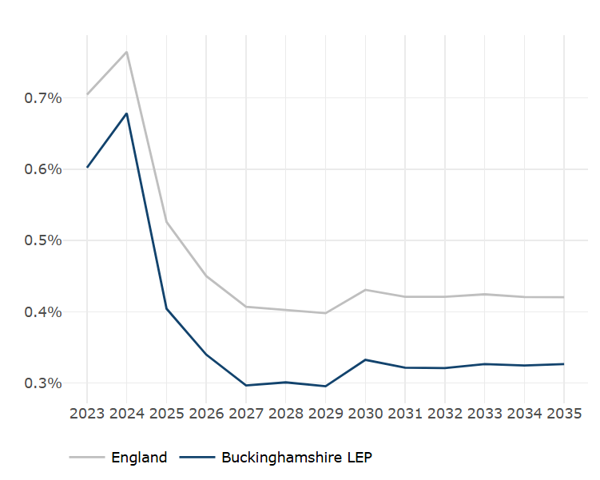
Projected employment growth in Buckinghamshire is lower than the national average. Future growth is ranked 26th of the 36 former Local Enterprise Partnership (LEP) areas
4% year on year employment growth is projected in Buckinghamshire between 2023 and 2025
Based on historical trends and likely future scenarios – employment growth in Buckinghamshire is projected to be lower than the national average.
This is the ‘policy-off’ position in that it doesn’t take into account potential policy interventions. It also doesn’t take into account local knowledge and insight.
The industry and occupation-level projections set out on the following pages should be treated with caution. They present one potential view of the future. And should provide a starting point for debate rather than the final word.
Source: The Skills Imperative 2035, DfE

Slide 104
Replacement demand (employees required to replace those leaving the labour market because of retirement, family formation etc) is projected to be particularly high in the ‘business and other services’, ‘trade, accommodation and transport’, and ‘non-marketed services’ industries.
6 Industries | thousands
 |  |  |  |  | 2020-2035
 |  |  |  |  | Net | Replacement | Total
 | 2020 | 2025 | 2035 |  | Change | Demand | Requirement
Levels (000s)
Primary sector and utilities | 5 | 5 | 5 |  | 1 | 2 | 3
Manufacturing | 20 | 19 | 16 |  | -3 | 8 | 5
Construction | 24 | 25 | 28 |  | 4 | 11 | 15
Trade, accomod. and transport | 74 | 76 | 78 |  | 4 | 36 | 40
Business and other services | 96 | 99 | 105 |  | 9 | 48 | 57
Non-marketed services | 65 | 66 | 66 |  | 2 | 35 | 37
All industries | 283 | 289 | 299 |  | 16 | 139 | 155
6 industries | Includes
Primary sector and utilities | Agriculture, mining & quarrying
Manufacturing | Food and drink manufacturing, engineering, other manufacturing
Construction | Construction
Trade, accommodation & transport | Wholesale, retail, transport, storage and hospitality
Business & other services | Media, information technology, finance & insurance, real estate, professional services, support services, arts & entertainment, other services
Non-marketed services | Public admin & defence, education, health & social work
Source: The Skills Imperative 2035, DfE

Slide 105
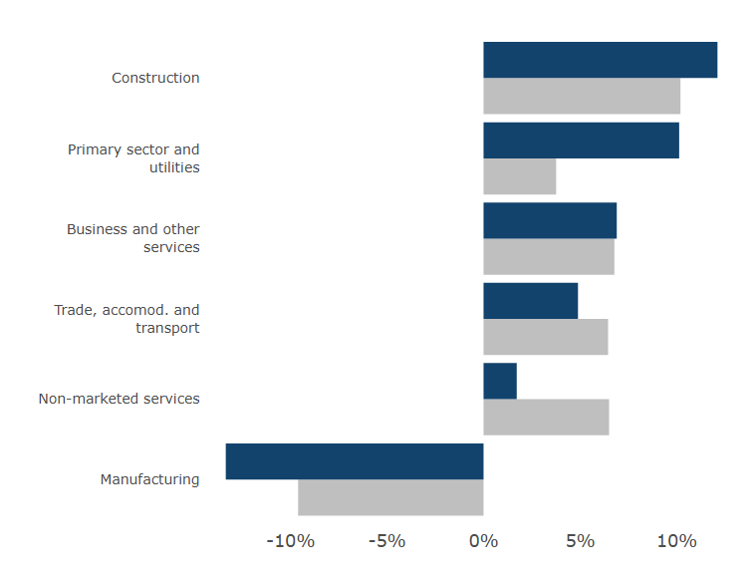
Projections suggest that greatest net job growth in Buckinghamshire between 2023 and 2035 will be in the business & other services industry. And in percentage terms in the construction industry. Employment is projected to fall within manufacturing, to a greater extent than nationally.
Employment by Industry (SIC 2007), 2010-2035, Buckinghamshire
Employment change (%) by Industry (SIC 2007), 2023-2035, Buckinghamshire and England
Buckinghamshire
England
Source: The Skills Imperative 2035, DfE

Slide 106
Buckinghamshire’s construction, hospitality, professional services, support services and information technology industries are projected to experience the greatest net employment growth over the next 10 years
Industry-level employment projections – 2025 to 2035
Industries projected to have greatest employment growth | Industries projected to have greatest employment contraction
Construction | Manufacturing
Hospitality
Professional services
Support services
Information technology
Source: The Skills Imperative 2035, DfE
The Skills Imperative 2035 projections are based on historical trends and likely future scenarios - integrating expert judgment, economic modelling. They are ‘policy-off’ in that they don’t take into account potential policy interventions. They assume that sectors which have performed relatively poorly will continue to do so and vice versa. As previously stated, he results should be seen as providing a starting point for debate rather than the final word.

Slide 107
Occupations projected to have the greatest net employment growth in Buckinghamshire over the next 10 years are all higher-level managerial and professional roles
Occupation-level employment projections – 2025 to 2035
Occupations projected to have greatest employment growth | Occupations projected to have greatest employment contraction
Business, media and public service professionals | Administrative occupations
Corporate managers and directors | Secretarial and related occupations
Other managers and proprietors | Elementary admin and service occupations
Science, research, engineering and technology professionals | Sales occupations
 | Skilled construction & building trades
Source: The Skills Imperative 2035, DfE

Slide 108
Key drivers of changing skill requirements include technological change, changing patterns of consumer demand, structural economic change, working practices and regulatory changes
Key drivers of changing skill requirements at local level are similar to those at national level. These include:
technological change - faster adoption of technology in the workplace, including increasing AI and automation, especially information and communications technology (ICT), which is affecting both the products and services produced, as well as the way they are produced, resulting in increased demands for IT skills across a range of sectors and occupations;
competition and changing patterns of consumer demand – resulting in increased emphasis on customer handling skills;
structural changes - including globalisation, sub-contracting and extension of supply chains, emphasising the need for high quality managerial skills
working practices - such as the introduction of team- or cell-based production in engineering, and call centres in financial services, resulting in increased demand for communication and team working skills; while more generally there has been an increase in labour market flexibility; and
regulatory changes - as well as increased concern about environmental issues, which have made important skill demands upon staff for some key sectors, including construction and finance; (survey evidence suggests that regulatory/legislative change is a particularly important driver of skills change in the public sector).
Source: The Skills Imperative 2035: Essential skills for tomorrow’s workforce: Revised long-run labour market and skills projections for the UK, DfE

Slide 109
Employers who anticipate a need for new skills within their workforce over the next 12 months are most likely to state that ‘specialist skills and knowledge’, ‘knowledge of products and services’ and ‘advanced or specialist IT skills’ need developing.
Source: Employer Skills Survey 2022, DfE
Base: All employers who anticipate need for new skills in next 12 months

Slide 110
FOCUS ON AI
Labour Market Transformation
According to the AI Opportunities Action Plan (2025), AI is expected to:
Create new roles in data science, AI ethics, robotics, and automation engineering.
Displace or transform routine and administrative jobs, especially in sectors like retail, transport, and clerical work.
Augment existing roles, enabling workers to focus on higher-value tasks.
The UK government views AI as a net opportunity, but acknowledges the need for targeted support to help workers transition.
Skills in Demand
The Technology Adoption Review (2025) highlights a growing demand for:
Digital and data literacy
AI and machine learning proficiency
Project and change management
Human-centred skills like creativity, critical thinking, and emotional intelligence
A significant technology skills gap is noted, particularly in SMEs and in regions outside the South East.

Slide 111
FOCUS ON AI
Barriers to Adoption
Key challenges to AI adoption include:
Cost of implementation
Lack of skilled workers
Uncertainty about regulation and safety
Resistance to organisational change
Government Response
The UK government has launched several initiatives to support AI adoption and workforce transition, including:
Skills England: Coordinating AI-related training and apprenticeships.
AI Skills Bootcamps: Backed by companies like Google, Amazon, and BT.
Digital Centre of Government: Driving AI adoption in public services.
Sector-Specific Impacts
The ONS 2025 survey on AI and management practices found:
Manufacturing firms face high costs and talent shortages when adopting AI.
Professional services are rapidly integrating AI into workflows.
Public sector adoption is growing, especially in health and education.
Digital exclusion
Research from the Digital Poverty Alliance and Deloitte shows that approximately 19 million people in the UK experience digital poverty, lacking access to digital devices, skills, or connectivity. As AI becomes increasingly embedded in essential services and employment opportunities, addressing these basic access issues becomes even more critical*.
*Source: Skills in the age of AI, Policy Connect 2025

Slide 112
FOCUS ON AI
Most assessments published regarding the likely impact of AI on the UK labour market are out of date. As are estimates of the size of the AI skills gap. The Government’s AI Opportunities Action Plan recognizes this and recommends that central government produces up-to-date estimates.
In 2025, the International Labour Organisation (ILO) produced updated estimates of the impact of GenAI on jobs*. Their analysis uses international occupational codes. Whilst these codes do not map neatly to UK Standard Occupational Codes, we can fuzzy match using job titles to estimate the number of people employed in Buckinghamshire in occupations the ILO deem to ‘Gradient 4’ AI exposure.
Gradient 4 being: high and consistent GenAI exposure across tasks within the occupation. Most current tasks in these jobs have a high potential of automation (see table).
SOC | Occupations at high risk of GenAI exposure | 2022 Jobs | Avg. Annual Openings | 2022 Employment Concentration
4159 | Other Administrative Occupations. | 6,835 | 220 | 1.08
4122 | Book-keepers, Payroll Managers and Wages Clerks | 4,562 | 145 | 1.05
4129 | Financial Administrative Occupations | 1,269 | 56 | 0.91
4133 | Stock Control Clerks and Assistants | 1,246 | 48 | 1.28
2422 | Finance and Investment Analysts and Advisers | 1,112 | 41 | 0.72
4131 | Records Clerks and Assistants | 873 | 31 | 0.88
4112 | Local Government Administrative Occupations | 745 | 39 | 0.69
4111 | National Government Administrative Occupations | 717 | 35 | 0.54
4134 | Transport and Distribution Clerks and Assistants | 560 | 24 | 1.02
7211 | Call and Contact Centre Occupations | 430 | 24 | 0.43
3133 | Database Administrators and Web Content Technicians | 368 | 11 | 0.99
4132 | Pensions and Insurance Clerks and Assistants | 309 | 9 | 0.60
4152 | Data Entry Administrators | 281 | 15 | 0.82
3531 | Brokers | 184 | 14 | 0.59
2141 | Web Design Professionals | 119 | 4 | 0.94
4217 | Typists and Related Keyboard Occupations | 22 | 1 | 0.80
 |  | 19,631 | 719
In total, around 20,000 employee jobs in Buckinghamshire are in occupations deemed to be most likely to be automated. Overall, Buckinghamshire does not have a higher concentration of employment in these occupations than the national average.
*Source: Occupations Exposed to AI, ILO, 2025

Slide 113
FOCUS ON AI
Impact on graduate roles
There is growing evidence that AI is contributing (along with broader economic factors) to a reduction in graduate job opportunities in the UK.
Research by Indeed UK in June 2025* found that:
  A drop in entry-level hiring was particularly prevalent among major professional services firms.
  Entry-level roles in professional occupations are particularly exposed to AI displacement.
Whilst research by McKinsey in July 2025** found that:
  Job adverts have dropped most for occupations highly exposed to AI, such as software development, data analysis, legal, HR, and media.
  Graduate-level job ads declined by 33% between May 2022 and May 2025, and youth unemployment rose from 10.9% to 14.3%, suggesting graduates are disproportionately affected.
In 2023 a University of London and Demos study*** warned that AI may remove the “bottom rung of the career ladder” for graduates, disrupting traditional pathways into employment. It calls for universities to focus on human-centric skills like creativity and critical thinking.
Whilst evidence is currently limited, the signals are that this is an area that warrants monitoring at a local level.
*Source: UKTech, June 2025
**Source: McKinsey, July 2025
***Source: University of London and Demos, 2023

Slide 114
Key stats
17% of all working Buckinghamshire residents work in central or greater London
(2011 Census).
1 in 8 employee jobs within the Buckinghamshire economy is in the health and care sector.
(BRES, 2023)
81% of Buckinghamshire’s working age residents are in employment
(APS, 2024)
21% of Buckinghamshire residents are aged 19 to 37, compared with 25% nationally
(Population Estimates, 2022-based)
18% of Buckinghamshire employers have hard-to-fill vacancies, compared with 15% nationally
(2022 Employer Skills Survey)
The proportion of Bucks workers with skills gaps increased from 3.9% in 2019 to 5.0% in 2022
(2022 Employer Skills Survey)
Approximately 22,800 residents are not working but would like to
(APS and modelled unemployment data 2024)
Buckinghamshire has 290 residents of state pension age for every 1,000 residents of working age
(Population Estimates, 2022-based)
58% of Buckinghamshire employers provided training to staff in 2022, lower than the national average of 60%.
(2022 Employer Skills Survey)
44% of employers who anticipate a need for new skills in their workforce anticipate the need for advanced or specialist IT skills
(2022 Employer Skills Survey)
53% of those completing 16-18 education in Bucks go onto university, compared with 38% nationally
(DfE, 2025)
2,790 Buckinghamshire residents started Apprenticeships in 2023/24 (DfE, 2025)

Slide 115
Acronyms and abbreviations
AI | Artificial Intelligence
FE | Further Education
GenAI | Generative Artificial Intelligence
HE | Higher Education
HEIs | Higher Education Institutes
ILO | International Labour Organisation
KS4 and KS5 | Key Stage 4 and Key Stage 5
LEP | Local Enterprise Partnership
OECD | Organisation for Economic Co-operation and Development
R&D | Research and Development
ONS | Office for National Statistics
SME | Small and Medium Sized Enterprises

Slide 116
Definitions
Buckinghamshire’s economic and innovation specialisms | High performance engineering; space; film and high end television.
Buckinghamshire’s economic and innovation specialisms or strength | High performance engineering; space; film and high end television; life sciences.
Claimant count | Residents claiming benefits due to being out-of-work or earning below the Administrative Earnings Threshold (18 hours a week at the National Living Wage).
Economic inactivity | Working age residents are not working or actively seeking work.
Foundation economy | The element of the economy that primarily serves the local population (e.g. health sector, education sector, hospitality, retail, vehicle repair).
Hard-to-fill vacancies | Vacancies that employers report as being hard to fill for any reason.
Key Stage 4 | A phase of education that usually occurs in Years 10 and 11 of secondary school.
Key Stage 5 | A phase of education typically for students ages 16 to 18.
Old age dependency ratio | The number of people of state pension age for every 1,000 people of working age.
Opportunity Bucks wards | Wards in which Buckinghamshire residents are experiencing greatest levels of hardship.

Slide 117
Definitions
Sector and industry | These terms are used interchangeably within the report.
Skills gap | Employees identified by employers are not being fully proficient in their role.
Skills shortage vacancies | Vacancies that are proving hard-to-fill due to a lack of applicants with the required skills or qualifications.
SMEs | Firms with less than 250 employees.
Standard Industrial Classification codes | A system used to classify and categorise industries in a consistent and structured way.
Standard Occupational Classification codes | A system used to classify and categorise occupations in a consistent and structured way.
Sustained destination | Students being continuously engaged in education, employment, or training for a minimum period.
Tradeable economy | Tradable goods and services can be sold and consumed outside of the region in which they are produced.
Unemployment | Residents who are not working but would like to, have actively sought work within the last four weeks and are available to start work within the next two weeks.

Slide 118
Further reading
Reports about the Buckinghamshire Economy
10 things you need to know about the Buckinghamshire Economy, 2025
The Buckinghamshire Economy 2024, 2024
Buckinghamshire Productivity Review, 2024
The Buckinghamshire Economy: industry, cluster and innovation strengths, 2024
Claimant count dashboard (live)
Buckinghamshire Apprenticeships 2024

