Slide 1
The Buckinghamshire Economy
10 things you need to know

Slide 2
10 things you should know about the Buckinghamshire economy
It’s not performing as well as it used to
Our high-value (tradeable) economy is small
Low-productivity sectors are becoming increasingly dominant
A lack of large, productive firms is affecting performance
The departure of major financial and insurance companies from Aylesbury has dented productivity
We export more workers than we import
Investment in the economy over the last 15 years has been weak
Firms highlight property costs, recruitment difficulties, transport challenges and housing costs as key barriers to growth
The county has three unique economic and innovation strengths: film and high-end TV, high performance technology and space. The county also has strengths in the life sciences and MedTech sector
Buckinghamshire’s SME business base is relatively stable and resilient

Slide 3
1. It’s not performing as well as it used to
Why?
Structural change within the economy
Low productivity sectors growing more quickly than high productivity sectors
High productivity sectors growing more slowly than the national average
(public sector productivity performance has been about average)
Buckinghamshire
England
By 2016… that difference had disappeared following below-average productivity growth between 2011 and 2016.
Since 2016.. the county’s productivity has largely been in line with the national average (in terms of both level and growth)
Until 2011.. Buckinghamshire’s productivity was consistently around 10% higher than the national average
Why have we seen structural change?
Loss of some high-value firms (closures, relocations)
Few high-value firms growing within / moving into the county
Growth of the local consumer economy
Source: ONS 2024

Slide 4
2. Our high value (tradeable) economy is small (which is not a good thing)
Tradable goods and services can be sold and consumed outside of the region in which they are produced. Cars and computer software are tradable. A meal at a restaurant is not.
Firms operating in tradable sectors
drive productivity growth
have strong multiplier effects (they create more additional jobs than firms in foundation / everyday sectors)
are less likely to be in direct competition with other local businesses, thus reducing the risk of displacement
Share of Gross Value Added (GVA) generated by tradeable sectors 2019 – Buckinghamshire and neighbouring areas
Tradeable sectors do not solely employ people in highly skilled roles, they also provide entry-level and career progression opportunities for individuals.
They are also not solely made up of large companies. The majority of firms operating in tradable sectors are Small and Medium-sized Enterprises (SMEs).
Source: Lightcast

Slide 5


3. Low-productivity sectors are becoming increasingly dominant
Over the last five years the county has seen a..
21% increase in jobs in the arts, entertainment and recreation industry
21% increase in jobs in the transport and storage industry
13% increase in jobs in the hospitality industry
In 2022 there were…
700 more warehouse operators
500 more gardeners
400 more cleaners
400 more LGV drivers
350 more kitchen assistants
..working in Buckinghamshire than in 2017
Some of this growth is linked to Buckinghamshire’s strong consumer economy – driven by the relatively high proportion of cash-rich / time-poor residents
Source: Lightcast, 2025

Slide 6
4. A lack of large, productive firms affects performance
Buckinghamshire has a higher proportion of Small and Medium Sized firms (particularly micro firms) than the national average, and more people working in SMEs.
Since larger firms tend to be more productive and can contribute to the economy in ways smaller firms cannot, the relative lack of large firms can restrict growth and innovation.
Buckinghamshire has lost some large firms in recent years through closures (Buckingham Group) and relocations (Hyundai, Johnson & Johnson)
Buckinghamshire’s large firms are more highly concentrated in the south of the county, particularly along the M4 corridor
Proportion of turnover in Buckinghamshire generated by large employers and SMEs
In 2024, 47% of all turnover generated by Buckinghamshire firms and institutions was generated by the 90 employers with more than 250 employees. They also provided 44% of all Buckinghamshire-based employee jobs.
Source: ONS 2024

Slide 7

5. The departure of major financial and insurance companies from Aylesbury has dented productivity
Lloyds Banking Group / Equitable Life – 700 job losses 2009 to 2011
The Share Centre - 250 job losses 2020
Financial and insurance industry jobs – Aylesbury Vale
Productivity in Aylesbury town has been declining for the last decade.
This is likely largely due to large scale job cuts made by Lloyds Group and Equitable Life in 2009. Lloyds Group was by far the biggest private sector employer in Aylesbury. This had knock-on supply chain implications for SMEs which supplied good and services to the company or relied on custom from Lloyds employees.
Other areas (e.g. Berkshire) were also hit by financial services job losses. But have developed or maintained other high-value industries (such as IT). Aylesbury has not attracted alternative large employers in high-value industries.
More recently, 250 financial services jobs were lost from the town in 2020 with the closure of The Share Centre.
In a different industry, the loss of Johnson & Johnson from High Wycombe could have a similarly significant effect on the economy
Source: ONS 2024

Slide 8
6. We export more workers than we import
In contrast to neighbouring areas, more Buckinghamshire residents leave the county for work than non-residents come in.
A comparatively high proportion of Buckinghamshire’s working residents (13%) work in London.
Buckinghamshire residents earn more (on average) than those working within the Buckinghamshire economy (whether they live in the county or not)
In addition to being a net-exporter of high skilled workers, Buckinghamshire is a net-exporter of young adults.
In the 12 months to June 2023, over 1,800 more 18-to-23-year-olds left Bucks than arrived
Source: Census 2021

Slide 9
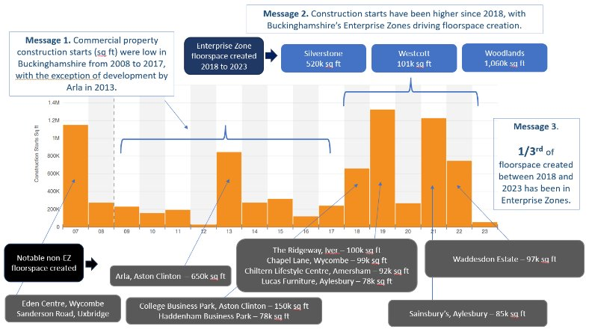
7. Investment in the economy over the last 15 years has been weak
Between 2008 and 2017 very little new commercial property built in Buckinghamshire.
Relative to business population size, Buckinghamshire has attracted less Innovate UK funding than the national average in recent years.
In addition, there has been below-average ICT investment (per job) and declining investment (per job) in intangible assets and all capital assets combined.
Equity investment in Buckinghamshire is largely very early stage and in low value sectors.
As successive governments have tried to reduce regional inequalities, Buckinghamshire has received less central government investment for regeneration / economic growth in recent years than areas facing greater structural challenges.
Sources: CoStar, Innovate UK, ONS and Beauhurst

Slide 10
8. Firms highlight property costs, recruitment difficulties, transport challenges and housing costs as key barriers to growth
Barriers to growth
Housing affordability
Housing affordability has worsened over the few decades. Housing is less affordable in Buckinghamshire than in neighbouring areas with average house prices 11.4 times average earnings
Job vacancies tend to be more difficult to fill in Buckinghamshire than nationally, with over 50% of vacancies identified as being hard-to-fill in 2019 compared with 37% nationally
Hard to fill vacancies
Firms have faced a range of barriers to growth in recent years. From uncertainty around Brexit to the Covid-19 pandemic and high energy costs. Additional local barriers to growth frequently cited by surveyed firms include property costs and availability, recruitment difficulties, road congestion, poor local public transport and the planning application process.
Sources: Bucks Council, ONS and DfE

Slide 11

9. The county has three unique economic and innovation strengths: film and high-end TV, high performance technology and space. The county also has strengths in the life sciences and MedTech sector
Reasons to be cheerful!
Buckinghamshire’s has three unique economic and innovation strengths:
Pinewood Studios, the National Film and Television School and the wider West of London film and high-end television cluster;
Silverstone Circuit and its associated high-performance technology cluster;
The Westcott space cluster
All are continually evolving. In the last five years there has been growth in:
low carbon transport (EV and battery storage) and sports technology capabilities at Silverstone
drone, in-orbit servicing, assembly and manufacturing and future networks (5G/6G) capabilities at Westcott
the application of immersive technology (VR, AR, MR) and Virtual Production within the county’s film and high-end television cluster.
Each is significant nationally and internationally and firmly rooted in their respective locations, with histories and evolutions that can be traced back 80 years.
Technological advancements in space and high-performance technology can significantly reduce carbon emissions, whilst the film industry is a major service exporter, attracting international investment and offering diverse job opportunities.
Buckinghamshire also has strengths in the life sciences and MedTech sector, with assets including the National Centre for Spinal Injuries Unit (the birthplace of the Paralympics) at Stoke Mandeville Hospital, the world-leading Epilepsy Society and major global life science firms. This sector has significant growth potential in Buckinghamshire given the county’s locational advantages (within the Oxford-Cambridge-London golden triangle, close to Heathrow Airport and close to London).
Many of the firms operating in these three areas are highly innovative SMEs undertaking cutting edge R&D.

Slide 12
10. Buckinghamshire’s SME business base is stable and resilient
Proportion of workforce employed in different sized firms
Small and Medium-Sized companies (SMEs) are more dominant in the Buckinghamshire economy than nationally, particularly micro firms (employing fewer than 10 people).
Mirco firms (VAT/PAYE registered) provide 23% of jobs in Buckinghamshire, compared with 16% nationally.
Around 40% of all Buckinghamshire’s (VAT/PAYE registered) SMEs operate in high-value / tradable industries
Despite facing significant challenges over recent years, Buckinghamshire’s SMEs are resilient with higher business survival rates than the national and regional averages, and neighbouring areas.
Buckinghamshire has higher business ‘birth’ rates (firms becoming VAT/PAYE registered) than the national average but slightly low business start-up rates (number of firms opening new business bank accounts)
Business survival
Source: ONS 2024

