Slide 1
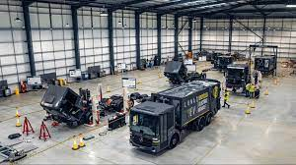





The Buckinghamshire Economy: 2024
Published: January 2024

Slide 2
Background

Slide 3
Background
This report presents the latest analysis of the performance, size and structure of the Buckinghamshire economy. The report has four sections:
Economic performance
Business population
Business dynamism
Industry structure and specialisms
Each section of the report includes:
An explainer - to provide readers with context and explanations regarding economic concepts and terminology
A summary slide - which provides the headline narrative along with an indication of comparative strengths and weaknesses
Charts and tables highlighting key points
Methodological information is provided within the report’s Annex.

Slide 4

Buckinghamshire’s economic evidence base reports
This report is part of a suite of evidence base reports produced for the county on an annual basis. The others currently being:
Buckinghamshire’s Labour Market and Skills Analysis
Buckinghamshire Businesses
Buckinghamshire’s International Trade
All reports are available to download from the Buckinghamshire Local Economic Intelligence Observatory

Slide 5
Contents
Section 1: Economic performance
Section 2: Business population
Section 3: Business dynamism
Section 4: Industry structure and specialisms
Annex

Slide 6
Economic Performance

Slide 7
Economic performance – explainer (1)
There are two main ways of estimating how well a local economy is performing
  The level of economic output
  The growth of economic output (e.g. change in output over time)
The main measures of economic output are Gross Domestic Product (GDP) and Gross Value Added (GVA).
GDP = GVA plus taxes, minus subsidies.
GVA is often used as a proxy for GDP. Added benefits are that GVA can be measured at company and industry level.

Slide 8
Economic performance – explainer (2)
Local economic output (e.g. GDP/GVA) is driven by:
  The size of the population
  The proportion of the population in employment
  The productivity of workers
Productivity measures how efficiently inputs (e.g. labour, skills, physical capital and intangible capital) are converted into outputs (goods and services).
Productivity is measured by dividing economic output (GVA) by the number of hours worked by those working within the geographic area in question.

Slide 9
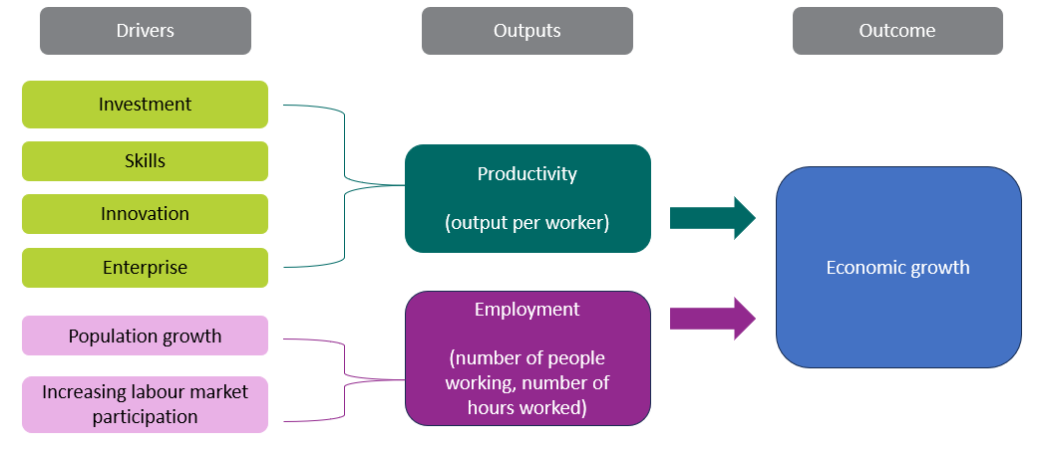
Economic performance – explainer (3)
Economic growth can be achieved by either increasing productivity or increasing employment
In developed economies with high levels of employment, raising productivity will be the most effective and sustainable way of achieving economic growth.
Simply adding more workers without improvements in productivity may not lead to long-term economic growth and can put a strain on resources and infrastructure.

Slide 10
Economic performance – context
The UK has experienced slow productivity growth in recent years, largely due to economic shocks (the 2007/2008 Global Financial Crisis and the Covid-19 pandemic) and political uncertainty - at home (Brexit) and abroad (the Russia / Ukraine conflict), which have led to low levels of public and private sector investment.
Despite slow productivity growth, employment rates have remained relatively high and unemployment relatively low. The biggest impact to individuals has been weak wage growth.
Improving productivity at the local level is complex and requires a multidimensional approach. Strong productivity growth requires a good performance in the key drivers of productivity (investment, skills, innovation and enterprise).
There are limited policy levers available at a local level to significantly affect local economic performance. National policy and external factors have the greatest influence. Constraints on local policy levers include: regulation, funding and political appetite.
Local economic growth policy design should take into account: constraints; trade-offs; the potential scale of impact; and timeframes.
Some issues to bear in mind regarding how productivity is measured at a local level are set out in the Annex.
National context
Local policy levers
Measurement

Slide 11
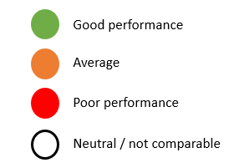
Summary: Economic performance of Buckinghamshire
In 2021, Buckinghamshire’s total GDP in current prices was £18,485m.
Buckinghamshire has experienced slow GDP growth over the last 20 years.
Buckinghamshire is estimated to have experienced slower GDP growth than neighbouring areas, and the national average, over the last decade.
Buckinghamshire has a more productive economy than much of the rest of the country, and is mid-pack when compared with its neighbouring areas.
Buckinghamshire has lower productivity levels and slower productivity growth than the South East average.
Buckinghamshire’s comparative performance on productivity weakened between 2011/12 and 2016.
Buckinghamshire’s comparative performance on productivity has improved since 2017, but is not as strong as pre-2011/12.

Slide 12
Buckinghamshire has experienced slow growth in GDP over the last 20 years.
In 2021, Buckinghamshire’s GDP was 14% higher (in 2019 prices) than in 2001. This places Buckinghamshire in 36th position of the 38 Local Enterprise Partnership (LEP) areas. Across England as a whole, GDP was 36% higher in 2021 than in 2001.
Over the last two decades, Buckinghamshire’s GDP (in 2019 prices) has generally risen year-on-year, with the notable exceptions of:
  2004
  2009 (Global Financial Crisis)
  2020 (Covid-19)
*health warning*
During the Covid-19 pandemic, it was harder than normal for the Office for National Statistics (ONS) to estimate economic output. In September 2023, ONS made large revisions to their estimates of economic output at the national level. Local level economic output data for 2020 and 2021 is therefore anticipated to be subject to change. We anticipate revised local data to be published in March 2024. In the meantime, economic output and productivity data for 2020 and 2021 should be treated with a high degree of caution.
Chained volume measure of GDP in 2019 money value
Source: ONS, 2022

Slide 13
Between 2004 and 2009, Buckinghamshire’s GDP growth was just above the national average. However, growth between 2010 and 2015 was much lower than both the national average and growth rate within neighbouring areas.
LEP areas | 5-year average annual growth in GDP |  |  | Annual growth in GDP
 | 2004-2009 | 2010-2015 | 2016-2021 | 2019-2020 | 2020-2021
Hertfordshire | 0.4% | 3.0% | 1.3% | -9.9% | 8.4%
South East Midlands | 0.0% | 3.3% | 0.1% | -13.6% | 10.5%
London | 1.7% | 3.1% | 0.3% | 11.5% | 8.9%
Berkshire | 2.5% | 4.3% | 2.4% | -6.9% | 6.5%
Buckinghamshire | 0.7% | 1.2% | 0.0% | -12.2% | 7.8%
Oxfordshire | 0.1% | 2.6% | 0.4% | -9.4% | 6.1%
ENGLAND | 0.6% | 2.5% | 0.4% | -11.5% | 8.9%
Looking at the last five years for which data is available (2016-2021), Buckinghamshire’s average annual GDP growth rate was estimated to be 0.0% (21st position out of the 38 LEP areas, and the slowest growth rate of neighbouring LEP areas).
However, the health warning regarding 2020 and 2021 data explained in the previous slide applies here. Therefore, data in columns where headers are shaded orange should be treated with caution until revised data is published later in the year.
Source: ONS, 2022
Chained volume measure of GDP in 2019 money value

Slide 14
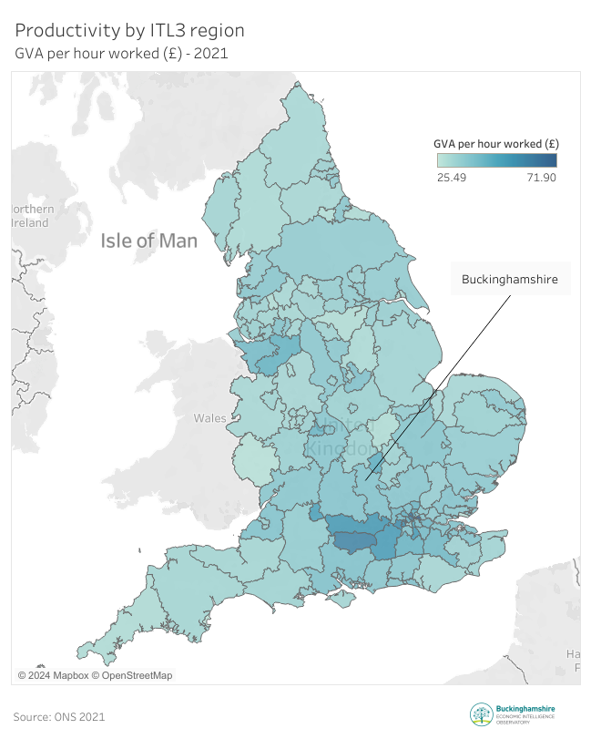
Buckinghamshire has a more productive economy than much of the rest of the country, and is mid-pack when compared with its neighbouring areas
Harrow & Hillingdon
England average
Berkshire
GVA per hour worked (£) - 2021
Milton Keynes
Hertfordshire
Buckinghamshire
Central Bedfordshire
Oxfordshire
West Northamptonshire
In 2021 Buckinghamshire was ranked 35th out of 133 ITL3* areas in England in terms of productivity
*See Annex for definition
Source: ONS, 2023

Slide 15
Buckinghamshire’s productivity is similar to the national (England) average, but the national average is skewed by some very high performing areas within London and the South East
GVA per hour worked - 2021
£38.91
Whilst Buckinghamshire’s productivity is similar to the national average, we need to bear in mind that a handful of areas in London and the South East (including Berkshire and Milton Keynes) have very high productivity which skews the national average. In fact, only 30 of the 133 ITL areas of England have productivity levels above the national average (see chart on previous slide). Buckinghamshire has higher productivity than the median of the 133 ITL3* areas
£38.65
£34.75
England
Buckinghamshire
Median of 133 ITL3* areas
Source: ONS, 2023
*See Annex for definition

Slide 16
Buckinghamshire’s comparative performance on productivity has weakened over the last decade or so
Buckinghamshire’s rank out of 133 ITL3* areas
Buckinghamshire v England (England = 100)
From a relatively strong position between 2007 and 2011, Buckinghamshire’s economy experienced slower than average productivity growth between 2011/12 and 2016, with productivity rates (GVA per hour worked) being more or less in line with the England average ever since.
In ranking terms, Buckinghamshire had the 22nd highest productivity rates of the 133 ITL3* areas of England in 2010 and 2011, falling to 47th position in 2017, before rising back up to 35th position in 2021.
Source: ONS, 2023
*See Annex for definition

Slide 17
Buckinghamshire performs more strongly on the disposable income of residents than on productivity, ranking 18th of the 133 ITL3* areas in terms of gross disposable household income (GDHI) per head of population and higher than all neighbouring areas
Whilst Buckinghamshire’s productivity is similar to the national average, the county performs more strongly in terms of the disposable income of residents. GDHI per head of population is 28% higher in Buckinghamshire than the England average, and Buckinghamshire is ranked 18th of 133 ITL3* areas on this measure.
Analysis conducted by ONS in 2021 found that areas with higher GDHI than productivity tended to be more rural but within commuting distance of large cities.
High levels of disposable income in Buckinghamshire are therefore likely linked to a high proportion of residents working in highly paid roles in London-based firms.
GDHI per head of population (£) by ITL3 area (2021)
Kensington & Chelsea / Hammersmith & Fulham
Central Bedfordshire
Buckinghamshire
Harrow & Hillingdon
Hertfordshire
Milton Keynes
Berkshire
Oxfordshire
West Northamptonshire
It should be noted that GDHI is calculated before housing costs such as rental and mortgage capital repayments.
Source: ONS, 2023
*See Annex for definition

Slide 18
Business population

Slide 19
Business population - explainer
The majority of business statistics are produced for those operating over a certain threshold (i.e. those registered for VAT or PAYE)
Businesses with a VAT taxable turnover of over £85,000 must register for VAT.
Businesses with one or more employee (who are paid £120 or more a week) must register for PAYE. This includes sole directors who take a salary from the company.
Businesses not registered for VAT or PAYE are referred to as being ‘unregistered.’
A business enterprise is the smallest combination of legal units (generally based on VAT and/or PAYE records) which has a certain degree of autonomy within an enterprise group.
A business unit is a branch, factor or office (etc) of a business enterprise.

Slide 20
Summary: Business population of Buckinghamshire
Overall, there are an estimated 67,300 private sector businesses operating in Buckinghamshire, just over half of whom are very small, in that they have no employees and are not registered for VAT or PAYE.
Buckinghamshire has a much larger business base (on a per head of population basis) than the national average
Buckinghamshire has experienced slower than national average growth in the number of VAT/PAYE businesses (enterprises) over the last decade.
Micro firms are more dominant in the Buckinghamshire economy that the national average, but large companies provide a significant number of jobs.
There are particularly high concentrations of VAT/PAYE businesses in the Beaconsfield, High Wycombe and Aylesbury areas.
Buckinghamshire’s largest businesses (employing more than 250 people) are mainly located in the south of the county, in particular along the M4 corridor, in Aylesbury, in the north of the county (in the area which includes Silverstone Park), and in the area to the north of Thame.

Slide 21
There were approximately 67,300 private sector businesses operating in Buckinghamshire in 2023
67,300 private sector businesses (estimate)
36,200 unregistered (estimate)
31,000 registered
At the beginning of 2023, we estimate that there were approximately 67,300 private sector (including non-profit) businesses in Buckinghamshire. Just over half of these businesses (approximately 36,200) had no employees and were not registered for VAT / PAYE.
There were 31,000 private sector VAT / PAYE registered enterprises in Buckinghamshire in 2023.
We estimate that the total number of private sector businesses in Buckinghamshire grew by approximately 2% between 2022 and 2023. With almost all of the growth being in the number of unregistered businesses. This is broadly in line with the national trend.
We have very limited information on the economic contribution of Buckinghamshire’s unregistered businesses.
Source: UK Business Count 2023, ONS and Business Population Estimates, Department for Business and Trade, 2023

Slide 22
Buckinghamshire has a much larger VAT/PAYE business base (on a per head of population basis) than the national average
60
businesses per 1,000 residents
47 businesses per 1,000 residents
45 businesses per 1,000 residents
Buckinghamshire
South East
England
In 2022, there were 60 VAT/PAYE registered businesses in Buckinghamshire per 1,000 residents, much higher than the national average of 45, and the regional average of 47.
Source: Business Demography 2022, ONS and ONS mid-year population estimates

Slide 23
  The number of VAT/PAYE registered businesses operating in Buckinghamshire has been relatively stable since 2017
Number of VAT/PAYE registered businesses (enterprises) in Buckinghamshire by year
The number of businesses in Buckinghamshire grew steadily between 2011 and 2017*, followed by a period of stability between 2017 and 2023.
There were 31,210 VAT/PAYE registered businesses (enterprises) operating in Buckinghamshire in March 2023, a decrease of 0.5% from March 2022. Nationally the number of enterprises decreased by 1.6%.
Between 2013 and 2023, Buckinghamshire experienced slower growth in the number of enterprises (17%) than the national (27%) and regional (19%) averages. And slower growth than the neighbouring South East Midlands and Hertfordshire LEP areas. Growth was similar to levels seen in Berkshire and Oxfordshire however.
Source: IDBR, 2023
*It is a little difficult to ascertain to what extent Buckinghamshire’s business population has grown over the last decade as the ONS widened their methodology in 2015 to include more solely PAYE businesses. The bars on the chart above are coloured differently to illustrate this change in methodology.

Slide 24
Micro firms are more dominant in the Buckinghamshire economy that the national average, but large companies provide a significant number of jobs
Businesses and employment by size of firm (Buckinghamshire)
Employees by size of firm (Buckinghamshire versus England)
The vast majority of VAT/PAYE enterprises in Buckinghamshire are micro in size (employing fewer than 10 people). Buckinghamshire has the highest proportion of micro firms of all 38 Local Enterprise Partnership areas.
Whilst large firms (with more than 250 employees) only account for 0.3% of all VAT/PAYE registered enterprises in Buckinghamshire, they provide 43% of all employee jobs.
Micro, small and medium-sized firms provide more employee jobs in Buckinghamshire than the national (England) average. Just under a quarter of employee jobs in Buckinghamshire are in firms employing fewer than 10 people, compared with 16% nationally.
Source: ONS, 2023

Slide 25
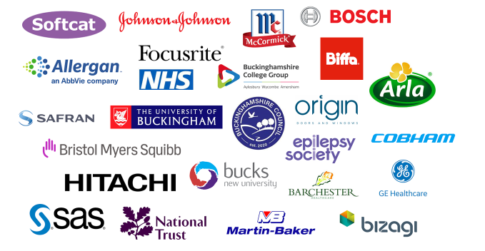
Buckinghamshire has fewer large employers than many other areas of the country. A selection of Buckinghamshire’s largest employers (operating within the private, public and third sectors) are set out below.

Slide 26
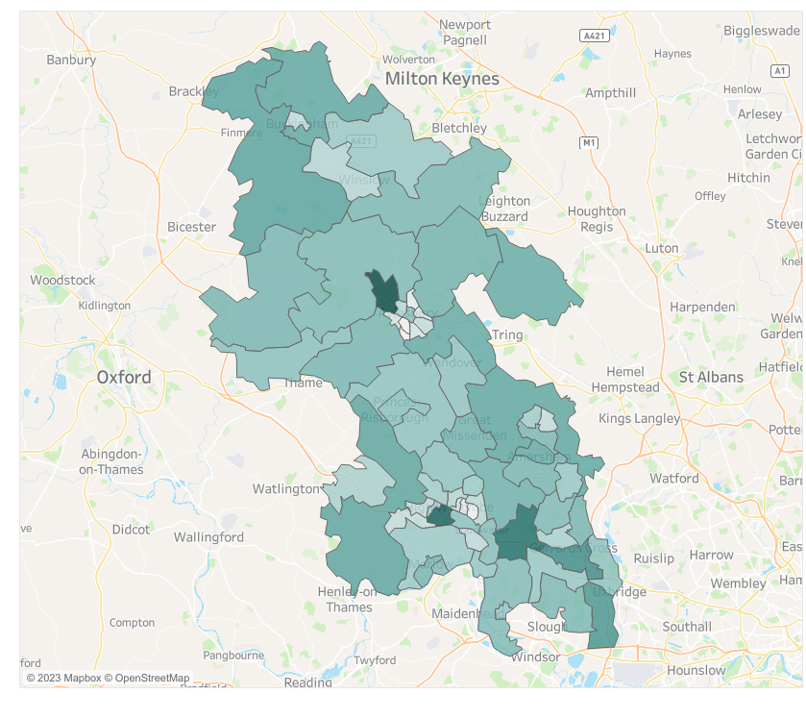
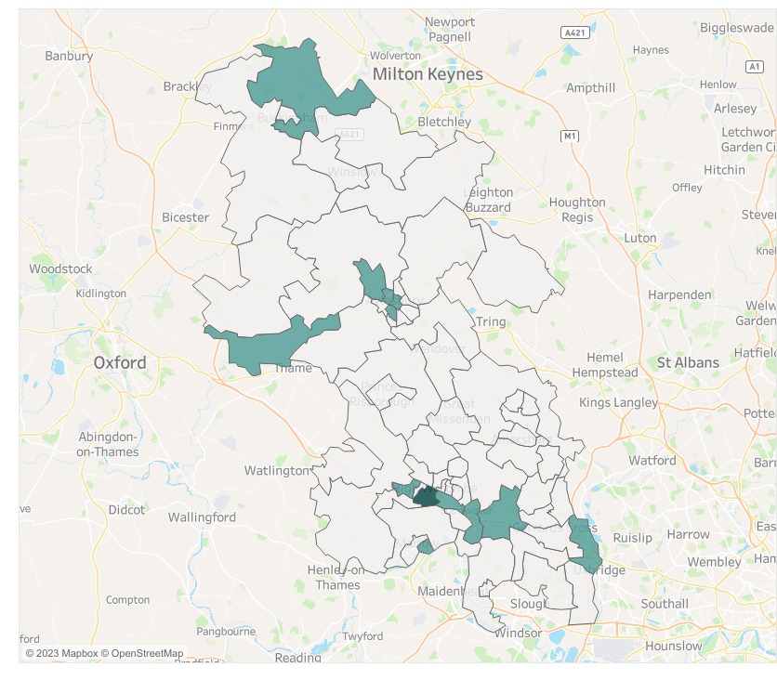


Where VAT/PAYE registered businesses (enterprises) are concentrated in Buckinghamshire - 2023
Where large businesses (employing 250+ people) are concentrated in Buckinghamshire - 2023
Interactive map
Interactive map
There are particularly high concentrations of businesses in the Beaconsfield, High Wycombe and Aylesbury areas.
Buckinghamshire’s largest businesses (employing more than 250 people) are mainly located in the south of the county, in particular along the M4 corridor, in Aylesbury, in the north of the county (in the area which includes Silverstone Park), and in the area to the north of Thame.
Source: IDBR, 2023

Slide 27
Business dynamism

Slide 28
Business dynamism – explainer (1)
Business dynamism is a vital driver of productivity and economic growth.
Typically, it is measured by the rate at which firms enter the market, grow, shrink, and then leave the market. I.e. start-up, grow and close.
A steady rate of business creation and closure is necessary for an economy to grow in the long-run, because it allows new ideas to flourish.
It is argued by some that reduced business dynamism in recent years has contributed to weak productivity growth¹.
High business survival rates in an area tend to be an indicator of a stable economic environment where businesses can thrive, and residents benefit from a stable job market. However, high survival rates that are due to lack of competition may not be beneficial in the long term.
¹ Ready for Change, the Resolution Foundation, 2023

Slide 29
Business dynamism – explainer (2)
Two measures are used within this report to examine trends in the creation of new businesses.
  Business birth rates – the number of firms registering for VAT/PAYE
  Business start-ups – the number of firms opening new business bank accounts
The first measures firms that begin operating above the VAT threshold and/or take on at least one employee.
Whilst the latter includes those operating below the VAT threshold and can include firms with no employees.
Those in the former group therefore will generally be larger than those in the latter group.
Further details can be found within the Annex.

Slide 30
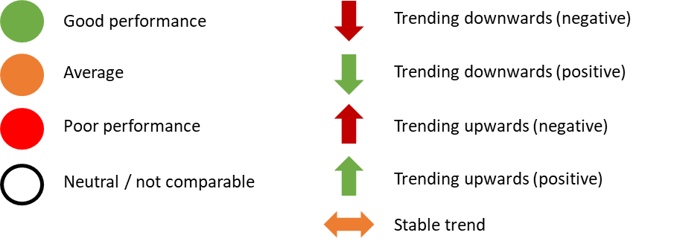
Summary: Business dynamism in Buckinghamshire
Buckinghamshire has high business survival rates
Buckinghamshire has relatively high business birth rates*
Buckinghamshire has relatively low business death rates
Buckinghamshire’s business start-up rates** are slightly below the national average
Business birth rates have been falling in recent years, as has been the case nationally
Business start-up rates in Buckinghamshire increased during Covid and fell back in 2022
Business death-rates in Buckinghamshire have been increasing post-Covid, as is the case nationally
Buckinghamshire has a relatively low proportion of high growth firms
The number of high growth firms in Buckinghamshire is falling
* ‘Birth rates’ refer to businesses registering for VAT/PAYE
** ‘Start-up rates’ refer to the opening of new business bank accounts

Slide 31
Buckinghamshire’s ‘new businesses’ have higher survival rates than the national and regional averages
Business survival rates for firms born between 2017 and 2021
Data on business survival is published for businesses that are VAT and/or PAYE registered.
For the last five years, ‘new businesses’ (i.e. those becoming VAT or PAYE registered) in Buckinghamshire have been more likely to survive than is the case nationally and regionally.
This was particularly the case in 2020 (the year of the onset of the Covid-19 pandemic). 77% of Buckinghamshire firms ‘born’ in this year have survived for two years, compared with the regional and national averages of 72% and 71% respectively.
Generally speaking, high business survival rates indicate a stable and supportive economic environment where businesses can thrive.
Source: ONS, 2020
Source: Business Demography 2022, ONS

Slide 32
Buckinghamshire also has high business survival rates when compared with neighbouring areas
Buckinghamshire has the highest business survival rates of neighbouring areas for firms born in 2017, 2019, 2020 and 2021, and the second highest for those born in 2018.
Source: Business Demography 2022, ONS

Slide 33
In 2022, Buckinghamshire had higher business ‘birth’ rates but slightly lower business start-up rates than the national average
 | Business ‘births’ (VAT/PAYE registrations) | Business ‘birth’ rate (births per 1,000 working age residents) | Business start-ups (opening a new business bank account) | Business start-up rates (start-ups per 1,000 working age residents)
Buckinghamshire | 3,075 | 9.0 | 3,331 | 10.1
South East | 44,160 | 7.6 | n/a | n/a
England | 300,580 | 8.4 | n/a | 10.3
Source: Business Demography 2022, ONS and BankSearch 2022

Slide 34
Buckinghamshire’s business ‘birth’ and start-up rates have been falling in recent years
Rates: Number of births and start-ups per 1,000 working age residents
Source: Business Demography 2022, ONS and BankSearch 2022

Slide 35
In 2022, nearly a third of Buckinghamshire’s business start-ups (new business bank accounts) were in the ‘real estate, professional services and support activities’ sector
 | Number of new bank accounts opened in 2022
Real estate, prof services & support activities | 1,060
Wholesale & retail | 525
Construction | 413
Arts, entertainment, rec & other services | 331
Transport, storage & communication | 311
Human health & social work | 240
Accommodation & food service | 155
Manufacturing | 141
Education | 63
Agriculture, forestry & fishing | 55
Mining, quarrying & utilities | 17
Financial & Insurance | 15
Public admin & defence | 5
Between 2018 and 2022, the number of start-ups in the wholesale & retail, construction and manufacturing (particularly food & drink manufacturing) sectors increased at the greatest rates. The growth in start-ups in the former two sectors likely linked to the rise in on-line retailing and large-scale construction activity being undertaken across the county. The transport, storage & communication, and real estate, professional services & support activities sectors saw the greatest contraction in start-ups over this period.*
Source: BankSearch, 2023
*Sectors with fewer than 50 start-ups in 2022 have been removed from the trend analysis

Slide 36
Buckinghamshire’s business death rates have followed a similar trajectory to the national average in recent years, with ‘deaths’ rising post Covid
Buckinghamshire’s business death rates* have followed a similar trajectory to the national average since 2017, albeit at a lower level.
Business death rates have risen (in Buckinghamshire and nationwide) since the onset on the Covid-19 pandemic in 2020.
Source: Business Demography 2022, ONS
*Business deaths as a proportion of business stock (i.e. active businesses)

Slide 37
Number of high growth firms* in Buckinghamshire
Buckinghamshire has a relatively low proportion of high growth firms, and the number of high growth firms in the county has fallen year-on-year since 2018
Number and proportion of high growth firms - 2022
 | Number high growth firm | % high growth (base = all VAT/PAYE businesses with 10+ employees)
Berkshire | 240 | 4.9%
Milton Keynes | 65 | 4.8%
Oxfordshire | 175 | 4.8%
Hertfordshire | 235 | 4.1%
Buckinghamshire | 100 | 3.7%
England | 10,190 | 4.1%
Source: Business Demography 2022, ONS
*enterprises with more than 10 employees that have average annualised growth in the number of employees greater than 20% per annum, over a three year period.

Slide 38
In December 2023 there were approximately 450 high growth / high ambition firms in Buckinghamshire being tracked by high growth firm specialists Beauhurst. Just under half were classified as ‘established’, and two fifths operate within the ‘business and professional services’ sector
Stage of evolution*
Sector of high growth firms
*see Annex for definitions
Source: Beauhurst, December 2023

Slide 39
Industrial structure and specialisms

Slide 40
Industrial structure and specialisms – explainer (1)
Industrial structure describes the composition of an area's economic activity.
We can understand the industrial structure of an area by considering
  The number of people employed in different industries
  The amount of economic output (GVA) generated by different industries
  The number of businesses operating in different industries
In the UK, industries are officially classified using Standard Industrial Classification (SIC) codes. These better describe traditional production industries than they do more modern service industries, or emerging industries such as ‘space’.
Alternative industry classification systems have been developed by companies such as the Data City and Beauhurst, that better define new and emerging industries.

Slide 41
Industrial structure and specialisms – explainer (2)
The knowledge economy is the element of an economy that is based on intellectual capabilities instead of natural resources or physical contributions. Products and services that are based on intellectual expertise advance technical and scientific fields, encouraging innovation in the economy as a whole*.
According to the OECD, “ageing populations and dwindling natural resources mean that growth in advanced economies will increasingly depend on knowledge-based increases in productivity. Unlike labour, natural resources and physical capital, knowledge-based capital is the only factor of production that will not suffer from scarcity”.
Three Standard Industrial Classification (SIC) code sectors are generally used to statistically analyse the knowledge economy at a local level. There are:
  Telecommunications; information technology
  Research and development; advertising and market research
  Other professional, scientific and technical activities
*Investopedia, accessed 22 August 2023

Slide 42
Industrial structure and specialisms – explainer (3)
Tradable goods and services can be sold and consumed outside of the region they are produced. In contrast, non-tradable goods and services can only be bought and consumed where they are produced. They form the foundational economy. Cars and computer software are tradable. A meal at a restaurant is not.
Tradeable sectors tend to drive productivity growth.
The traded sector benefits local economies in other ways. The traded sector generates income which can be spent locally. This results in what economists call the multiplier effect. Put simply, the multiplier effect is the number of additional jobs one additional job creates. Non-tradable sectors also have a multiplier effect, but studies show that it’s much lower.
Tradable sectors also serve a market that reaches beyond the local economy. This means that they are much less likely to be in direct competition with other local businesses, reducing the risk of displacement.
The UK is a service sector economy, and commentators such as the Resolution Foundation believe that greater emphasis should be placed on growing tradable service sectors in which local areas specialise. Within Buckinghamshire, the dominant tradable service sector is the film and TV sector.
Source: the What Works Centre for Local Economic Growth

Slide 43
Summary: Buckinghamshire’s industrial structure and specialisms (part 1)
Buckinghamshire’s service sector generates 86% of economic output.
Buckinghamshire service sector has experienced particularly weak growth since 2007/08.
Buckinghamshire has the smallest tradeable sector (both in terms of economic output and employment) within the ITL2* area.
A lower proportion of Buckinghamshire’s GVA is generated by knowledge sectors than the national average, despite similar levels of employment.
Buckinghamshire has experienced slower growth of its knowledge economy than neighbouring Berkshire, Milton Keynes and Oxfordshire over recent years.
*See Annex for definition

Slide 44
Summary: Buckinghamshire’s industrial structure and specialisms (part 2)
The construction, manufacturing and wholesale sectors generate the most GVA for Buckinghamshire
The admin & support services, and the health & social work sectors provide the most employee jobs within Buckinghamshire
Twice as many people work within the wholesale sector in Buckinghamshire than the national average
The admin & support services and construction sectors have increased their contribution (in terms of jobs, firms and economic output) to the Buckinghamshire economy in recent years, whilst the relative contribution of the professional, scientific & technical and information & communication sectors has decreased.
Buckinghamshire’s strategic growth sectors and clusters as identified in 2019 are: TV & film; high performance engineering; space and MedTech. All retain significant potential for growth and productivity gains.
Buckinghamshire’s green economy specialisms include: low carbon transport, ‘reduce, repair, recycle’, diversion of waste from landfill and power.
Buckinghamshire’s high growth firms are more likely to be operating within the industrials and the built environment sectors than is the case nationally.
Whilst numbers are small, a higher proportion of Buckinghamshire’s high growth firms specialise in EdTech, vegan or vegetarian products and organic goods than the national average.

Slide 45
As with most western economies, Buckinghamshire’s economy is dominated by the service sector
GVA (CVM, 2019 prices, £m) generated by Buckinghamshire’s service and production sectors (2007 to 2021)
In 2021 (latest available data) approximately 86% of Buckinghamshire’s economic output was generated by the service sector. This is similar to the national picture.
However, whilst the growth of Buckinghamshire’s production sector since 2007 has been just below the national average (17% versus 20%), the growth of the county’s service sector has been particularly weak (2% versus 16%).
Initial data suggests that Buckinghamshire’s service sector was also harder hit by the impact of the Covid-19 pandemic than nationally. Although this is subject to changes as we await updated data in 2024. If true, this is likely due in part to the difficulties faced by companies operating within the Heathrow Airport supply chain, which was particularly hard hit as a result of severely reduced air travel.
Production sector: Manufacturing, construction, agriculture, mining and utilities
Service sector: Wholesale; retail; transport; storage; hospitality; financial services; real estate; information & communication; professional, scientific & technical; admin & support services; public administration; health; education; the arts and recreation
Source: ONS, 2023

Slide 46
Buckinghamshire has the smallest tradeable sector (both in terms of economic output and employment) within the ITL2 area, and a smaller tradeable sector (in output terms) than the national average
The size of Buckinghamshire’s foundational economy could, in part, be driven by high employment rates and high wages, which enable a greater proportion of residents to purchase local services such as cleaning, health and fitness, hair and beauty, and animal care.
Source: Lightcast, 2023

Slide 47
Buckinghamshire has specialisms (i.e. higher than national average levels of employment) in 10 tradable clusters. These are listed in the table below.
Tradable cluster specialisms | GVA (2019)
Downstream Chemical | £466,085,835
Appliances and Personal Goods | £283,508,448
Furniture and Wood Products | £52,400,708
Precision Technology | £204,386,762
Professional Services | £481,000,910
Construction Products and Services | £6,430,258
Creative | £238,898,778
Digital | £620,813,295
Paper and Packaging | £15,471,352
Production Technology | £284,041,814
Within the ‘downstream chemical’ cluster, Buckinghamshire’s particular specialism is the ‘wholesale of pharmaceutical goods’.
Within the ‘appliances and personal goods’ cluster, Buckinghamshire’s particular specialism is the ‘wholesale of computers, computer peripheral equipment and software’.
Within the precision technology cluster, Buckinghamshire has a specialism in ‘manufacture of instruments and appliances for measuring, testing and navigation.
Within the ‘creative’ cluster, Buckinghamshire’s particular specialism is in ‘motion picture, video and TV’
Source: Lightcast, 2023

Slide 48
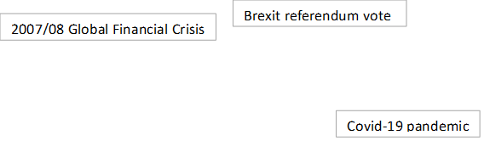
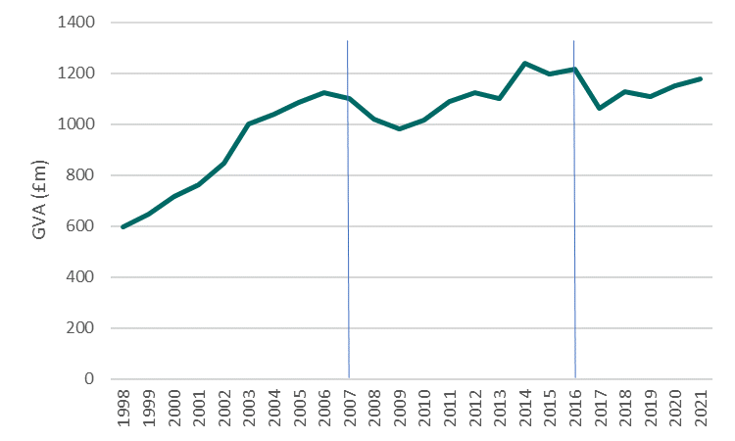
Buckinghamshire’s knowledge economy has experienced slow growth since the Global Financial Crisis
Buckinghamshire’s knowledge economy GVA over time
GVA generated by Buckinghamshire’s knowledge economy grew rapidly from 1998 to 2006 (just before the global financial crisis). Since 2006, GVA generated by the knowledge economy has grown very little. It was only 7% higher in 2021 than in 2007 (compared with 52% across England as a whole).
Buckinghamshire’s knowledge economy GVA fell after the financial crisis (as it did nationally) and after the Brexit referendum vote (growth slowed but didn’t fall nationally). However, it appears not to have fallen at the time of the economic shock of the Covid-19 pandemic
Source: ONS, 2023

Slide 49
In terms of knowledge economy growth, Berkshire has been the success story within the ITL2 region
Whilst Buckinghamshire’s knowledge economy GVA grew by 7% between 2007 and 2021, Berkshire’s grew by a staggering 177%. In Oxfordshire growth was 71% and in Milton Keynes was 72%.
Source: ONS, 2023

Slide 50
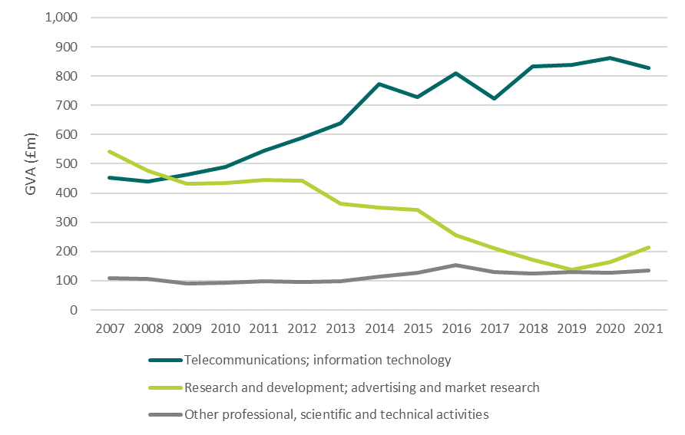
Within Buckinghamshire’s knowledge economy, growth has been greatest in the telecommunications / IT sub-sector
Berkshire’s knowledge economy growth has been pretty much purely driven by the growth in output of the telecommunications / IT sub-sector.
In Oxfordshire growth has been greatest in the research & development; advertising and market research sub-sector.
Within Buckinghamshire’s knowledge sector, growth has been greatest in the telecommunications / IT sub-sector (albeit at a much slower rate than in Berkshire), whilst the amount of GVA generated by the research & development; advertising and market research sector fell between 2007 and 2019, before ticking upwards between 2019 and 2021 . Cross-referencing this with employment data, we believe that the majority of the fall was in the market research element of the sector, rather than R&D.
Source: ONS, 2023

Slide 51
In 2021, Buckinghamshire’s economic output was driven by the construction, manufacturing and wholesale sectors
Share of GVA by sector, 2021
The construction, manufacturing and wholesale sectors generate the most economic output (GVA) for Buckinghamshire.
The wholesale sector contributes twice as much to local GVA as it does to national GVA, and the construction sector 1.6 times more. Buckinghamshire’s wholesale specialisms are the wholesale of pharmaceuticals and computers / software.
Two high productivity sectors: professional, scientific & technical; and financial & insurance; generate a smaller proportion of Buckinghamshire’s total economic output than the national average. Whilst the contribution of the highly productive information & communication and manufacturing sectors is in line with the national average.
Source: ONS, 2023
Note: Real estate industry data excludes owner occupiers imputed rental values

Slide 52
The admin & support services, and the health & social work sectors provide the most employee jobs within Buckinghamshire.
Share of employees by sector, 2022
The admin & support services, and the health & social work sectors provide the most employee jobs within Buckinghamshire. The former providing comparatively more jobs than the national average, and the latter providing fewer.
Twice as many people work within the wholesale sector in Buckinghamshire than the national average.
Other sectors employing a higher proportion of the employee workforce locally than nationally include: education, construction, information & communication, arts & entertainment and motor trades.
Please note, this analysis excludes those who are self-employed. Self-employment is more prevalent certain sectors / occupations, including: construction, hairdressing, sport, TV and film, taxi driving and animal care.
Source: BRES, 2022

Slide 53
Buckinghamshire has a higher proportion of businesses operating within the professional, scientific & technical and the information & communication sectors than the national average.
Share of businesses (enterprises) by sector, 2023
Just under a fifth of businesses in Buckinghamshire operate within the professional, scientific and technical sector (which includes businesses such as law firms, accounting firms, and engineering companies), a higher proportion than nationally. Despite this, the sector produces comparatively less economic output than the national average.
Buckinghamshire also has a higher proportion of firms within the information & communication sector than the national average. This sector includes computer programming and consultancy firms, and motion picture, video and TV companies The economic output created by this sector in Buckinghamshire is similar to the national average.
A higher proportion of firms operating within these two sectors are micro in size than the national average, and a higher proportion of these firms categorise themselves as providing ‘consultancy.’
In total, 17% of firms in Buckinghamshire are consultancies, compared with 12% nationally. However, the number of consultancies is falling (within Buckinghamshire numbers decreased by 16% between 2020 and 2023), likely linked to changes to tax rules (IR35).
Source: UK Business Count, 2023

Slide 54
Two sectors stand out as increasing their presence within Buckinghamshire’s economy over the last decade: construction and admin & support services
The table to the left provides a rough indication of how Buckinghamshire’s industry structure has changed over the last decade*. The figures in the chart show the extent to which sectors have increased or decreased their share of firms, employees and local economic output. The construction and admin & support services sectors have increased their share of all three, as has the utilities sector to a lesser extent.
The professional, scientific & technical and information & communication sectors have a reduced share of firms, employment and GVA. These are both high productivity sectors. The financial & insurance sector has experienced the greatest drop in share of GVA, followed by the transport & storage sectors.
*data provided is the latest 10 years available, with the exception of employees as the timeseries does not extend back beyond 2015
Sources: ONS, 2023, UK Business Count, 2023 and BRES 2022

Slide 55
Buckinghamshire’s strategic growth sectors and clusters are: TV & film; high performance engineering; space and MedTech. The table below provides a summary of their features and fortunes.
Sector | Cluster | Asset/s | Maturity | Fortunes over last 5 years | Future potential | Challenges
TV and film | West of London Screen Cluster | Pinewood National Film and Television School CoStar National Lab (forthcoming) | Mature | The sector has had a bumpy few years. Demand for studio space and a skilled workforce has boomed, but significant disruption has been caused by Covid-19 and the US writer and actor strikes. | Remains strong. Further expansion of studio space is in the pipeline, both within the county and in neighbouring areas Establishment of CoStar National Lab at Pinewood. | Attracting and retaining talent; dependency on the US; meeting and capitalising on demand
High performance engineering | Silverstone Technology Cluster | Silverstone Technology Park Digital Manufacturing Centre The National College for Motorsport Silverstone University Technology College | Mature / evolving | Further expansion of site and establishment of the Digital Manufacturing Centre. Firms on site experiencing high growth (including Lunaz and Saietta). | Remains strong. Collaborative opportunities with other clusters. Net zero innovation. | Recruiting skilled staff, connectivity
Space | Westcott Space Cluster | National Space Propulsion Test Facility In-orbit servicing and manufacturing facility Drone test and development centre Future Networks Development Centre Innovation Centre Incubation Centre | Growth | Key assets have come into operation. Growing number of companies. Firms on site experiencing high growth (including URA Thrusters) | Remains strong Westcott site continues to develop and expand its offering. As the sector matures, more commercial opportunities are expected leading to anticipated productivity growth for the local economy. | Recruiting skilled staff, dependency on overseas recruitment, connectivity
MedTech | Stoke Mandeville Digital Health Cluster | Health research and innovation centre Health and Social Care Partnership | Emergent | Opening of the Health Research and Innovation Centre at Stoke Mandeville. | Potential for cluster at Woodlands Enterprise Zone. Buckinghamshire located near the UK’s life sciences golden triangle. | Recruiting skilled staff. Growing presence within the county.

Slide 56
Some key facts and figures about Buckinghamshire’s strategic growth sectors and clusters are in the table below.
Sector / cluster | Key facts and figures
TV and film | Approximately 18,200 people work in the creative sector in Buckinghamshire. There are twice as many creative industry jobs within the Buckinghamshire economy than the national average. A high proportion of the workforce are freelancers.
High performance engineering | Approximately 8,000 people work in the sector in Buckinghamshire. Over 4,000 companies operating in precision engineering alone are located within a one-hour radius of Silverstone.
Space | It is anticipated that the 10-year plan for the Westcott Space Cluster will create over 2,000 jobs. Nammo products are used on spacecraft around the solar system. They will provide the chemical thrusters and main engines for the Earth Return Orbiter and Orbit Insertion Module for the 2027. In 2024 URA Thrusters will deliver two sustainable propulsion flight models for launch and in-orbit demonstration. These will be Europe and the UK’s first water electrolysis and electrospray thrusters. Airborne Engineering is the first company in Europe to test a Vertical Take-off Vertical Landing rocket.
MedTech | Approximately 32,000 people work in Buckinghamshire’s life sciences, health and social care sector. For every 10 people working in the core life sciences sector in England there are 13 people working in the sector in Buckinghamshire. In addition, companies involved with the wholesale of pharmaceuticals goods employ nearly 9 times as many people in Buckinghamshire than the national average. A new research and innovation centre on the Stoke Mandeville Hospital Site opened in 2021. The County is home to global leading lifescience companies, including Janssen (Johnson & Johnson), Abbvie, GE Healthcare and Danaher, Cyvita and Bristol Myers Squibb. The health and social care sector continues to grow to deal with the health needs of an ageing population and the need to respond to the aftermath of the Covid-19 pandemic.

Slide 57
Buckinghamshire’s green economy specialisms include: low carbon transport, ‘reduce, repair, recycle’, diversion of waste from landfill and power.
According to research conducted on behalf of Buckinghamshire LEP and Buckinghamshire Business First, the county’s key strengths and opportunities within the green economy lie across four key sectors:
Low carbon transport – companies such as Robert Bosch and Gridserve, both headquartered in Buckinghamshire, are at the forefront of developing and scaling the technology required to address the UK’s high emissions from surface transport. Together with the rapidly growing EV technologies within the Silverstone Cluster, there is the potential for Buckinghamshire-led innovation to deliver significant change.
Reduce, Reuse, Repair, Recycle – a wide range of companies in Buckinghamshire operate in this sector, from Olleco (who recycle waste food into renewable energy) to GreenTech Distribution (who recycle old mobile devices) and start-up sustainable nappy companies Kit & Kin and Mama Bamboo.
Diversion of waste from landfill – major multi-national waste company Biffa is headquartered in Buckinghamshire, as are a number of other smaller waste firms, mainly around the High Wycombe and Marlow areas. Getting to net zero will be impossible without addressing emissions associated with resource consumption, for which this sector is key.
Power – civil nuclear supplier Urenco, along with a number of solar energy and biomass companies, have a presence in Buckinghamshire.
The full audit and interactive map can be viewed here.

Slide 58
Buckinghamshire’s high growth firms are more likely to be operating within the industrials* and the built environment sector than is the case nationally.
(*Industrials includes engineering, food & drink processing and manufacturing of consumer goods).
High growth firms by sector
High growth firms by buzzword
Whilst numbers are small, a higher proportion of Buckinghamshire’s high growth firms specialise in EdTech, vegan or vegetarian products and organic goods than the national average.
Source: Beauhurst, 2023

Slide 59
Summary

Slide 60
Summary
As has been the case nationally, the Buckinghamshire economy has faltered in recent years.
Whilst the county’s economy is strong when compared with most other areas of England, it is not as strong as it once was, and tends to be out-performed by its neighbours and the rest of the South East.
The latest data suggests some improvements in productivity growth over the last few years.
To continue and accelerate this trend, consideration should be given to (amongst other things):
  Growing Buckinghamshire’s tradable and knowledge economy sectors, in particular those in which we have a competitive advantage (i.e. our strategic growth sectors / clusters).
  Increasing the number of high growth firms located within the county.
This evidence base, along with evidence on Buckinghamshire’s labour market and skills needs, innovation and international trade, plus deep-dive analysis of the drivers of productivity and local sector/cluster specialisms, will be used to inform future local economic strategy.

Slide 61
Annex

Slide 62
Data sources
The analysis presented within this report draws on the following Office for National Statistics (ONS) data sources:
  Sub-regional GVA 2021
  Sub-regional Productivity 2021
  UK Business Population: Size, activity, and location 2023 (see next slide for further details)
  Business Demography 2022 (see next slide for further details)
  Business Register and Employment Survey 2022
Plus, information from data providers Beauhurst (on high growth firms) and BankSearch (on business start-ups), along with locally generated intelligence.

Slide 63
Business Demography – 2022
Data sources
UK Business Population: Size, activity and location 2022
This dataset presents annual data on the number of businesses (enterprises) registered for Value Added Tax (VAT) and/or Pay As You Earn (PAYE)
Low turnover non-employing (unregistered) businesses are not covered by this data
The data is produced by the Office for National Statistics from the Inter-Departmental Business Register (IDBR)
The 2022 data measures businesses that were active between December 2020 and December 2021
Being ‘active’ means that they either had turnover of employment at any time in the reference year
This data is a useful indicator of entrepreneurship and economic growth
The full dataset can be accessed here
This dataset presents annual data on the number of businesses (enterprises) registered for Value Added Tax (VAT) and/or Pay As You Earn (PAYE)
Low turnover non-employing (unregistered) businesses are not covered by this data
The data is produced by the Office for National Statistics from the Inter-Departmental Business Register (IDBR)
The 2022 data measures businesses that were active on 11 March 2022
Being ‘active’ means that they either had turnover of employment at any time in the reference year.
The full dataset can be accessed here

Slide 64
Geographic areas
Area | Definition
International Territorial Level (ITL) areas | Europe-wide geographic units that exist at three levels. Within England, ITL1 relates to regions (e.g. the South East), ITL2 is the next level down (e.g. Berkshire, Buckinghamshire and Oxfordshire) and ITL3 is the smallest geographic level (e.g. Buckinghamshire).
Local Enterprise Partnership (LEP) areas | Local Enterprise Partnership areas were developed to align with functional economic areas of England. For analytical purposes, there are 38 LEP areas. From April 2024, LEP functions will be integrated into local democratic structures.

Slide 65
Measuring productivity
The Office for National Statistics (ONS) publish sub-regional estimates of labour productivity on an annual basis. Three things to bear in mind with the data are:
It is subject to on-going methodological revisions. These revisions can be big. For example, revisions adopted in 2018 resulted in Buckinghamshire’s productivity performance being significantly downgraded. Future revisions to the currently published 2020 and 2021 data could be significant due to continuous improvements to the estimates of what happened to the economy during the Covid-19 pandemic.
A handful of areas of the country have very high levels of productivity (in particular London and Berkshire) and therefore skew the national and regional (South East) averages. Hence why of the 38 Local Enterprise Partnership (LEP) areas, only eight have productivity levels above the national average.
A quirk in the way productivity data is calculated (the inclusion of estimates of the value of home ownership) artificially inflates Buckinghamshire’s productivity figures to a greater extent than in many other parts of the country.

Slide 66
Stages of business evolution
Stages of evolution | Applicability criteria
Seed | A youngish company with a small team, low valuation and funding received (low for its sector), uncertain product-market fit or just getting started with the process of getting regulatory approval. Funding likely to come from grant-awarding bodies, equity crowdfunding and business angels.
Venture | A company that has been around for a few years, has either got significant traction, technology or regulatory approval progression and funding received and valuation both in the millions. Funding likely to come from venture capital firms.
Growth | A company that has been around for 5+ years, has multiple offices or branches (often across the world), has either got substantial revenues, some profit, highly valuable technology or secured regulatory approval significant traction, technology or regulatory approval progression, funding received and valuation both in the millions. Funding likely to come from venture capital firms, corporates, asset management firms, mezzanine lenders.
Stages of evolution | Applicability criteria
Established | A company that has been around for 15+ years, or 5-15 years with a 3 year consecutive profit of £5m+ or turnover of £20m+. It is likely to have multiple (often worldwide) offices, be a household name, and have a lot of traction. Funding received, if any, is likely to come from corporates, private equity, banks, specialist debt funds and major international funds.
Zombie | The company has met one or more of these conditions: website and/or social media presence show prolonged neglect. key people have all left the company and it appears to have no employees. has appointed administrators or liquidators. status in Companies House is dissolved but the company still appears to be active.
Source: Beauhurst, 2024

