Slide 1

Buckinghamshire Labour Market and Skills Analysis: 2023
August 2023

Slide 2
About
This slide deck has been produced to share analysis of Buckinghamshire’s labour market and skills needs in an accessible way.
Links to source data are provided wherever possible.
If you have any queries, feedback or suggestions for further analysis, please contact Caroline Hargrave – caroline.hargrave@buckslep.co.uk

Slide 3
What would you like to know?
At a glance
Buckinghamshire’s labour market and skills strengths
Buckinghamshire’s labour market and skills challenges

Slide 4
What would you like to know?
Section 1: About the economy
What kind of economy does Buckinghamshire have?
What are Buckinghamshire’s largest sectors?
What are Buckinghamshire’s sector specialisms?
Which sectors are predicted to create the most jobs in Buckinghamshire over the next 10 years?
How many people work in Buckinghamshire’s key sectors?
Who are Buckinghamshire’s biggest employers?
How many people commute into and out of the county for work?
What is the occupational profile of the Buckinghamshire workforce?
What are the occupations of Buckinghamshire residents?
What are Buckinghamshire’s occupational specialisms?
What are the occupations of Buckinghamshire’s self-employed workforce?

Slide 5
What would you like to know?
Section 2: About the labour market
What levels of economic activity and inactivity are there within Buckinghamshire?
How has unemployment in Buckinghamshire changed over time?
How many people are claiming unemployment benefit?
To what extent has productivity been growing in Buckinghamshire in recent years?
To what extent have wages been growing in Buckinghamshire in recent years?
What is Buckinghamshire’s demographic profile?
To what extent is there deprivation within Buckinghamshire?

Slide 6
What would you like to know?
Section 3: Skills available for local economy
How qualified is the local labour pool?
Who are Buckinghamshire’s main providers of education and training?
What are Buckinghamshire’s apprenticeship take-up levels?
How have apprenticeship reforms and the Covid-19 pandemic affected the take-up of apprenticeships in Buckinghamshire?
What subjects have been studied by those graduating from Buckinghamshire’s Higher Education Institutions?
What to those graduating from Buckinghamshire’s Higher Education Institutions do next?
Where do Buckinghamshire graduates live after graduating?
To what extent do Buckinghamshire employers provide training to their staff?
How do employers fill vacancies and develop talent pipelines?

Slide 7
What would you like to know?
Section 4: Skills demand within the local economy
How can demand for skills be measured?
What types of jobs are in greatest demand in Buckinghamshire?
Which sectors are predicted to create the most jobs in Buckinghamshire over the next 10 years?
What skills need developing in Buckinghamshire?
What is the demand for digital skills within Buckinghamshire?
In which sectors and occupations should we prioritise skills activities to meet current and future demand within Buckinghamshire?
What training do Buckinghamshire employers find most valuable?

Slide 8
What would you like to know?
Section 5: The extent of skills mismatches within Buckinghamshire
To what extent do Buckinghamshire employers struggle to fill vacancies, and why?
What job roles are particularly difficult to fill? And how does Buckinghamshire compare with the national average?
To what extent are there skills mismatches within the existing workforce?

Slide 9
At a glance…

Slide 10
Buckinghamshire’s labour market and skills strengths
Strengths
High employment rates.
High wages (particularly for residents but also Buckinghamshire workers).
High levels of qualifications amongst residents.
Higher than average Level 2 and 3 attainment by young people.
High proportion of young people entering ‘sustained positive destinations’ after both Key Stage 4 and Key Stage 5.
Further and Higher Education Institutions with a strong history of employer engagement, and a focus on applied learning and employability.
World-class talent in industries such as high-performance engineering, film & TV, space and medtech
Significant job growth expected in a variety of sectors over the next few years, in particular in the film & TV and construction sectors.
A strong collaborative culture (between education institutions, and between employers and educators).
High levels of employer involvement in the local skills agenda.
Clear long-term economic growth aspirations set out in the Buckinghamshire Local Industrial Strategy.
A top performing Careers Hub.
A top performing business Growth Hub

Slide 11
Buckinghamshire’s labour market and skills challenges
Challenges (1 of 2)
High levels of out-commuting of highly skilled residents
Buckinghamshire’s unemployment and claimant count rates are closer to the national average than they have been historically (historically they have been much lower).
An increasing proportion of economically inactive working-age residents are inactive due to ill health.
Ensuring strong local talent pipelines for growing sectors (including life sciences, health and social care; film & TV; construction; high performance engineering; space).
Ensuring a strong talent pipeline of green skills (including digital and engineering skills) to enable the shift towards a net zero economy.
Retaining and attracting talent (school leavers, graduates and high skilled residents) – linked to the perceived attractiveness of the County’s main towns and the rural nature of much of the County.
Low take-up of apprenticeships, and fewer apprenticeships at level 2.
Higher than average rates of 16-17 year olds classified as being NEET or ‘activity not known.’
A lack of engineering training provision within the county.
Low levels of interest in construction and health and social care careers, resulting in employers. struggling to fill vacancies.
Pockets of inequality and poor social mobility.

Slide 12
Buckinghamshire’s labour market and skills challenges
Challenges (2 of 2)
Recruitment difficulties causing problems for employers in many sectors and hampering business growth. In some cases this is linked to wider issues such as a lack of affordable housing and poor transport links.
Employer demand for new entrants to be better ‘work ready.’
Lower than average levels of training by County employers.
Ever-growing and evolving demand for digital skills, including utilising AI.
Ensuring opportunities in growth sectors are accessible to all.
Mismatch between the demand for skills and labour within the local economy, and the skills held and jobs sought by local residents.

Slide 13
Section 1: About the economy

Slide 14



What kind of economy does Buckinghamshire have?
Back to index
As with most of the developed world, Buckinghamshire’s economy is dominated by the service sector, which provides 85% of all local employee jobs¹.
A higher proportion of those working in the Buckinghamshire economy work for small firms (employing fewer than 50 people) than the national average².
Defining features of Buckinghamshire’s economy include:
The dominance of small businesses².
High levels of self-employment, particularly within the county’s creative and construction sectors.
World-class economic assets and high performing clusters of business activity in the areas of film and TV, high-performance engineering, space and MedTech.
A comparatively large wholesale sector (particularly the wholesale of pharmaceutical goods, machinery and equipment, computers and software)¹.
Larger than average construction, business admin and support, info and comms, and mining, quarrying & utilities sectors¹.
Approximately 1 in every 6 people working in the Buckinghamshire economy are self-employed³
¹ Business Register and Employment Survey, 2021, ONS
² Inter Departmental Business Register, 2022. ONS
³ Annual Population Survey – workplace analysis (Jan – Dec 2022), ONS

Slide 15
Back to index
What kind of economy does Buckinghamshire have?
There were 31,355 VAT/PAYE registered businesses (enterprises) operating in Buckinghamshire in March 2022, a decrease of 0.4% from March 2021. These businesses operated from 34,520 individual units (or workplaces). A decrease of 0.5% from March 2021¹.
Business survival rates in Buckinghamshire are higher than the national average.
In 2021 (latest available data), Buckinghamshire had a relatively stable business population. Fewer businesses were created, and fewer businesses closed (as a proportion of all existing business) than the national average.
In 2021, there were slightly more high growth businesses in Buckinghamshire than the national average (4.2% of all businesses employing more than 10 people, compared with 3.8%)².
¹ UK Business Count, 2022, ONS
² Business demography, UK - Office for National Statistics (ons.gov.uk)

Slide 16
What are Buckinghamshire’s largest employment sectors?
Back to index
The health and social care and the business admin and support services sectors are the largest in Buckinghamshire in terms of the number of people they employ.
The wholesale;
construction and
business admin and support services sectors employ comparatively more people in Buckinghamshire than the national average.
Source: Business Register and Employment Survey, 2021, ONS
Sector definitions can be found here

Slide 17
What are Buckinghamshire’s largest employment sectors?
Back to index
The prevalence of part-time working varies considerably by sector
Buckinghamshire’s retail and health and social care sectors employ the largest number of people on a part-time basis.
Buckinghamshire’s business admin & support and professional, scientific and technical and health sectors employ the largest number of people on a full-time basis.
Source: Business Register and Employment Survey, 2021, ONS
Sector definitions can be found here

Slide 18
What are Buckinghamshire’s sector specialisms?
Back to index
Buckinghamshire has nearly twice much employment in the wholesale sector than the national average.
The chart to the right shows how the structure of Buckinghamshire’s economy differs to the national economy, based on the number of employees in different sectors.
The orange ring is the national average, and the turquoise ring is employment within the Buckinghamshire economy. Where the turquoise ring sits outside the orange ring, Buckinghamshire has a higher proportion of people employed than the national average.
The numbers on the chart are location quotients. A location quotient over 1 shows a local specialism. The five broad sectors* of the economy in which Buckinghamshire has a specialism are: wholesale (1.8 times more employment in this sector locally than nationally), construction (1.4 times more), info and comms (1.2 times more), business admin (1.2 times more) and mining, quarrying & utilities (1.2 times more).
Source: Business Register and Employment Survey, 2021, ONS
*this analysis uses broad Standard Industrial Classification codes. The analysis on the following pages provides more granular insight

Slide 19



What are Buckinghamshire’s sector specialisms?
Back to index
There are twice as many creative industry jobs within the Buckinghamshire economy than the national average, many of which are in the film and TV sector. Buckinghamshire also has higher than average levels of employment in advertising, specialist design, artistic creation and sound recording / music publication¹.
Some sectors or clusters of business activity are not well defined within the Standard Industrial Classification (SIC) code system or are not captured well when using the broad classification codes (see previous pages).
However, using 4 and 5 digit SIC codes, along with our knowledge of the local economy, we can dig deeper to gain a more granular understanding of Buckinghamshire’s sector specialisms and the demand for labour and skills within them
There are approximately 70 companies involved with the wholesale of pharmaceuticals goods in Buckinghamshire. They employ nearly 9 times as many people in county than the national average¹.
There are approximately 60 companies involved with waste collection in Buckinghamshire. They employ nearly 5 times as many people in county than the national average¹.
¹ Business Register and Employment Survey, 2021, ONS

Slide 20
Which sectors are predicted to create the most jobs in Buckinghamshire over the next 10 years?
Key growth sectors (from an employment perspective) within Buckinghamshire over the next 10 years will be:
Construction (in part due to HS2, East West Rail, Aylesbury Garden Town related construction activity, and a large house building programme)
Film and TV (linked to expansion plans at Pinewood Studios, plus the continuing inward investment boom of the West of London Screen Cluster, with many new studios opening within the next few years)
Life sciences, health and social care (linked to both the health needs of an ageing population and the need to respond to the aftermath of the Covid-19 pandemic)
Space (linked to expansion of the Westcott Space Cluster)
High performance engineering (linked to expansion of the Silverstone Enterprise Zone and an increasing focus on the need for green technologies to combat climate change)
The Space, Creative Industries, High Performance Engineering and MedTech sectors are identified within Buckinghamshire’s Local Industrial Strategy as key sectors. Each has a significant ‘asset’ located within the County (Westcott Space Cluster, Pinewood Studios, Silverstone Park and Technology Cluster and Stoke Mandeville hospital) and strong long-term growth prospects.
The construction, film/TV and health & social care sectors are expected to create the greatest volume of jobs in Buckinghamshire over the next five years.
Pinewood Studios’ expansion plans are predicted to create 8,000 new jobs, including 3,000 construction jobs. There are also plans for a new studio at Marlow.
It is anticipated that the 10-year plan for the Westcott Space Cluster will create over 2,000 jobs.
The construction of HS2 is expected to create around 4,000 jobs over the lifetime of the project in Buckinghamshire and the surrounding areas.

Slide 21
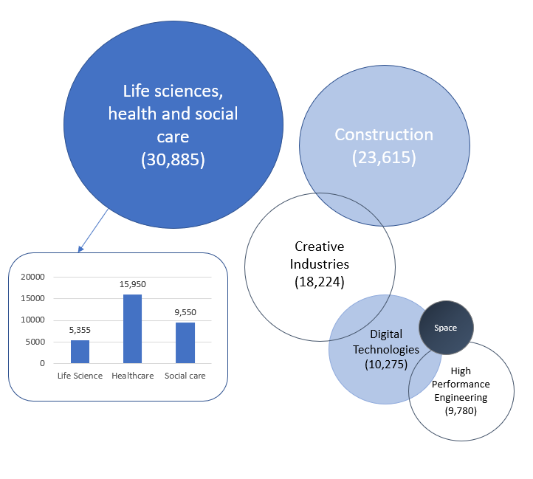
How many people work in Buckinghamshire’s key sectors?
In total, approximately 40% of all those working in the Buckinghamshire economy work in the county’s key sectors¹.
These sectors vary considerably in size, with health and social care currently the largest and space the smallest.
¹Business Register and Employment Survey, 2021, ONS
Note 1 - whilst the digital technology sector is not expected to grow significantly in Buckinghamshire over the next decade, it does employ more people locally than nationally, and is a growing sector globally. Note 2 – It is difficult to measure how many people are employed in the space sector in Buckinghamshire. An estimate will be provided in due course.

Slide 22
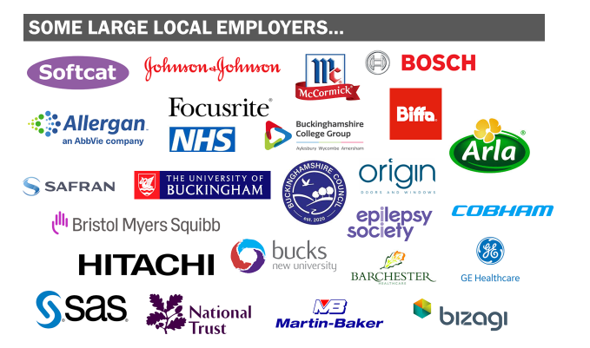
Who are Buckinghamshire’s biggest employers?
Some of Buckinghamshire’s largest employers can be found in the graphic to the right
In addition to the above, national companies who employ large numbers of people within the local economy include national construction companies, national retail chains, national hospitality chains, national care home chains and global film production companies.

Slide 23
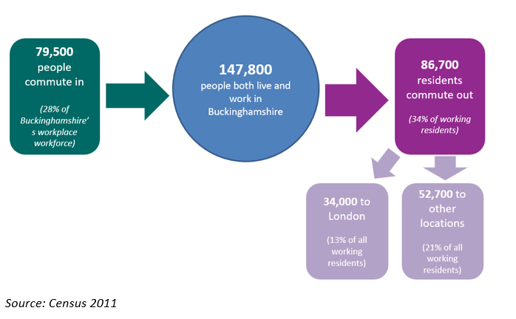
How many people commute into and out of the county for work?
Buckinghamshire has one of least ‘self-contained’ labour markets in England. In 2011 (latest available data), around a third of working residents travelled out of the county for work whilst 28% of all those working within the Buckinghamshire economy travel into the county from elsewhere. In total, 34,000 Buckinghamshire residents usually work in London.
There are some sector specific commuting patterns. Within the film and TV sector for example (which is concentrated in the south of the county), film crews of up to 1,000 per large production, primarily freelancers, move between studios.
Source: Census 2011, ONS
Commuting patterns matter when undertaking local labour market and skills analysis, particularly when trying to compare data on the demand for, and supply of, skills. For example, whilst Buckinghamshire may have a large number of highly qualified residents, high levels of out-commuting, often for high paid jobs, means that the skills of many of these residents are not available to Buckinghamshire employers, nor are these individuals directly contributing to the output and productivity of the local economy.

Slide 24
What is the occupational profile of the Buckinghamshire workforce?
This chart shows how the broad occupational profile of Buckinghamshire’s workforce compares with the occupational profile of England as a whole.
The largest occupational group in Buckinghamshire is ‘professional’. A similar proportion of the local workforce work in professional roles than nationally.
The second largest occupational group in Buckinghamshire is ‘associate professional & technical’. A large proportion of the workforce work in this occupational group locally than nationally (18% versus 15%).
More people work in managerial roles in the Buckinghamshire economy than nationally. Fewer people work in ‘sales and customers service’ and in ‘process, plant and machine operatives’ and elementary roles.
Source: Annual Population Survey (workplace analysis) – Jan to Dec 2022

Slide 25
What are the occupations of Buckinghamshire residents?
This chart shows how the occupational profile of Buckinghamshire residents differs to the occupational profile of Buckinghamshire-based workers.
The two are more similar than they have been in previous years. The biggest difference is at the top end. 16% of Buckinghamshire residents work as ‘managers, directors and senior officials’, compared to 14% within the local economy.
Source: Annual Population Survey (workplace and resident analysis) – Jan to Dec 2022

Slide 26
What are Buckinghamshire’s occupational specialisms?
(workplace analysis)
This table lists Buckinghamshire’s top occupational specialisms (number of employee jobs as a proportion of all employees, compared with employee jobs nationally).
The top occupation is ‘animal care and control services’, in which 1.5 as many people are employed locally than the national average, followed by ‘artistic, literary and media occupations’, ‘agricultural and related trades’ and ‘elementary cleaning occupations’.
Description | 2021 Jobs | 2021 Employment Concentration
Animal Care and Control Services | 1,200 | 1.5
Artistic, Literary and Media Occupations | 1,900 | 1.4
Agricultural and Related Trades | 1,600 | 1.4
Elementary Cleaning Occupations | 8,600 | 1.4
Cleaning and Housekeeping Managers and Supervisors | 1,000 | 1.3
Hairdressers and Related Services | 1,600 | 1.3
Sales, Marketing and Related Associate Professionals | 11,000 | 1.3
Functional Managers and Directors | 9,800 | 1.2
Elementary Construction Occupations | 1,200 | 1.2
Information Technology and Telecommunications Professionals | 9,000 | 1.2
Sports and Fitness Occupations | 1,300 | 1.2
Construction and Building Trades | 3,500 | 1.2
Elementary Sales Occupations | 1,100 | 1.2
Production Managers and Directors | 3,900 | 1.2
Managers and Directors in Retail and Wholesale | 3,100 | 1.1
Electrical and Electronic Trades | 3,500 | 1.1
Employment Concentrations (EC) are a way of quantifying how concentrated a particular sector or occupation is in a local area as compared to the nation. An EC greater than 1 indicates a specialism. An EC of 2 would show that twice as many people are employed in a certain sector or occupation locally than nationally.
Source: EMSI Analyst

Slide 27
What are Buckinghamshire’s resident’s occupational specialisms?
This table lists the top occupational specialisms of Buckinghamshire’s residents (number of residents in an occupation as a proportion of all working residents compared with the proportion nationally).
The top occupation is ‘chief executives and senior officials’, in which 2.1 as many people are employed locally than the national average, followed by ‘functional managers and directors’, ‘managers and proprietors in other services’ and ‘sales, marketing and related associate professionals.’
Description | 2021 Jobs | 2021 Employment Concentration
111 Chief Executives and Senior Officials | 2,700 | 2.1
113 Functional Managers and Directors | 17,300 | 1.8
125 Managers and Proprietors in Other Services | 8,700 | 1.5
355 Sales, Marketing and Related Associate Professionals | 10,500 | 1.4
343 Sports and Fitness Occupations | 1,900 | 1.4
213 Information Technology Professionals | 9,200 | 1.3
612 Animal Care and Control Services | 1,100 | 1.3
112 Production Managers and Directors | 7,800 | 1.3
243 Business, Research and Administrative Professionals | 4,400 | 1.3
244 Business and Financial Project Management Professionals | 2,600 | 1.3
249 Media Professionals | 1,900 | 1.3
414 Administrative Occupations: Office Managers and Supervisors | 2,800 | 1.2
341 Artistic, Literary and Media Occupations | 4,100 | 1.2
242 Finance Professionals | 4,600 | 1.2
Employment Concentrations (EC) are a way of quantifying how concentrated a particular sector or occupation is in a local area as compared to the nation. An EC greater than 1 indicates a specialism. An EC of 2 would show that twice as many people are employed in a certain sector or occupation locally than nationally.
Note – only occupations with more than 1,000 residents are included
Source: 2021 Census

Slide 28
What are the main occupations of Buckinghamshire’s self-employed workforce?
Occupation | Self-employed
Taxi and Cab Drivers and Chauffeurs | 2,700
Cleaners and Domestics | 1,700
Carpenters and Joiners | 1,600
Hairdressers and Barbers | 1,500
Gardeners and Landscape Gardeners | 1,500
Painters and Decorators | 1,400
Shopkeepers and Proprietors – Wholesale and Retail | 1,200
Beauticians and Related Occupations | 1,200
Animal Care Services Occupations | 1,100
Electricians and Electrical Fitters | 1,100
Construction and Building Trades | 1,100
Plumbers and Heating and Ventilating Engineers | 900
Authors, Writers and Translators | 900
Elementary Construction Occupations | 800
Actors, Entertainers and Presenters | 800
Bricklayers and Masons | 700
Photographers, Audio-visual and Broadcasting Equipment Operators | 700
Childminders and Related Occupations | 600
Van Drivers | 600
The table to the right provides estimates of the number of people working in different occupations on a self-employed basis within Buckinghamshire. Many of these occupations sit within the construction sectors. The majority of those who are self-employed do not have any employees.
Estimates based on national data (APS 2021) along with local data from EMSI Analyst

Slide 29
Section 2: About the labour market

Slide 30
Economic activity of Buckinghamshire residents – 2022
Working age population (329,600)
Economically active (277,900 – 84%)
Economically inactive
(51,700 – 16%)
Employed (269,100 – 82%)
Unemployed (8,800 – 3%)
Want a job (13,100 – 4%)
Don’t want a job (38,600 – 12%)
Employees (229,600 – 70%)
Self-employed (38,700 – 12%)
Reason economically inactive
Source: Annual Population Survey, 12 months to December 2022, ONS
In April 2023, 8,700 people were claiming unemployment related benefits (85% were estimated to be unemployed and 15% working some hours / having low earnings) (Source: DWP, StatXplore)ants
Note 1: students aged 16+ who are in full-time education (school / college / university) will be classified as economically active if they also have a job (e.g. part-time bar work) or are actively seeking work. They will be classified as economically inactive if they are not working and are not actively seeking work.
Note 2: Numbers may not add to totals due to rounding.

Slide 31
What is the current state of the labour market and how has this changed over time?
Overall, Buckinghamshire’s employment and unemployment rates are better than they were 10 years ago. It 2022, Buckinghamshire was estimated to have the highest employment rate of all 38 Local Enterprise Partnership (LEP) areas.
However, recent unemployment rates have been similar to the national average. Historically in Buckinghamshire they have been lower. Also, the numbers of people claiming unemployment-related benefits have not yet returned to pre-pandemic levels (see slide 33 onwards). This is in line with the national trend.
Buckinghamshire currently (2022) has the lowest economic inactivity rate of all Local Enterprise Partnership areas. People can be classified as being economically inactive (i.e. not working and not currently seeking work) for a wide range of reasons (see slide 32).
Employment rate – 2012 to 2022
Unemployment rate – 2012 to 2022
Economic inactivity rate – 2012 to 2022
Source: Annual Population Survey, ONS
Please note: The Buckinghamshire sample size of the Annual Population Survey is relatively small, and therefore the percentages should be treated with a degree of caution as they are subject to error.

Slide 32
Spotlight on economic inactivity
Proportion of working age-population who are economically inactive, by reason for inactivity
(note, the Buckinghamshire sample size of the Annual Population Survey is relatively small, and therefore the percentages in the chart below should be treated with a degree of caution)
The proportion of working-age residents who are economically inactive* due to ill health appears to have doubled over the last five years. This is in line with the national picture and is broadly considered to be a result of fall-out from the Covid-19 pandemic (e.g. long-Covid or delays in receiving treatment) and longer NHS waiting times.
The proportion who are inactive due to being full-time students appears to have dropped considerably between 2021 and 2022. It is unclear whether there has been a decline in the number of full-time students living in Buckinghamshire, or whether more students are working and therefore classified as employed rather than inactive.
The proportion of working-age residents stating they are retired increased during the height of the pandemic (2020 and 2021) and in 2022 fell back down to 2019 levels. Possibly due to the increased cost of living.
Source: Annual Population Survey, 12 months to December 2022, ONS
*not working and not actively seeking work

Slide 33
How has unemployment in Buckinghamshire changed over time?
Buckinghamshire’s unemployment rate over the last decade and a half has been lower than the national average. Overall, it has tracked national trends but at a lower level, rising following the Great Recession and falling to its lowest rate in recent years in 2018.
Source: Annual Population Survey (resident analysis)

Slide 34
How many people in Buckinghamshire are claiming unemployment related benefits?
The number of Buckinghamshire residents claiming unemployment related benefits shot up following the onset of the Covid-19 pandemic and has been gradually falling since March 2021.
Buckinghamshire’s claimant count rate (claimants as a proportion of all residents aged 16-64) in June 2023 stood at 2.6%, lower than the national average of 3.8%. There has been little change in the number and percentage of claimants over the last 12 months.
Further analysis is presented on the following pages. Head to the Buckinghamshire Economic Intelligence Observatory for the latest data.
Source: Claimant Count, 2023

Slide 35
How does Buckinghamshire’s Claimant Count rate compare to other areas?
In June 2023, Buckinghamshire had the 10th lowest Claimant Count rate of the 38 LEP areas. At the start of the pandemic, Buckinghamshire had the 4th lowest Claimant Count.
Source: Claimant Count, 2023

Slide 36
Which areas have seen the biggest increases in Claimant Count rates since the onset of the pandemic?
Buckinghamshire’s Claimant Count rate was 0.9 percentage points higher in June 2023 than in March 2020. This places Buckinghamshire 7th of 38 LEP areas in terms of the impact of Covid-19 on Claimant Count rates. London experienced the greatest increase.

Slide 37
How does the Claimant Count rate vary within Buckinghamshire and by age?
Area | March 2020 |  | June 2023 |  | March 2020 - June 2023
Parliamentary constituency | Number | % | Number | % | Change | % point change
Aylesbury | 1,420 | 1.8 | 2,340 | 2.9 | 920 | 1.1
Beaconsfield | 820 | 1.4 | 1,265 | 2.1 | 445 | 0.7
Buckingham | 710 | 1.1 | 1,280 | 2.0 | 570 | 0.9
Chesham and Amersham | 750 | 1.4 | 1,245 | 2.2 | 495 | 0.8
Wycombe | 1,840 | 2.6 | 2,740 | 4.0 | 900 | 1.4
Buckinghamshire | 5,540 | 1.7 | 8,870 | 2.6 | 3,330 | 0.9
England | 1,063,505 | 3.0 | 1,342,570 | 3.8 | 279,065 | 0.8
Within Buckinghamshire, the Claimant Count rate is highest (June 2023) in the Wycombe parliamentary constituency area at 4.0%. Wycombe’s Claimant Count rate is higher than the national average. Buckingham constituency area has the lowest Claimant Count rate at 2.0%.
More granular data (ward level and age breakdown) is available on the Buckinghamshire Economic Intelligence Observatory website - https://www.buckseconomy.co.uk/jobs-and-skills/jobs-skills-dashboards-charts-and-maps/claimant-count/
Source: Claimant Count, 2023

Slide 38
Section 3: Skills supply

Slide 39
How qualified is the local labour pool?
Back to index
48% of Buckinghamshire’s working age population have a Level 4 or higher qualification (see chart). The majority of these people will be degree holders. This is five percentage points higher than the national average. A similar proportion are qualified to Level 2 and 3 as the national average, whilst fewer have no qualifications or are qualified to Level 1.
The table below describes what these levels mean in practice.
There tends to be higher demand from employers for people with higher-level technical qualifications (at Levels 3, 4 and 5) than the number of people achieving or entering the labour market on achieving qualifications at these levels.
Sectors in which there is a high demand for people with qualifications at higher technical level include: high performance engineering, space, film and TV and digital technologies.
In some sectors, employers seek recruits who hold a degree, despite a degree not necessarily being required to undertake the role.
Level | Description
Level 1 | Fewer than 5+ GCSEs / NVQ 1
Level 2 | 5+ GCSEs / NVQ 2 or equivalent
Level 3 | 2+ A-levels / NVQ 3 or equivalent
Level 4+ | HNC, HND, NVQ 4 and 5, degree or higher
Source: Annual Population Survey (Jan – Dec 2021), ONS

Slide 40
Who are Buckinghamshire’s main providers of education and training?
Back to index
Secondary schools
Buckinghamshire is one of a handful of counties in England where secondary education is selective. There are 13 grammar schools and 21 upper schools in the County. The County also has one Free School and one University Technical College (Aylesbury UTC - which focuses on construction and digital provision)
Higher Education (HE)
Buckinghamshire has three Higher Education Institutions:
Buckinghamshire New University
University of Buckingham
National Film and Television School
The University of Bedfordshire also has a presence in the County, delivering nursing and midwifery qualifications from its Stoke Mandeville campus.
Further Education (FE)
Buckinghamshire College Group is the largest provider of full-time education and training for 16-18 year olds in Buckinghamshire, with 30% of the county’s 16–18-year-olds studying at the college.
The college also caters for adult (19+ learners).
Adult Education
Buckinghamshire has a county-wide adult education service - Buckinghamshire Adult Learning.
Bordering Bucks
In addition to the above, the Silverstone UTC, the South Central Institute of Technology and Henley Business School are situated on the Buckinghamshire border.
Apprenticeships
Buckinghamshire College Group and Buckinghamshire New University are the largest providers of apprenticeship training within Buckinghamshire. A significant proportion of apprenticeship provision in Buckinghamshire is delivered by out of area providers.
Pinewood Studios
There are a dozen private training companies serving the creative industries and its supply chain, many of whom are located at Pinewood Studios.

Slide 41
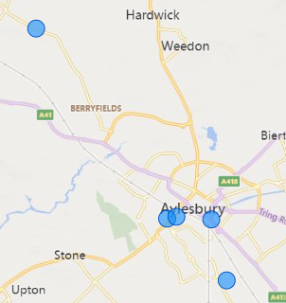
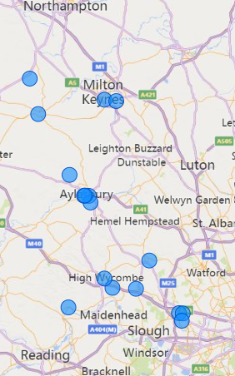
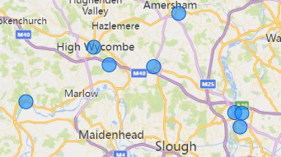
Who are Buckinghamshire’s main providers of post-16 education and training? (excluding schools)
Back to index
1. Silverstone University Technical College (UTC)
2. The University of Buckingham
3. South Central Institute of Technology (IoT) (Milton Keynes College)
4. Open University
5. Bucks Construction Academy
6. Aylesbury University Technical College (UTC)
7. Bucks College Group (Aylesbury Campus)
8. Buckinghamshire New University (Aylesbury Campus)
9. University of Bedfordshire (Aylesbury Campus)
10. Bucks College Group (Amersham Campus)
11. Buckinghamshire New University (High Wycombe Campus)
12. Bucks College Group (High Wycombe Campus)
13. Henley Business School (Greenlands Campus)
14. National Film & Television School
15. Buckinghamshire New University (Uxbridge Campus)
16. West London Institute of Technology (IoT) (Uxbridge Campus)
17. Brunel University
5
1
2
4
3
8
6
7
9
10
11
12
14
15
16
13
17
Click here for an interactive version of map

Slide 42
What do young people in Buckinghamshire do after Year 11, or after 16-18 education?
Back to index
Following Year 11 (Key Stage 4), in 2020/21 most young people from state funded mainstream schools (67%) in Buckinghamshire entered a school sixth form. This is much higher than the national average of 39%. Nationally, more young people entered Further Education (36% compared with 22% in Buckinghamshire) and Sixth Form Colleges (13% compared with 4% in Buckinghamshire). Overall, 94% entered sustained education in Buckinghamshire, compared to 89% nationally. Moving into apprenticeships and employment are less common in Buckinghamshire than nationally.
Source: Key Stage 4 destinations, DfE, 2022
The university destination is deeply ingrained in Buckinghamshire as the pathway of choice on completion of compulsory education. In 2020/21, 66% of young people in Buckinghamshire went from a state funded mainstream school to university, higher than the national average of 57%.
A third (33%) of those leaving college in Buckinghamshire in 2020/21 entered work, higher than the national average of 24%, and likely a reflection of the vocational focus of the Buckinghamshire College Group.
Source: 16-18 destinations, DfE, 2022
In 2020/21, 80 young people in Buckinghamshire entered employment after Year 11, and 1,050 entered employment on completion of 16-18 education

Slide 43
What do young people in Buckinghamshire do after Year 11, or after 16-18 education?
Back to index
Buckinghamshire has the highest proportion of young people entering ‘sustained positive destinations’ after both KS4 and KS5 of all 38 LEP areas.
 | KS4 (Y11) [State-funded schools] - Bucks |  | National |  | KS5 (Y12 / Y13) [State-funded schools & colleges] - Bucks |  | National
 | No. pupils | % | % |  | No. pupils | % | %
Cohort | 5,851 |  |  |  | 4,911
Sustained education, apprenticeship or employment | 5,640 | 96 | 94 |  | 4,125 | 84 | 79
Sustained education | 5,484 | 94 | 89 |  | 2,834 | 58 | 52
Higher Education | - | - | - |  | 2,491 | 51 | 36
Further Education | 1,260 | 22 | 36 |  | 288 | 6 | 13
School Sixth Form | 3,940 | 67 | 39 |  | - | - | 1
Sixth Form College | 226 | 4 | 13 |  | - | - | 1
Other education (includes independent schools) | 58 | 1 | 1 |  | 55 | 1 | 3
Apprenticeship | 75 | 1 | 2 |  | 240 | 5 | 6
Employment | 81 | 1 | 2 |  | 1,051 | 21 | 21
Not a sustained destination | 161 | 3 | 5 |  | 536 | 11 | 15
Unknown | 50 | 1 | 1 |  | 250 | 5 | 5
Source:
Key stage 4 destination measures, Academic Year 2020/21
16-18 destination measures, Academic Year 2020/21

Slide 44
What are Buckinghamshire’s apprenticeship take-up levels?
Back to index
 | Number of apprenticeship starts
 | 2016/17 | 2017/18 | 2018/19 | 2019/20 | 2020/21 | 2021/22 | 2022/23 | 2016/17 to 2022/23 change
Buckinghamshire | 2,960 | 2,610 | 2,850 | 2,270 | 2,470 | 2,710 | 2,750 | -7%
England | 494,880 | 375,760 | 393,380 | 322,530 | 321,440 | 349,190 | 337,140 | -32%
Buckinghamshire has historically had a small but stable number of people taking apprenticeships. Pre-Covid-19, there were fewer apprentices in the local workforce than the national average, and fewer young people choosing apprenticeships at the ages of 16 or 18. Apprenticeships starts decreased between 2016/17 and 2019/20, likely due to funding reforms, including the introduction of the Apprenticeship Levy.
The number of Buckinghamshire residents starting apprenticeships declined between 2016/17 and 2019/20 but has risen in recent years
However, starts did not decreased in Buckinghamshire as sharply as they did nationally. Between 2019/20 and 2020/21 the number of apprenticeships started by Buckinghamshire residents increased, whilst starts decreased nationally.
Between 2021/22 and 2022/23, growth in the number of apprenticeship starts in Buckinghamshire slowed to a 1% increase. Over the same period, apprenticeship starts nationally declined slightly by -3%.
Since 2019/20, the greatest increase in apprenticeship starts in Buckinghamshire was in the area of ‘health, public services and care’, likely linked to an increased profile and need for people to work in this sector as a result of the Covid-19 pandemic and also increased activity as a result of establishment of the Bucks Health and Social Care Academy.
Source: Apprenticeship statistics, DfE

Slide 45
Who is undertaking apprenticeships in Buckinghamshire? At what level? And has this changed in recent years?
Back to index
In 2022/23, 52% of all those starting Apprenticeships were female and 48% were male.
In 2022/23, 46% of Apprenticeships were started by people over the age of 25, up from 40% in 2016/17. Over the same period, the proportion of Apprenticeships started by those under 19 years of age decreased from 29% to 23%.
There has been a significant shift in the number of Apprenticeships being started at different levels. In 2016/17, 49% of Apprenticeship starts were at Level 2, dropping to only 19% in 2022/23.
Over the same period, there has been a sharp increase in Higher Apprenticeship starts (Level 4 and above). Over a third (38%) of Apprenticeship starts in 2022/23 were at this level, up from 8% in 2016/17.
Source: Apprenticeships and traineeships, Academic Year 2022/23

Slide 46
How have apprenticeship reforms and the Covid-19 pandemic affected the take-up of apprenticeships in Buckinghamshire?
Back to index
Apprenticeship reforms
Several reforms to apprenticeships came into effect in 2017. These included a move to employer designed standards, a requirement for 20% off-the-job training and the introduction of a levy for larger employers.
Buckinghamshire has a relatively small number of apprenticeship levy paying organisations (estimated to be in the region of 280), and a disproportionately high number of SME, particularly micro-sized businesses, who typically need more support to recruit and manage apprentices.
In terms of the impact of reforms, local providers report witnessing greatest change amongst large employers wishing to spend their levy. Within the public sector in particular, employers such as the local health trust and the police force have been keen to grow apprenticeship provision to spend their levy.
Further reforms were announced at the Spring 2021 budget. These include apprenticeship levy transfer changes and increased financial incentives for smaller employers to take on new apprentices.
Impact of Covid-19
The Covid-19 pandemic negatively impacted the apprenticeship experience for some of those part-way through their apprenticeships when the pandemic began and led to a decrease in the number of new apprenticeship vacancies (an estimated drop of 45% in 2020 in Buckinghamshire compared with 2019). Some apprentices were furloughed, whilst others had their on and off-the-job activities re-timetabled to fit with the situation the sector they were working in was facing (for example, health and social care apprentices were required to work rather than study, whilst some construction apprentices were required to study rather than work).

Slide 47
What subjects have been studied by those graduating from Buckinghamshire’s Higher Education Institutions?
Back to index
In 2021/22, Higher Education qualifiers (those successfully completing Higher Education qualifications) from Buckinghamshire HEIs were concentrated in three subject areas: business and management (30%), education and teaching (20%) and subjects allied to medicine (16%).
In contrast, the proportion of Higher Education qualifiers in England are distributed across a wider range of subject areas, with smaller concentrations in business and management (19%), subjects allied to medicine (11%) and education (7%).
The high number of qualifiers undertaking subjects related to business and management is attributed to the presence of the University of Buckingham Business School, along with a range of business degrees offered by Buckinghamshire New University.
Undergraduate health and medical courses within Buckinghamshire are provided by the University of Buckingham (Medical School), Bucks New University (nursing, health and social care, health and social science, operating department practice, public health) and the University of Bedfordshire (Stoke Mandeville campus) (nursing and midwifery).
The Buckinghamshire Health and Social Care Academy helps facilitate partnership working between these institutions and health providers.
Source: HESA, 2021/2022 qualifiers (published 2023)

Slide 48
What do those graduating from Buckinghamshire’s Higher Education Institutions do next?
Back to index
Those graduating from Higher Education Institutions (HEIs) in Buckinghamshire are more likely than average to enter employment. In the last year for which we have data, 63% entered full-time employment and 12% entered part-time employment. The corresponding figures for England being 61% and 10% respectively.
The above average proportion of Buckinghamshire HE graduates entering employment could be related to the proximity of Buckinghamshire to London, which offers a large and relatively accessible supply of jobs, particularly at graduate entry-level. It could also be related to the type of degrees on offer, many of which are more vocational than academic.
Buckinghamshire New University places a strong focus on employability, focusing on degrees that are professional and practical, as well as academic. This focus, along with high levels of industry involvement, is likely to contribute to its high graduate employability ranking. NTFS has very strong links with industry. Many graduates go on to become creative leaders for the UK’s largest and most high-profile film and television content creators (NFTS Graduate Impact Report, 2020).
In contrast to the national average, a lower proportion of HE graduates in Buckinghamshire continue into full-time further study, or a combination of employment and further study. A possible reason could be that many of the subjects available for graduate study in Buckinghamshire, may not be allied to careers that require further study at postgraduate level.
Source: HESA, 2020/21 graduates (published 2023)

Slide 49
Where do Buckinghamshire graduates live after graduating?
Back to index
Just over a third (34%) of Buckinghamshire HE graduates remain in the South East one year after graduating, with just under a third (30%) moving to London.
Graduates opting to move to London are likely to do so to access a wider range of graduate entry-level jobs, and to enjoy the London lifestyle.
There is a slight change 3 years post graduation, as a greater proportion of graduates move back to the South East.
Source: Graduate Outcomes in 2020/21, DfE, (published 2023)

Slide 50
To what extent do Buckinghamshire employers provide training to their staff?
Back to index
In 2019 (latest available data), just over half (57%) of employers in Buckinghamshire provided training to their employees. This is lower than the national average of 61%.
Training funded or arranged for employees by Buckinghamshire employers is primarily job specific training (84%), along with health and safety/first aid training (69%); basic (55%) and extensive (33%) induction training for new staff; training in new technology (55%); management training (28%) and supervisory training (25%).
The lower-than-average proportion of employers providing training in Buckinghamshire could be linked to the relatively high proportion of micro-businesses in comparison to the national average. For such employers, having the few staff they employ away on training may not be possible due to their workload, or the employer may lack the financial resources to provide training.
Further insight from the 2019 Employer Skills Survey shows that 71% of employers not providing training believe that all their staff are fully proficient or have no need for training. A further 12% said training was not provided as it was not considered to be a priority, and 7% said there was no training available in the relevant subject area.
12% of Buckinghamshire employers not providing training do not see it as a priority
7% of Buckinghamshire employers not providing training cannot find training available in the relevant subject area
Source: Employer Skills Survey, 2019 (published 2020)

Slide 51
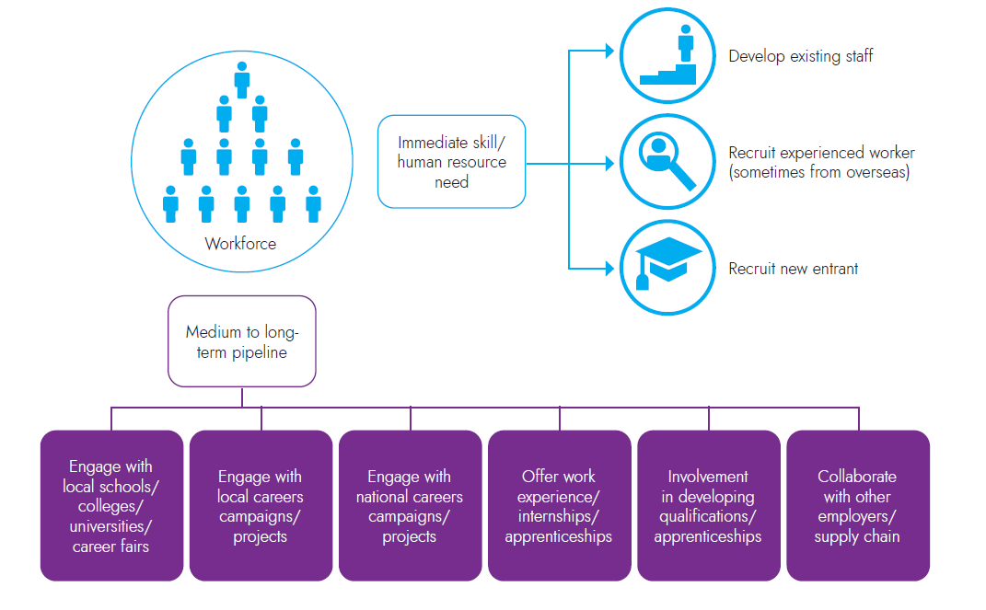
How do employers fill vacancies and develop talent pipelines?
Back to index
This diagram shows some of the ways in which employers address their skills needs

Slide 52
Section 4: Skills demand

Slide 53
How can demand for skills be measured?
Back to index
Skills demand can be measured in several different ways.
We can examine levels of demand from local employers by analysing on-line job postings and using intelligence from local recruitment agencies. What job vacancies are being advertised and what skills are being cited within job adverts?
We can review literature (including reports produced by national sector bodies and the Migration Advisory Committee) and speak to employers to get a sense of skills shortage occupations (i.e. jobs that employers find difficult to fill due to a lack of applicants with the required skills). Some skills shortage occupations have been classified as such for many years (think engineers, chefs, medical practitioners and social workers), others come and go.
We can also review literature and speak to employers to get a sense of jobs that employers find difficult to fill for non-skills related reasons. For example, not enough people are interested in the type of work or are unable to easily access a location (for example, fruit and vegetable pickers).
Finally, we can get a sense of sectors and occupations that are expected to grow and estimate how this might affect future demand for skills, via employment projections, knowledge of global trends and through knowledge of developments in the pipeline at local level.

Slide 54
What types of jobs are in greatest demand in Buckinghamshire?
Back to index
Whilst there are limitations associated with using online job postings to ascertain demand for labour in a local economy (for example, the posting of job vacancies online is more common in some sectors and for some occupations (notably professional occupations) than others and there can be difficulties in assigning job postings to sectors and locations) they can provide a useful gauge of demand at an occupational level, and are particularly useful for more granular deep dive analysis into the specific skills employers are seeking.
The chart below presents in broad terms, job postings by occupational group for Buckinghamshire and England in 2022. We see that overall, Buckinghamshire had lower demand for professionals than the national average, and greater demand for people in mid-skilled roles (e.g. care, leisure and other service occupations, administrative, sales and customer service, and skilled trades). The level of demand differs to what might be expected given the occupational profile of those working in the Buckinghamshire economy). The difference likely being due to the occupational profile including those who work for themselves, whilst job posting data being based on demand for employees only.
Source: Lightcast Job Postings, Jan 2022-Dec 2022.

Slide 55
What types of jobs are in greatest demand in Buckinghamshire?
Back to index
Top job postings in Buckinghamshire in 2022, as a proportion of all job postings (dark green bars indicate higher level of demand locally than nationally)
In 2022, the job in highest demand in Buckinghamshire (according to online job postings) was care workers and home carers. Nationally, this was second only to programmers and software development professionals.
Jobs that were in higher demand locally than nationally included:
Care and nursing roles
Admin roles
Customer service roles
Chefs, kitchen and catering roles
Teaching and nursery roles
Accountancy roles
Cleaner roles
Sales and retail assistant roles
Source: Lightcast Job Postings, Jan 2022-Dec 2022.

Slide 56
Which occupations have seen demand grow over the last two years?
Back to index
Job creation: occupations with more job postings in Bucks in 2022 than in 2020
(dark green bars indicate higher % growth locally than nationally)
Job postings in Buckinghamshire between 2020 and 2022 increased by 63% (81% nationally), as recruitment difficulties and staff retention issues became more prominent during the Covid-19 recovery period.
Reasons for this included people taking early retirement, young people remaining in full-time education, a greater demand for home working flexibility and more people out-of-work due to being long term sick or looking after home or family.
Local intelligence also suggests that Brexit made it more difficult for employers to recruit EU workers to fill labour shortages. Some employers have sought to fill positions previously filled by EU workers with overseas workers from elsewhere.
Source: Lightcast Job Postings, 2020 – 2022.

Slide 57
Which occupations have seen demand reduce over the last two years?
Back to index
Reduced demand: occupations with fewer job postings in Bucks in 2022 than in 2020
(dark green bars indicate higher % reduction locally than nationally)
Few occupations, both locally and nationally, experienced reduced demand with fewer job postings in 2022 than in 2020. Occupations that did experience reduced demand in Buckinghamshire had a greater drop in proportion to the national average.
Occupations for which there was lower demand in 2022 than in 2020 include:
Call and contact centre occupations
Care managers and proprietors
Dental nurses
Labourers
Finance and investment roles
In addition to the impact of the Covid-19 pandemic, drops in job vacancies could also reflect the level of churn in the job market. With, in some cases, people being more likely to stay in roles than they might overwise have done, for financial security.
Source: Lightcast Job Postings, 2020 – 2022.

Slide 58
Which sectors are predicted to create the most jobs in Buckinghamshire over the next 10 years?
Back to index
Key growth sectors (from an employment perspective) within Buckinghamshire over the next 10 years will be:
Construction (in part due to HS2, East West Rail, Pinewood Studios expansion, Aylesbury Garden Town related construction activity, and a large house building programme)
Creative Industries (linked to expansion plans at Pinewood Studios, Wycombe Film Studios and proposed Marlow Film Studios, plus the continuing growth of the West of London Screen Cluster with many new studios recently being opened or are currently being proposed)
Life sciences, health and social care (linked to both the health needs of an ageing population and the need to respond to the aftermath of the Covid-19 pandemic)
Space (linked to expansion of the Westcott Space Cluster)
High performance engineering (linked to expansion of the Silverstone Park and Technology Cluster and an increasing focus on the need for green technologies to combat climate change)
The construction, creative and health and social care sectors are expected to create the greatest volume of jobs over the next five years.
Pinewood Studios’ expansion plans are predicted to create over 8,000 new jobs, and over 3,000 construction jobs.¹
The construction of HS2 is expected to create around 4,000 jobs in Buckinghamshire and the surrounding areas over the lifetime of the project.²
It is anticipated that the 10-year plan for the Westcott Space Cluster will create over 2,000 jobs.
The Space, Creative Industries, High Performance Engineering and MedTech sectors are identified within Buckinghamshire’s Local Industrial Strategy as key sectors. Each has a significant ‘asset’ located within the county (Westcott Space Cluster, Pinewood Studios, Silverstone Park and Technology Cluster and Stoke Mandeville hospital) and strong long-term growth prospects.
More detailed analysis of workforce trends, skills shortages and local training provision for these sectors is available from Buckinghamshire LEP.
¹ pinewood-south-and-alderbourne-farm-summary-document.pdf (pinewoodcommunications.co.uk)
² EKFB

Slide 59
What skills need developing in Buckinghamshire?
Back to index
In 2019 (latest available data), the top three skills employers in Buckinghamshire believed needed improving within their workforce were: ‘knowledge of products and services offered by their organisation’, ‘specialist skills or knowledge needed to perform the role’, and ‘adapting to new equipment or materials.’ These were also the top three skill needs of employers nationwide.
Employers anticipate the need for new skills due to factors such as new legislative or regulatory requirements (49%); the introduction of new technologies or equipment (38%); the development of new products or services (38%); the introduction of new working practices (36%); increased competitive pressure (19%); and Brexit (19%).
Source: Employer Skills Survey: Table 155, 2019 (published 2020)

Slide 60
What is the demand for digital skills within Buckinghamshire?
Back to index
As is the case nationally and globally, digital skills are in high and growing demand within Buckinghamshire.
In 2019 (latest available data)¹:
A third of Buckinghamshire employers with employees deemed ‘not fully proficient’ stated that these employees lack the required IT skills.
A third of Buckinghamshire employers struggling to recruit people with the required skills said that applicants lacked the required digital skill.
Nearly three quarters of Buckinghamshire employers expected the need for new skills within their business over the next 12 months. Of these, 45% expected the need for new digital skills.
A third of Buckinghamshire employers who struggle to recruit people with the required skills say that applicants lack the required digital skills. ¹
A quarter of Buckinghamshire non-digital occupation job postings between 2016 and 2022 required a digital skill where mentioned. ²
Research undertaken with Buckinghamshire SMEs by Buckinghamshire Business First in 2019, found that whilst the majority (76%) believed that new and emerging technologies would assist their business and improve their offerings and outputs, only 41% of were currently prepared to take advantage of such technologies. This figure is likely to have increased as a result of the pivoting required during the Covid-19 pandemic.
Buckinghamshire businesses also reported digital literacy as a critical requirement for people to be work ready across all sectors.³ This includes the ability to use a mobile and computer hardware; using key software packages such as Microsoft Office; and to undertake basic tasks such as finding information, entering data and communicating. Between 2016 and 2022, approximately a quarter of Buckinghamshire non-digital occupation job postings required a digital skill where mentioned.²
Digital and data skills are also expected to be critical for the workforce to deliver on net zero commitments, along with requirements for embracing Industry 4.0 linked to AI, robotics and digitisation. A case in point is that all of Buckinghamshire’s strategic growth sectors (high performance engineering, creative, medtech and space) require digital talent.
¹ Employer Skills Survey, 2019 (published 2020)
² Lightcast, 2022
³ Local intelligence gathered through the LSIP, 2023

Slide 61
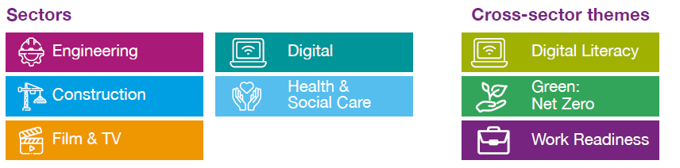
In which sectors and occupations should we prioritise skills activities to meet current and future demand within Buckinghamshire?
Back to index
Extensive research was undertaken by Buckinghamshire LEP between 2018 and 2022 on behalf of the Buckinghamshire Skills Advisory Panel to deepen local understanding of the labour market and skills landscape.
To inform the development of the Buckinghamshire Local Skills Improvement Plan (LSIP), further research was undertaken in 2022 by Buckinghamshire Business First and the LEP, to narrow down skills priorities and focus in on key skills challenges where changes were deemed to be needed to make local post-16 technical education or training more responsive and closely aligned to local labour market needs. This included reviewing data on skills needs at an occupational level (where practical) to enable alignment to Institute for Apprenticeships and Technical Education (IfATE) occupational routes and pathways.
In addition to reviewing existing analysis and local strategies, a mapping exercise was undertaken using the latest available data to establish employment levels, employment growth and skills gaps to identify the key priorities for local intervention.
The priority sectors and cross-sector themes that were identified for the LSIP are:
An overview of priority sector occupations and further information on current skills gaps, provision and possible solutions are available via the LSIP report and sector and cross-sector theme plans (Annex C).

Slide 62
What training do Buckinghamshire employers find most valuable?
Back to index
In 2020, Buckinghamshire Skills Advisory Panel members reported that local employers find the following training most valuable:
Leadership (including managing remote teams)
Diversity and inclusion
Critical strategic skills (e.g. business planning)
Mental health awareness
Apprenticeships
Courses that help develop soft skills (e.g. personal responsibility, self-management, positive attitude and personal presentation)
Additional research was conducted in 2022 for the Local Skills Improvement Plan (LSIP) with local employers by BBF and the LEP, to identify possible ways to address skills issues and gaps in provision through accredited and non-accredited training, for LSIP priority sectors and cross sector themes. Findings can be accessed via the LSIP report and sector and cross-sector theme plans (Annex C).

Slide 63
Section 5: The extent of skills mismatches within Buckinghamshire

Slide 64
To what extent do Buckinghamshire employers struggle to fill vacancies, and why?
Back to index
In 2019 (latest available data), just over a quarter (28%) of vacancies in Buckinghamshire were skills shortage vacancies. This is slightly higher than the national average (25%). In addition, a quarter of vacancies were hard-to-fill, which is more than double the national average at 12%.
Further evidence from the 2019 Employer Skills Survey shows that, of the hard-to-fill vacancies in Buckinghamshire, 45.5% of them are associate professional roles. This is the highest of any LEP area by a significant margin. Likewise, Buckinghamshire has the highest proportion of all 38 LEP areas of high-skill roles identified as hard-to-fill.
Further analysis of the 2019 Employer Skills Survey suggests that the quantity of applicants rather than the quality of applicants is a key issue in Buckinghamshire. It shows that 58% of hard-to-fill vacancies are caused by ‘not enough people interested in doing this type of job’. In addition, 46% are caused by the ‘low numbers of applicants generally’. Both causes in Buckinghamshire are the highest of all 38 LEP areas.
Source: Employer Skills Survey, 2019 (published 2020)

Slide 65
To what extent are Buckinghamshire businesses experiencing staffing difficulties?
Back to index
Key challenges
“Recruiting a workforce with the exacting skills we require in an industry where there is a big skills gap.”
“Our market space is highly skilled engineering contractors in the defence & aerospace sectors. There are shortages of skilled staff and budget constraints. If rates do not increase in line with inflation and in recognition of the skill shortage, contractors will move into other sectors and we could find our sales reducing.”
In March / April 2023, around a third of Buckinghamshire businesses responding to Buckinghamshire Business First and Buckinghamshire LEP’s Business Barometer survey cited staff recruitment and retention issues as their main challenge for the year ahead and for many this is inhibiting business growth.
Illustrative quotes are provided to the right.
Barriers to growth
“Ability to find trained or suitable candidates for business expansion.”
“Lack of skilled technicians.”
Source: Buckinghamshire Business Barometer – Q1 2023

Slide 66
What job roles are particularly difficult to fill? And how does Buckinghamshire compare with the national average?
Back to index
Occupations for which jobs advertised online are advertised for the longest duration (days)
Occupation | Main industry | Unique Online Job Postings from Jan 2022 - Dec 2022 (BUCKS) | Median Posting Duration from Jan 2022 - Dec 2022 (BUCKS) | Median Posting Duration from Jan 2022 - Dec 2022 (ENG) | Difference in median posting duration between Bucks and England | Annual Median Advertised Salary (BUCKS) | Annual Median Advertised Salary (ENG) | Difference in median advertised salary (Bucks and England)
Research and Development Managers | Professional, scientific and technical | 22 | 49 | 30 | 19 | n/a | n/a | n/a
Administrative Occupations: Government and Related Organisations | Public admin and defence | 59 | 39 | 30 | 9 | £25,216 | £28,992 | -£3,776
Artistic, Literary and Media Occupations | Information and communication / arts, entertainment and recreation | 319 | 36 | 31 | 5 | £32,384 | £35,776 | -£3,392
Assemblers and Routine Operatives | Manufacturing | 199 | 36 | 33 | 3 | £25,216 | £25,024 | £192
Skilled Metal, Electrical and Electronic Trades Supervisors | Manufacturing | 76 | 36 | 34 | 2 | £40,064 | £38,080 | £1,984
Other Drivers and Transport Operatives | Transport and storage | 108 | 35 | 32 | 3 | £28,032 | £26,048 | £1,984
Electrical and Electronic Trades | Construction | 680 | 35 | 33 | 2 | £34,496 | £34,496 | £0
Architects, Town Planners and Surveyors | Professional, scientific and technical / construction | 523 | 35 | 33 | 2 | £44,992 | £47,808 | -£2,816
Nursing and Midwifery Professionals | Human health and social work | 2251 | 35 | 33 | 2 | £40,640 | £38,336 | £2,304
Vehicle Trades | Repair of motor vehicles | 489 | 35 | 33 | 2 | £37,056 | £33,472 | £3,584
Construction Operatives | Construction | 115 | 35 | 33 | 2 | £35,968 | £35,008 | £960
Elementary Sales Occupations | Retail | 21 | 35 | 33 | 2 | n/a | n/a | n/a
Metal Forming, Welding and Related Trades | Manufacturing | 134 | 35 | 33 | 2 | £30,976 | £28,608 | £2,368
Sales Related Occupations | Retail | 2147 | 34 | 32 | 2 | £27,456 | £27,968 | -£512
Engineering Professionals | Manufacturing / professional, scientific and technical | 1377 | 34 | 33 | 1 | £40,064 | £40,128 | -£64
Production Managers and Directors | Manufacturing / construction | 447 | 34 | 33 | 1 | £40,128 | £42,688 | -£2,560
Textiles and Garments Trades | Manufacturing | 46 | 34 | 33 | 1 | n/a | n/a | n/a
Health Associate Professionals | Human health and social work | 742 | 34 | 33 | 1 | £28,544 | £28,608 | -£64
Therapy Professionals | Human health and social work | 445 | 34 | 34 | 0 | £35,968 | £37,056 | -£1,088
Construction and Building Trades | Construction | 458 | 34 | 33 | 1 | £40,128 | £37,568 | £2,560
Plant and Machine Operatives | Manufacturing | 350 | 34 | 33 | 1 | £32,000 | £27,328 | £4,672
Managers and Proprietors in Health and Care Services | Human health and social work | 159 | 34 | 33 | 1 | £42,624 | £42,944 | -£320
On average, jobs advertised on-line in Buckinghamshire are advertised for 32 days, this is higher than the national average of 31 days, suggesting that employers in Buckinghamshire take longer to recruit. Occupations for which jobs are advertised for the most days are listed in the table above. Jobs in the manufacturing; health; professional, scientific and technical and construction sectors feature most heavily. For about half of the jobs listed, Buckinghamshire employers are estimated to be offering lower than national average salaries.
Source: Lightcast, job postings data, 2022

Slide 67
To what extent are there skills mismatches within the existing workforce?
Back to index
Whilst Buckinghamshire employers find it more difficult to recruit than average, they appear to have fewer skills mismatches (on aggregate) within their existing workforce.
According to the 2019 Employer Skills Survey (ESS), 3.9% of staff are not fully proficient in Buckinghamshire, which is lower than the national average at 4.6%. Whilst 31% of employers in Buckinghamshire reported overqualified staff, which is also lower than the national average at 34%.
Whilst Buckinghamshire performs better than the national average, the data does still suggest some mismatch. Will greater exploration needed to understand how staff could be better utilised by their employers.
Source: Employer Skills Survey, 2019 (published 2020)

Slide 68
Annex

Slide 69
Standard Industrial Classification codes (1 of 2)
Back to index
Broad industry group | Sometimes shortened to… | Includes…
1: Agriculture, forestry & fishing (A) | Farming | Farming, forestry, fishery, aquaculture
2: Mining, quarrying & utilities (B, D and E) | Utilities | Mining, quarrying, electricity, gas supply, air conditioning, sewerage, water and waste
3 : Manufacturing (C) |  | All types of manufacturing
4 : Construction (F) |  | All types of construction
5 : Motor trades (Part G) |  | Wholesale, retail and repair of motor vehicles
6 : Wholesale (Part G) |  | Wholesale of goods, from food to pharmaceuticals
7 : Retail (Part G) |  | All types of retail (including online)
8 : Transport & storage (inc postal) (H) |  | Land, water and air transport, warehousing, postal and courier activities
9 : Accommodation & food services (I) | Hospitality | Hotels, restaurants and pubs
10 : Information & communication (J) | Digital technologies | Computer consultancy, programming, film and TV, publishing, telecommunications
11 : Financial & insurance (K) |  | Banks, insurance, pensions

Slide 70
Standard Industrial Classification codes (2 of 2)
Back to index
Broad industry group | Sometimes shortened to… | Includes…
12 : Property (L) |  | Real estate, renting, buying and selling of own property
13 : Professional, scientific & technical (M) |  | Business consultancy, management consultancy, head offices, accountancy, veterinary, legal, architectural, design, R&D, advertising, PR, market research, translation
14 : Business administration & support services (N) | Business admin and support | Employment agencies, cleaning of building, landscape, security, renting and leasing activity, travel agencies, HR support
15 : Public administration & defence (O) |  | Local government, police, fire, prisons, defence
16 : Education (P) |  | All types of education
17 : Health (Q) |  | Hospitals, care homes, GPs, social work, dental practices
18 : Arts, entertainment, recreation & other services (R,S,T and U) | Arts, entertainment and recreation | Sport facilities, sports clubs, gyms, gambling, libraries, performing arts, historic sites, museums, visitor attractions

