Slide 1
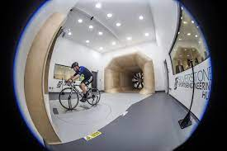
Buckinghamshire Businesses: 2023
October 2023

Slide 2
About
This report mainly presents analysis of the number, size and industry of VAT and/or PAYE registered businesses located in Buckinghamshire. The data presented is based on a snapshot of the Office for National Statistics (ONS) Inter-Departmental Business Register (IDBR) taken on 10 March 2023.
Towards the end of the report we provide estimates of the overall number of businesses in Buckinghamshire, including those that are not registered for VAT and/or PAYE, along with data on business start-ups (incl. sole traders) in Buckinghamshire sourced from BankSearch, which reflects the opening of a first current account from a small business banking product range.
For further details see: UK Business Activity: size, activity and location: 2023, Business Population Estimates 2023 and UK Business Counts 2023.
Definitions can be found here.

Slide 3
Headlines (1)
There were 31,210 VAT/PAYE registered businesses (enterprises) operating in Buckinghamshire in March 2023, a decrease of 0.5% from March 2022. Nationally there was a decrease of 1.6% over this period.
These businesses operated from 34,355 individual units (or workplaces). A decrease of 0.5% from March 2022. Nationally, there was a decrease of 1.5%.
Buckinghamshire experienced slower growth in the number of enterprises (17%) than the national (27%) and regional (19%) average from 2013 to 2023.
Overall, at the beginning of 2023, we estimate that there were approximately 67,300 private sector (including non-profit) businesses in Buckinghamshire. More than half of these businesses (approximately 36,200) had no employees and were not registered for VAT/ PAYE.
In 2023, 80% of VAT/PAYE registered businesses in Buckinghamshire were companies, and 17% were sole proprietors or partnerships. This compares to 77% and 19% nationally.
Buckinghamshire has the highest share of VAT/PAYE businesses in the micro category (0-9 employees) of all LEP areas. This is largely driven by the high proportion of firms employing fewer than five people.
Whilst only 0.3% of businesses in Buckinghamshire are large, they provide 43% of employee jobs in the local economy. Nationally, 56% of jobs are in large firms.
Despite having the highest share of businesses in the smallest employment band, 9.6% of Buckinghamshire’s businesses have turnovers of more than £1m, ranking 31st out of the 38 LEP areas.
Approximately one in five businesses in Buckinghamshire operates in the ‘professional, scientific and technical’ sector, which is a higher proportion than nationally. This sector includes law firms, accounting firms, and engineering companies. In Buckinghamshire, 19% of businesses operate in this sector, compared to the national average of 16%.

Slide 4
Headlines (2)
The highest proportion of micro firms (employing fewer than 10 people) in Buckinghamshire are in the ‘construction’, ‘agriculture, forestry & fishing’, ‘property’, ‘professional, scientific & technical’ and ‘information & communication’ sectors.
Buckinghamshire has a higher proportion of businesses operating in the ‘information and communication’ sector than the national average. This sector includes computer programming and consultancy firms, and motion picture, video and TV companies. In Buckinghamshire, 10% of businesses operate in this sector, compared with the national average of 7%.
Buckinghamshire has fewer businesses operating in the retail and hospitality sectors than nationally. This could be due to the county's relatively high property costs, which may make it less attractive for small retail and hospitality businesses to establish themselves.
Over the last decade, the ‘construction’, ‘business administration & support services’, and ‘retail’ sectors have seen the greatest increase in business numbers in Buckinghamshire. Whilst there have been small drops in the number of ‘wholesale’ and ‘agriculture, forestry & fishing’ businesses over this period.
Between 2022 and 2023, the ‘retail’, ‘business administration & support services’ and ‘construction’ sectors saw the greatest increase in business numbers, likely to be driven by the accelerated trend towards online retailing due to the Covid-19 pandemic and large infrastructure projects such as HS2, East West Rail and the house building programme in and around Aylesbury.
Whereas the ‘professional, scientific and technical’ sector along with ‘information and communication’ sectors saw a large decrease in the number of businesses between 2022 and 2023. This could be related to IR35 tax changes which led to some individuals who previously operated as a company becoming employees.
Overall private sector business start-ups are estimated to be on a downward trend in Buckinghamshire since 2012.
The majority of Buckinghamshire business start-ups are limited companies. However, the onset of Covid-19 saw a slight drop in the number of limited companies whilst the number of sole trader start-ups doubled. Uncertainty arising from Covid-19 and the introduction of furlough and home working may have boosted entrepreneurialism and convinced those with side projects to fully pursue them.

Slide 5
VAT / PAYE Businesses

Slide 6
Change in the number of VAT/PAYE businesses in Buckinghamshire over recent years (1)
Number of VAT/PAYE registered businesses (enterprises) by year - Buckinghamshire
There were 31,210 VAT/PAYE registered businesses (enterprises) operating in Buckinghamshire in March 2023, a decrease of 0.5% from March 2022.
These businesses operated from 34,355 individual units (or workplaces). A decrease of 0.5% from March 2022.
The decrease in the number of business enterprises in Buckinghamshire between 2022 and 2023 was lower than the 1.6% decrease nationally. The number of business units in England fell by 1.5% over the same period.
The number of businesses in Buckinghamshire grew steadily between 2011 and 2017*, followed by a period of stability in business numbers between 2017 and 2023.
In comparison to neighbouring LEP areas (see next page), Buckinghamshire experienced the third slowest business count growth between 2013 and 2023, exceeding Oxfordshire and Berkshire.
However, Buckinghamshire ranks higher than neighbouring LEP areas in terms of the change in number of businesses between 2022 and 2023.
Buckinghamshire experienced slower growth (17%) than the national (27%) and regional (19%) averages in the number of enterprises from 2013 to 2023.
Source: IDBR, 2023
*It is a little difficult to ascertain to what extent Buckinghamshire’s business population has grown over the last decade as the ONS widened their methodology in 2015 to include more solely PAYE businesses. The bars on the chart above are coloured differently to illustrate this change in methodology.

Slide 7
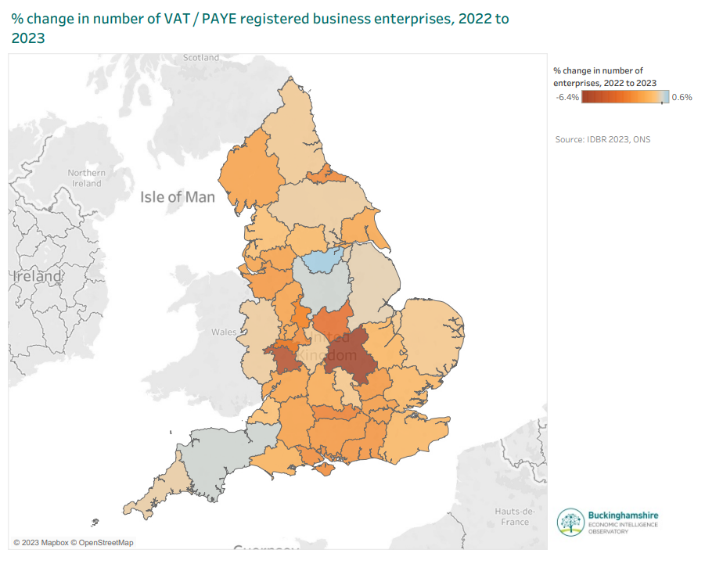
Change in the number of VAT/PAYE businesses in Buckinghamshire over recent years (2)
% change in the number of VAT/PAYE registered business enterprises in Buckinghamshire, neighbouring LEP areas, the South East and England
LEP area | % change in businesses 2013-2023 | % change in businesses 2022-2023
London | 41% | -1.9%
South East Midlands | 32% | -6.4%
Hertfordshire | 25% | -2.1%
Buckinghamshire | 17% | -0.5%
Thames Valley Berkshire | 17% | -2.8%
Oxfordshire | 15% | -1.4%
South East region | 19% | -1.9%
England | 27% | -1.6%
Source: IDBR, 2023
Across the country, the South Yorkshire LEP area had the highest percentage increase in the number of enterprises between 2022 and 2023 whilst the South East Midlands LEP area had the largest decrease (see map).
Overall, just 3 of the 38 LEP areas experienced an increase, albeit marginal. 25 LEP areas experienced a decrease of 1% or more.
Interactive map
Source: IDBR, 2023

Slide 8
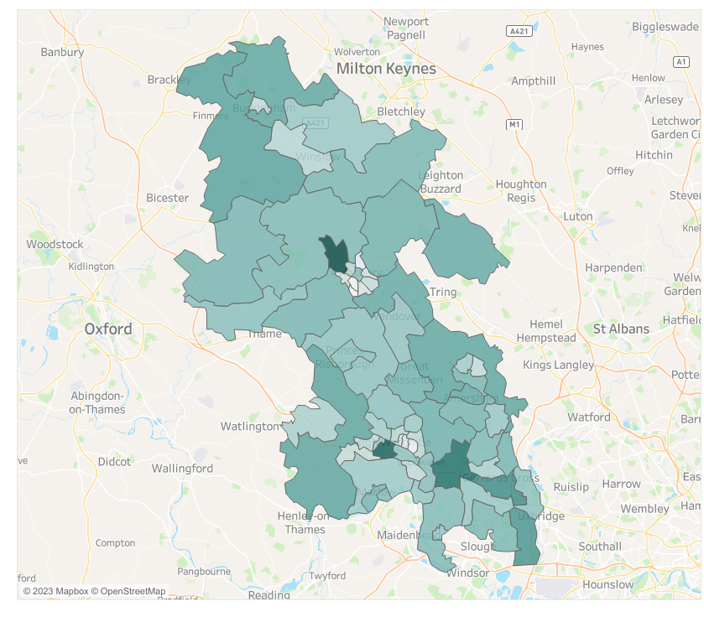
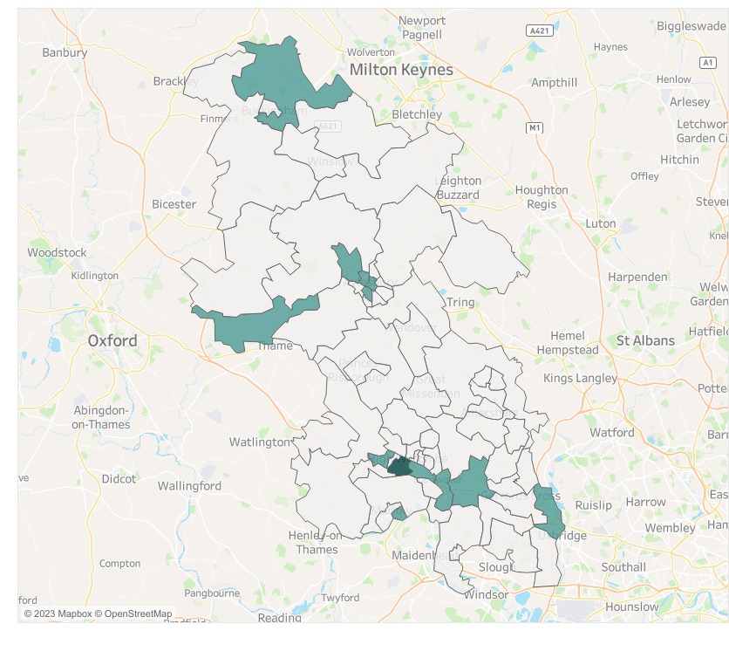
Where VAT/PAYE registered businesses (enterprises) are concentrated in Buckinghamshire - 2023
Where large businesses (employing 250+ people) are concentrated in Buckinghamshire - 2023
Interactive map
Interactive map
There are particularly high concentrations of businesses in the Beaconsfield, High Wycombe and Aylesbury areas.
Buckinghamshire’s largest businesses (employing more than 250 people) are mainly located in the south of the county, in particular along the M4 corridor, in Aylesbury, in the north of the county (in the area which includes Silverstone Park), and in the area to the north of Thame.
Source: IDBR, 2023

Slide 9
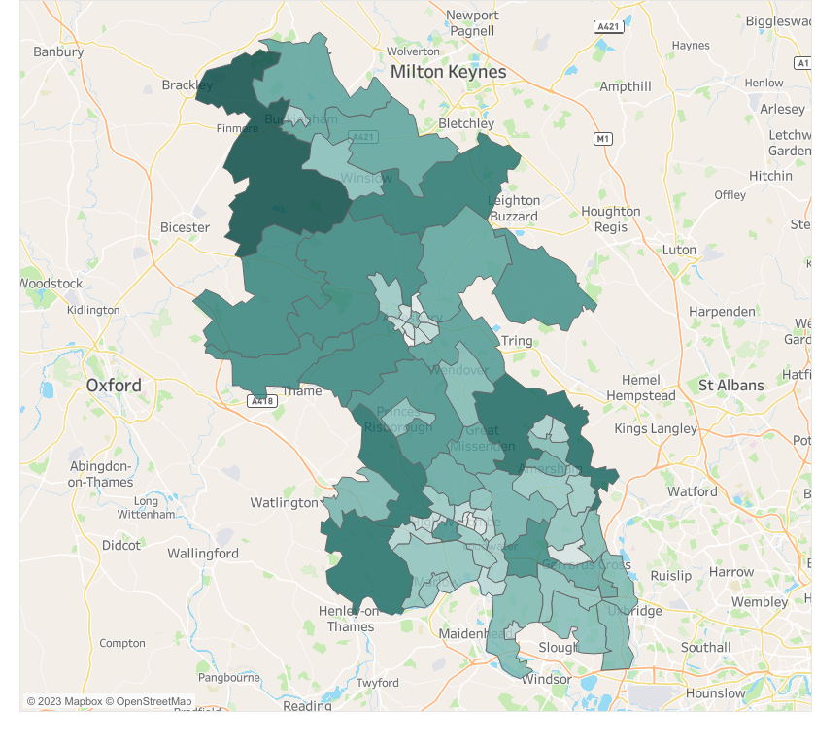
VAT/PAYE businesses by status
Percentage of VAT/PAYE businesses (enterprises) by status - Buckinghamshire
Location of VAT/PAYE registered sole proprietors/partnerships in Buckinghamshire - 2023
 | 2018 | 2019 | 2020 | 2021 | 2022 | 2023
Sole proprietors | 15% | 14% | 13% | 13% | 13% | 12%
Partnership | 6% | 6% | 6% | 5% | 5% | 5%
Sole proprietors and partnerships | 21% | 20% | 19% | 18% | 17% | 17%
Companies | 76% | 77% | 78% | 79% | 80% | 80%
Government and non-profit making bodies | 3% | 3% | 3% | 3% | 3% | 3%
Source: IDBR, 2023
In 2023, 80% of VAT/PAYE registered businesses in Buckinghamshire were companies, and 17% were sole proprietors or partnerships.
This compares to 77% and 19% nationally.
The share of sole proprietors and partnerships has declined in recent years and the share of companies has increased. This trend is also evident nationally.
There is a higher concentration of sole proprietors/partnerships in the west and north of Buckinghamshire than in the south-east of the county (see map).
Interactive map
Source: IDBR, 2023

Slide 10
Size of VAT/PAYE businesses in Buckinghamshire
Size of businesses by number of employees
 | 0 to 4 |  |  | 5 to 9 |  |  | Micro (0 to 9) |  |  | Small (10 to 49) |  |  | Medium (50 to 249) |  |  | Large (250+)
LEP area | No. | % | Rank | No. | % | Rank | No. | % | Rank | No. | % | Rank | No. | % | Rank | No. | % | Rank
Buckinghamshire | 25,450 | 81.5% | 1 | 2,980 | 9.5% | 38 | 28,430 | 91.1% | 1 | 2,280 | 7.3% | 38 | 405 | 1.3% | 36 | 90 | 0.3% | 33
Hertfordshire | 48,900 | 80.4% | 3 | 6,085 | 10.0% | 35 | 54,985 | 90.5% | 2 | 4,660 | 7.7% | 37 | 890 | 1.5% | 29 | 250 | 0.4% | 23
London | 423,815 | 80.6% | 2 | 50,585 | 9.6% | 37 | 474,400 | 90.2% | 4 | 409,70 | 7.8% | 36 | 8,185 | 1.6% | 24 | 2,300 | 0.4% | 14
Oxfordshire | 24,350 | 76.7% | 17 | 3,640 | 11.5% | 27 | 27,990 | 88.2% | 28 | 3,035 | 9.6% | 15 | 560 | 1.8% | 6 | 155 | 0.5% | 4
South East Midlands | 59,040 | 80.2% | 4 | 7,370 | 10.0% | 34 | 66,410 | 90.2% | 3 | 5,785 | 7.9% | 35 | 1,105 | 1.5% | 26 | 305 | 0.4% | 22
Thames Valley Berkshire | 34,190 | 79.6% | 5 | 4,160 | 9.7% | 36 | 38,350 | 89.3% | 11 | 3,540 | 8.2% | 34 | 810 | 1.9% | 2 | 260 | 0.6% | 1
South East region | 318,990 | 78.8% |  | 43,475 | 10.7% |  | 362,465 | 89.5% |  | 34,675 | 8.6% |  | 6,090 | 1.5% |  | 1,615 | 0.4%
England | 1,845,670 | 77.9% |  | 267,970 | 11.3% |  | 2,113,640 | 89.2% |  | 209,555 | 8.8% |  | 37,305 | 1.6% |  | 9,630 | 0.4%
Source: IDBR, 2023
Buckinghamshire has the highest share of VAT/PAYE businesses in the micro category (0-9 employees) of all LEP areas. This is largely driven by the high proportion of firms employing fewer than five people.
Buckinghamshire has the smallest proportion of large businesses (with over 250 employees) of neighbouring LEP areas.
Whilst only 0.3% of businesses in Buckinghamshire are large, they provide 43% of employee jobs in the local economy. Nationally, 56% of jobs are in large firms (ONS, 2023).

Slide 11
Size of VAT/PAYE businesses in Buckinghamshire
Size of businesses by turnover
 | £0 to £49,999 |  |  | £50,000 - £99,999 |  |  | £100,000 - £199,999 |  |  | £200,000 - £499,999 |  |  | £500,000 - £999,999 |  |  | £1,000,000 and over
LEP area | No. | % | Rank | No. | % | Rank | No. | % | Rank | No. | % | Rank | No. | % | Rank | No. | % | Rank
Buckinghamshire | 5,040 | 16.1% | 15 | 6,450 | 20.7% | 20 | 10,095 | 32.3% | 7 | 4,235 | 13.6% | 18 | 2,390 | 7.7% | 35 | 3,000 | 9.6% | 31
GCGP | 6,450 | 17.6% | 8 | 7,250 | 19.8% | 31 | 11,250 | 30.8% | 26 | 4,810 | 13.2% | 28 | 2,890 | 7.9% | 32 | 3,910 | 10.7% | 13
Hertfordshire | 9,105 | 15.0% | 28 | 12,795 | 21.0% | 16 | 19,765 | 32.5% | 4 | 7,970 | 13.1% | 30 | 4,750 | 7.8% | 33 | 6,405 | 10.5% | 16
London | 82,895 | 15.8% | 21 | 108,670 | 20.7% | 21 | 164,805 | 31.3% | 16 | 70,240 | 13.4% | 24 | 42,545 | 8.1% | 23 | 56,705 | 10.8% | 10
Oxfordshire | 5,300 | 16.7% | 10 | 6,165 | 19.4% | 34 | 9,775 | 30.8% | 25 | 4,470 | 14.1% | 7 | 2,695 | 8.5% | 5 | 3,335 | 10.5% | 17
South East Midlands | 13,585 | 18.5% | 4 | 15,660 | 21.3% | 12 | 22,545 | 30.6% | 30 | 8,965 | 12.2% | 38 | 5,570 | 7.6% | 37 | 7,275 | 9.9% | 28
Thames Valley Berkshire | 6,800 | 15.8% | 20 | 8,885 | 20.7% | 19 | 14,010 | 32.6% | 3 | 5,290 | 12.3% | 37 | 3,155 | 7.3% | 38 | 4,830 | 11.2% | 3
South East region | 63,330 | 15.6% |  | 83,895 | 20.7% |  | 130,315 | 32.2% |  | 54,085 | 13.4% |  | 32,050 | 7.9% |  | 41,170 | 10.2%
England | 375,255 | 15.8% |  | 493,980 | 20.8% |  | 743,495 | 31.4% |  | 319,290 | 13.5% |  | 192,830 | 8.1% |  | 245,275 | 10.3%
Source: IDBR, 2023
Despite having the highest share of businesses in the smallest employment bands, 9.6% of Buckinghamshire’s businesses have turnovers of more than £1m, ranking 31st among the 38 LEPs, while 16.1% of Buckinghamshire’s businesses have turnovers below £50,000, ranking 15th.
Buckinghamshire businesses most commonly have turnovers between £100,000 and £199,000, with just under a third (32.3%) of VAT/PAYE businesses falling within this turnover band.

Slide 12
Buckinghamshire’s VAT/PAYE businesses by industry
Approximately one in five businesses in Buckinghamshire operate in the ‘professional, scientific and technical’ sector, which is a higher proportion than nationally.
This sector includes businesses such as law firms, accounting firms, and engineering companies. In Buckinghamshire, 20% of businesses operate in this sector, compared to the national average of 16%.
Buckinghamshire also has a higher proportion of businesses operating in the ‘information and communication’ sector than the national average. This sector includes computer programming and consultancy firms, and motion picture, video and TV companies. In Buckinghamshire, 10% of businesses operate in this sector, compared to the national average of 7%.
Buckinghamshire has fewer businesses operating in the retail and hospitality sectors than nationally. This could be due to the county's relatively high property costs, which may make it less attractive for small retail and hospitality businesses to establish themselves.
Source: IDBR, 2023

Slide 13
Buckinghamshire’s VAT/PAYE businesses by industry and size
Industry | Micro (0 to 9) | % | Small (10 to 49) | % | Medium-sized (50 to 249) | % | Large (250+) | % | Total
Agriculture, forestry & fishing | 970 | 96% | 40 | 4% | 5 | 0% | 0 | 0% | 1,015
Mining, quarrying & utilities | 105 | 78% | 20 | 15% | 5 | 4% | 0 | 0% | 135
Manufacturing | 1,140 | 83% | 185 | 13% | 40 | 3% | 15 | 1% | 1,380
Construction | 4,190 | 96% | 160 | 4% | 20 | 0% | 5 | 0% | 4,370
Motor trades | 845 | 93% | 60 | 7% | 5 | 1% | 0 | 0% | 910
Wholesale | 940 | 80% | 175 | 15% | 50 | 4% | 10 | 1% | 1,175
Retail | 1,910 | 92% | 150 | 7% | 15 | 1% | 5 | 0% | 2,085
Transport & storage (inc postal) | 925 | 91% | 80 | 8% | 10 | 1% | 0 | 0% | 1,015
Accommodation & food services | 860 | 74% | 280 | 24% | 20 | 2% | 5 | 0% | 1,165
Information & communication | 3,025 | 94% | 150 | 5% | 25 | 1% | 10 | 0% | 3,210
Financial & insurance | 490 | 93% | 30 | 6% | 5 | 1% | 0 | 0% | 525
Property | 1,310 | 96% | 55 | 4% | 5 | 0% | 0 | 0% | 1,370
Professional, scientific & technical | 5,810 | 95% | 240 | 4% | 35 | 1% | 5 | 0% | 6,090
Business administration & support services | 2,690 | 92% | 185 | 6% | 30 | 1% | 10 | 0% | 2,915
Public administration & defence | 115 | 96% | 5 | 4% | 0 | 0% | 0 | 0% | 120
Education | 400 | 73% | 70 | 13% | 65 | 12% | 10 | 2% | 545
Health | 860 | 75% | 210 | 18% | 60 | 5% | 10 | 1% | 1,140
Arts, entertainment, recreation & other services | 1,840 | 90% | 185 | 9% | 15 | 1% | 0 | 0% | 2,045
Total | 28,430 | 91% | 2,280 | 7% | 405 | 1% | 90 | 0% | 31,210
The following sectors have the highest proportion of micro firms (employing less than 10 people):
Construction
Public administration & defence
Property
Agriculture, forestry & fishing
Professional, scientific & technical
Information & communication
The following sectors have the highest proportion of large (employing 250+ people) businesses:
Education
Manufacturing
Health
Source: IDBR, 2023

Slide 14
Buckinghamshire’s VAT/PAYE businesses by industry – 2013 to 2023
Change in business numbers by industry – 2013 to 2023
Change in business numbers by industry – 2022 to 2023
Over the last decade, the ‘construction’, ‘business administration & support services’, and ‘retail’ sectors have seen the greatest increase in business numbers in Buckinghamshire. Whilst there have been small drops in the number of ‘wholesale’ and ‘agriculture, forestry & fishing’ businesses over this time period.
Between 2021 and 2022, the ‘retail’, ‘business admin & support services’ and ‘construction’ sectors saw the greatest increase in business numbers, likely driven by the accelerated trend towards online retailing due to the Covid-19 pandemic and large infrastructure projects such as HS2, East West Rail and the house building programme in and around Aylesbury.
Source: IDBR, 2023

Slide 15
Overall private sector business estimates

Slide 16
Overall estimate of private sector businesses in Buckinghamshire
67,300 private sector businesses (estimate)
36,200 unregistered (estimate)
31,000 registered
The data presented so far within this report relates to businesses registered for VAT/PAYE. The figures include a handful of public sector enterprises. The figures exclude the large number of private sector firms operating below the VAT threshold or not registered for PAYE. Whilst data on this latter group is not published at local level, we have estimated numbers for Buckinghamshire based on regional (South East) data. We have also removed the public sector enterprises from the data, to provide an estimate of the total number of private sector businesses in Buckinghamshire.
At the beginning of 2023, we estimate that there were approximately 67,300 private sector (including non-profit) businesses in Buckinghamshire. Just over half of these businesses (approximately 36,200) had no employees and were not registered for VAT* / PAYE**.
There were 31,000 private sector VAT / PAYE registered businesses in Buckinghamshire in 2022.
*Businesses with a VAT taxable turnover of over £85,000 must register for VAT
**Businesses with one or more employee (who are paid £120 or more a week) must register for PAYE. This includes sole directors who take a salary from the company.
We estimate that the total number of private sector business in Buckinghamshire grew by approximately 2% between 2022 and 2023. Almost all of the growth being in the number of unregistered businesses. This is broadly in line with the national trend.

Slide 17
Business start-ups

Slide 18
New business start-ups
Number of Buckinghamshire business start-ups and business start-up rate (per 1,000 Buckinghamshire residents).
The number of Buckinghamshire business start-ups (see definition here) increased in the years immediately following the 2008 financial crisis.
However, since 2012 the business start-up rate has been on a downward trend, with relatively large drops in 2013 (-14%) and 2018 (-12%).
There was a slight uptick in the business start-up rate in Buckinghamshire in 2020 during the onset of Covid-19.
This uptick was not sustained for long and was followed by a large drop in 2022 (-15%), likely reflecting the harsher business environment stemming from rising interest rates, energy costs, wages and cost of living.
Source: BankSearch, 2023

Slide 19
Legal status
Buckinghamshire business start-ups by legal status.
The majority of Buckinghamshire business start-ups are limited companies, growing from 47% in 2008 to a 69% share in 2022.
In contrast, the proportion of Buckinghamshire start-ups being sole traders has reduced, from just over a third (36%) in 2008 to just under a quarter share (23%) in 2022.
Despite this, the number of sole trader new business start-ups doubled between 2019 and 2020, coinciding with the onset of Covid-19.
Uncertainty arising from Covid-19 and the introduction of furlough and home working may have boosted entrepreneurialism and convinced those with side projects to fully pursue them.
The proportion of sole trader business start-ups has since dropped back, but remains higher than pre-Covid-19 levels.
Source: BankSearch, 2023

Slide 20
Sector
Average annual growth in start-ups by sector – 2018 to 2022
 | Number of start-ups 2022
Real estate, prof services & support activities | 1,060
Wholesale & retail | 525
Construction | 413
Arts, entert, rec & other services | 331
Transport, storage & communication | 311
Human health & social work | 240
Accommodation & food service | 155
Manufacturing | 141
Education | 63
Agriculture, forestry & fishing | 55
Mining, quarrying & utilities | 17
Financial & Insurance | 15
Public admin & defence | 5
The real estate, professional services and support activities sector has the largest number of business start-ups in Buckinghamshire of all sectors, with twice as many start-ups as the wholesale and retail sector (in second position) in 2022.
There are comparatively few business start-ups in the mining, quarrying & utilities; financial & insurance and public admin & defence sectors.
Between 2018 and 2022, there was an upward trend in the number of start-ups in the wholesale & retail; construction; and manufacturing sectors (see chart). The transport, storage & communication and real estate, professional services & support activities sectors saw the greatest contraction in start-ups over this period.*
Some of these trends are likely linked to the Covid-19 pandemic (e.g. growth in on-line retail and home renovations). In the case of construction, the growth is also likely to be linked to large-scale construction projects being undertaken across the county, not least HS2.
Source: BankSearch, 2023
*Sectors with fewer than 50 start-ups in 2022 have been removed from the trend analysis

Slide 21
Location
Proportion of Buckinghamshire business start-ups by Index of Multiple Deprivation decile, where 0% to 20% is most deprived areas, and 81% to 100% is least deprived areas.
The majority of business start-ups are in urban areas of Buckinghamshire, accounting for 71% in 2022.
This has grown gradually from 65% in 2008.
In addition, the majority of business start-ups are in the least deprived areas of Buckinghamshire (see chart).
However, the proportion of Buckinghamshire business start-ups in least deprived areas has reduced since 2015, with a relatively large drop in 2020 during the onset of Covid-19.
In contrast, the proportion of Buckinghamshire business start-ups increased in more deprived areas.
Source: BankSearch, 2023

Slide 22
Definitions and sources
Definition
A business may be VAT and/or PAYE registered and therefore appear on the government business register (the IDBR), or it may exist without being registered.
A registered business or enterprise is the smallest combination of legal units (generally based on VAT and/or PAYE records) which has a certain degree of autonomy within an enterprise group.
A branch or office of a larger organisation is not in itself an enterprise. For example, a supermarket chain will count as one business, with the employment and turnover of individual stores, distribution centres etc included within this.
A business start-up reflects the opening of a first current account from a small business banking product range. They represent businesses new to banking or those previously operated through a personal account. The data exclude businesses operating through personal accounts, those without banking relationships or those banking with other institutions.
Sources
There is no single database in the UK which contains details of every active business. Government’s statistical business register, the Inter-Departmental Business Register (the IDBR), contains all businesses operating VAT and/or PAYE schemes.
The Department for Business, Energy and Industrial Strategy (BEIS)’s Business Population Estimates take data on businesses on the IDBR, and then estimate the number of additional very small businesses unregistered for VAT or PAYE.
BankSearch, for data on business start-ups, collects data from the main suppliers of business banking services to provide the number of first current accounts opened from a small business banking product range.

