Slide 1
Terriers & Amersham Hill
Economic Ward Profile
August 2023

Slide 2
About this profile
Buckinghamshire LEP have produced a set of economic profiles for the 10 wards of Buckinghamshire where people are experiencing the most hardship to inform the work of the Opportunity Bucks programme. The 10 wards are:
This profile is for the Terriers & Amersham Hill ward in High Wycombe.
It sets out:
An overview of the local economy (including key businesses, employment hotspots, high growth firms and key employment sites)
A profile of residents (including demographics and labour market status)
Analysis of potential barriers to employment (including health, transport, caring responsibilities, English language proficiency, qualifications and childcare)
The majority of data presented within this profile is from the 2021 Census (ONS). Other data sources used are: childcare provider data (Ofsted); claimant count (DWP); business data (Companies House); data on high growth firms (Beauhurst); the Business Register and Employment Survey (ONS) and property data (CoStar).
Most data is rounded to the nearest 100.
Town | Ward
Aylesbury | Aylesbury North Aylesbury North-West Aylesbury South-West
Chesham | Chesham
High Wycombe | Abbey Booker, Cressex & Castlefield Ryemead & Micklefield Terriers & Amersham Hill Totteridge & Bowerdean West Wycombe
Maps showing the location of each ward can be found here.

Slide 3
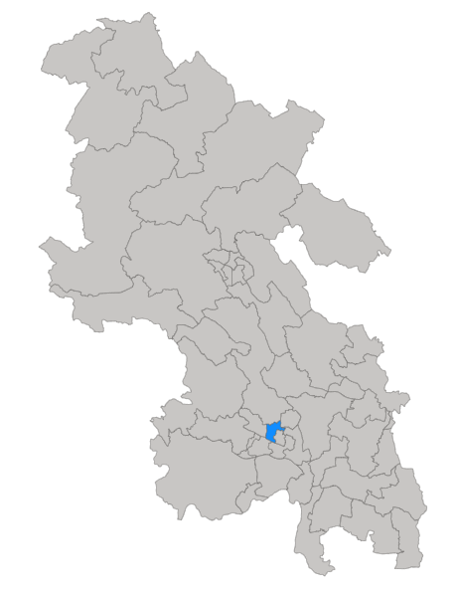
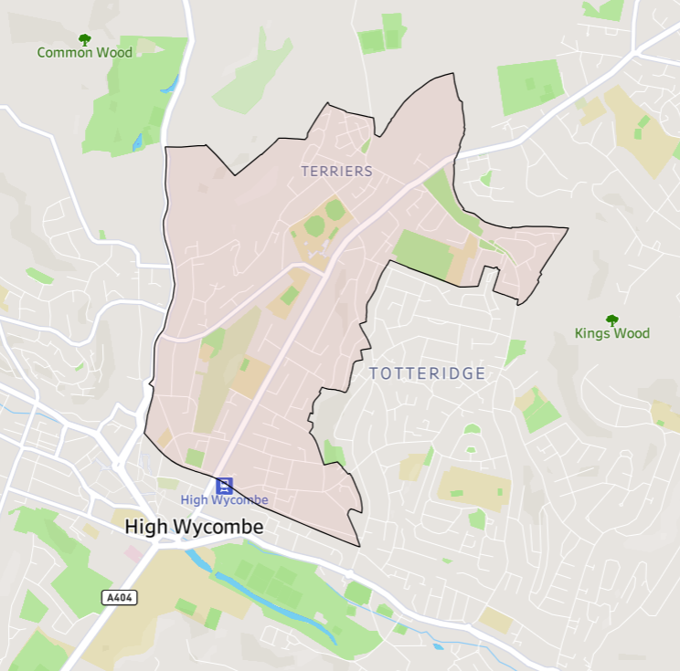
Terriers & Amersham Hill ward is located in High Wycombe, to the north of the town centre (see maps below).
Click here for interactive map

Slide 4
Fast facts
11,000 residents
4,400 households
7,400 residents of working age (16-64)
600 active companies²
5.2% unemployment rate (March 2021)
1 key employment site³
270 people claiming unemployment-related benefits (the Claimant Count)¹ (April 2023)
1,000 economically inactive residents of working age (excluding students)
8 high growth / high growth potential companies⁴
¹ DWP, via NOMIS
² Companies House
³ Bucks LEP
⁴Beauhurst
All data from Census 2021, ONS, unless otherwise stated

Slide 5
Key statistics
 | Terriers & Amersham Hill | Buckinghamshire | England | Ward v Bucks average | Rank (of all 49 Buckinghamshire wards)
Employment rate (no. of working-age residents in employment / no. of working age residents – excluding students) | 80% | 81% | 77% | -1 percentage points | 33rd
Unemployment rate (no. of working-age residents who are unemployed / no. of working age residents who are economically active – i.e. employed or unemployed) | 5.2% | 4.4% | 5.8% | +0.8 percentage points | 8th
Claimant count rate (no. of claimants / working age population) | 4.0% | 2.6% | 3.8% | +1.4 percentage points | 7th
% of working age never worked or long-term unemployed | 6% | 5% | 7% | +1 percentage points | 11th
% of working age employed in routine occupations | 8% | 8% | 11% | Equal | 16th
% of working age with below Level 2 qualifications | 16% | 18% | 22% | -2 percentage points | 37th
% not in good health | 12% | 11% | 15% | +1 percentage points | 11th
Under 5s per childcare place | 2 | 3 | 4 | -1 | 23rd *
All data from Census 2021, ONS, unless otherwise stated
¹ DWP, via NOMIS
² Ofsted
* Out of 48 Buckinghamshire wards (rank not available for Chesham ward)

Slide 6
What the data tells us
Terriers & Amersham Hill is predominantly residential, with few key employment sites.
In many respects the ward is more ‘average’ in terms of the labour market situation of residents than most other Opportunity Bucks wards.
The ward has a relatively mixed economy containing employers from a diverse range of sectors and employers of all sizes.
.
However, Terriers & Amersham Hill has the 7th higher proportion of residents claiming out-of-work related benefits of all 49 Buckinghamshire wards.
A higher proportion of the ward’s unemployed residents are aged over 50 than in all other Opportunity Bucks wards, as are a high proportion of the ward’s economically inactive population.
Slightly more female than male residents are unemployed, the only Opportunity Bucks ward in which this is the case.
Also of note is that a relatively high proportion of Terriers & Amersham Hill’s unemployed and economically inactive population have a degree level or above qualification.
A higher proportion of Terriers & Amersham Hill’s working-age residents are economically inactive due to ‘looking after home or family’ than the county and national average.
Residents are more likely to work close to home (within 2km) and are more likely to walk to work than the county average.

Slide 7
Issues for exploration
Improving connections between local employers and the resident population. Working with employers to understand their recruitment challenges and providing support to help them develop more flexible recruitment approaches to attract and develop pathways into work for lower skilled residents and /or those with complex needs.
Targeting of tailored interventions for who are unemployed or economically inactive but would like a job but face specific or multiple barriers.
Working with DWP to understand the characteristics and needs of those claiming unemployment related benefits and their ability to access local employment opportunities.
Trialling interventions aimed at older workers (50+) as a relatively high proportion of unemployed or economically inactive residents fall within this age group.
Trialling labour market interventions aimed at highly qualified residents in as a relatively high proportion of unemployed or economically inactive residents are degree holders.

Slide 8
Section 1: The Local Economy

Slide 9
Local economic context
Buckinghamshire’s recent economic performance has been broadly on par with the national average, both in terms of economic output (GVA) per head of population and productivity (GVA per hours worked in the local economy) ¹.
However, the local economy experienced slower-than-average growth over the last two decades and has been more susceptible to adverse economic events (i.e. the great financial crisis of 2008 and the Covid-19 pandemic in 2020/21). Economic growth is important because a growing economy can help facilitate improvements in the economic position of families and individuals, particularly those on low-to-middle incomes.
As is the case nationally, the Buckinghamshire economy is dominated by the service sector, and by Small and Medium-sized Enterprises (SMEs). However, Buckinghamshire’s SMEs play a more important role in the local economy than nationally, generating 58% of all jobs (compared with 46% nationally) ². Buckinghamshire has higher levels of self-employment than the national average, although the number of residents classified as self-employed has dropped in recent years ³.
For more information about the Buckinghamshire economy, please visit the Buckinghamshire Economic Intelligence Observatory website – www.buckseconomy.co.uk
¹ Regional gross value added (balanced) by industry: city and enterprise regions and Subregional productivity: labour productivity indices by economic enterprise region, 2023, ONS
² Inter Departmental Business Register, 2022. ONS
³ Annual Population Survey, Jan – Dec 2022, ONS

Slide 10
Structure of the local economy
The health, business admin & support, retail and professional, scientific & technical sectors provide the greatest number of jobs in the High Wycombe & Aylesbury area. The latter three being more significant providers of jobs locally than nationally.
Terriers & Amersham Hill is situated within the High Wycombe & Aylesbury travel to work area (TTWA)¹. This area roughly covers the southern two-thirds of the county of Buckinghamshire.
The health, business admin & support, retail and professional, scientific & technical sectors provide the greatest number of jobs in the High Wycombe & Aylesbury TTWA. The latter three being more significant providers of jobs locally than nationally. Whilst employing fewer people, the wholesale, construction and information & communication sectors are also more significant locally than nationally. The latter includes the film and TV industry, a significant and growing sector with a nucleus at Pinewood Studios. Outside of the county, significant employment areas within commuting distance include London, Slough and Heathrow Airport.
Employment hotspots are shown on the maps on the two following slides.
¹A travel to work area is a collection of wards for which "of the resident east 75% actually work in the area, and also, that of everyone working in the area, at least 75% actually live in the area".
Source: BRES 2021, ONS

Slide 11
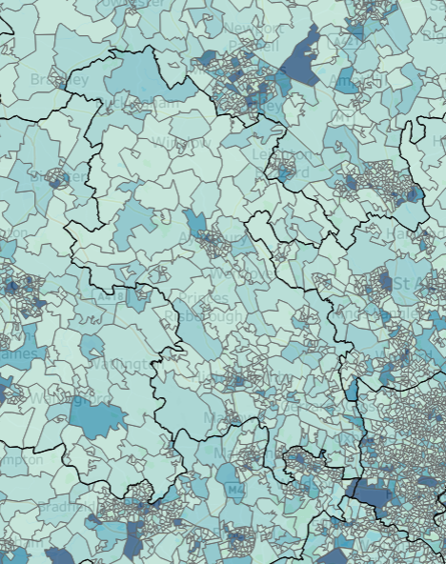
Employment Hotspots Wider area
Milton Keynes
+
Luton
Hemel Hempstead
Areas within commutable distance of Terriers & Amersham Hill where high numbers of jobs are located include: London, Slough, Heathrow and Hemel Hempstead.
Oxford
Slough
Terriers & Amersham Hill
Heathrow
Click here for an interactive map
Source: BRES 2021, ONS

Slide 12
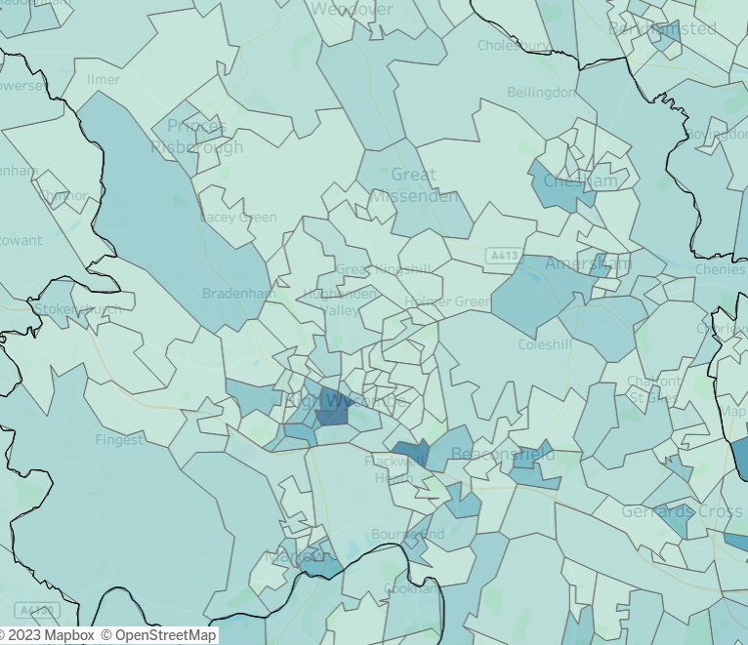
Employment Hotspots Local area
+
More local areas with high concentrations of jobs are highlighted in the darker colours on this map. They include: central High Wycombe, the Cressex Business Park, Loudwater, Marlow, Chesham, Amersham and Beaconsfield.
Terriers & Amersham Hill
Click here for an interactive map
Source: BRES 2021, ONS

Slide 13
Businesses
The highest proportion of businesses in Terriers & Amersham Hill are in the ‘wholesale & retail’ sector, closely followed by ‘real estate’ and ‘professional, scientific & technical’ sectors.
In May 2023, approximately 600 active businesses registered with Companies House¹ had their head office in the Terriers & Amersham Hill ward. Many will not have employees.
The largest proportion of businesses located within the ward are in the ‘wholesale & retail’ sector (14%), similar to the Buckinghamshire and national averages.
This is closely followed by ‘real estate’ (13%), with a proportion higher than the Buckinghamshire and national averages (10%), and ‘professional, scientific & technical’ (13%), with a lower proportion than both the Buckinghamshire (17%) and national (14%) averages.
Terriers & Amersham Hill also has a higher proportion of ‘information & communication’ and ‘financial & insurance’ businesses than the Buckinghamshire and national averages.
¹ Companies House data has been used to estimate the number of businesses at ward level, as other sources (such as ONS’s Inter-Departmental Business Register) do not provide data for 2022 ward geographies at present. Limitations of Companies House data can be found within the Appendix.
Source: Companies House, May 2023

Slide 14
Large employers
There is one key employment site within the ward (see slide 18).
Some of the ward’s larger employers are listed below:
The Royal Grammar School
Sasse Limited
Energizer
Partners& Limited
WaterRower
APMG International
Wilkinson Sword
Risk Management Services
Godstowe Preparatory School
Aspire Schools
Profiles of a selection¹ of businesses situated within the ward are provided on the following slides.
¹See Appendix for details of how these companies were selected

Slide 15
Business profiles
Energizer sells and distributes household products (batteries and lighting products)
Sector: Wholesale
Employee size band: Medium 50-249
http://energizer.com/
Risk Management Services provides security services to industry and commerce.
Sector: Security
Employee size band: Medium 50-249
https://riskmanagementsecurity.co.uk/
Ignite Solutions is a leading accredited retailer and e-tailer sales & marketing service provider.
Sector: Marketing
Employee size band: Small 10-49
https://www.ignite.uk.com/
Partners& Limited advises and sells commercial and personal insurance policies.
Sector: Finance & Insurance
Employee size band: Large 250+
https://www.partnersand.com/
Sasse Limited provides commercial cleaning services.
Sector: Waste Management
Employee size band: Large 250+
https://www.sasse-group.com/
Resinex markets and distributes thermoplastic raw materials within the UK.
Sector: Wholesale
Employee size band: Small 10-49
https://www.resinex.co.uk/
Wilkinson Sword sells and distributes wet shave and skincare products.
Sector: Wholesale
Employee size band: Medium 50-249
https://www.wilkinsonsword.com/
Anduff Car Wash develops and operates conveyor car wash sites across the UK.
Sector: Cleaning
Employee size band: Large 250+
https://www.imocarwash.com/
Source: Beauhurst, 2023

Slide 16
High growth companies (1)
APMG-International runs a professional qualifications exam board, offering qualifications for a range of roles such as project management and IT.
Stage of evolution: Established
Number of employees: 50-249
Incorporation date: 1993
https://apmg-international.com/
There are 8 high growth / high growth potential companies located within the ward.
ARP Electrical provides electrical installation services.
Stage of evolution: Venture
Number of employees: 0-9
Incorporation date: 2016
http://arpelectrical.co.uk/
Chiltern Support and Housing operates as a residential home, and provides a range of home care and transition services, for at-risk adults.
Stage of evolution: Growth
Number of employees: 10-49
Incorporation date: 2008
https://chilternsupport.com/
Maiden Insurance Partnership provides a range of insurance services.
Stage of evolution: Established
Number of employees: 10-49
Incorporation date: 2002
https://www.maideninsurancepartnerships.com/
Source: Beauhurst, 2023

Slide 17
High growth companies (2)
SalaryWise develops financial technology for businesses.
Stage of evolution: Seed
Number of employees: 0-9
Incorporation date: 2021
https://www.salarywise.com/
WaterRower develops and manufactures a water rowing machine.
Stage of evolution: Growth
Number of employees: 50-249
Incorporation date: 2007
https://www.waterrower.co.uk/
Worleys Garage offers new and used cars as well as MOT testing and repair services.
Stage of evolution: Established
Number of employees: 10-49
Incorporation date: 1998
https://www.worleys.co.uk/
ZEN develops software that aims to help donors and beneficiaries monitor charity donations and spending.
Stage of evolution: Seed
Incorporation date: 2009
https://zen-charity.net/
Source: Beauhurst, 2023

Slide 18
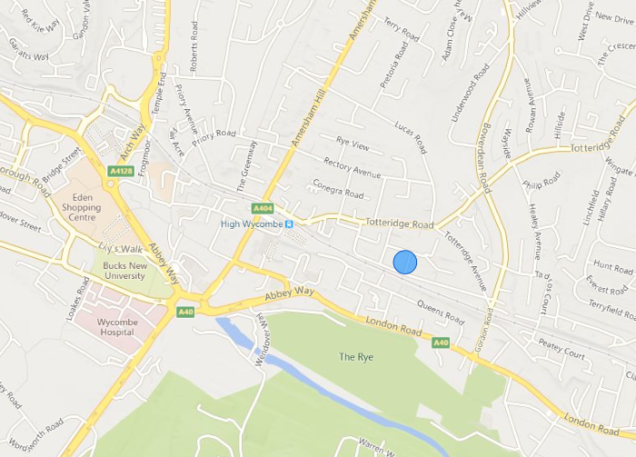
Key employment sites
There is one key employment site within the ward, The Valley Centre.
The Valley Centre
Note: Bubble size reflects the net internal floorspace of the business park properties.
Source: CoStar, 2023

Slide 19
Section 2: Profile of Residents

Slide 20
Age Profile
Terriers & Amersham Hill has a younger age profiles than the Buckinghamshire and national averages
At the time of the Census (2021), approximately 11,000 people lived in the Terriers & Amersham Hill ward, of whom 67% (7,400) were of working age, higher than the Buckinghamshire and national averages of 61% and 63% respectively.
Terriers & Amersham Hill also had a slightly higher proportion of under 16s than the Buckinghamshire and England averages, but a lower proportion of people aged 65 and over.
Base: 11,000 residents
Source: Census, 2021, ONS

Slide 21
Ethnicity
A higher proportion of Terriers & Amersham Hill residents identify as being of Asian, black or mixed ethnicity than the Buckinghamshire and national averages
Terriers & Amersham Hill has a more ethnically diverse population than Buckinghamshire and England as a whole. In 2021, approximately 34% of residents were of Asian, black, mixed or other ethnicity, higher than the county (20%) and national (19%) averages.
21% of Terriers & Amersham Hill residents identified themselves as being of Asian ethnicity, 5% as black and 5% as mixed ethnicity.
Conversely, a smaller proportion of residents (66%) in Terriers & Amersham Hill identified themselves as being of white ethnicity than the county (80%) and national (81%) averages.
Base: 11,000 residents
Note: This data based on individual’s perceived ethnic group and cultural background.
Source: Census, 2021, ONS

Slide 22
Socio-economic classification
The socio-economic classification profile of Terriers & Amersham Hill residents is similar to the county profile.
The socio-economic classification profile of Terriers & Amersham Hill residents is broadly similar to the county profile.
When compared with Buckinghamshire as a whole, a slightly lower proportion of the ward’s residents work in higher managerial, admin and professional occupations, or are small employers and own account workers, than the county average.
A slightly higher proportion have never worked or are long-term unemployed that the county average, and a slightly higher proportion are full-time students.
Base: 7,400 working-age residents
Source: Census, 2021, ONS

Slide 23
Labour market participation
Working-age residents of the ward (excluding full-time students) are slightly less likely to be in employment and slightly more likely to be unemployed than the county average.
Terriers & Amersham Hill’s working-age residents (excluding full-time students) are slightly less likely to be in employment and slightly more likely to be unemployed than the county average. A slightly lower proportion of working-age residents (excluding students) are economically inactive (i.e. not working and not currently seeking work) than the county average.
The unemployment rate at the time of the census (the number of people who are unemployed divided by the number who are economically active (i.e. employed or unemployed)) ¹ was 5.2%.. This was higher than the county average (4.4%) and lower than the national average (5.8%).
Please note, this figure differs from the ‘unemployed’ percentage figure in the chart to the right which shows the proportion of all working-age residents (excluding students) - whether they are economically active or inactive - who are unemployed.
Base: 6,700 working-age residents (excluding full-time students)
¹ This is the official way of measuring unemployment.
Source: Census, 2021, ONS

Slide 24
Labour market participation
The vast majority of working-age Terriers & Amersham Hill residents (excluding full-time students) who are in employment work as employees. 17% are self-employed, the majority of whom employ no other people.
Working-age residents of Terriers & Amersham Hill (excluding full-time students) who are economically inactive, are more likely to be ‘looking after home or family’ than the county and national average. Fewer have taken early retirement.
Base: 5,400 working-age residents (excluding full-time students) who are in employment
Base: 1,000 working-age residents (excluding full-time students) who are economically inactive (i.e. not working and not currently seeking work)
Source: Census, 2021, ONS

Slide 25
Unemployed residents by age and sex
A slightly higher proportion of the ward’s unemployed residents are female than male, the only Opportunity Bucks ward in which this is the case.
A relatively high proportion of unemployed residents are older (over the age of 50)
Base: 280 unemployed residents (excluding full-time students)
Source: Census, 2021, ONS

Slide 26
Economically inactive residents of working age by age and sex
The ward’s economically inactive residents of working age tend to be older, with 4 in 10 being over the age of 50. Few are in the 16–24-year-old age bracket
A higher proportion of the ward’s economically inactive working age residents are female than male
Base: 1,000 economically inactive residents of working age (excluding full-time students)
Source: Census, 2021, ONS

Slide 27
Unemployed residents by ethnicity
The majority of unemployed residents are of white ethnicity
Of the 280 residents classified as unemployed at the time of the 2021 Census, the majority were of white ethnicity (see columns in the chart to the right).
When comparing the unemployed population with the population of the ward as a whole, those who identify themselves as being of black or ‘other ethnic group’ ethnicity are most likely to be unemployed (see dots in the chart to the right), although absolute numbers of residents are small.
Base: 280 unemployed residents (excluding full-time students) and all residents of working age
Source: Census, 2021, ONS

Slide 28
Economically inactive residents by ethnicity
Residents of working age who identify as being of Asian ethnicity were most likely to be economically inactive at the time of the 2021 Census
Of the 1,000 working age residents, excluding full-time students, classified as economically inactive at the time of the 2021 Census, the majority were of white ethnicity followed by those of Asian ethnicity (see columns in the chart to the right).
When comparing the ethnic profile of the ward’s economically inactive population with the ethnic profile of the population of the ward as a whole, those who identify themselves as being of Asian ethnicity are more likely to be economically inactive than those from other ethnic groups (see dots in the chart to the right).
Base: 1,000 economically inactive residents of working age (excluding full-time students)
Source: Census, 2021, ONS

Slide 29
Unemployed residents by highest level of qualification
Over a third of Terriers & Amersham Hill residents who were unemployed at the time of the 2021 Census had a degree (or higher) level qualification. Approximately a fifth had no or level 1 / entry level qualifications.
Over a third (39%) of Terriers & Amersham Hill residents who were unemployed at the time of the 2021 Census had a degree (or higher) level qualification. Approximately a fifth (19%) had no or level 1 / entry level qualifications.
When compared to the qualification levels held by working-age residents (slide 47), those who are unemployed are more likely to have lower-level qualifications.
Base: 280 unemployed residents (excluding full-time students)
Source: Census, 2021, ONS

Slide 30
Economically inactive residents by highest level of qualification
Just over a fifth of Terriers & Amersham Hill working-age residents who were economically inactive at the time of the 2021 Census have no qualifications. With a further 12% having low level qualifications (level 1 and below).
Just over a fifth (22%) of Terriers & Amersham Hill working-age residents who were economically inactive at the time of the 2021 Census have no qualifications. With a further 12% having low level qualifications (level 1 and below).
When compared to the qualification levels held by working-age residents (slide 47), those who are economically inactive are more likely to have no or lower-level qualifications. They are also more likely to have no or lower-level qualifications than those who are unemployed.
Base: 1,000 economically inactive residents of working age (excluding full-time students)
Source: Census, 2021, ONS

Slide 31
Unemployed residents by socio-economic classification
Just over half of the ward’s unemployed residents are classified as long-term unemployed or have never worked.
At the time of the 2021 Census, just over half (53%) of Terriers & Amersham Hill’s unemployed residents had never worked or were long-term unemployed. This was slightly higher than the county average (48%) and slightly lower than the national average (54%).
19% usually work in managerial, admin or professional roles and 17% usually work in semi-routine or routine operations.
Base: 280 unemployed residents (excluding full-time students)
Note, we are unable to replicate this analysis for economically inactive residents of working age.
Source: Census, 2021, ONS

Slide 32
Unemployment-related benefit claimants (the Claimant Count)
The proportion of Terriers & Amersham Hill residents claiming unemployment-related benefits has been higher than the Buckinghamshire average over the last five years.
In April 2023, 270 Terriers & Amersham Hill residents were claiming unemployment-related benefits.
Prior to the onset of the Covid-19 pandemic, the claimant rate¹ for Terriers & Amersham Hill was higher than the Buckinghamshire average but below the national average.
Across all three areas, the claimant rate increased as a result of the Covid-19 pandemic.
In April 2021² the claimant count rate in Terriers & Amersham Hill was 6.1%, higher than the Buckinghamshire average (4.4%), but slightly lower than the national average (6.3%).
By April 2023, Terriers & Amersham Hill’s claimant rate had fallen to 4.0%, but remained higher than the Buckinghamshire average and more than twice the pre-pandemic rate.
¹ Unemployment-related benefit claimants as a proportion of all residents aged 16-64
² Data is presented for the month of April as this is estimated to be the month least affected by job market seasonality
Source: Claimant count, 2023, DWP

Slide 33
Unemployment-related benefit claimants by age
Claimants from Terriers & Amersham Hill are less likely to be aged 25 to 49 than the county and national average and are more likely to be older (aged 50+).
In April 2023, a higher proportion of unemployment-related benefit claimants from Terriers & Amersham hill were over the age of 50 than the county and national averages.
A smaller proportion were aged 25-49, whilst the proportion aged 16-24 was in-line with the county average.
Base: 270 claimants
Source: Claimant count, 2023, DWP

Slide 34
Employment by occupation
The occupational profile of Terriers & Amersham Hill’s employed residents varies slightly from the county profile, with more residents employed in professional occupations but fewer employed in managerial occupations than the county average.
In 2021, the largest occupational group of Terriers & Amersham Hill’s employed residents was ‘professional’. A greater proportion of residents worked in ‘professional’ roles in Terriers & Amersham Hill than the Buckinghamshire and national average.
The second largest occupational group in Terriers & Amersham Hill was ‘associate professional and technical’, which was slightly higher than the Buckinghamshire and national average.
In contrast, a lower proportion of Terriers & Amersham Hill’s residents worked in ‘managers, directors and senior officials’ roles than the Buckinghamshire average.
Across other occupational groups, a slightly higher proportion of ward residents work in ‘sales and customer service’ and ‘elementary’ roles than the Buckinghamshire average.
Base: 5,800 residents over the age of 16 and in employment
Source: Census, 2021, ONS

Slide 35
Employment by industry
A higher proportion of Terriers & Amersham Hill residents work in the ‘wholesale & retail’; ‘information & communication’; ‘education’; ‘human health & social work activities’; and ‘accommodation & food service activities’ than the Buckinghamshire average
In 2021, the three main industries in which ward residents worked were: ‘wholesale and retail’, ‘health and social care’ and ‘education’. A higher proportion of residents work in all three of these industries than the county average.
Residents are also more likely to work in the ‘information & communication’ and ‘hospitality’ sectors than the county average.
Base: 5,800 residents over the age of 16 and in employment
Source: Census, 2021, ONS

Slide 36
Public and private sector employment
A slightly higher proportion of Terriers & Amersham Hill residents are estimated to work in the public sector than the Buckinghamshire average.
As is the case at the county and national level, residents of Terriers & Amersham Hill are estimated* to be more likely to be employed in the private sector than in the public sector.
In 2021, 29% of Terriers & Amersham Hill’s employed residents were estimated to be working in the public sector. This was slightly higher than the Buckinghamshire average (28%) but was slightly lower than the national average (30%).
*Data shown are estimates and should be treated with caution. Public sector employment has been calculated using data for the ‘public administration and defence; compulsory social security’; ‘education’; and ‘human health & social work activities’ SIC sectors. As these sectors are broad, data will include some private sector employment.
Base: 5,800 residents over the age of 16 and in employment
Source: Census, 2021, ONS

Slide 37
Terriers & Amersham Hill ward residents employed by Buckinghamshire NHS
Band | Ward residents | % of residents working in Bucks NHS | Pay range £s | Educational level requirement
Band 2 | 21 | 24% | £22,383 | None
Band 3 | 14 | 16% | £22,816-£24,336 | NVQ L3
Band 4 | 12 | 14% | £25,147-£27,596 | Foundation degree
Band 5 | 20 | 23% | £28,407-£34,581 | Graduate
Band 6 | 21 | 24% | £35,392-£42,618 | Graduate
Band 7 or above | < 10 | n/a | Above £43,742 | Masters or equivalent
Medical staff | < 10 | n/a | £29,384 - £119,133 | Post graduate +
Total (excluding medical staff) | 88 | 100%
In total, approximately 90 residents are employed by Buckinghamshire NHS, a quarter of whom are employed on the lowest pay scale. Approximately half of residents working for the NHS are doing so in graduate-level or above positions.
Source: Bucks NHS (May 2023)

Slide 38
Home working
A lower proportion of Terriers & Amersham Hill residents work from home than the Buckinghamshire average.
In 2021, 37% of Terriers & Amersham Hill’s employed residents worked mainly at or from home. This was a higher proportion than the national average (32%). However, it was lower than the Buckinghamshire average (42%).
Please note that as the 2021 Census took place in March 2021, during a period of rapid change stemming from Covid-19, this data should be treated with caution in terms of future planning.
Base: 5,800 residents over the age of 16 and in employment
Source: Census, 2021, ONS

Slide 39
Distance travelled to work
In 2021, almost a quarter (23%) of Terriers & Amersham Hill residents in employment¹ travelled ‘less than 2km’ to their place of work. This was higher than the Buckinghamshire (18%) and national (20%) average.
A higher proportion of Terriers & Amersham Hill residents travelled ‘2km - 5km’ (22%) than the Buckinghamshire average (17%), however this was slightly lower than the national average (23%).
A higher proportion of residents in Terriers & Amersham Hill and Buckinghamshire travel 30km and over to their place of work than the national average. This is likely primarily due to Buckinghamshire’s close proximity to employment hotspots outside of the county, such as London and Heathrow airport.
In 2011 (latest available data) Buckinghamshire had one of the least ‘self-contained’ labour markets in England. With around a third of working residents travelling out of the county for work, and 28% of all those working within the Buckinghamshire economy travelling into the county from elsewhere.
A higher proportion of Terriers & Amersham Hill residents travel ‘less than 2km’ to work than the Buckinghamshire and national average.
¹ This chart excludes those who work mainly or at home, or work mainly at an offshore installation, in no fixed place, or outside the UK.
Base: 2,900 residents over the age of 16 and in employment who travel to work
Source: Census, 2021, ONS

Slide 40
Method of travel to work
A higher proportion of Terriers & Amersham Hill residents travel ‘on foot’ and by ‘bus, minibus or coach’ to work than the Buckinghamshire average.
In 2021, of the Terriers & Amersham Hill residents who travel to their place of work, just under three quarters (72%) travelled by car or van. This was lower than the Buckinghamshire average (80%), but higher than the national average (71%).
Of those who travel to work, a lower proportion of Terriers & Amersham Hill residents travel by car or van than the Buckinghamshire average.
72%
80%
71%
Terriers & Amersham Hill
Buckinghamshire
England
Looking in more detail at those not travelling by car or van, 14% travel by foot (higher than the county and national averages), and 5% by bus, minibus or coach (lower than the national average but higher than the Buckinghamshire average)
Base: 2,900 residents over the age of 16 and in employment who travel to work
Source: Census, 2021, ONS

Slide 41
Section 3: Barriers to employment

Slide 42
In this section we present data for some potential barriers to sustained employment. These are:
Health status
English language proficiency
Access to childcare provision
Providing unpaid care
Access to a car or van
Highest level of qualifications
There will be additional factors that could be hindering residents’ ability to access sustained employment.

Slide 43
Health status
English language proficiency
Based on responses to the 2021 Census, 12% of those of working-age living in the Terriers & Amersham Hill ward are deemed to be ‘not in good health’.
This was a higher proportion than the county average (11%) but lower than the national average (15%) and equates to approximately 900 people.
Overall, 2.3% of Terriers & Amersham Hill’s working-age residents cannot speak English well or at all. This is higher than the Buckinghamshire (1.2%) and national (2.1%) averages and equates to approximately 170 people.
12%
11%
15%
Terriers & Amersham Hill
Buckinghamshire
England
Base: 7,400 working-age residents
Base: 7,400 working-age residents
Source: Census, 2021, ONS

Slide 44
Childcare Provision
Total number of childcare places offered is approximately equivalent to:
In 2022, Terriers & Amersham Hill had 9 childcare providers registered on the Early Years Register (EYR)¹, offering 352 places at the point of registration². 36 childcare providers are located in wards that neighbour Terriers & Amersham Hill, offering a total of 1,281 places at the point of registration.
The proportion of childcare places offered within the ward compared to the total population of Terriers & Amersham Hill residents aged 5 and under is equivalent to 42%, slightly higher than the 39% Buckinghamshire average³. The proportion for Terriers & Amersham Hill was also higher than the 24% average across the 10 Opportunity Bucks wards where people are experiencing the most hardship.
Alternatively, there are an average of 2 residents aged 5 and under for each childcare place offered in Terriers & Amersham Hill. This was lower than the average across Opportunity Bucks wards and lower than the average for Buckinghamshire.
¹ Ofsted Early Years Register data on childcare provider places covers all places for children up to the 31st August following their fifth birthday. Place numbers mentioned are actual place numbers where recorded, and not estimated place numbers.
² This analysis should be treated with caution as childcare provider data only includes those where a local authority location has been provided. Childminders in particular are likely to withhold the sharing of postcode data.
^{3 *} Approximately 14% of childcare places in Buckinghamshire cannot be assigned to a ward as the provider has redacted their postcode. In order to provide a comparison between wards and county, figures for Buckinghamshire (county) do not include postcode redacting providers. If included, the proportion of childcare places offered in the county would be approximately equivalent to 45% of residents aged 5 and under.
42%
24%
39%*
Terriers & Amersham Hill
Opportunity Bucks wards
Buckinghamshire
…of the total number of residents aged 5 and under.
Or approximately…
2
4
3
…residents aged 5 and under per childcare place offered.
EYR places are available to children aged up to the 31st August following their fifth birthday. The number of residents aged 5 are aged up to 31st December following their fifth birthday.
Source: Ofsted, 2022, Childcare provider level data, Dataset 1
Notes:
Neighbouring wards: Totteridge & Bowerdean; Hazlemere; Tylers Green & Loudwater; Ryemead & Micklefield; Abbey; Downley.

Slide 45
Provision of unpaid care
Terriers & Amersham Hill’s working-age residents are less likely to be providing unpaid care than the county and national averages
In 2021, approximately 560 Terriers & Amersham Hill residents of working age were providing unpaid care¹. This equated to 7.6% of the working age population, lower than the county (9.2%) and national (9.9%) averages.
Base: 7,400 working-age residents
¹ An unpaid carer may look after, give help or support to anyone who has long-term physical or mental ill-health conditions, illness or problems related to old age. This does not include any activities as part of paid employment. This help can be within or outside of the carer's household
Source: Census, 2021, ONS

Slide 46
Access to car or van
A higher proportion of Terriers & Amersham Hill households do not have access to a car or van than the Buckinghamshire average.
In 2021, a higher proportion of Terriers & Amersham Hill households did not have access to a car or van (17%) than the Buckinghamshire average (11%). However, this was lower than the national average of 24%.
44% of households in Terriers & Amersham Hill had access to 1 car or van. This was higher than both the Buckinghamshire (37%) and national (41%) average.
The proportion of Terriers & Amersham Hill households with access to 2 or more cars or vans (39%) was lower than the Buckinghamshire average (51%) but was higher than the national average (35%).
Base: 4,400 households
Source: Census, 2021, ONS

Slide 47
Highest level of qualifications
A higher proportion of Terriers & Amersham residents have Level 4 or above qualifications than the county and national average.
In 2021, 48% of Terriers & Amersham Hill’s working-age population had a Level 4 or higher qualification (see chart). The majority will be degree holders. This was 4 percentage points higher than the Buckinghamshire average, and 11 percentage points higher than the national average. A similar proportion to county and national averages were qualified to Levels 2 and 3.
A similar higher proportion had no qualifications (9%) compared to the Buckinghamshire average (9%) however, the proportion was lower than the national average (12%).
Level | Description
Level 1 | Fewer than 5+ GCSEs / NVQ 1
Level 2 | 5+ GCSEs / NVQ 2 or equivalent
Level 3 | 2+ A-levels / NVQ 3 or equivalent
Level 4+ | HNC, HND, NVQ 4 and 5, degree or higher
Other | Includes Apprenticeships, vocational quals and quals obtained overseas
Base: 7,400 working-age residents
Source: Census, 2021, ONS

Slide 48
Appendix

Slide 49
Glossary
Term | Definition
Unpaid care | An unpaid carer may look after, give help or support to anyone who has long-term physical or mental ill-health conditions, illness or problems related to old age. This does not include any activities as part of paid employment. This help can be within or outside of the carer's household.
Claimants | People claiming Jobseeker's Allowance plus those who claim Universal Credit who are out of work.
Economically active | Those in employment plus those that are unemployed. Those that are unemployed are deemed economically active as they are seeking work and willing and able to accept a job. For further details see the economic activity diagram here.
Economically inactive | Those not in employment and have not been seeking work within recent weeks.
Semi-skilled and blue-collar occupations | Production and maintenance roles
High growth companies | Has met one of Beauhurst’s tracking triggers including: secured equity investment; secured venture debt; underwent a management buyout or buy-in; attended a selected accelerator programme; has been or is a scale-up; spun out of an academic institution; was featured in a selected high-growth list; accepted a large innovation grant
Key employment sites | A business park, retail park or industrial estate.

Slide 50
Data limitations
Data source | Limitations
Companies House | Data is sourced from the information that companies submit to Companies House. Submitted data is not checked or verified by Companies House. This includes SIC codes, which are chosen by a company to designate which industry they are active in. A company is expected to choose an appropriate SIC code, however it may not accurately reflect their business activities. A company can also be both ‘active’ and classified as a dormant company not trading under SIC code 9999 (dormant companies have been removed from analysis in this resource). Companies House figures are also likely to be overestimated as a single parent trading company can register multiple subsidiaries. A company can also be added to the register before it begins trading.
Claimant Count | The claimant count is a proxy measure for unemployment. It is useful because it is produced at a granular geographic level (e.g. ward level) and is timely (produced monthly). When using claimant count data be aware that not all those who are unemployed will claim unemployment-related benefits. And not all claimants are unemployed. Some will be working but on low incomes / few hours and therefore will be entitled to claim unemployment-related benefits.
Estimates of public and private sector employment | Data shown are estimates and should be treated with caution. Public sector employment has been calculated using data for the ‘public administration and defence; compulsory social security’; ‘education’; and ‘human health & social work activities’ Standard Industrial Classification (SIC) code sectors. As these sectors are broad, data will include some private sector employment.

Slide 51
Other information
Data source | Information
Business profiles | Businesses selected are mainly those with the highest level of turnover and/or the highest number of employees. The employee size band refers to the company-wide workforce, therefore not all jobs will be Buckinghamshire-based. In addition, some profiles of other ‘typical’ businesses in an area have been profiles, along with some businesses operating within the county’s strategic growth sectors.

