Slide 1

Ryemead & Micklefield
Economic Ward Profile
August 2023

Slide 2
About this profile
Buckinghamshire LEP have produced a set of economic profiles for the 10 wards of Buckinghamshire where people are experiencing the most hardship to inform the work of the Opportunity Bucks programme. The 10 wards are:
This profile is for the Ryemead & Micklefield ward in High Wycombe.
It sets out:
An overview of the local economy (including key businesses, employment hotspots, high growth firms and key employment sites)
A profile of residents (including demographics and labour market status)
Analysis of potential barriers to employment (including health, transport, caring responsibilities, English language proficiency, qualifications and childcare)
The majority of data presented within this profile is from the 2021 Census (ONS). Other data sources used are: childcare provider data (Ofsted); claimant count (DWP); business data (Companies House); data on high growth firms (Beauhurst); the Business Register and Employment Survey (ONS) and property data (CoStar).
Most data is rounded to the nearest 100.
Town | Ward
Aylesbury | Aylesbury North Aylesbury North-West Aylesbury South-West
Chesham | Chesham
High Wycombe | Abbey Booker, Cressex & Castlefield Ryemead & Micklefield Terriers & Amersham Hill Totteridge & Bowerdean West Wycombe
Maps showing the location of each ward can be found here

Slide 3
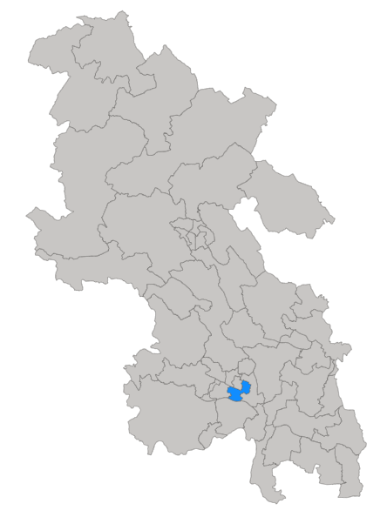
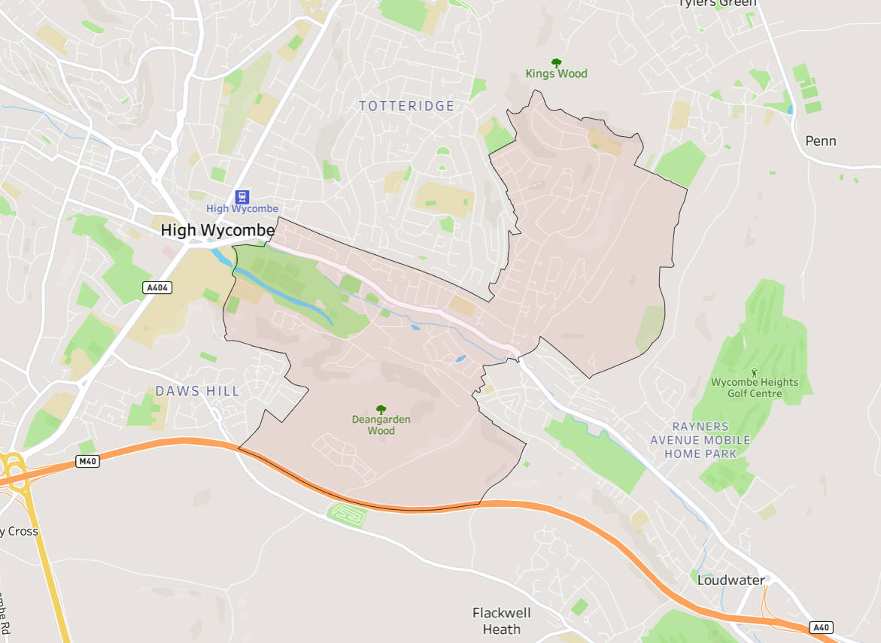
Ryemead & Micklefield ward is located in High Wycombe, to the south-east of the town centre (see maps below).
Click here for interactive map

Slide 4
Fast facts
11,500 residents
4,700 households
7,600 residents of working age (16-64)
700 active companies²
5.3% unemployment rate (March 2021)
4 key employment sites³
315 people claiming unemployment-related benefits (the Claimant Count)¹ (April 2023)
1,100 economically inactive residents of working age (excluding students)
2 high growth / high growth potential companies⁴
¹ DWP, via NOMIS
² Companies House
³ Bucks LEP
⁴Beauhurst
All data from Census 2021, ONS, unless otherwise stated

Slide 5
Key statistics
 | Ryemead & Micklefield | Buckinghamshire | England | Ward v Bucks average | Rank (of all 49 Buckinghamshire wards)
Employment rate (no. of working-age residents in employment / no. of working age residents – excluding students) | 80% | 81% | 77% | -1 percentage point | 37th
Unemployment rate (no. of working-age residents who are unemployed / no. of working age residents who are economically active – i.e. employed or unemployed) | 5.3% | 4.4% | 5.8% | +0.9 percentage points | 7th
Claimant count rate¹ (no. of claimants / working age population) | 4.4% | 2.6% | 3.8% | +1.8 percentage points | 4th
% of working age never worked or long-term unemployed | 6% | 5% | 7% | +1 percentage points | 10th
% of working age employed in routine occupations | 9% | 8% | 11% | +1 percentage points | 8th
% of working age with below Level 2 qualifications | 21% | 18% | 22% | +3 percentage points | 9th
% not in good health | 13% | 11% | 15% | +2 percentage points | 7th
Under 5s per childcare place² | 14 | 3 | 4 | +11 | 46th *
All data from Census 2021, ONS, unless otherwise stated
¹ DWP, via NOMIS
² Ofsted
* Out of 48 Buckinghamshire wards (rank not available for Chesham ward)

Slide 6
What the data tells us
The ward is mainly residential but has some employment sites including four business parks and retail units (mainly occupied by national chains) located along the A40
The ward has a mixed economy, with a few medium-to-large employers.
The ward is home to a younger and more ethnically diverse population than the Buckinghamshire average.
Working-age residents of the ward (excluding full-time students) are slightly less likely to be in employment and slightly more likely to be unemployed than the county average.
.
Of those who are economically inactive, a greater proportion are ‘looking after home or family’ than the county or national average.
It is estimated that there is less childcare provision within the Ryemead & Micklefield ward than the county average.
Residents of the ward are more likely to be unemployed and are more likely to be claiming unemployment-related benefits than the county average.
Residents more likely to be unemployed include: men; those with lower-level qualifications; and those from ethnic minority groups.
A higher proportion of Ryemead & Micklefield households do not have access to a car or van than the Buckinghamshire average. And a higher proportion travel between 2 and 5km to work.

Slide 7

Issues for exploration
Improving connections between local employers and the resident population. Working with employers to understand their recruitment challenges and providing support to help them develop more flexible recruitment approaches to attract and develop pathways into work for lower skilled residents and/or those with complex needs.
Maximising occupancy of key employment sites to provide more jobs within walking distance for residents, given lower than average levels of access to a car or van and lower than average proportion of residents travelling less than 2km to work.
Expansion of key employment sites to provide more jobs within walking distance for residents, for the reasons outlined above.
Increasing childcare provision within the ward to make it easier for parents to work, given that higher proportions of economically inactive residents of working-age are ‘looking after home/family’ and indications are that childcare provision is relatively scare.
Understanding the extent to which bus services are connecting residents to key existing and future employment sites, to ensure routes / timetables are maintained, or are improved.
Targeting of tailored interventions for who are unemployed or economically inactive but would like a job but face specific or multiple barriers.

Slide 8
Section 1: The Local Economy

Slide 9
Local economic context
Buckinghamshire’s recent economic performance has been broadly on par with the national average, both in terms of economic output (GVA) per head of population and productivity (GVA per hours worked in the local economy) ¹.
However, the local economy experienced slower-than-average growth over the last two decades and has been more susceptible to adverse economic events (i.e. the great financial crisis of 2008 and the Covid-19 pandemic in 2020/21). Economic growth is important because a growing economy can help facilitate improvements in the economic position of families and individuals, particularly those on low-to-middle incomes.
As is the case nationally, the Buckinghamshire economy is dominated by the service sector, and by Small and Medium-sized Enterprises (SMEs). However, Buckinghamshire’s SMEs play a more important role in the local economy than nationally, generating 58% of all jobs (compared with 46% nationally) ². Buckinghamshire has higher levels of self-employment than the national average, although the number of residents classified as self-employed has dropped in recent years ³.
For more information about the Buckinghamshire economy, please visit the Buckinghamshire Economic Intelligence Observatory website – www.buckseconomy.co.uk
¹ Regional gross value added (balanced) by industry: city and enterprise regions and Subregional productivity: labour productivity indices by economic enterprise region, 2023, ONS
² Inter Departmental Business Register, 2022. ONS
³ Annual Population Survey, Jan – Dec 2022, ONS

Slide 10
Structure of the local economy
The health, business admin & support, retail and professional, scientific & technical sectors provide the greatest number of jobs in the High Wycombe & Aylesbury area. The latter three being more significant providers of jobs locally than nationally.
Ryemead & Micklefield is situated within the High Wycombe & Aylesbury travel to work area (TTWA)¹. This area roughly covers the southern two-thirds of the county of Buckinghamshire.
The health, business admin & support, retail and professional, scientific & technical sectors provide the greatest number of jobs in the High Wycombe & Aylesbury TTWA. The latter three being more significant providers of jobs locally than nationally. Whilst employing fewer people, the wholesale, construction and information & communication sectors are also more significant locally than nationally. The latter includes the film and TV industry, a significant and growing sector with a nucleus at Pinewood Studios. Outside of the county, significant employment areas within commuting distance include London, Slough and Heathrow Airport.
Employment hotspots are shown on the maps on the two following slides.
¹A travel to work area is a collection of wards for which "of the resident east 75% actually work in the area, and also, that of everyone working in the area, at least 75% actually live in the area".
Source: BRES 2021, ONS

Slide 11
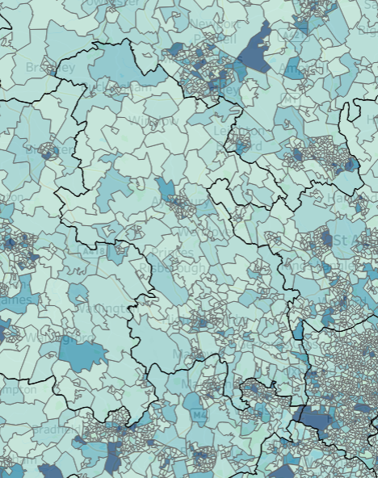
Employment Hotspots
Wider area
Milton Keynes
+
Luton
Hemel Hempstead
Areas within commutable distance of Ryemead & Micklefield where high numbers of jobs are located include: London, Slough, Heathrow and Hemel Hempstead.
Oxford
Slough
Ryemead & Micklefield
Heathrow
Click here for an interactive map
Source: BRES 2021, ONS

Slide 12
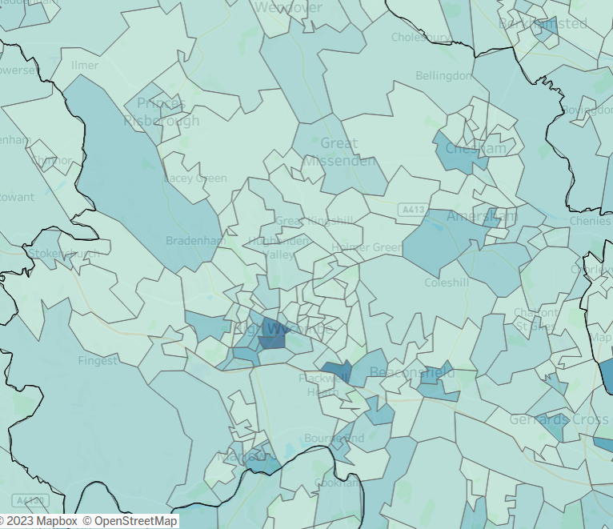
Employment Hotspots
Local area
+
More local areas with high concentrations of jobs are highlighted in the darker colours on this map. They include: central High Wycombe, the Cressex Business Park, Loudwater, Marlow, Chesham, Amersham and Beaconsfield.
Ryemead & Micklefield
Click here for an interactive map
Source: BRES 2021, ONS

Slide 13
Businesses
As with Buckinghamshire as a whole, the highest proportion of businesses in Ryemead & Micklefield are in the ‘professional, scientific & technical’ sector.
In May 2023, approximately 700 active businesses registered with Companies House¹ had their head office in the Ryemead & Micklefield ward. Many will not have employees.
The largest proportion of businesses located within the ward were in the ‘professional, scientific & technical’ sector (18%), higher than both the Buckinghamshire (17%) and national (14%) averages. The second highest proportion were in the ‘information & communication’ sector (14%), higher than the Buckinghamshire (11%) and national (9%) averages.
The ward has fewer businesses in the ‘wholesale & retail’ sectors than the county average, but more operating in the ‘education’ and ‘transport & storage’ sectors.
¹ Companies House data has been used to estimate the number of businesses at ward level, as other sources (such as ONS’s Inter-Departmental Business Register) do not provide data for 2022 ward geographies at present. Limitations of Companies House data can be found within the Appendix.
Source: Companies House, May 2023

Slide 14
Large employers
There are four key employment sites within the ward (see slide 17).
Some of the ward’s larger employers are listed below:
  NHS (adult mental health services)
  Tesco
  Lidl
  Optima
  Tetra Pak
  TVF Ltd
  OAG
  Asolvi
  Star Micronics
  Ryeview Manor Care Home
Profiles of a selection¹ of businesses situated within the ward are provided on the following slides.
¹See Appendix for details of how these companies were selected

Slide 15








Business profiles
Optima Contracting – leading international glass partitioning manufacturer providing glass partitions and doors.
Sector: Construction
Employee size band: Large 250+
http://optimasystems.com/
Star Micronics – manufacturer of point of sale hardware thermal and dot matrix receipt printers, ticket, barcode and label printers for the retail and hospitality industries.
Sector: Manufacturing
Employee size band: Small 10-49
OAG – design, supply and installation of specialist architectural glazing solutions.
Sector: Construction
Employee size band: Medium 50-249
http://oag.uk.com/
Tetra Pak Processing – suppliers of packaging material for liquid foods and the supply and installation of filling and distribution equipment for the liquid food industry.
Sector: Wholesale
Employee size band: Medium 50-249
http://tetrapak.com/
Asolvi UK – Development and sale of computer software products.
Sector: Information Technology
Employee size band: Medium 50-249
http://asolvi.com/
TVF (UK) – Fire protection equipment and the provision of associated maintenance services.
Sector: Fire Service Activities
Employee size band: Medium 50-249
https://tvfltd.co.uk/
The Chalfonts Independent Grammar School
Sector: Secondary Education
Employee size band: Small 10-49
https://www.thechalfontsgrammar.co.uk/
Multipond – Sale of machinery principally to the food industry.
Sector: Wholesale
Employee size band: Small 10-49
http://multipond.com/
Source: Beauhurst, 2023

Slide 16


High growth companies
There are two high growth / high growth potential companies located within the Ryemead & Micklefield ward
Sky Medical Technology develops bioelectronic devices integrated with OnPulse neuromodulation technology to prevent and treat a wide range of acute and chronic circulatory conditions.
Stage of evolution: Established
Number of employees: 25-49
https://skymedtech.com/
Bradbury Tracks manufactures bespoke curtain rails, blinds, and other similar window furnishings.
Stage of evolution: Established
Number of employees: 10-24
https://www.bradburytracks.co.uk/
Source: Beauhurst, 2023

Slide 17
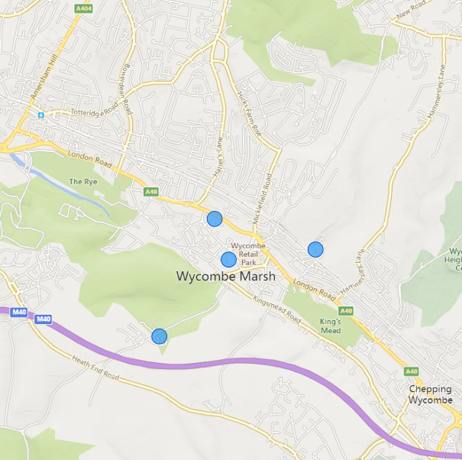
Key employment sites
The map to the right shows the location of key employment sites (business parks, industrial estates and shopping centres) in the Ryemead & Micklefield ward
1. Peregrine Business Park
2. Wye Industrial Estate
2
3. High Wycombe Business Park
1
3
4. Abbey Barn Business Centre
4
Note: Bubble size reflects the net internal floorspace of the business park properties.
Source: CoStar, 2023

Slide 18
Section 2: Profile of Residents

Slide 19
Age Profile
A higher proportion of Ryemead & Micklefield residents are of working age (16-64) than the Buckinghamshire and national averages
At the time of the Census (2021), approximately 11,500 people lived in the Ryemead & Micklefield ward, of whom 66% (8,900) were of working age, higher than the Buckinghamshire and national averages of 61% and 63% respectively.
Ryemead & Micklefield also had a higher proportion of under 16s (22%) than the Buckinghamshire (20%) and England (19%) averages, but a lower proportion of people aged 65 and over, (12%) compared with the Buckinghamshire (19%) and national (18%) averages.
Base: 11,500 residents
Source: Census, 2021, ONS

Slide 20
Ethnicity
A higher proportion of Ryemead & Micklefield residents identify as being of Asian, black or mixed ethnicity than the Buckinghamshire and national averages
Ryemead & Micklefield has a more ethnically diverse population than Buckinghamshire and England as a whole. In 2021, approximately 32% of residents were of Asian, black, mixed or other ethnicity, higher than the county (20%) and national (19%) averages.
16% of Ryemead & Micklefield residents identify themselves as being of Asian ethnicity, 7% as black and 6% as of mixed ethnicity.
Conversely, a smaller proportion of ward residents (68%) in identify themselves as being of white ethnicity than the county (80%) and national (81%) averages.
Base: 11,500 residents
Note: This data based on individual’s perceived ethnic group and cultural background.
Source: Census, 2021, ONS

Slide 21
Socio-economic classification
A higher proportion of Ryemead & Micklefield’s working-age population work in semi-routine or routine occupations than the county average, and fewer in higher managerial, admin or professional roles.
The socio-economic classification profile of Ryemead and Micklefield residents is broadly similar to the national profile.
When compared with Buckinghamshire as a whole, a higher proportion of the ward’s residents usually work in semi-routine or routine occupations than the county average, and fewer in higher managerial, admin or professional roles. A slightly higher proportion have never worked or are long-term unemployed that the county average. Although the figure is slightly below the national average.
Base: 7,600 working-age residents
Source: Census, 2021, ONS

Slide 22
Labour market participation
Working-age residents of the ward (excluding full-time students) are slightly less likely to be in employment and slightly more likely to be unemployed than the county average.
Ryemead and Micklefield’s working-age residents (excluding full-time students) are slightly less likely to be in employment and slightly more likely to be unemployed than the county average. A similar proportion of working-age residents (excluding students) are economically inactive (i.e. not working and not currently seeking work) as the county average.
The unemployment rate at the time of the census (the number of people who are unemployed divided by the number who are economically active (i.e. employed or unemployed)) ¹ was 5.3%. This was higher than the county average (4.4%) and lower than the national average of (5.8%).
Please note, this figure differs from the ‘unemployed’ percentage figure in the chart to the right which shows the proportion of all working-age residents (excluding students) - whether they are economically active or inactive - who are unemployed.
Base: 7,000 working-age residents (excluding full-time students)
¹ This is the official way of measuring unemployment.
Source: Census, 2021, ONS

Slide 23
Labour market participation
The vast majority of working-age Ryemead & Micklefield residents (excluding full-time students) who are in employment work as employees. 16% are self-employed, the majority of whom employ no other people.
Working-age residents of Ryemead & Micklefield (excluding full-time students) who are economically inactive, are more likely to be ‘looking after home or family’ than the county and national average. Fewer have taken early retirement.
Base: 5,600 working-age residents (excluding full-time students) who are in employment
Base: 1,110 working-age residents (excluding full-time students) who are economically inactive (i.e. not working and not currently seeking work)
Source: Census, 2021, ONS

Slide 24
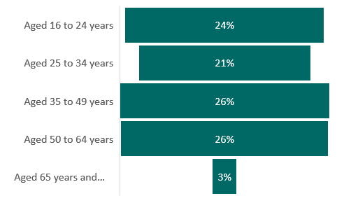
Unemployed residents by age and sex
The ward’s unemployed residents are fairly evenly distributed across the four main age bands
A higher proportion of the ward’s unemployed residents are male than female
Base: 300 unemployed residents (excluding full-time students)
Source: Census, 2021, ONS

Slide 25
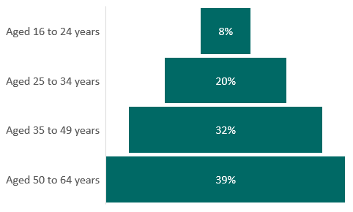
Economically inactive residents of working age by age and sex
The ward’s economically inactive residents of working age tend to be older, with 4 in 10 being over the age of 50. Few are in the 16–24-year-old age bracket
A higher proportion of the ward’s economically inactive working age residents are female than male
Base: 1,100 economically inactive residents of working age (excluding full-time students)
Source: Census, 2021, ONS

Slide 26
Unemployed residents by ethnicity
The majority of unemployed residents are of white ethnicity
Of the 300 residents classified as unemployed at the time of the 2021 Census, the majority were of white ethnicity, followed by those of Asian ethnicity (see columns in the chart to the right).
When comparing the ethnic profile of the ward’s unemployed population with the ethnic profile of the population of the ward as a whole, those who identify themselves as being mixed or multiple ethnicity are more likely to be unemployed than those from other ethnic groups (see dots in the chart to the right).
Base: 300 unemployed residents (excluding full-time students) and all residents of working age
Source: Census, 2021, ONS

Slide 27
Economically inactive residents by ethnicity
Residents of working age who identify as being of Asian ethnicity were most likely to be economically inactive at the time of the 2021 Census
Of the 1,100 working age residents (excluding full-time students) classified as being economically inactive at the time of the 2021 Census, the majority were of white ethnicity, followed by those of Asian ethnicity (see columns in the chart to the right).
When comparing the ethnic profile of the ward’s economically inactive population with the ethnic profile of the population of the ward as a whole, those who identify themselves as being of Asian ethnicity are more likely to be economically inactive than those from other ethnic groups (see dots in the chart to the right).
Base: 1,100 economically inactive residents of working age (excluding full-time students)
Source: Census, 2021, ONS

Slide 28
Unemployed residents by highest level of qualification
Over a quarter of Ryemead & Micklefield residents who were unemployed at the time of the 2021 Census had a degree (or higher) level qualification. Approximately a third had no or level 1 / entry level qualifications.
Over a quarter of Ryemead & Micklefield residents who were unemployed at the time of the 2021 Census had a degree (or higher) level qualification. Approximately a third (32%) had no or only level 1 / entry level qualifications.
When compared to the qualification levels held by all working-age residents (slide 46), those who are unemployed are more likely to have lower-level qualifications.
Base: 300 unemployed residents (excluding full-time students)
Source: Census, 2021, ONS

Slide 29
Economically inactive residents by highest level of qualification
A quarter of Ryemead & Micklefield working-age residents who were economically inactive at the time of the 2021 Census have no qualifications. With a further 16% having low level qualifications (level 1 and below).
A quarter of Ryemead & Micklefield ward’s working-age residents who were economically inactive at the time of the 2021 Census have no qualifications. With a further 16% having low level qualifications (level 1 and below).
When compared to the qualification levels held by working-age residents (slide 46), those who are economically inactive are much more likely to have no or lower-level qualifications. They are also much more likely to have no or lower-level qualifications than those who are unemployed.
Base: 1,100 economically inactive residents of working age (excluding full-time students)
Source: Census, 2021, ONS

Slide 30
Unemployed residents by socio-economic classification
Just over half of the ward’s unemployed residents are classified as long-term unemployed or have never worked.
At the time of the 2021 Census, just over half (53%) of Ryemead & Micklefield’s unemployed residents had never worked or were long-term unemployed. This was higher than the county average (48%) and slightly lower than the national average (54%).
17% usually worked in managerial, admin or professional roles and 17% usually worked in semi-routine or routine operations.
Base: 300 unemployed residents (excluding full-time students)
Note, we are unable to replicate this analysis for economically inactive residents of working age.
Source: Census, 2021, ONS

Slide 31
Unemployment-related benefit claimants (the Claimant Count)
The proportion of Ryemead & Micklefield residents claiming unemployment-related benefits has been higher than both the Buckinghamshire and national averages during the last three years. Rates more than tripled between 2019 and 2021, before slowly declining to 2023
In April 2023, 315 Ryemead & Micklefield residents were claiming unemployment-related benefits.
Prior to the onset of the Covid-19 pandemic, the claimant rate¹ for Ryemead & Micklefield was higher than the Buckinghamshire average but below the national average.
Across all three areas, the claimant rate increased as a result of the Covid-19 pandemic. Between 2019 and 2021, the increase in the claimant rate for Ryemead & Micklefield outpaced the Buckinghamshire and national average.
In April 2021² the claimant count rate in Ryemead & Micklefield was 7.4%, far higher than the Buckinghamshire average (4.4%) and higher than the national average (6.3%).
By April 2023, Ryemead & Micklefield’s claimant rate had fallen to 4.4%, but remained higher than the county and national averages and more than twice the pre-pandemic rate.
¹ Unemployment-related benefit claimants as a proportion of all residents aged 16-64
² Data is presented for the month of April as this is estimated to be the month least affected by job market seasonality
Source: Claimant count, 2023, DWP

Slide 32
Unemployment-related benefit claimants by age
Claimants from Ryemead & Micklefield are more likely to be aged 25 to 49 than the county and national average.
Claimants from Ryemead & Micklefield are more likely to be aged 25-49 than the county and national average, which is likely to reflect the age profile of the ward.
Of note is the higher proportion of claimants aged 40-44 in Ryemead & Micklefield (16%) compared to the Buckinghamshire (12%) and national average (11%).
The proportion of claimants aged 50+ in Ryemead & Micklefield (22%) is lower than the Buckinghamshire (26%) and national (23%) average.
Base: 315 claimants
Source: Claimant count, April 2023, DWP

Slide 33
Employment by occupation
The occupational profile of Ryemead & Micklefield’s employed residents is very similar to the national picture. It does vary from the county profile however, with fewer residents employed in managerial, professional and associate professional roles than the Buckinghamshire average.
In 2021, the largest occupational group of Ryemead & Micklefield’s employed residents was ‘professional’. However, a slightly smaller proportion of residents worked in professional roles than the Buckinghamshire average.
The second largest occupational group in Ryemead & Micklefield was ‘associate professional & technical’, but again with a slightly smaller proportion of residents than the Buckinghamshire average.
The largest difference occurs in ‘managers, directors and senior official’ roles. Whilst the 14% proportion in Ryemead & Micklefield was slightly higher than the 13% national average, it was much lower than the 19% Buckinghamshire average.
Base: 5,900 residents over the age of 16 and in employment
Source: Census, 2021, ONS

Slide 34
Employment by industry
A higher proportion of Ryemead & Micklefield residents work in the wholesale & retail; health & social care; admin & support services; transport & storage; and hospitality industries than the Buckinghamshire average
A higher proportion of Ryemead & Micklefield residents work in the county’s two largest industries (in terms of employment), ‘wholesale & retail’ and ‘health and social care’.
A slightly higher proportion also work within the ‘construction’, ‘manufacturing’, ‘transport & storage’, ‘hospitality’ and ‘admin and support services’ industries than the county average.
A lower proportion of residents work in the ‘professional, scientific & technical’ and ‘public admin’ sectors than the county average.
Base: 5,900 residents over the age of 16 and in employment
Source: Census, 2021, ONS

Slide 35
Public and private sector employment
A lower proportion of Ryemead & Micklefield’s employed residents are estimated to work in the public sector than the Buckinghamshire and national average.
As is the case at the county and national level, residents of Ryemead & Micklefield are estimated* to be more likely to be employed in the private sector than in the public sector.
In 2021, 27% of Ryemead & Micklefield residents aged 16 and over and in employment were estimated to be working in the public sector. This was slightly lower than the Buckinghamshire (28%) and national (30%) average.
*Data shown are estimates and should be treated with caution. Public sector employment has been calculated using data for the ‘public administration and defence; compulsory social security’; ‘education’; and ‘human health & social work activities’ SIC sectors. As these sectors are broad, data will include some private sector employment.
Base: 5,900 residents over the age of 16 and in employment
Source: Census, 2021, ONS

Slide 36
Ryemead & Micklefield residents employed by Buckinghamshire NHS
Band | Ward residents | % of residents working in Bucks NHS | Pay range £s | Educational level requirement
Band 2 | 24 | 24% | £22,383 | None
Band 3 | 10 | 10% | £22,816-£24,336 | NVQ L3
Band 4 | 12 | 12% | £25,147-£27,596 | Foundation degree
Band 5 | 22 | 22% | £28,407-£34,581 | Graduate
Band 6 | 13 | 13% | £35,392-£42,618 | Graduate
Band 7 or above | 17 | 17% | Above £43,742 | Masters or equivalent
Medical staff | < 10 | n/a | £29,384 - £119,133 | Post graduate +
Total (excluding medical staff) | 98 | 100%
In total, approximately 100 residents are employed by Buckinghamshire NHS, a quarter of whom are employed on the lowest pay scale. Just over half of residents working for the NHS are doing so in graduate-level positions.
Source: Bucks NHS (May 2023)

Slide 37
Home working
A lower proportion of Ryemead & Micklefield residents work from home than the Buckinghamshire average.
In 2021, 34% of Ryemead & Micklefield residents in employment worked mainly at or from home. This was a slightly higher proportion than the national average (32%). However, it was lower than the Buckinghamshire average (42%).
Please note that as the 2021 Census took place in March 2021, during a period of rapid change stemming from Covid-19, this data should be treated with caution in terms of future planning.
Base: 5,900 residents over the age of 16 and in employment
Source: Census, 2021, ONS

Slide 38
Distance travelled to work
In 2021, almost a third (31%) of Ryemead & Micklefield residents in employment¹ travelled ‘2 to 5km’ to their place of work. This was much higher than the Buckinghamshire (17%) and national (23%) average.
A lower proportion of Ryemead & Micklefield residents travelled ‘less than 2km’ (14%) than the Buckinghamshire (18%) and national (20%) average.
A higher proportion of residents in Ryemead & Micklefield and Buckinghamshire travelled 30km and over to their place of work than the national average. This is likely primarily due to Buckinghamshire’s close proximity to employment hotspots outside of the county, such as London and Heathrow airport.
In 2011 (latest available data at the time of writing) Buckinghamshire had one of the least ‘self-contained’ labour markets in England. With around a third of working residents travelling out of the county for work, and 28% of all those working within the Buckinghamshire economy travelling into the county from elsewhere.
A much higher proportion of Ryemead & Micklefield residents aged 16 and over and in employment travelled ‘2 to 5km’ to work than the Buckinghamshire and national average.
¹ This chart excludes those who work mainly or at home, or work mainly at an offshore installation, in no fixed place, or outside the UK.
Base: 3,100 residents over the age of 16 and in employment who travel to work
Source: Census, 2021, ONS

Slide 39
Method of travel to work
In 2021, of the Ryemead & Micklefield residents who travelled to their place of work, just over three quarters (77%) travelled by car or van. This was lower than the Buckinghamshire average (80%), but higher than the national average (71%).
A much higher proportion of Ryemead & Micklefield residents travel by ‘bus, minibus or coach’ to work than the Buckinghamshire average.
Of those who travel to work, a lower proportion of Ryemead & Micklefield residents travelled by car or van than the Buckinghamshire average.
77%
80%
71%
Ryemead & Micklefield
Buckinghamshire
England
Looking in more detail at those not travelling by car or van, 8% travel by foot (lower than the county and national averages), and 6% by bus, minibus or coach (in line with the national average but higher than the Buckinghamshire average).
Base: 3,100 residents over the age of 16 and in employment who travel to work
Source: Census, 2021, ONS

Slide 40
Section 3: Barriers to employment

Slide 41
In this section we present data for some potential barriers to sustained employment. These are:
  Health status
  English language proficiency
  Access to childcare provision
  Providing unpaid care
  Access to a car or van
  Highest level of qualifications
There will be additional factors that could be hindering residents’ ability to access sustained employment.

Slide 42
Health status
English language proficiency
Based on responses to the 2021 Census, 13% of those of working-age living in the Abbey ward are deemed to be ‘not in good health’.
This is a higher proportion than the county average (11%) but lower than the national average (15%) and equates to approximately 1,000 people.
Overall, 1.7% of Ryemead & Micklesfield’s working-age residents cannot speak English well or at all. This is higher than the Buckinghamshire average (1.2%) but lower than the national average (2.1%) and equates to approximately 130 people.
13%
11%
15%
Ryemead & Micklefield
Buckinghamshire
England
Base: 7,600 working-age residents
Base: 7,600 working-age residents
Source: Census, 2021, ONS

Slide 43

Childcare Provision
Total number of childcare places offered is approximately equivalent to:
In 2022, Ryemead & Micklefield had two childcare providers registered on the Early Years Register (EYR)¹, offering 74 places at the point of registration². 36 childcare providers are located in wards that neighbour Ryemead & Micklefield, offering a total of 1,281 places at the point of registration.
The proportion of childcare places offered within the ward compared to the total population of Ryemead & Micklefield residents aged 5 and under is equivalent to 7%, lower than the 39% Buckinghamshire average³. The proportion for Ryemead & Micklefield is also lower than the 24% average across the 10 Opportunity Bucks wards where people are experiencing the most hardship.
Alternatively, there are an average of 14 residents aged 5 and under for each childcare place offered in Ryemead & Micklefield. This was higher than the average across Opportunity Bucks wards and the average for Buckinghamshire.
¹ Ofsted Early Years Register data on childcare provider places covers all places for children up to the 31st August following their fifth birthday. Place numbers mentioned are actual place numbers where recorded, and not estimated place numbers.
² This analysis should be treated with caution as childcare provider data only includes those where a local authority location has been provided. Childminders in particular are likely to withhold the sharing of postcode data.
^{3 *} Approximately 14% of childcare places in Buckinghamshire cannot be assigned to a ward as the provider has redacted their postcode. In order to provide a comparison between wards and county, figures for Buckinghamshire (county) do not include postcode redacting providers. If included, the proportion of childcare places offered in the county would be approximately equivalent to 45% of residents aged 5 and under.
7%
24%
39%*
Ryemead & Micklefield
Opportunity Bucks wards
Buckinghamshire
…of the total number of residents aged 5 and under.
Or approximately…
14
4
3
…residents aged 5 and under per childcare place offered.
EYR places are available to children aged up to the 31st August following their fifth birthday. The number of residents aged 5 are aged up to 31st December following their fifth birthday.
Source: Ofsted, 2022, Childcare provider level data, Dataset 1
Notes:
Neighbouring wards: Tylers Green & Loudwater, Totteridge & Bowerdean, Terriers & Amersham Hill, Abbey.

Slide 44
Provision of unpaid care
Ryemead & Micklefield’s working-age residents are slightly less likely to be providing unpaid care than the county and national averages
In 2021, approximately 620 Ryemead & Micklefield residents of working age were providing unpaid care¹. This equated to 8.2% of the working age population, lower than the county (9.2%) and national (9.9%) averages.
Base: 7,600 working-age residents
¹ An unpaid carer may look after, give help or support to anyone who has long-term physical or mental ill-health conditions, illness or problems related to old age. This does not include any activities as part of paid employment. This help can be within or outside of the carer's household
Source: Census, 2021, ONS

Slide 45
Access to car or van
A higher proportion of Ryemead & Micklefield households do not have access to a car or van than the Buckinghamshire average.
In 2021, a higher proportion of Ryemead & Micklefield households did not have access to a car or van (16%) than the Buckinghamshire average (11%). However, this was lower than the national average of 24%.
44% of households in Ryemead & Micklefield had access to 1 car or van. This was higher than both the Buckinghamshire (37%) and national (41%) average.
The proportion of Ryemead & Micklefield households with access to 2 or more cars or vans (39%) was lower than the Buckinghamshire average (51%) but was higher than the national average (35%).
Base: 4,700 households
Source: Census, 2021, ONS

Slide 46
Highest level of qualifications
A slightly higher proportion of Ryemead & Micklefield residents have no or only low (level 1 & entry) level qualifications than the county average.
In 2021, 41% of Ryemead & Micklefield’s working-age population had a Level 4 or higher qualification (see chart). The majority will be degree holders. This was three percentage points lower than the Buckinghamshire average but was four percentage points higher than the national average. A similar proportion to county and national averages were qualified to Levels 2 and 3.
A slightly higher proportion had no qualifications (10%) compared with the Buckinghamshire average (9%) however, the proportion was still lower than the national average (12%).
Level | Description
Level 1 | Fewer than 5+ GCSEs / NVQ 1
Level 2 | 5+ GCSEs / NVQ 2 or equivalent
Level 3 | 2+ A-levels / NVQ 3 or equivalent
Level 4+ | HNC, HND, NVQ 4 and 5, degree or higher
Other | Includes Apprenticeships, vocational quals and quals obtained overseas
Base: 7,600 working-age residents
Source: Census, 2021, ONS

Slide 47
Appendix

Slide 48
Glossary
Term | Definition
Unpaid care | An unpaid carer may look after, give help or support to anyone who has long-term physical or mental ill-health conditions, illness or problems related to old age. This does not include any activities as part of paid employment. This help can be within or outside of the carer's household.
Claimants | People claiming Jobseeker's Allowance plus those who claim Universal Credit who are out of work.
Economically active | Those in employment plus those that are unemployed. Those that are unemployed are deemed economically active as they are seeking work and willing and able to accept a job. For further details see the economic activity diagram here.
Economically inactive | Those not in employment and have not been seeking work within recent weeks.
Semi-skilled and blue-collar occupations | Production and maintenance roles
High growth companies | Has met one of Beauhurst’s tracking triggers including: secured equity investment; secured venture debt; underwent a management buyout or buy-in; attended a selected accelerator programme; has been or is a scale-up; spun out of an academic institution; was featured in a selected high-growth list; accepted a large innovation grant
Key employment sites | A business park, retail park or industrial estate.

Slide 49
Data limitations
Data source | Limitations
Companies House | Data is sourced from the information that companies submit to Companies House. Submitted data is not checked or verified by Companies House. This includes SIC codes, which are chosen by a company to designate which industry they are active in. A company is expected to choose an appropriate SIC code, however it may not accurately reflect their business activities. A company can also be both ‘active’ and classified as a dormant company not trading under SIC code 9999 (dormant companies have been removed from analysis in this resource). Companies House figures are also likely to be overestimated as a single parent trading company can register multiple subsidiaries. A company can also be added to the register before it begins trading.
Claimant Count | The claimant count is a proxy measure for unemployment. It is useful because it is produced at a granular geographic level (e.g. ward level) and is timely (produced monthly). When using claimant count data be aware that not all those who are unemployed will claim unemployment-related benefits. And not all claimants are unemployed. Some will be working but on low incomes / few hours and therefore will be entitled to claim unemployment-related benefits.
Estimates of public and private sector employment | Data shown are estimates and should be treated with caution. Public sector employment has been calculated using data for the ‘public administration and defence; compulsory social security’; ‘education’; and ‘human health & social work activities’ Standard Industrial Classification (SIC) code sectors. As these sectors are broad, data will include some private sector employment.

Slide 50
Other information
Data source | Information
Business profiles | Businesses selected are mainly those with the highest level of turnover and/or the highest number of employees. The employee size band refers to the company-wide workforce, therefore not all jobs will be Buckinghamshire-based. In addition, some profiles of other ‘typical’ businesses in an area have been profiles, along with some businesses operating within the county’s strategic growth sectors.

