Slide 1

Abbey
Economic Ward Profile
August 2023

Slide 2
About this profile
Buckinghamshire LEP have produced a set of economic profiles for the 10 wards of Buckinghamshire where people are experiencing the most hardship to inform the work of the Opportunity Bucks programme. The 10 wards are:
This profile is for the Abbey ward in High Wycombe.
It sets out:
An overview of the local economy (including key businesses, employment hotspots, high growth firms and key employment sites)
A profile of residents (including demographics and labour market status)
Analysis of potential barriers to employment (including health, transport, caring responsibilities, English language proficiency, qualifications and childcare)
The majority of data presented within this profile is from the 2021 Census (ONS). Other data sources used are: childcare provider data (Ofsted); claimant count (DWP); business data (Companies House); data on high growth firms (Beauhurst); the Business Register and Employment Survey (ONS) and property data (CoStar).
Most data is rounded to the nearest 100.
Town | Ward
Aylesbury | Aylesbury North Aylesbury North-West Aylesbury South-West
Chesham | Chesham
High Wycombe | Abbey Booker, Cressex & Castlefield Ryemead & Micklefield Terriers & Amersham Hill Totteridge & Bowerdean West Wycombe
Maps showing the location of each ward can be found here.

Slide 3
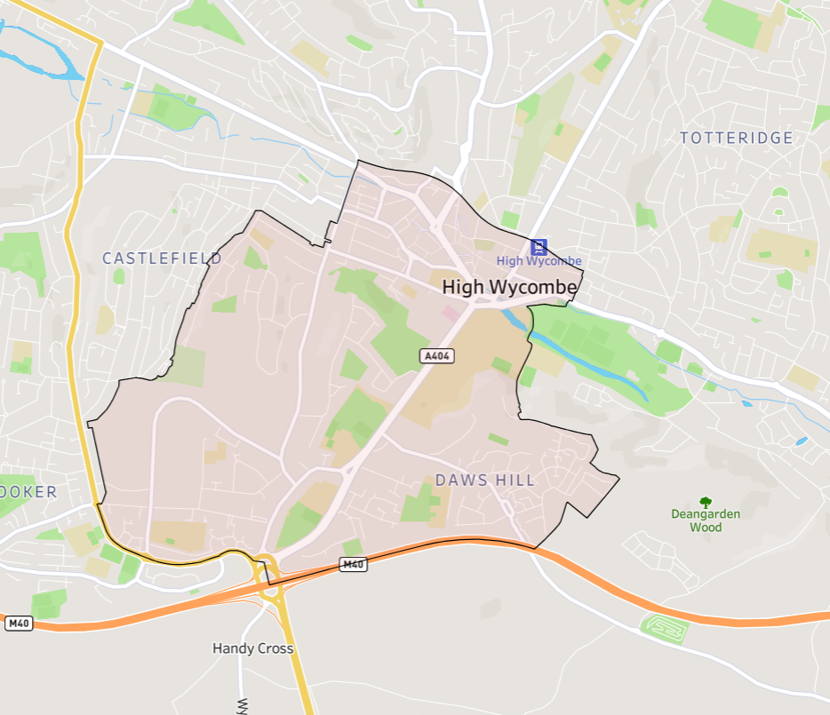
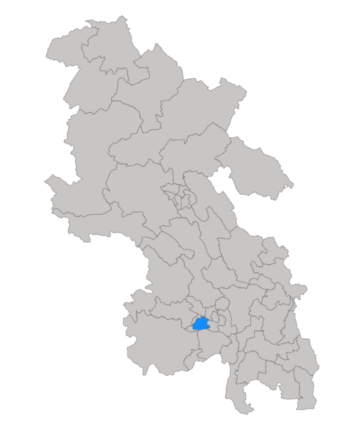
Abbey ward is located in High Wycombe. It covers the town centre and the south-west of the town down to the M40 (see maps below).
Click here for interactive map

Slide 4
Fast facts
13,800 residents
4,800 households
9,300 residents of working age (16-64)
2,300 active companies²
7.2% unemployment rate (March 2021)
6 key employment sites³
430 people claiming unemployment-related benefits (the Claimant Count)¹ (April 2023)
1,300 economically inactive residents of working age (excluding students)
33 high growth / high growth potential companies⁴
¹ DWP, via NOMIS
² Companies House
³ Bucks LEP
⁴Beauhurst
All data from Census 2021, ONS, unless otherwise stated

Slide 5
Key statistics
 | Abbey | Buckinghamshire | England | Ward v Bucks average | Rank (of all 49 Buckinghamshire wards)
Employment rate (no. of working-age residents in employment / no. of working age residents – data excluding students) | 79% | 81% | 77% | -2 percentage points | 39th
Unemployment rate (no. of working-age residents who are unemployed / no. of working age residents who are economically active – i.e. employed or unemployed) | 7.2% | 4.4% | 5.8% | +2.8 percentage points | 2nd
Claimant count rate¹ (no. of claimants / working age population) (April 2023) | 5.1% | 2.6% | 3.8% | +2.5 percentage point | 2nd
% of working age who have never worked or are long-term unemployed | 7% | 5% | 7% | +2 percentage points | 6th
% of working age employed in routine occupations | 8% | 8% | 11% | Equal | 13th
% of working age with below Level 2 qualifications | 20% | 18% | 22% | +2 percentage point | 10th
% of working age who are not in good health | 11% | 11% | 15% | Equal | 23rd
Under 5s per childcare place² (2022) | 2 | 3 | 4 | -1 | 11th *
All data from Census 2021, ONS, unless otherwise stated
¹ DWP, via NOMIS
² Ofsted
* Out of 48 Buckinghamshire wards (rank not available for Chesham ward)

Slide 6
What the data tells us
.
.
The ward contains a mix of residential and employment areas. Key employment sites include the Cressex Business Park, the Wycombe town centre shopping area, Wycombe Hospital and Buckinghamshire New University (BNU).
The ward is home to a large number of companies (the 2nd highest number of all 49 Buckinghamshire wards). It is home to more large employers than most other wards within the county and a high number of high-growth companies.
The population of the ward is much more ethnically diverse than the Buckinghamshire average. The population is also younger than the county average. Likely linked to the presence of BNU, a relatively high proportion of the working age population are students.
Ward residents are more likely to have a degree or higher qualifications and are more likely to have no qualifications than the county average. They are also more likely to be employed in both professional occupations at one end of the scale and in elementary occupations at the other.
Residents of the ward are more likely to be unemployed and are more likely to be claiming unemployment-related benefits than the county average.
The population of the ward is more polarised than the county average in terms of qualification levels and occupations held.
A higher proportion of the ward’s economically inactive working-age population are ‘looking after family or home’ than the county average.
In comparison to the county average, a relatively high proportion of the ward’s residents cannot speak English well or at all.
A high proportion of working residents work very close to home (less than 2km) and a relatively high proportion travel by foot to work.

Slide 7

Issues for exploration
Improving connections between local employers and the resident population. Working with employers to understand their recruitment challenges and providing support to help them develop more flexible recruitment approaches to attract and develop pathways into work for lower skilled residents and/or residents with complex needs.
Targeting of tailored interventions for those who are unemployed or economically inactive but would like a job but face specific or multiple barriers. Including English language difficulties and spending a long time out of the labour market.
Working with DWP to understand the characteristics and needs of those claiming unemployment related benefits and their ability to access local job opportunities.

Slide 8
Section 1: The Local Economy

Slide 9
Local economic context
Buckinghamshire’s recent economic performance has been broadly on par with the national average, both in terms of economic output (GVA) per head of population and productivity (GVA per hours worked in the local economy) ¹.
However, the local economy experienced slower-than-average growth over the last two decades and has been more susceptible to adverse economic events (i.e. the great financial crisis of 2008 and the Covid-19 pandemic in 2020/21). Economic growth is important because a growing economy can help facilitate improvements in the economic position of families and individuals, particularly those on low-to-middle incomes.
As is the case nationally, the Buckinghamshire economy is dominated by the service sector, and by Small and Medium-sized Enterprises (SMEs). However, Buckinghamshire’s SMEs play a more important role in the local economy than nationally, generating 58% of all jobs (compared with 46% nationally) ². Buckinghamshire has higher levels of self-employment than the national average, although the number of residents classified as self-employed has dropped in recent years ³.
For more information about the Buckinghamshire economy, please visit the Buckinghamshire Economic Intelligence Observatory website – www.buckseconomy.co.uk
¹ Regional gross value added (balanced) by industry: city and enterprise regions and Subregional productivity: labour productivity indices by economic enterprise region, 2023, ONS
² Inter Departmental Business Register, 2022. ONS
³ Annual Population Survey, Jan – Dec 2022, ONS

Slide 10
Structure of the local economy
The health, business admin & support, retail, and professional, scientific & technical sectors provide the greatest number of jobs in the High Wycombe & Aylesbury area. The latter three being more significant providers of jobs locally than nationally.
Abbey is situated within the High Wycombe & Aylesbury travel to work area (TTWA)¹. This area roughly covers the southern two-thirds of the county of Buckinghamshire.
The health, business admin & support, retail, and professional, scientific & technical sectors provide the greatest number of jobs in the High Wycombe & Aylesbury TTWA. The latter three being more significant providers of jobs locally than nationally. Whilst employing fewer people, the wholesale, construction and information & communication sectors are also more significant locally than nationally. The latter includes the film and TV industry, a significant and growing sector with a nucleus at Pinewood Studios. Outside of the county, significant employment areas within commuting distance include London, Slough and Heathrow Airport.
Employment hotspots are shown on the maps on the following two slides.
¹A travel to work area is a collection of wards for which "of the resident at least 75% work in the area, and also, that of everyone working in the area, at least 75% live in the area".
Source: BRES 2021, ONS

Slide 11
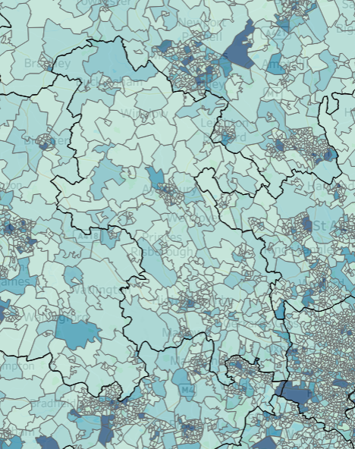
Employment Hotspots
Wider area
Milton Keynes
+
Luton
Hemel Hempstead
Areas within commutable distance of Abbey where high numbers of jobs are located include: London, Slough, Heathrow and Hemel Hempstead.
Oxford
Slough
Abbey
Heathrow
Click here for an interactive map
Source: BRES 2021, ONS

Slide 12
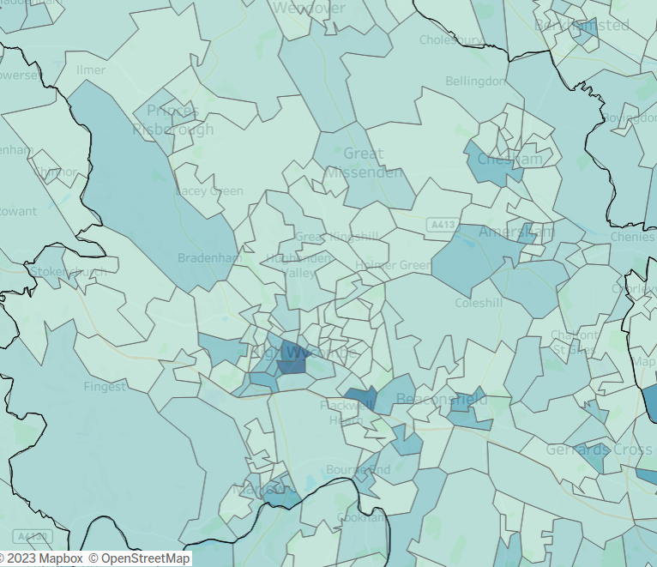
Employment Hotspots
Local area
+
Local areas with high concentrations of jobs are highlighted in the darker colours on this map. They include: central High Wycombe, the Cressex Business Park, Loudwater, Marlow, Chesham, Amersham and Beaconsfield.
Abbey
Click here for an interactive map
Source: BRES 2021, ONS

Slide 13
Businesses
The sector profile of businesses in the Abbey ward is broadly in line with the national picture.
In May 2023, approximately 2,300 active businesses registered with Companies House¹ had their head office in the Abbey ward. This is the second highest number of all 49 Buckinghamshire wards. Many of these businesses will not have employees.
The proportion of businesses by sector in Abbey broadly follows the national picture.
The largest proportion of businesses are in the ‘professional, scientific & technical’ (14%) sector, lower than the Buckinghamshire average (17%) and the ‘wholesale & retail; repair of motor vehicles’, similar to the Buckinghamshire (13%) average.
Abbey and Buckinghamshire as a whole have a higher proportion of businesses in ‘information & communication’ (11%) than the national average (9%).
¹ Companies House data has been used to estimate the number of businesses at ward level, as other sources (such as ONS’s Inter-Departmental Business Register) do not provide data for 2022 ward geographies at present. Limitations of Companies House data can be found within the Appendix.
Source: Companies House, May 2023

Slide 14
Large employers
There are six key employment sites within the ward (see slide 18).
Some of the ward’s larger employers are listed below:
  Sainsbury’s
  Morrisons
  Buckinghamshire New University
  Places for People Leisure
  Buckinghamshire Healthcare Trust
  Wycombe Abbey School
  Hovis
  Instron
  MSCN
  Smartcomm
Profiles of a selection¹ of businesses situated within the ward are provided on the following slides.
¹See Appendix for details of how these companies were selected

Slide 15








Business profiles
Taylor Wimpey UK Limited residential developer, operating at a local level from 24 regional businesses across the UK.
Sector: Property
Employee size band: Large 250+
https://www.taylorwimpey.co.uk/corporate
June Medical develops a range of medical devices and products.
Sector: Life Sciences
Employee size band: Small 10-49
https://junemedical.com/
Geodis - provision of European and domestic road services and logistics solutions to a wide customer base.
Sector: Transport
Employee size band: Large 250+
http://geodis.com/
Constant Air Systems offers a range of mechanical contracting and prefabrication and site services to industrial businesses.
Sector: Construction
Employee size band: Medium 50-249
https://constantair.co.uk/
Instron Ltd leading provider of mechanical testing systems.
Sector: Manufacturing
Employee size band: Large 250+
https://www.instron.com/en-gb/
Biffa provides waste management services, such as recycling and rubbish collection.
Sector: Waste Management
Employee size band: Large 250+
https://www.biffa.co.uk/
Life Build Solutions property construction company, specialising in refurbishment and new build projects across a range of sectors.
Sector: Construction
Employee size band: Small 10-49
https://www.lifebuild.co.uk/
Mint Velvet designs and sells a range of women's clothing.
Sector: Retail
Employee size band: Large 250+
https://www.mintvelvet.co.uk/
Please note, employee numbers are company-wide and are not specific to Buckinghamshire.
Source: Beauhurst, 2023

Slide 16




High growth companies (1)
Optima designs and manufactures glass partitions and drywalls.
Stage of evolution: Established
Number of employees: 250+
Incorporation date: 1986
https://optimasystems.com/
There are 33 high growth / high growth potential companies located within the Abbey ward.
The eight companies profiled are those with the most employees who have scaled their turnover or employees by more than 10% over the last three years.
Wycombe Abbey operates an independent boarding and day school for girls aged 11-18.
Stage of evolution: Established
Number of employees: 250+
Incorporation date: 1896
https://www.wycombeabbey.com/#intro
Origin Frames manufactures sliding doors and windows made from aluminium.
Stage of evolution: Established
Number of employees: 250+
Incorporation date: 2002
https://origin-global.com/
MSCM manufactures and supplies subsea equipment to the oil and gas industry.
Stage of evolution: Established
Number of employees: 50-249
Incorporation date: 1999
https://www.mscmltd.co.uk/
Source: Beauhurst, 2023
Please note, employee numbers are company-wide and are not specific to Buckinghamshire.

Slide 17




High growth companies (2)
Smartcomm provides audio visual, communications and IT services.
Stage of evolution: Established
Number of employees: 50-249
Incorporation date: 1999
https://smartcomm.co.uk/
Vectaire designs and manufactures ventilations products and systems such as fans and cookers hoods.
Stage of evolution: Established
Number of employees: 50-249
Incorporation date: 1987
https://www.vectaire.co.uk/
ADA Fastfix supplies a range of building materials.
Stage of evolution: Established
Number of employees: 50-249
Incorporation date: 2002
https://www.adafastfix.co.uk/
Staytite manufactures and sells a range of fasteners, including bolts, nuts and screws.
Stage of evolution: Established
Number of employees: 50-249
Incorporation date: 1979
https://www.staytite.com/
Source: Beauhurst, 2023
Please note, employee numbers are company-wide and are not specific to Buckinghamshire.

Slide 18
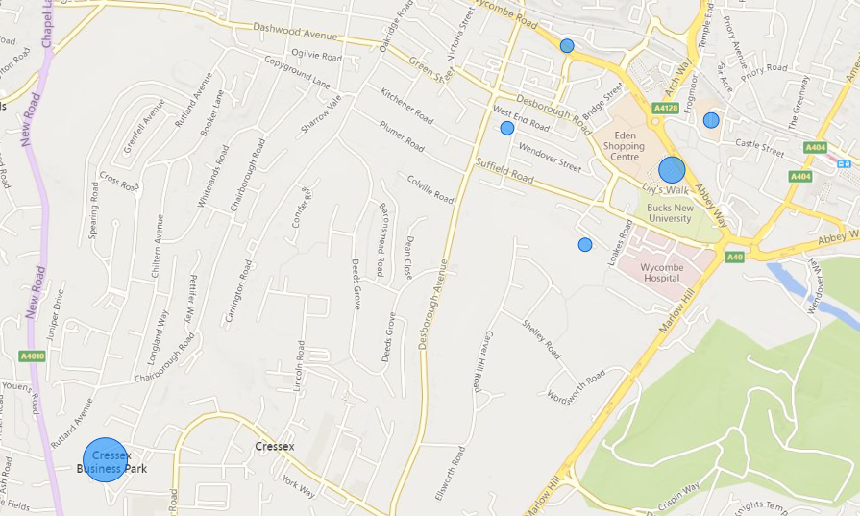
Key employment sites
The map below shows the location of key employment sites (business parks, industrial estates and shopping centres) in the Abbey ward
1. Cressex Business Park
4
2. Eden Shopping Centre
3
5
2
3. Chilterns Shopping Centre
6
4. Buckingham Place
5. Wycombe Industrial Mall
1
6. Fairfield Works
Note: Bubble size reflects the net internal floorspace of the business park properties.
Source: CoStar, 2023

Slide 19
Section 2: Profile of Residents

Slide 20
Age Profile
Abbey ward has a younger population than the county and national averages.
Abbey ward has a younger age profile than the county and national average.
At the time of the Census (2021), approximately 13,800 people lived in the ward, of whom 67% were of working age, higher than the Buckinghamshire and national averages.
Abbey also had a higher proportion of under 16s (22%) than the Buckinghamshire and England averages, and a lower proportion of residents aged 65 and over.
Base: 13,800 residents
Source: Census, 2021, ONS

Slide 21
Ethnicity
A higher proportion of Abbey residents identify as being of Asian, black, mixed or other ethnicity than the Buckinghamshire and national averages
Abbey has a more ethnically diverse population than Buckinghamshire and England as a whole. In 2021, nearly half of all residents were of Asian, black, mixed or other ethnicity, considerably higher than the county (20%) and national (19%) averages. This is the second highest proportion of all 49 Buckinghamshire wards.
Just over a third of Abbey residents identified themselves as being Asian, again, a much greater proportion than across the county and country as a whole, and the second highest proportion of all Buckinghamshire wards..
Conversely, a smaller proportion of residents (51%) in Abbey identified themselves as being of white ethnicity than the county (80%) and national (81%) averages.
Base: 13,800 residents
Note: This data based on individual’s perceived ethnic group and cultural background.
Source: Census, 2021, ONS

Slide 22
Socio-economic classification
A higher proportion of Abbey’s working-age population are full-time students than the county and national averages.
The socio-economic classification profile of Abbey residents is broadly similar to the national profile.
The main difference being that a higher proportion of working age residents of Abbey ward are full-time students than the national average.
When compared with Buckinghamshire as a whole, a higher proportion of the ward’s residents usually work in semi-routine or routine occupations than the county average, and fewer in higher managerial, admin or professional roles.
A slightly higher proportion have never worked or are long-term unemployed that the county average. Although the figure is similar to the national average.
Base: 9,300 working-age residents
Source: Census, 2021, ONS

Slide 23
Labour market participation
Working-age residents of the ward (excluding full-time students) are slightly less likely to be in employment and slightly more likely to be unemployed than the county average.
Abbey’s working-age residents (excluding full-time students) are slightly less likely to be in employment and slightly more likely to be unemployed than the county average. A similar proportion of working-age residents (excluding students) are economically inactive (i.e. not working and not currently seeking work) to the county average.
The unemployment rate at the time of the census (the number of people who are unemployed divided by the number who are economically active (i.e. employed or unemployed)) ¹ was 7.2%. This was higher than the county (4.4%) and national (5.8%) average.
Please note, this figure differs from the ‘unemployed’ percentage figure in the chart to the right which shows the proportion of all working-age residents (excluding students) - whether they are economically active or inactive - who are unemployed.
Base: 7,940 working-age residents (excluding full-time students)
¹ This is the official way of measuring unemployment.
Source: Census, 2021, ONS

Slide 24
Labour market participation
The vast majority of working-age Abbey residents (excluding full-time students) who are in employment work as employees. 17% are self-employed, the majority of whom employ no other people.
Working-age residents of Abbey (excluding full-time students) who are economically inactive, are much more likely to be ‘looking after home or family’ than the county and national average. Fewer have taken early retirement.
Base: 6,300 working-age residents (excluding full-time students) who are in employment
Base: 1,300 working-age residents (excluding full-time students) who are economically inactive (i.e. not working and not currently seeking work)
Source: Census, 2021, ONS

Slide 25
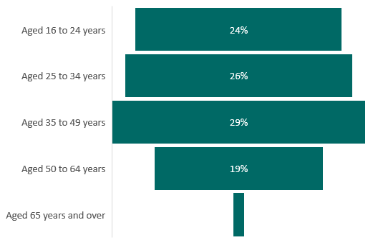
Unemployed residents by age and sex
The ward’s unemployed residents are fairly evenly distributed across the four main age bands
A higher proportion of the ward’s unemployed residents are male than female
Base: 370 unemployed residents (excluding full-time students)
Source: Census, 2021, ONS

Slide 26
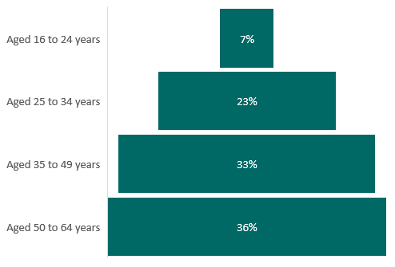
Economically inactive residents of working age by age and sex
The ward’s economically inactive residents of working age tend to be older, with 36% being over the age of 50. Few are in the 16–24-year-old age bracket
A higher proportion of the ward’s economically inactive working age residents are female than male
Base: 1,300 economically inactive residents of working age (excluding full-time students)
Source: Census, 2021, ONS

Slide 27
Unemployed residents by ethnicity
The majority of unemployed ward residents at the time of the 2021 Census were of white or Asian ethnicity.
Of the 370 residents classified as unemployed at the time of the 2021 Census, the majority were of white or Asian ethnicity (see columns in the chart to the right).
When comparing the ethnic profile of the ward’s unemployed population with the ethnic profile of the population of the ward as a whole, those who identify as being of mixed/multiple ethnicity or as being from an ‘other ethnic group’ were most likely to be unemployed at the time of the 2021 Census (see dots in the chart to the right). Although absolute numbers are small.
Base: 370 unemployed residents (excluding full-time students) and all residents of working age
Source: Census, 2021, ONS

Slide 28
Economically inactive residents by ethnicity
Residents of working age who identify as being of Asian ethnicity were most likely to be economically inactive at the time of the 2021 Census
Of the 1,300 working age residents (excluding full-time students) classified as being economically inactive at the time of the 2021 Census, the majority were of Asian or white ethnicity (see columns in the chart to the right).
When comparing the ethnic profile of the ward’s economically inactive population with the ethnic profile of the population of the ward as a whole, those who identify themselves as having Asian ethnicity are more likely to be economically inactive than those from other ethnic groups (with the exception of the small number of residents from an ‘other ethnic group’). See dots in the chart to the right.
Base: 1,300 economically inactive residents of working age (excluding full-time students)
Source: Census, 2021, ONS

Slide 29
Unemployed residents by highest level of qualification
Two fifths of Abbey residents who were unemployed at the time of the 2021 Census had a degree (or higher) level qualification. Approximately a quarter had no or level 1 / entry level qualifications.
Two fifths of Abbey residents who were unemployed at the time of the 2021 Census had a degree (or higher) level qualification, whilst approximately a quarter had no or level 1 / entry level qualifications.
When compared to the qualification levels held by all working-age residents (slide 47), those who are unemployed are slightly more likely to have lower-level qualifications.
Base: 370 unemployed residents (excluding full-time students)
Source: Census, 2021, ONS

Slide 30
Economically inactive residents by highest level of qualification
Just under a third of Abbey working-age residents who were economically inactive at the time of the 2021 Census have no qualifications. With a further 17% having low level qualifications (level 1 and below).
Just under a third (30%) of Abbey ward’s working-age residents (excluding students) who were economically inactive at the time of the 2021 Census have no qualifications. With a further 17% having low level qualifications (level 1 and below).
When compared to the qualification levels held by all working-age residents (slide 47), those who are economically inactive are much more likely to have no or lower-level qualifications. They are also much more likely to have no or lower-level qualifications than those who are unemployed.
Base: 1,300 economically inactive residents of working age (excluding full-time students)
Source: Census, 2021, ONS

Slide 31
Unemployed residents by socio-economic classification
Just under half of the ward’s unemployed residents are classified as long-term unemployed or have never worked.
At the time of the 2021 Census, just under half (48%) of Abbey’s unemployed residents had never worked or were long-term unemployed. This was the same as the county average and slightly lower than the national average.
17% usually worked in managerial, admin or professional roles and 23% usually worked in semi-routine or routine operations.
Base: 370 unemployed residents (excluding full-time students)
Note, we are unable to replicate this analysis for economically inactive residents of working age.
Source: Census, 2021, ONS

Slide 32
Unemployment-related benefit claimants (the Claimant Count)
The proportion of Abbey residents claiming unemployment-related benefits has been higher than both the Buckinghamshire and national averages during the last three years.
In April 2023, 430 Abbey residents were claiming unemployment-related benefits.
Prior to the onset of the Covid-19 pandemic, the claimant rate¹ for Abbey residents was higher than the Buckinghamshire and national average.
Across all three areas, the claimant rate increased as a result of the Covid-19 pandemic. Between 2019 and 2021, the increase in the claimant rate for Abbey outpaced the Buckinghamshire and national average.
In April 2021 the claimant count rate in Abbey was 7.5%, far higher than the Buckinghamshire (4.4%) and national (6.3%) average.
By April 2023, Abbey’s claimant rate had fallen to 5.1%, but remained higher than the Buckinghamshire and national average, and higher than the pre-pandemic rate.
¹ Unemployment-related benefit claimants as a proportion of all residents aged 16-64
² Data is presented for the month of April as this is estimated to be the month least affected by job market seasonality
Source: Claimant count, 2023, DWP

Slide 33
Unemployment-related benefit claimants by age
Claimants from Abbey are more likely to be aged 25 to 49 than the county and national average.
Claimants from Abbey ward are more likely to be aged 25-49 than the county and national average, which is likely to reflect the age profile of the ward.
The proportion of claimants aged 50+ is lower in Abbey than the Buckinghamshire and national average.
Base: 430 claimants
Source: Claimant count, April 2023, DWP

Slide 34
Employment by occupation
A higher proportion of Abbey residents are employed in professional and elementary occupations than the county average, but fewer in managerial and skilled trade roles.
The occupational profile of Abbey’s working residents is somewhat polarised, with a high proportion of residents working in both professional roles on one hand and in elementary roles on the other than the county average.
Proportionally fewer residents work in mid-level occupations (e.g. skilled trades and admin/secretarial occupations) and in managerial roles than the county average.
Base: 6,800 residents over the age of 16 and in employment
Source: Census, 2021, ONS

Slide 35
Employment by industry
A higher proportion of Abbey residents work in the ‘wholesale & retail’, ‘human health & social activities’; and ‘information & communication’ industries than the Buckinghamshire average.
Abbey residents are more likely to work in Buckinghamshire’s largest two industries (wholesale & retail, and health & social care) than the county average.
Residents are also more likely to work in the ‘information and communication’ sector than the county average, and much more likely than the national average.
Residents are less likely to work in the construction, financial & insurance, professional, scientific & technical and public administration sectors than the county average.
Base: 6,800 residents over the age of 16 and in employment
Source: Census, 2021, ONS

Slide 36
Public and private sector employment
A lower proportion of Abbey residents aged 16 and over and in employment are estimated to work in the public sector than the national average.
As is the case at the county and national level, residents of Abbey are estimated* to be more likely to be employed in the private sector than in the public sector.
In 2021, 28% of Abbey residents aged 16 and over and in employment were estimated to be working in the public sector. This was the same as the Buckinghamshire average, but lower than the national average (30%).
*Data shown are rough estimates and should be treated with caution. Public sector employment has been calculated using data for the ‘public administration and defence; compulsory social security’; ‘education’; and ‘human health & social work activities’ Standard Industrial Classification sectors. As these sectors are broad, data will include some private sector employment.
Base: 6,800 residents over the age of 16 and in employment
Source: Census, 2021, ONS

Slide 37
Abbey residents employed by Buckinghamshire NHS
Band | Ward residents | % of residents working in Bucks NHS | Pay range £s | Educational level requirement
Band 2 | 41 | 15% | £22,383 | None
Band 3 | 17 | 6% | £22,816-£24,336 | NVQ L3
Band 4 | 21 | 8% | £25,147-£27,596 | Foundation degree
Band 5 | 89 | 33% | £28,407-£34,581 | Graduate
Band 6 | 53 | 20% | £35,392-£42,618 | Graduate
Band 7 or above | 23 | 9% | Above £43,742 | Masters or equivalent
Medical staff | 26 | 10% | £29,384 - £119,133 | Post graduate +
Total (excluding medical staff) | 270 | 100%
In total, approximately ward 270 residents are employed by Buckinghamshire NHS, 15% of whom are employed on the lowest pay scale. 71% of residents working for the NHS are doing so in graduate-level or above positions.
Source: Bucks NHS (May 2023)

Slide 38
Home working
A lower proportion of Abbey residents are estimated to work from home than the Buckinghamshire average.
In 2021, 36% of Abbey residents aged 16 and over and in employment worked mainly at or from home. This was a higher proportion than the national average (32%). However, it was lower than the Buckinghamshire average (42%).
Please note that as the 2021 Census took place in March 2021, during a period of rapid change stemming from Covid-19, this data should be treated with caution in terms of future planning.
Base: 6,800 residents over the age of 16 and in employment
Source: Census, 2021, ONS

Slide 39
Distance travelled to work
In 2021, more than a third (36%) of Abbey residents aged 16 and over in employment¹ travelled ‘less than 2km’ to their place of work. This was significantly higher than the Buckinghamshire (18%) and national (20%) average.
In contrast, a lower proportion of Abbey residents travelled between ‘2km and 20km’ (40%) than the Buckinghamshire (55%) and national (64%) average.
A higher proportion of residents in Abbey and Buckinghamshire travelled 30km and over to their place of work than the national average. This is likely primarily due to Buckinghamshire’s close proximity to employment hotspots outside of the county, such as London and Heathrow airport.
In 2011 (latest available data at the time of writing) Buckinghamshire had one of the least ‘self-contained’ labour markets in England. With around a third of working residents travelling out of the county for work, and 28% of all those working within the Buckinghamshire economy travelling into the county from elsewhere.
A much higher proportion of Abbey residents travel ‘less than 2km’ to work than the Buckinghamshire and national average.
¹This chart excludes those who work mainly or at home, or work mainly at an offshore installation, in no fixed place, or outside the UK.
Base: 3,400 residents over the age of 16 and in employment who travel to work
Source: Census, 2021, ONS

Slide 40
Method of travel to work
In 2021, of the Abbey residents in employment who travelled to their place of work, two thirds (66%) travelled by car or van to work. This was much lower than the Buckinghamshire (80%) and lower than the national (71%) average.
A much higher proportion of Abbey residents travel ‘on foot’ to work than the Buckinghamshire and national average.
Of those that travel to work, a lower proportion of Abbey residents travelled by car or van than the Buckinghamshire average.
66%
80%
71%
Abbey
Buckinghamshire
England
Looking in more detail at those not travelling by car or van, 18% travel on foot (higher than the Buckinghamshire (10%) and national (11%) averages), and 6% by bus, minibus or coach (in line with the national average but higher than the Buckinghamshire average).
Base: 3,400 residents over the age of 16 and in employment who travel to work
Source: Census, 2021, ONS

Slide 41
Section 3: Barriers to employment

Slide 42
In this section we present data on some potential barriers to sustained employment. These are:
  Health status
  English language proficiency
  Access to childcare provision
  Providing unpaid care
  Access to a car or van
  Highest level of qualification
There will be additional factors that could hinder residents’ ability to access sustained employment.

Slide 43
Health status
English language proficiency
Based on responses to the 2021 Census, 11% of those of working-age living in the Abbey ward are deemed to be ‘not in good health’.
This was the same as the county average but lower than the national average (15%) and equates to approximately 1,000 people.
Overall, 3.9% of Abbey’s working-age residents cannot speak English well or at all. This is higher than the Buckinghamshire (1.2%) and national (2.1%) average and equates to approximately 370 people.
11%
11%
15%
Abbey
Buckinghamshire
England
Base: 9,300 working-age residents
Base: 9,300 working-age residents
Source: Census, 2021, ONS

Slide 44

Childcare Provision
Total number of childcare places offered is approximately equivalent to:
In 2022, Abbey had 17 childcare providers registered on the Early Years Register (EYR)¹, offering 636 places at the point of registration². 23 childcare providers are located in wards that neighbour Abbey, offering a total of 779 places at the point of registration.
The proportion of childcare places offered within the ward compared to the total population of Abbey residents aged 5 and under is equivalent to 61%, higher than the 39% Buckinghamshire average³. The proportion for Abbey was also higher than the 24% average across the 10 Opportunity Bucks wards where people are experiencing the most hardship.
Alternatively, there are an average of 2 residents aged 5 and under for each childcare place offered in Abbey. This was lower than the average across Opportunity Bucks wards and lower than the average for Buckinghamshire.
¹ Ofsted Early Years Register data on childcare provider places covers all places for children up to the 31st August following their fifth birthday. Place numbers mentioned are actual place numbers where recorded, and not estimated place numbers.
² This analysis should be treated with caution as childcare provider data only includes those where a local authority location has been provided. Childminders in particular are likely to withhold the sharing of postcode data.
^{3 *} Approximately 14% of childcare places in Buckinghamshire cannot be assigned to a ward as the provider has redacted their postcode. In order to provide a comparison between wards and county, figures for Buckinghamshire (county) do not include postcode redacting providers. If included, the proportion of childcare places offered in the county would be approximately equivalent to 45% of residents aged 5 and under.
61%
24%
39%*
Abbey
Opportunity Bucks wards
Buckinghamshire
…of the total number of residents aged 5 and under.
Or approximately…
2
4
3
…residents aged 5 and under per childcare place offered.
EYR places are available to children aged up to the 31st August following their fifth birthday. The number of residents aged 5 are aged up to 31st December following their fifth birthday.
Source: Ofsted, 2022, Childcare provider level data, Dataset 1
Notes:
Neighbouring wards: Tylers Green & Loudwater, Totteridge & Bowerdean, Terriers & Amersham Hill, Abbey.

Slide 45
Provision of unpaid care
Abbey’s working-age residents are slightly less likely to be providing unpaid care than the county and national averages
In 2021, approximately 690 Abbey residents of working age were providing unpaid care¹. This equated to 7.4% of the working age population, lower than the county and national averages.
Base: 9,300 working-age residents
¹ An unpaid carer may look after, give help or support to anyone who has long-term physical or mental ill-health conditions, illness or problems related to old age. This does not include any activities as part of paid employment. This help can be within or outside of the carer's household
Source: Census, 2021, ONS

Slide 46
Access to car or van
A higher proportion of Abbey households do not have access to a car or van than the Buckinghamshire average.
In 2021, a higher proportion of Abbey households did not have access to a car or van (21%) than the Buckinghamshire average (11%). However, this was lower than the national average of 24%.
39% of households in Abbey had access to 1 car or van and 40% to 2 or more vehicles.
Base: 4,800 households
Source: Census, 2021, ONS

Slide 47
Highest level of qualifications
A slightly higher proportion of Abbey residents have level 4 or above qualifications than the county average and a slightly higher proportion have no qualifications.
In 2021, 45% of Abbey’s working-age population had a Level 4 or higher qualification. The majority will be degree holders. This was one percentage point higher than the Buckinghamshire average, and eight percentage points higher than the national average. A slightly lower proportion to county and national averages were qualified to Levels 2 and 3.
A slightly higher proportion had no qualifications (11%) compared with the Buckinghamshire average (9%) however, the proportion was lower than the national average (12%).
Level | Description
Level 1 | Fewer than 5+ GCSEs / NVQ 1
Level 2 | 5+ GCSEs / NVQ 2 or equivalent
Level 3 | 2+ A-levels / NVQ 3 or equivalent
Level 4+ | HNC, HND, NVQ 4 and 5, degree or higher
Other | Includes Apprenticeships, vocational quals and quals obtained overseas
Base: 9,300 working-age residents
Source: Census, 2021, ONS

Slide 48
Appendix

Slide 49
Glossary
Term | Definition
Unpaid care | An unpaid carer may look after, give help or support to anyone who has long-term physical or mental ill-health conditions, illness or problems related to old age. This does not include any activities as part of paid employment. This help can be within or outside of the carer's household.
Claimants | People claiming Jobseeker's Allowance plus those who claim Universal Credit who are out of work.
Economically active | Those in employment plus those that are unemployed. Those that are unemployed are deemed economically active as they are seeking work and willing and able to accept a job. For further details see the economic activity diagram here.
Economically inactive | Those not in employment and who have not been seeking work within recent weeks.
High growth / high growth potential companies | These are companies who have met one of Beauhurst’s tracking triggers including: secured equity investment; secured venture debt; underwent a management buyout or buy-in; attended a selected accelerator programme; has been or is a scale-up; spun out of an academic institution; was featured in a selected high-growth list; accepted a large innovation grant
Key employment sites | A business park, retail park or industrial estate.

Slide 50
Data limitations
Data source | Limitations
Companies House | Data is sourced from the information that companies submit to Companies House. Submitted data is not checked or verified by Companies House. This includes SIC codes, which are chosen by a company to designate which industry they are active in. A company is expected to choose an appropriate SIC code, however it may not accurately reflect their business activities. A company can also be both ‘active’ and classified as a dormant company not trading under SIC code 9999 (dormant companies have been removed from analysis in this resource). Companies House figures are also likely to be overestimated as a single parent trading company can register multiple subsidiaries. A company can also be added to the register before it begins trading.
Claimant Count | The claimant count is a proxy measure for unemployment. It is useful because it is produced at a granular geographic level (e.g. ward level) and is timely (produced monthly). When using claimant count data be aware that not all those who are unemployed will claim unemployment-related benefits. And not all claimants are unemployed. Some will be working but on low incomes / few hours and therefore will be entitled to claim unemployment-related benefits.
Estimates of public and private sector employment | Data shown are estimates and should be treated with caution. Public sector employment has been calculated using data for the ‘public administration and defence; compulsory social security’; ‘education’; and ‘human health & social work activities’ Standard Industrial Classification (SIC) code sectors. As these sectors are broad, data will include some private sector employment.

Slide 51
Other information
Data source | Information
Business profiles | Businesses selected are mainly those with the highest level of turnover and/or the highest number of employees. The employee size band refers to the company-wide workforce, therefore not all jobs will be Buckinghamshire-based. In addition, some profiles of other ‘typical’ businesses in an area have been profiles, along with some businesses operating within the county’s strategic growth sectors.

