Slide 1
Buckinghamshire Labour Market and Skills Analysis: 2022
February 2022

Slide 2
About
This slide deck has been produced to share analysis of Buckinghamshire’s labour market and skills needs in an accessible way.
Much of the information presented within this deck is also available in the Evidence Annex A of the 2022 Buckinghamshire Local Skills Report.
Links to source data are provided wherever possible.
If you have any queries, feedback or suggestions for further analysis, please contact Caroline Perkins – caroline.perkins@buckslep.co.uk

Slide 3
What would you like to know?
At a glance
Buckinghamshire’s labour market and skills strengths
Buckinghamshire’s labour market and skills challenges

Slide 4
What would you like to know?
Section 1: About the economy
What kind of economy does Buckinghamshire have?
What are Buckinghamshire’s largest sectors?
What are Buckinghamshire’s sector specialisms?
Which sectors are predicted to create the most jobs in Buckinghamshire over the next 10 years?
How many people work in Buckinghamshire’s key sectors?
Which sectors have been hard-hit by Covid-19?
Who are Buckinghamshire’s biggest employers?
How many people commute into and out of the county for work?
What is the occupational profile of the Buckinghamshire workforce?
What are the occupations of Buckinghamshire residents?
What are Buckinghamshire’s occupational specialisms?
What are the occupations of Buckinghamshire’s self-employed workforce?

Slide 5
What would you like to know?
Section 2: About the labour market
What levels of economic activity and inactivity are there within Buckinghamshire?
How has Covid-19 impacted unemployment in Buckinghamshire?
How has unemployment in Buckinghamshire changed over time?
How many people are claiming unemployment benefit?
How many people have been furloughed in Buckinghamshire?
To what extent has productivity been growing in Buckinghamshire in recent years?
To what extent have wages been growing in Buckinghamshire in recent years?
What is Buckinghamshire’s demographic profile?
To what extent is there deprivation within Buckinghamshire?

Slide 6
What would you like to know?
Section 3: Skills available for local economy
How qualified is the local labour pool?
Who are Buckinghamshire’s main providers of education and training?
What are Buckinghamshire’s apprenticeship take-up levels?
How have apprenticeship reforms and the Covid-19 pandemic affected the take-up of apprenticeships in Buckinghamshire?
What subjects have been studied by those graduating from Buckinghamshire’s Higher Education Institutions?
What to those graduating from Buckinghamshire’s Higher Education Institutions do next?
Where do Buckinghamshire graduates live after graduating?
To what extent do Buckinghamshire employers provide training to their staff?
How do employers fill vacancies and develop talent pipelines?

Slide 7
What would you like to know?
Section 4: Skills demand within the local economy
How can demand for skills be measured?
What types of jobs are in greatest demand in Buckinghamshire?
How did Covid-19 affect the job market? And will there be any long-lasting changes?
Which sectors are predicted to create the most jobs in Buckinghamshire over the next 10 years?
What skills need developing in Buckinghamshire?
What is the demand for digital skills within Buckinghamshire?
In which sectors and occupations should we prioritise skills activities to meet current and future demand within Buckinghamshire?
What other occupations have been identified by employers locally as being in particularly high demand or being difficult to recruit into?
What specific skills have been reported by Buckinghamshire employers as being difficult to source or requiring focus due to anticipated future demand?
What training do Buckinghamshire employers find most valuable?

Slide 8
What would you like to know?
Section 5: The extent of skills mismatches within Buckinghamshire
To what extent do Buckinghamshire employers struggle to fill vacancies, and why?
To what extent are there skills mismatches within the existing workforce?

Slide 9
At a glance…

Slide 10
Buckinghamshire’s labour market and skills strengths
Clear long-term economic growth aspirations set out in the Buckinghamshire Local Industrial Strategy.
Significant job growth expected in a variety of sectors over the next few years, in particular in the film & TV and construction sectors.
High levels of employer involvement in the local skills agenda.
A strong collaborative culture (between education institutions, and between employers and educators).
Further and Higher Education Institutions with a strong history of employer engagement, and a focus on applied learning and employability.
A top performing Careers Hub.
High performing schools.
Higher than average Level 2 and 3 attainment by young people aged 19 and high levels of qualifications amongst residents.
World-class talent in industries such as high-performance engineering, film & TV, space and medtech.

Slide 11
Buckinghamshire’s labour market and skills challenges (1)
{Early 2022] Recruitment difficulties causing problems for employers in many sectors and hampering economic recovery from the Covid-19 pandemic. Linked to a reduction in the size of the economically active population, and a rise in the number of economically inactive working-age residents.
[Early 2022] Unemployment at highest levels since 2016 (although lower than anticipated at the start of the pandemic and improving).
Growing mismatch between the demand for skills and labour within the local economy, and the skills and jobs sought by local residents.
The need to ensure strong local talent pipelines for growing sectors (including life sciences, health and social care; film & TV; construction; high performance engineering; space).
The need to ensure a strong talent pipeline of green skills (including digital and engineering skills) to enable the shift towards a net zero economy.
Retaining and attracting talent (school leavers, graduates and high skilled residents) – linked to the perceived attractiveness of the County’s main towns and the rural nature of much of the County.

Slide 12
Buckinghamshire’s labour market and skills challenges (2)
Low take-up of apprenticeships.
A lack of engineering training provision within the county.
Low levels of interest in construction and health and social care careers, resulting in employers struggling to fill vacancies.
Employer views of the ‘work-readiness’ of young people, exacerbated by Covid-19.
Pockets of inequality and poor social mobility.
Lower than average levels of training by County employers
The ever-growing and evolving demand for digital skills.
A need to ensure opportunities in growth sectors are accessible to all.

Slide 13
Section 1: About the economy

Slide 14
What kind of economy does Buckinghamshire have?
As with most of the developed world, Buckinghamshire’s economy is dominated by the service sector, which provides 85% of all local employee jobs¹. Three in every five jobs in Buckinghamshire exist in the ‘foundational economy’ with the remainder being within the ‘tradable economy’.
42% of the workforce work for micro & small firms (employing fewer than 49 people) compared to 32% nationally².
Defining features of Buckinghamshire’s economy are:
The predominance of small businesses².
High levels of self-employment, particularly within the county’s creative and construction sectors.
World-class economic assets and high performing clusters of business activity in the areas of film and TV, high-performance engineering, space and MedTech.
A large wholesale sector (particularly the wholesale of pharmaceutical goods, machinery and equipment, computers and software)¹.
A larger than average digital sector¹.
1 in every 6 people working in the Buckinghamshire economy is self-employed³
¹ Business Register and Employment Survey, 2020, ONS
² Inter Departmental Business Register, ONS
³ Annual Population Survey (12 months to June 2021), ONS

Slide 15
What kind of economy does Buckinghamshire have?
The number of VAT / PAYE registered businesses (enterprises) in Buckinghamshire increased by 1% between 2020 and 2021, from 31,280 to 31,470. These businesses operate from 34,750 premises within the County¹.
Between 2014 and 2019, the rate of business births in Buckinghamshire exceeded the rate of business deaths². In 2020 the gap narrowed, in Buckinghamshire and nationally.
In recent years, business survival rates in Buckinghamshire have been higher than the national average. Fewer businesses have been created and fewer businesses have closed in Buckinghamshire (as a proportion of all existing business) than the national average.
In 2020, the number of business births as a proportion of all businesses was lower than the national average (10% versus 12%). However, business births as a proportion of the local working-age population were higher in Buckinghamshire than nationally (10.0 per 1,000 people versus 9.1).
In 2020, there were slightly more high growth businesses in Buckinghamshire (as a proportion of all businesses employing more than 10 people) than the national average (4.6% compared with 4.4%)².
% of firms ‘born’ in 2015 operating 5 years later
39%
44%
Business survival rates in Buckinghamshire are higher than the national average. For example, 44% of firms ‘born’ in Buckinghamshire in 2015 were still operating 5 years later, compared to 39% nationally².
¹ UK Business Count, 2020, ONS
² Business Demography, 2020, ONS

Slide 16
What are Buckinghamshire’s largest sectors? (in terms of employment)
Proportion of the workforce employed in different sectors
Buckinghamshire’s largest sector in terms the number of jobs it provides is the health and social care sector. Followed by business admin and support services; education; professional, scientific and technical; and retail.
Sector definitions can be found here.
Source: Business Register and Employment Survey, 2020, ONS

Slide 17
What are Buckinghamshire’s largest sectors? (in terms of employment)
Number of full and part-time workers by sector
The prevalence of part-time working varies considerably by sector. Buckinghamshire’s retail and health and social care sectors employ the largest number of people on a part-time basis. Buckinghamshire’s wholesale, health, business admin & support and professional, scientific and technical sectors employ the most people on a full-time basis.
Sector definitions can be found here.
Source: Business Register and Employment Survey, 2020, ONS

Slide 18
What are Buckinghamshire’s sector specialisms?
Employment location quotients
The chart to the right shows how the structure of Buckinghamshire’s economy differs to the national economy, based on the number of people employed in different sectors.
The purple ring is the national average, and the blue ring is employment within the Buckinghamshire economy. Where the blue ring sits outside the purple ring, Buckinghamshire has a higher proportion of people employed than the national average.
The numbers on the chart are location quotients. A location quotient over 1 shows a local specialism. The four broad sectors* of the economy in which Buckinghamshire has a specialism are: wholesale (1.9 times more employment in this sector locally than nationally), construction (1.4 times more) and digital tech (1.3 times more).
*this analysis uses broad Standard Industrial Classification codes. The analysis on the following pages provides more granular insight

Slide 19
What are Buckinghamshire’s sector specialisms?
Some sectors or clusters of business activity are not well defined within the Standard Industrial Classification (SIC) code system or are not captured well when using the broad classification codes (see previous pages).
However, using 4 and 5 digit SIC codes, along with our knowledge of the local economy, we can dig deeper to gain a more granular understanding of Buckinghamshire’s sector specialisms and the demand for labour and skills within them.
There are twice as many creative industry jobs within the Buckinghamshire economy than the national average, many of which are in the film and TV sector. Buckinghamshire also has higher than average levels of employment in advertising, specialist design, artistic creation and sound recording / music publication¹.
For every 10 people working in the core life sciences sector in England there are 13 people working in the sector in Buckinghamshire. In addition, companies involved with the wholesale of pharmaceuticals goods employ nearly 9 times as many people in Buckinghamshire than the national average¹.
The Silverstone Technology Cluster, a world leading local cluster of high-tech businesses, has grown significantly in recent years. Over 4,000 companies operating in precision engineering alone are located within a one-hour radius of Silverstone.
¹ Business Register and Employment Survey, 2019, ONS

Slide 20
Which sectors are predicted to create the most jobs in Buckinghamshire over the next 10 years?
Key growth sectors (from an employment perspective) within Buckinghamshire over the next 10 years will be:
Construction (in part due to HS2, East West Rail, Aylesbury Garden Town related construction activity, and a large house building programme)
Film and TV (linked to expansion plans at Pinewood Studios, plus the continuing inward investment boom of the West of London Screen Cluster, with many new studios opening within the next few years)
Life sciences, health and social care (linked to both the health needs of an ageing population and the need to respond to the aftermath of the Covid-19 pandemic)
Space (linked to expansion of the Westcott Space Cluster)
High performance engineering (linked to expansion of the Silverstone Enterprise Zone and an increasing focus on the need for green technologies to combat climate change)
The construction, film/TV and health & social care sectors are expected to create the greatest volume of jobs in Buckinghamshire over the next five years.
Pinewood Studios’ expansion plans are predicted to create 3,500 new jobs, including 1,500 construction jobs. There are also plans for a new studio at Marlow.
The construction of HS2 is expected to create around 4,000 jobs in Buckinghamshire and the surrounding areas.
It is anticipated that the 10-year plan for the Westcott Space Cluster will create over 2,000 jobs.
The Space, Creative Industries, High Performance Engineering and MedTech sectors are identified within Buckinghamshire’s Local Industrial Strategy as key sectors. Each has a significant ‘asset’ located within the County (Westcott Space Cluster, Pinewood Studios, Silverstone Park and Technology Cluster and Stoke Mandeville hospital) and strong long-term growth prospects.
See the Buckinghamshire Economic Intelligence Observatory website for more detailed analysis of workforce trends, skills shortages and local training provision within these sectors.

Slide 21
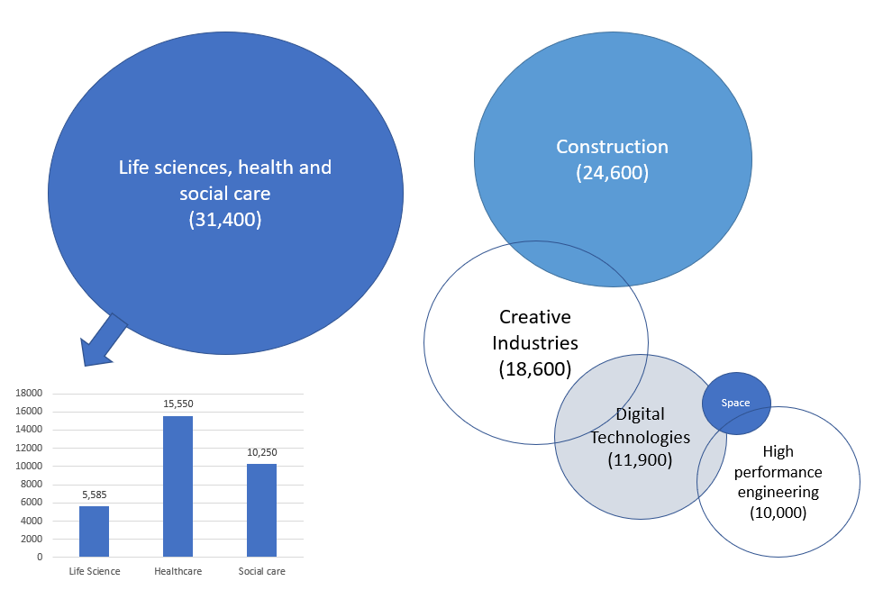
How many people work in Buckinghamshire’s key sectors?
In total, approximately 40% of all those working in the Buckinghamshire economy work in the county’s key sectors.
These sectors vary considerably in size, with health and social care currently the largest and space the smallest.
Business Register and Employment Survey, 2019, ONS
Note 1 - whilst the digital technology sector is not expected to grow significantly in Buckinghamshire over the next decade, it does employ more people locally than nationally, and is a growing sector globally. Note 2 – It is difficult to measure how many people are employed in the space sector in Buckinghamshire. An estimate will be provided in due course.

Slide 22
Which sectors face continued Covid-19 related disruption?
Sectors and occupations that continue to face Covid-19 related disruption, particularly when mitigation measures are put in place to slow the spread of new variants include:
Hospitality
Live events
Aviation
Travel & transport (including inbound tourism)
Leisure & entertainment (including visitor attractions, fitness instructors)
Personal services (including hair and beauty)
Arts & culture (including theatres)
Suppliers to the above
For the latest business news, see the ‘how’s business in Bucks?’ blogs on the Buckinghamshire Economic Intelligence Observatory website.

Slide 23
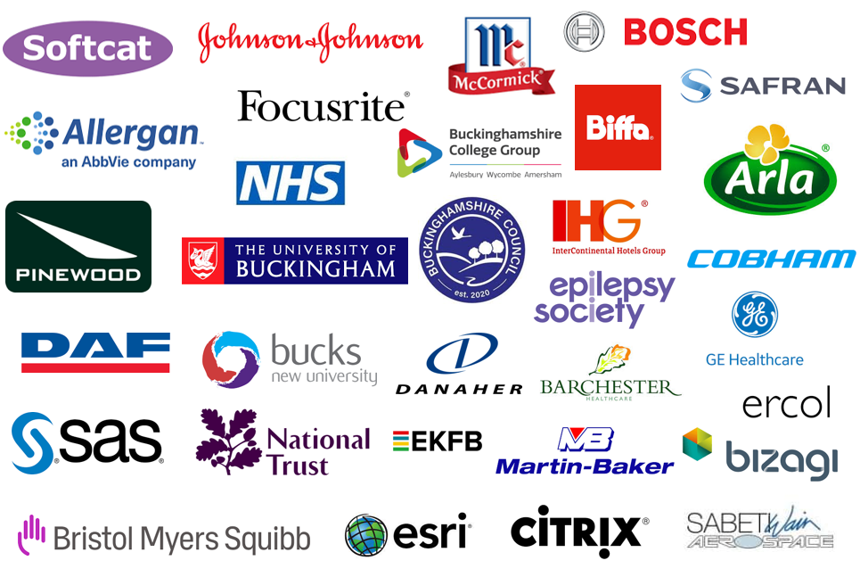
Who are Buckinghamshire’s biggest employers?
In addition to the above, national companies who employ large numbers of people within the local economy include national construction companies, national retail chains, national hospitality chains, national care home chains and global film production companies.

Slide 24
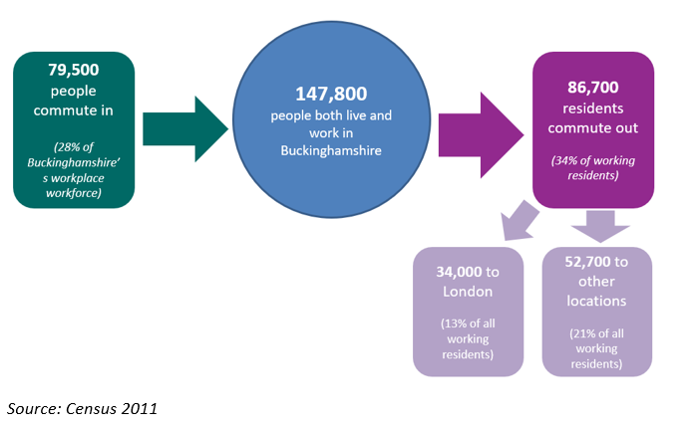
How many people commute into and out of the county for work?
Commuting patterns matter when undertaking local labour market and skills analysis, particularly when trying to compare data on the demand for, and supply of, skills. For example, whilst Buckinghamshire may have a large number of highly qualified residents, high levels of out-commuting, often for high paid jobs, means that the skills of many of these residents are not available to Buckinghamshire employers, nor are these individuals directly contributing to the output and productivity of the local economy.
Source: Census 2011, ONS
Buckinghamshire has one of least ‘self-contained’ labour markets in England. Pre-Covid-19, around a third of working residents travelled out of the county for work whilst 28% of all those working within the Buckinghamshire economy travel into the county from elsewhere. In total, 34,000 Buckinghamshire residents usually work in London.
There are some sector specific commuting patterns. Within the film and TV sector for example (which is concentrated in the south of the county), film crews of up to 1,000 per large production, primarily freelancers, move between studios.
It remains to be seen how the Covid-19 pandemic will affect commuting patterns in the long term. It seems likely that whilst out-commuting professionals will reduce the number of days they commute to city offices, an increased acceptance of home working could result in more residents taking-up higher paid out-of-County roles than previously. The shift of professionals from offices into their homes however takes their demand for locally consumed services (e.g. coffee shops, cafes, gyms, retail) with them. This could lead to increased demand for people locally with consumer service sector skills.

Slide 25
What is the occupational profile of the Buckinghamshire workforce?
This chart shows how the broad occupational profile of Buckinghamshire’s workforce compares to the occupational profile of England as a whole.
The largest occupational group in Buckinghamshire is ‘professional’. However, a slightly smaller proportion of the local workforce work in professional roles than nationally.
The second largest occupational group in Buckinghamshire is ‘associate professional & technical’. A large proportion of the workforce work in this occupational group locally than nationally (20% versus 16%).
Fewer people work in ‘sales and customers service’ and in ‘process, plant and machine operatives’ roles in the Buckinghamshire economy than nationally
Annual Population Survey (July 20 – Jun 21), ONS

Slide 26
What are the occupations of Buckinghamshire residents?
This chart shows how the occupational profile of Buckinghamshire residents differs to the occupational profile of Buckinghamshire-based workers.
The biggest difference is at the top end. 15% of Buckinghamshire residents work as ‘managers, directors and senior officials’, compared to 13% within the local economy and 11% nationally.
Buckinghamshire residents are slightly more likely to work in professional and associate professional roles than those working in the Buckinghamshire economy.
Buckinghamshire residents are also less likely to work in admin and elementary roles than Buckinghamshire workers.
Annual Population Survey (July 20 – Jun 21), ONS

Slide 27
What are Buckinghamshire’s occupational specialisms?
This table provides a more granular picture. It lists Buckinghamshire’s top 10 occupational specialisms (number of employee jobs as a proportion of all employees).
The top occupation is ‘animal care and control services’, in which 1.7 as many people are employed locally than the national average. Followed by ‘artistic, literary and media occupations’. This is likely linked to the presence of Pinewood Studios in the south of the County.
Some of the County’s occupational specialisms reflect the relative affluence of Buckinghamshire residents, and their level of discretionary spend. These include: animal care; hair and beauty; cleaning and sports / fitness occupations.
Description | 2019 Jobs | 2019 Location Quotient
Animal Care and Control Services | 1,200 | 1.7
Artistic, Literary and Media Occupations | 1,900 | 1.5
Hairdressers and Related Services | 1,600 | 1.4
Elementary Cleaning Occupations | 8,600 | 1.3
Cleaning and Housekeeping Managers and Supervisors | 1,000 | 1.3
Sales, Marketing and Related Associate Professionals | 11,000 | 1.3
Sports and Fitness Occupations | 1,300 | 1.2
Functional Managers and Directors | 9,800 | 1.2
Childcare and Related Personal Services | 6,900 | 1.2
Vehicle Trades | 2,300 | 1.2
Location quotients (LQ) are a way of quantifying how concentrated a particular sector or occupation is in a local area as compared to the nation. A LQ greater than 1 indicates a specialism. A LQ of 2 would show that twice as many people are employed in a certain sector or occupation locally than nationally.
Source: EMSI Analyst

Slide 28
What are the occupations of Buckinghamshire’s self-employed workforce?
Occupation | Self-employed
Taxi and Cab Drivers and Chauffeurs | 2,700
Cleaners and Domestics | 1,700
Carpenters and Joiners | 1,600
Hairdressers and Barbers | 1,500
Gardeners and Landscape Gardeners | 1,500
Painters and Decorators | 1,400
Shopkeepers and Proprietors – Wholesale and Retail | 1,200
Beauticians and Related Occupations | 1,200
Animal Care Services Occupations | 1,100
Electricians and Electrical Fitters | 1,100
Construction and Building Trades | 1,100
Plumbers and Heating and Ventilating Engineers | 900
Authors, Writers and Translators | 900
Elementary Construction Occupations | 800
Actors, Entertainers and Presenters | 800
Bricklayers and Masons | 700
Photographers, Audio-visual and Broadcasting Equipment Operators | 700
Childminders and Related Occupations | 600
Van Drivers | 600
The table to the right provides estimates of the number of people working in different occupations on a self-employed basis within Buckinghamshire. Many of these occupations sit within the construction and creative sectors. The majority of those who are self-employed do not have any employees.
The extent to which those who are self-employed have been economically impact by the Covid-19 pandemic has depended on the following factors:
Ability to work from home.
Eligibility for the Self-Employed Income Support Scheme (SEISS) (based on earnings and length of time self-employed).
Whether or not individuals are company directors paid in part via dividends (those who are, have experienced some of the biggest drops in income).
In terms of ability to work from home, most of the top occupations undertaken by self-employed people could not be undertaken from home.
Estimates based on national data along with local data from EMSI Analyst

Slide 29
Section 2: About the labour market

Slide 30
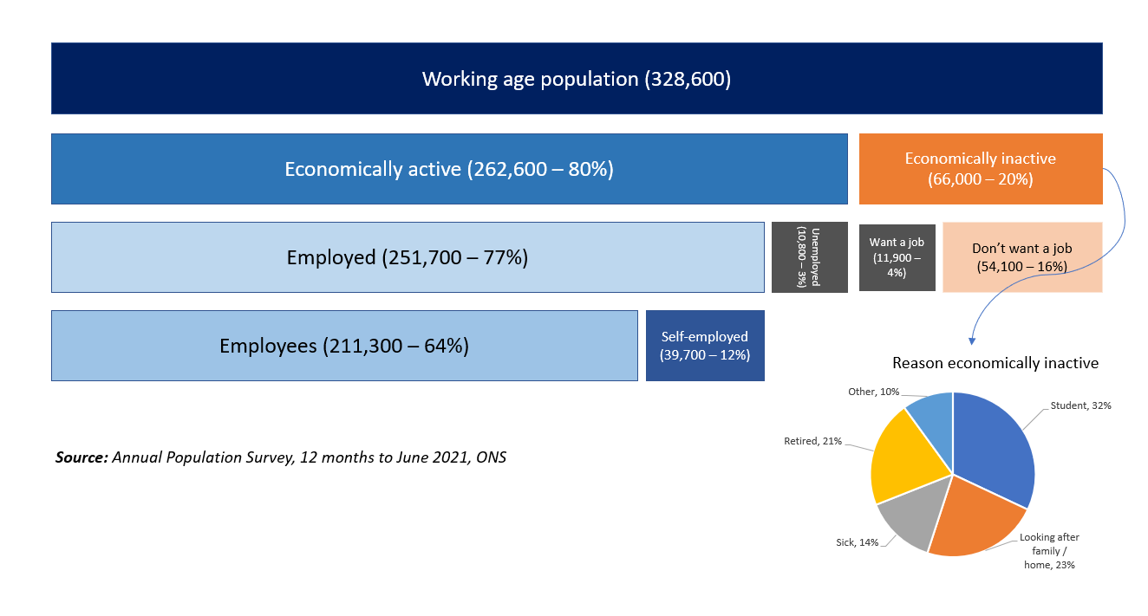
What levels of economic activity and inactivity are there within Buckinghamshire?
The big issue in the 2021 labour market was that as the economy picked up, there were fewer people available to work in Buckinghamshire than pre-pandemic.
The proportion of working age residents deemed to be economically inactive rose from 16% to 20% between the year to June 2020 and the year to June 2021. Reasons included: more people than normal taking early retirement; more young people than normal remaining in education rather than entering the workplace; some people (particularly those with health conditions) leaving the labour market due to Covid-19 fears; and some non-UK nationals returned home. These trends cumulatively led to there being around 12,000 fewer Buckinghamshire residents being available to work in the year to June 2021 than pre-pandemic.
Buckinghamshire’s employment rate had been consistently higher than the national rate over the last 16 years.
Unemployment, which is difficult to accurately measure within Buckinghamshire, is lower than the national average but pre-pandemic had been rising since 2017.
Of those who were economically inactive, the majority do not want a job.
In total, in 2021 there were approximately 22,000 working age residents who were not working but wanted a job (unemployed people plus those who were inactive but wanted a job).
Source: Annual Population Survey (July 20 to June 2021), ONS

Slide 31
How has Covid-19 affected unemployment in Buckinghamshire?
It has historically been difficult to accurately measure how many Buckinghamshire residents are unemployed.
Why?
In the UK, unemployment is measured using data collected from the ONS Annual Population Survey (APS). The sample size for Buckinghamshire is pretty small, which results in estimates that are not particularly reliable.
The estimates are based on data collected over a 12-month period and there are a few months between collection and publication. In March 2021 for example, the latest published data covered the period October 2019 to September 2020. It therefore included some data collected pre-Covid and some data collected during the Covid-19 pandemic.
Local unemployment data derived from the APS is therefore not particularly reliable and is not timely enough to measure the impact of Covid-19 in real or near time.
Definitions
Someone is officially classified as being unemployed if they do not have a job, have been actively seeking work for at least four weeks and are available to start work within the next two weeks.
The unemployment rate is the number of people who are unemployed divided by the number of people who are economically active.

Slide 32
How has unemployment in Buckinghamshire changed over time?
This chart shows how the unemployment rate in Buckinghamshire is estimated to have changed over the last 16 years, in comparison to the national average.
Buckinghamshire’s unemployment rate over the last decade and a half has been lower than the national average. Overall, it has tracked national trends but at a lower level, rising following the Great Recession and falling to its lowest rate in recent years in 2019. The latest rising tend reflects the impact of the Covid-19 pandemic.
Source: Annual Population Survey (July 2020 to June 2021), ONS

Slide 33
How many people in Buckinghamshire are claiming unemployment related benefits?
The Claimant Count combines the number of people claiming Jobseeker's Allowance with those who claim Universal Credit and are required to seek work and be available for work.
Whilst the Claimant Count is not a measure of unemployment, it is a useful proxy at the local level as it is based on administrative data rather than survey estimates. It is also a timely measure as data is released on a monthly basis. Data released in the second week in April 2021, for example, measures the number of claimants in the month to the second week in March 2021.
Some things to bear in mind when using Claimant Count data:
Not all those who are unemployed claim benefits. This is largely due to people finding new work quickly or having other sources of financial support (such as a partner’s income, a redundancy payoff or savings).
In normal (non-pandemic) times, it is estimated that around 55% of unemployed Buckinghamshire residents claim benefits and are therefore counted within the Claimant Count. A much lower proportion than the national average.
Not all those counted within the Claimant Count are unemployed. Some are working a small number of hours and / or are earning a low income. Changes made at the beginning of the pandemic means that more people are eligible for the Claimant Count than previously.
Due to the phased nature of recent changes to the benefits system, the Claimant Count cannot be used to accurately measure historical trends. To deal with this issue, the Department for Work and Pensions (DWP) publish the Alternative Claimant Count, which models what the count would have been if Universal Credit had been in place since 2013. This data is less timely than the Claimant Count itself. For example, data for August 2020 was published in October 2020. And is published quarterly rather than monthly. It does provide information on the flow of individuals onto and off the Claimant Count however, which is useful and not available for the standard Claimant Count data.

Slide 34
How many people in Buckinghamshire are claiming unemployment related benefits?
The number of Buckinghamshire residents claiming unemployment related benefits shot up following the onset of the Covid-19 pandemic and has been gradually falling since March 2021.
Buckinghamshire’s claimant count rate (claimants as a proportion of all residents aged 16-64) in December 2021 stood at 3.1%, lower than the national average of 4.5%
Further analysis of Claimant Count and Alternative Claimant Count data is presented on the following pages. As this data is released on a monthly basis, please download Buckinghamshire LEP’s Monthly Claimant Count Report for the latest data.
Claimant Count Rate
Number of Claimants
Source: Claimant Count, 2021

Slide 35
How does Buckinghamshire’s Claimant Count rate compare to other areas?
In December 2021, Buckinghamshire had the 6th lowest Claimant Count rate of the 38 LEP areas. At the start of the pandemic, Buckinghamshire had the 4th lowest Claimant Count.
Claimant Count Rate
Source: Claimant Count, 2021

Slide 36
Which areas have seen the biggest increases in Claimant Count rates since the onset of the pandemic?
Buckinghamshire’s Claimant Count rate was 1.4 percentage points higher in December 2021 than in March 2020. This places Buckinghamshire mid-table in terms of the impact of Covid-19 on Claimant Count rates. London experienced the greatest increase, with Cumbria and Tees Valley experiencing the smallest increases.
Percentage Point Increase in Claimant Count Rate (Mar 2020 to Dec 2021)
Source: Claimant Count, 2021

Slide 37
How does the Claimant Count rate vary within Buckinghamshire and by age?
Area | March 2020 |  | December 2021 |  | March 2020 - December 2021
Parliamentary constituency | Number | % | Number | % | Change | % point change
Aylesbury | 1,420 | 1.8 | 2,520 | 3.2 | 1,100 | 1.4
Beaconsfield | 820 | 1.4 | 1,680 | 2.8 | 860 | 1.4
Buckingham | 710 | 1.1 | 1,405 | 2.2 | 695 | 1.1
Chesham & Amersham | 750 | 1.4 | 1,435 | 2.6 | 685 | 1.2
Wycombe | 1,840 | 2.6 | 3,270 | 4.7 | 1,430 | 2.1
Buckinghamshire | 5,540 | 1.7 | 10,310 | 3.1 | 4,770 | 1.4
England | 1,063,505 | 3.0 | 1,589,200 | 4.5 | 525,695 | 1.5
Within Buckinghamshire, the Claimant Count rate is highest (December 2021) in the Wycombe parliamentary constituency area at 4.7%. Wycombe’s Claimant Count rate is higher than the national average. Buckingham has the lowest Claimant Count rate at 2.2%.
Age | March 2020 |  | December 2021
 | Number | Share of total | Number | Share of total
Aged 16-24 | 885 | 16% | 1,390 | 13%
Aged 25-49 | 3,065 | 55% | 6,110 | 59%
Aged 50+ | 1,590 | 29% | 2,810 | 27%
All ages | 5,540 | 100% | 10,310 | 100%
Over half of all those claiming ‘out-of-work’ related benefits are aged between 25 and 49. The proportion of both younger (16-24) and older (50+) claimants is smaller than pre-pandemic.
Source: Claimant Count, 2021

Slide 38
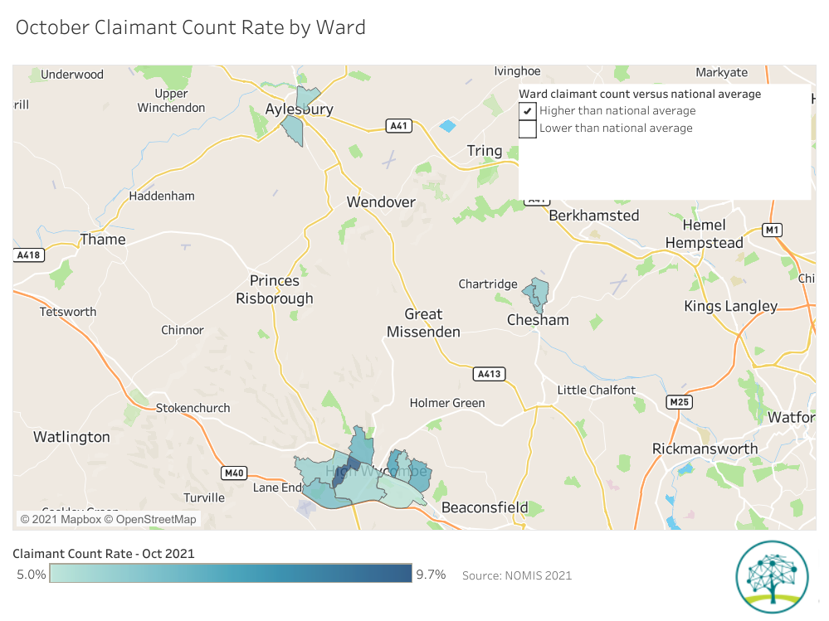
In October 2021 13 Buckinghamshire wards had ‘higher than national average’ claimant count rates. There are three clusters with high claimant count rates in Bucks. All are in urban areas. The largest geographic cluster is in High Wycombe.
How does the Claimant Count rate vary within Buckinghamshire?
Source: DWP, 2021 (via www.nomisweb.co.uk)
Click here for interactive version of map - October Claimant Count Rate by Ward | Tableau Public

Slide 39
What is the historic Claimant Count trend?
Using Alternative Claimant Count data (modelled data which estimates what the Claimant Count would have been if Universal Credit had been in place since 2013), we see that Buckinghamshire’s Claimant Count rate was low (under 2%) for five years prior to the Covid-19 pandemic. Between 2013 and 2015, Buckinghamshire’s Claimant Count fell from just over 3% to just under 2%.
Source: Alternative Claimant Count, DWP

Slide 40
What have been the flows of people onto and off the Claimant Count?
Prior to the Covid-19 pandemic, approximately 1,000 people flowed onto the Claimant Count and 1,000 people flowed off the Claimant Count every month. April and May 2020 saw massive increases in the number of people flowing onto the Claimant Count, with few people flowing off the Count. Subsequently, the summer months have tended to see more people leave the Count than join, whereas the winter months, when Covid-19 mitigation measures have been in place, have seen slightly more people join the Count than leave.

Slide 41
To what extent has productivity been growing in Buckinghamshire in recent years?
In recent years, Buckinghamshire has been outpaced by other areas of the UK in terms of productivity growth (GVA per hour worked). The result being a drop in position from 4th out of 38 LEP areas in 2010, to 9th in 2019. Buckinghamshire’s productivity is now just above the national average, or below the national average if the influence of the housing market is stripped out. Buckinghamshire has seen greater employment growth in low productivity sectors than in high productivity sectors in recent years.
Source: Subregional Productivity, ONS, 2021

Slide 42
To what extent have wages been growing in Buckinghamshire in recent years?
Wages for both Buckinghamshire residents and Buckinghamshire workers are higher than the national average. Buckinghamshire residents earn more than those working in the Buckinghamshire economy, although the gap closed in 2021 .
Between 2014 and 2021, wages within the Buckinghamshire economy grew at a faster rate than did the wages of residents (10%) and wages cross the country as a whole. This could be linked to Buckinghamshire employers finding it difficult to recruit and needing to increase wages to attract those who could commute to higher paying localities, such as London.
Source: Annual Survey of Hours and Earnings, 2014 - 2021

Slide 43
What is Buckinghamshire’s demographic profile?
Approximately 547,000 people currently live in Buckinghamshire, of whom 60% are of working age (lower than the national average of 62%). Buckinghamshire has a lower proportion of 20–34-year-olds than the national average and a greater proportion of people aged 35 and over, and under 16 (see chart).
A comparatively high proportion of the local population are over the age of 90. Analysis by Buckinghamshire Council suggests that between 2018 and 2038, the county will experience a 147% growth in people aged over 90, and a 40% growth in people aged over 60. There are also expected to be 10% more 8- to 18-year-olds, but fewer people still in the 20-35 age bracket. In 2018 there were three working age people per older dependent (aged 65+) in Buckinghamshire. By 2038, this is predicted to reduce to two.
Source: ONS Mid-Year Population Estimates, 2020

Slide 44
What is Buckinghamshire’s demographic profile?
How might the age profile of the Buckinghamshire population impact economic growth and the demand for labour and skills?
Ageing population
An ageing population and shrinking relative size of the economically active population will have long-term implications for the health and social care sector, which has experienced a high level of strain due to the Covid-19 pandemic. The sector has traditionally experienced recruitment difficulties, particularly in the social care segment, and in recent years has relied more and more on overseas workers to fill vacancies. Retaining staff will be key, particularly as recruiting EU citizens will be more difficult following the UK’s exit from the EU.
Availability of housing
The availability of housing is a challenge for economic growth and could be further impacted by an ageing population. People are living longer, and retirees often choose to continue residing in their family home rather than downsizing, due to a lack of availability of suitable housing and / or high costs of retirement homes (Demos, 2014). This creates dual pressure on councils and house builders to supply enough homes for working age families, along with supplying enough retirement homes to encourage retirees to downsize. The Aylesbury Vale area of Buckinghamshire has seen some of the highest rates of housebuilding in the country in recent years (Aylesbury Garden Town Socio-Economic Study, 2020). Much of this housing has been aimed at working age families and is therefore likely to help increase the size of the labour pool for local employers.
Town centre appeal
Despite being home to three Higher Education Institutions, attracting and retaining young people in Buckinghamshire has traditionally been a challenge, particularly given the social and cultural lure of London and other major cities. The lack of appeal of Buckinghamshire’s main town centres to young people is often cited as a contributary factor.

Slide 45
To what extent is there deprivation within Buckinghamshire?
At an aggregate level, Buckinghamshire’s deprivation levels are low. However, there are of pockets of deprivation within the county (particularly in Wycombe, Aylesbury and Chesham) and there is evidence of inequality.
With a 2019 Index of Multiple Deprivation (IMD) deprivation score of 10.1, Buckinghamshire is deemed the least deprived LEP area in England.
None of Buckinghamshire’s neighbourhoods are included in the 10% most deprived nationally for income or employment. However, 6% of neighbourhoods in Aylesbury Vale, and 1% of neighbourhoods in Wycombe are in the 10% most deprived neighbourhoods nationally in terms of education.
Within Buckinghamshire, pupils at non-selective schools achieve much lower attainment 8 scores than those at grammar schools, and leavers are less likely to continue in education. Additionally, young people eligible for Free School Meals (FSM) on average achieve a lower attainment 8 scores in Buckinghamshire than nationally (DfE, 2019).
These findings are reinforced by a report from the Social Mobility Commission (2019), which found that Wycombe, South Bucks and Chiltern have some of the largest education gaps in England, with Chiltern having the lowest social mobility in England.

Slide 46
Section 3: Skills supply

Slide 47
How qualified is the local labour pool?
45% of Buckinghamshire’s working age population have a Level 4 or higher qualification (see chart). The majority of these people will be degree holders. This is five percentage points higher than the national average. A similar proportion are qualified to Level 2 and 3 as the national average, whilst fewer have no qualifications or are qualified to Level 1.
The table below describes what these levels mean in practice.
There tends to be higher demand from employers for people with higher-level technical qualifications (at Levels 3, 4 and 5) than the number of people achieving or entering the labour market on achieving qualifications at these levels.
Sectors in which there is a high demand for people with qualifications at higher technical level include: high performance engineering, space, film and TV and digital technologies.
In some sectors, employers seek recruits who hold a degree, despite a degree not necessarily being required to undertake the role.
Level | Description
Level 1 | Fewer than 5+ GCSEs / NVQ 1
Level 2 | 5+ GCSEs / NVQ 2 or equivalent
Level 3 | 2+ A-levels / NVQ 3 or equivalent
Level 4+ | HNC, HND, NVQ 4 and 5, degree or higher
Source: Annual Population Survey (Jan – Dec 2020), ONS

Slide 48
Who are Buckinghamshire’s main providers of education and training?
Secondary schools
Buckinghamshire is one of the last remaining counties in England where education is selective. There are 13 grammar schools and 21 upper schools in the County. The County also has one Free School and one University Technical College (Buckinghamshire UTC - which focuses on construction and digital provision)
Higher Education (HE)
Buckinghamshire has three Higher Education Institutions:
University of Buckingham
Buckinghamshire New University
National Film and Television School
The University of Bedfordshire also has a presence in the County, delivering nursing and midwifery qualifications from its Stoke Mandeville campus.
Further Education (FE)
Buckinghamshire College Group is the largest provider of 16-18 full-time education and training in Buckinghamshire, with 30% of the county’s 16–18-year-olds studying at the college.
The College also caters for adult (19+ learners).
Adult Education
Buckinghamshire has a County-wide adult education service - Buckinghamshire Adult Learning.
Apprenticeships
Buckinghamshire College Group and Buckinghamshire New University are the largest providers of apprenticeship training within Buckinghamshire. A significant proportion of apprenticeship provision in Buckinghamshire is delivered by out of area providers.
Bordering Bucks
In addition to the above, the Silverstone UTC, the South Central Institute of Technology and Henley Business School are situated on the Buckinghamshire border.
Pinewood Studios
There are a dozen private training companies serving the creative industries and its supply chain located at Pinewood Studios.

Slide 49
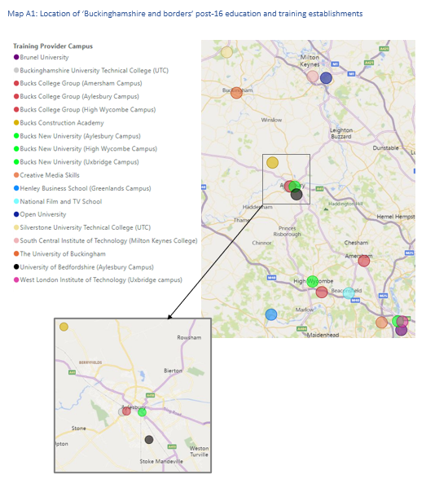
Who are Buckinghamshire’s main providers of education and training?
Click here for an interactive version of map

Slide 50
What do young people in Buckinghamshire do after Year 11, or after 16-18 education?
Following Year 11 (Key Stage 4), in 2019/20 most young people from state funded mainstream schools (64%) entered a school sixth form. This much higher than the national average of 37%. Nationally, more young people entered Further Education (36% compared to 22% in Buckinghamshire) and Sixth Form Colleges (13% compared to 5% in Buckinghamshire). Overall, 92% entered sustained education in Buckinghamshire, compared to 87% nationally. Moving into apprenticeships and employment are less common in Buckinghamshire than nationally.
Source: Key Stage 4 destinations, DfE, 2020
The university destination is deeply ingrained in Buckinghamshire as the pathway of choice after school, and to a lesser extent after college. In 2019/20, 64% of young people in Buckinghamshire went from a state funded mainstream school to university, higher than the national average of 55%.
Two fifths (40%) of those leaving college in Buckinghamshire in 2019/20 entered work, higher than the national average of 28%, and likely a reflection of the vocational focus of the Buckinghamshire College Group.
Source: 16-18 destinations, DfE, 2020
In 2019/20, 110 young people in Buckinghamshire entered employment after Year 11, and 1,116 entered employment on completion of 16-18 education

Slide 51
What do young people in Buckinghamshire do after Year 11, or after 16-18 education?
 | Key Stage 4 (Y11) [State-funded schools] - Bucks |  | National | Key Stage 5 (Y12 or Y13) [State funded schools and colleges] – Bucks |  | National
 | Number of pupils | % | % | Number of pupils | % | %
Cohort | 5,673 |  |  | 4,628
Sustained education, apprenticeship or employment | 5,448 | 96 | 94 | 4,030 | 87 | 81
Sustained education | 5,223 | 92 | 87 | 2,658 | 57 | 49
Higher Education |  | 0 |  | 2,363 | 51 | 37
Further Education | 1,272 | 22 | 36 | 228 | 5 | 9
School Sixth Form | 3,635 | 64 | 37 |  |  | 1
Sixth Form College | 255 | 5 | 13 |  |  | 1
Other education (includes independent schools) | 61 | 1 | 1 | 67 | 1 | 3
Apprenticeship | 122 | 2 | 4 | 256 | 6 | 8
Employment | 103 | 2 | 3 | 1,116 | 24 | 24
Not a sustained desination | 162 | 3 | 5 | 394 | 9 | 13
Unknown | 63 | 1 | 1 | 204 | 4 | 6
Source: Key stage 4 destination measures, Academic Year 2019/20 – Explore education statistics – GOV.UK (explore-education-statistics.service.gov.uk) and 16-18 destination measures, Academic Year 2019/20 – Explore education statistics – GOV.UK (explore-education-statistics.service.gov.uk)

Slide 52
What are Buckinghamshire’s apprenticeship take-up levels?
 | Number of apprenticeship starts
 | 2016/17 | 2017/18 | 2018/19 | 2019/20 | 2020/21 | 2016/17 to 2019/20 change
Buckinghamshire | 2,960 | 2,600 | 2,860 | 2,270 | 2,470 | -17%
England | 494,880 | 375,760 | 393,380 | 322,530 | 321,440 | -35%
Source: Apprenticeship statistics, DfE
Buckinghamshire has historically had a small but stable number of people taking apprenticeships. Pre-Covid-19, there were fewer apprentices in the local workforce than the national average, and fewer young people choosing apprenticeships at the ages of 16 or 18. Apprenticeships starts decreased between 2016/17 and 2019/20, likely due to funding reforms, including the introduction of the Apprenticeship Levy. However, starts did not decreased in Buckinghamshire as sharply as they did nationally. Between 2019/20 and 2020/21 the number of apprenticeships started by Buckinghamshire residents increased, whilst starts decreased nationally. The greatest increase in numbers was in the area of ‘health, public services and care’ , likely linked to an increased profile and need for people to work in this sector as a result of the Covid-19 pandemic and also increased activity as a result of establishment of the Bucks Health and Social Care Academy.

Slide 53
Who is undertaking Apprenticeships in Buckinghamshire? At what level? And has this changed in recent years?
In 2020/21, 54% of all those starting Apprenticeships were female and 46% were male.
In 2020/21 50% of Apprenticeships were started by people over the age of 25, up from 36% in 2015/16. Over the same period, the proportion of Apprenticeship started by those under 19 years of age decreased from 32% to 17%.
There has been a significant shift in the number of Apprenticeships being started at different levels. In 2015/16, 54% of Apprenticeship starts were at Level 2, dropping to only 20% in 2020/21.
Over the same period, there has been a sharp increase in Higher Apprenticeship starts (Level 4 and above). Over a third of Apprenticeship starts in 2020/21 were at this level, up from 5% in 2015/16.
Source: Apprenticeships and traineeships, Academic Year 2020/21 – Explore education statistics – GOV.UK (explore-education-statistics.service.gov.uk)

Slide 54
How have apprenticeship reforms and the Covid-19 pandemic affected the take-up of apprenticeships in Buckinghamshire?
Apprenticeship reforms
Several reforms to apprenticeships came into effect in 2017. These included a move to employer designed standards, a requirement for 20% off-the-job training and the introduction of a levy for larger employers.
Buckinghamshire has a relatively small number of apprenticeship levy paying organisations (estimated to be in the region of 280), and a disproportionately high number of SME, particularly micro-sized businesses, who typically need more support to recruit and manage apprentices.
In terms of the impact of reforms, local providers report witnessing greatest change amongst large employers wishing to spend their levy. Within the public sector in particular, employers such as the local health trust and the police force have been keen to grow apprenticeship provision to spend their levy.
Further reforms were announced at the Spring 2021 budget. These include apprenticeship levy transfer changes and increased financial incentives for smaller employers to take on new apprentices.
Impact of Covid-19
Covid-19 negatively impacted the apprenticeship experience for some of those part-way through their apprenticeships and led to a decrease in the number of new apprenticeship vacancies (an estimated drop of 45% in 2020 in Buckinghamshire compared to 2019). Some apprentices were furloughed, whilst others had their on and off-the-job activities re-timetabled to fit with the situation the sector they were working in was facing (for example, health and social care apprentices were required to work rather than study, whilst some construction apprentices were required to study rather than work).

Slide 55
What subjects have been studied by those graduating from Buckinghamshire’s Higher Education Institutions?
In 2019/20, Higher Education qualifiers (those successfully completing Higher Education qualifications) from Buckinghamshire HEIs were concentrated in three subject areas: business and management (25%), education and teaching (20%) and subjects allied to medicine (18%). In contrast, the proportion of Higher Education qualifiers in England are distributed across a wider range of subject areas, with smaller concentrations in business and management (18%), subjects allied to medicine (10%) and education (8%).
The high number of qualifiers undertaking subjects related to business and management is attributed to the presence of the University of Buckingham Business School, along with a range of business degrees offered by Buckinghamshire New University.
Undergraduate health and medical courses within Buckinghamshire are provided by the University of Buckingham (Medical School), Bucks New University (nursing, health and social care, health and social science, operating department practice, public health) and the University of Bedfordshire (Stoke Mandeville campus) (nursing and midwifery).
The newly established Buckinghamshire Health and Social Care Academy helps facilitate partnership working between these institutions and health providers.
Source: HESA, 2019/2020 qualifiers (published 2021)

Slide 56
What to those graduating from Buckinghamshire’s Higher Education Institutions do next?
Those graduating from Higher Education Institutions (HEIs) in Buckinghamshire are more likely than average to enter employment. In the last year for which we have data, 64% entered full-time employment and 12% entered part-time employment. The corresponding figures for England being 55% and 11% respectively.
The above average proportion of Buckinghamshire HE graduates entering employment could be related to the proximity of Buckinghamshire to London, which offers a large and relatively accessible supply of jobs, particularly at graduate entry-level. It could also be related to the type of degrees on offer, many of which are more vocational than academic.
Source: HESA, 2018/19 graduates (published 2021)
All three of Buckinghamshire’s HEIs are in the top half of the table for graduate employability. Of the 437 UK HEIs, the National Film and Television School (NFTS) ranks 4th, Buckinghamshire New University 34th and the University of Buckingham 40th (HESA, 2021).
Buckinghamshire New University places a strong focus on employability, focusing on degrees that are professional and practical, as well as academic. This focus, along with high levels of industry involvement, is likely to contribute to its high graduate employability ranking. NTFS has very strong links with industry. Many graduates go on to become creative leaders for the UK’s largest and most high-profile film and television content creators (NFTS Graduate Impact Report, 2020).
In contrast to the national average, a lower proportion of HE graduates in Buckinghamshire continue into full-time further study, or a combination of employment and further study. A possible reason could be that many of the subjects available for graduate study in Buckinghamshire, may not be allied to careers that require further study at postgraduate level.

Slide 57
Where do Buckinghamshire graduates live after graduating?
Just under half (40%) of Buckinghamshire HE graduates remain in the South East one year after graduating, with just over a quarter moving to London.
Graduates opting to move to London are likely to do so to access a wider range of graduate entry-level jobs, and to enjoy the London lifestyle.
There is little change 5 years post graduation.
Source: Graduate Outcomes in 2018/19, DfE, (published 2021)

Slide 58
To what extent do Buckinghamshire employers provide training to their staff?
Proportion of employers providing training
Pre-Covid-19, just over half (57%) of employers in Buckinghamshire provided training to their employees. This is lower than the national average of 61%.
Training funded or arranged for employees by Buckinghamshire employers is primarily job specific training (84%), along with health and safety/first aid training (69%); basic (55%) and extensive (33%) induction training for new staff; training in new technology (55%); management training (28%) and supervisory training (25%).
The lower-than-average proportion of employers providing training in Buckinghamshire could be linked to the relatively high proportion of micro-businesses in comparison to the national average. For such employers, having the few staff they employ away on training may not be possible due to their workload, or the employer may lack the financial resources to provide training.
Further insight from the 2019 Employer Skills Survey shows that 71% of employers not providing training believe that all their staff are fully proficient or have no need for training. A further 12% said training was not provided as it was not considered to be a priority, and 7% said there was no training available in the relevant subject area.
12% of Buckinghamshire employers not providing training do not see it as a priority
7% of Buckinghamshire employers not providing training can not find training available in the relevant subject area
Source: Employer Skills Survey, 2019 (published 2020)

Slide 59
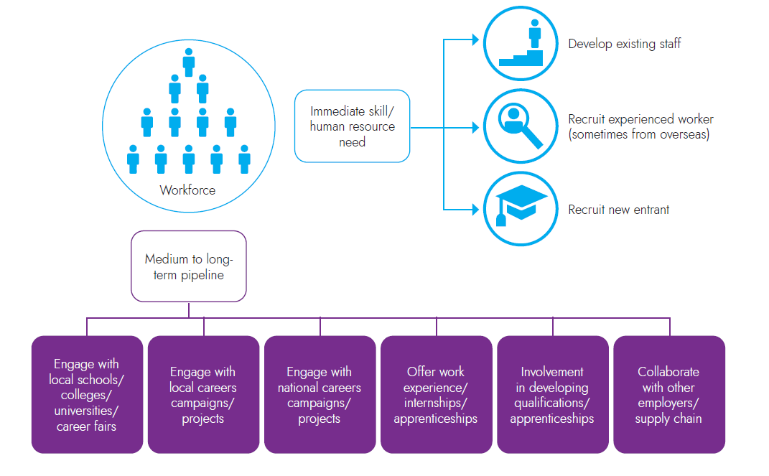
How do employers fill vacancies and develop talent pipelines?
This diagram shows some of the ways in which employers address their skills needs

Slide 60
Section 4: Skills demand

Slide 61
How can demand for skills be measured?
Skills demand can be measured in several different ways.
We can examine levels of demand from local employers by analysing on-line job postings and using intelligence from local recruitment agencies. What job vacancies are being advertised and what skills are being cited within job adverts?
We can review literature (including reports produced by national sector bodies and the Migration Advisory Committee) and speak to employers to get a sense of skills shortage occupations (i.e. jobs that employers find difficult to fill due to a lack of applicants with the required skills). Some skills shortage occupations have been classified as such for many years (think engineers, chefs, medical practitioners and social workers), others come and go.
We can also review literature and speak to employers to get a sense of jobs that employers find difficult to fill for non-skills related reasons. For example, not enough people are interested in the type of work or are unable to easily access a location (for example, fruit and vegetable pickers).
Finally, we can get a sense of sectors and occupations that are expected to grow and estimate how this might affect future demand for skills, via employment projections, knowledge of global trends and through knowledge of developments in the pipeline at local level.

Slide 62
What types of jobs are in greatest demand in Buckinghamshire?
Whilst there are limitations associated with using online job postings to ascertain demand for labour in a local economy (for example, the posting of job vacancies online is more common in some sectors and for some occupations (notably professional occupations) than others and there can be difficulties in assigning job postings to sectors and locations) they can provide a useful gauge of demand at an occupational level, and are particularly useful for more granular deep dive analysis into the specific skills employers are seeking.
The chart below presents in broad terms, job postings by occupational group for Buckinghamshire and England in 2021. We see that overall, Buckinghamshire had lower demand for professionals than the national average, and greater demand for people in mid-skilled roles (e.g. sales and customer service, administrative, care and other services occupations and skilled trades). The level of demand differs to what might be expected given the occupational profile of those working in the Buckinghamshire economy). The difference probably being due to the occupational profile including those who work for themselves, whilst the job posting data being based on demand for employees only.
Source: Job Postings 2021, Labour Insight, Burning Glass Technologies

Slide 63
What types of jobs are in greatest demand in Buckinghamshire?
Top job postings in Buckinghamshire in 2021, as a proportion of all job postings (purple bars indicate higher level of demand locally than nationally)
In 2021, the job in highest demand in Buckinghamshire (according to online job postings) was office / admin assistant. This was also the case nationally.
Jobs that were in higher demand locally than nationally included:
Office / admin assistants
Customer service representatives
Account manager / representatives
Labourer / material handler
Lawyer
Accountant
Source: Job Postings 2019, Labour Insight, Burning Glass Technologies

Slide 64
How did Covid-19 affect the job market?
Job creation: occupations with more job postings in Bucks in 2021 than in 2019
Occupations for which there was greater demand in 2021 compared with 2019:
Health and social care roles (care in particular)
Roles linked to the increase in online retail (e.g. driver roles)
Teaching roles (including tutors)
Legal and finance roles
Some construction roles
Admin roles
Source: Labour Insight, Burning Glass Technologies

Slide 65
How did Covid-19 affect the job market?
Reduced demand: occupations with fewer job postings in Bucks in 2021 than in 2019
Occupations for which was lower demand in 2021 than in 2019 include
Hospitality (chefs, food service, waiting staff, housekeeping)
Events
Marketing
In addition to the impact of the Covid-19 pandemic, drops in job vacancies could also reflect the level of churn in the job market. With, in some cases, people being more likely to stay in roles than they might overwise have done, for financial security.
Source: Labour Insight, Burning Glass Technologies

Slide 66
How did Covid-19 affect the job market? And will there be any long-lasting changes?
In terms of long-lasting changes, the Covid-19-fuelled acceleration of the use of on-line retailing has been well documented. By examining job posting data for the sector (see table), we can see the impact this is having on the demand for skills. In quarter 4 of 2020, there was higher demand for drivers, pharmacy workers, labourers, warehouse workers and software developers than in quarter 4 of 2019, and lower demand for people working at tills or on the shop floor.
Two other roles for which there has been a surge in demand over the last 12 months are demand planners (people who forecast future demand for products to time movement within the supply chain) and cybersecurity specialists (as cyber-crime has increased as more transactions are being undertaken online). The latter is likely to be in high demand for years to come.
Retail sector job postings (UK), 2019 and 2020 comparison
 | % of all retail job postings |  | Change in demand between Q4 2019 and Q4 2020
Occupation | 2019 | Q4 2020
Customer service, sales and retail assistants | 29.4% | 24.5% | -4.9%
Retail Store Manager / Supervisor | 8.8% | 7.8% | -1.0%
Pharmacist | 3.1% | 4.5% | 1.4%
Delivery Driver | 2.7% | 4.3% | 1.6%
Labourer / Material Handler | 2.2% | 3.3% | 1.1%
Pharmacy Technician | 1.3% | 2.2% | 0.9%
Project Manager | 3.2% | 2.2% | -1.0%
Software Developer / Engineer | 1.3% | 1.8% | 0.6%
Account Manager / Representative | 4.1% | 1.7% | -2.4%
Warehouse / Inventory Associate | 0.7% | 1.7% | 1.0%
Source: Labour Insight, Burning Glass Technologies

Slide 67
Which sectors are predicted to create the most jobs in Buckinghamshire over the next 10 years?
Key growth sectors (from an employment perspective) within Buckinghamshire over the next 10 years will be:
Construction (in part due to HS2, East West Rail, Aylesbury Garden Town related construction activity, and a large house building programme)
Creative Industries (linked to expansion plans at Pinewood Studios, plus the continuing growth of the West of London Screen Cluster with many new sound studios opening within the next few years)
Life sciences, health and social care (linked to both the health needs of an ageing population and the need to respond to the aftermath of the Covid-19 pandemic)
Space (linked to expansion of the Westcott Space Cluster)
High performance engineering (linked to expansion of the Silverstone Enterprise Zone and an increasing focus on the need for green technologies to combat climate change)
The construction, creative and health and social care sectors are expected to create the greatest volume of jobs over the next five years.
Pinewood Studios’ expansion plans are predicted to create 3,500 new jobs, including 1,500 construction jobs.
The construction of HS2 is expected to create around 4,000 jobs in Buckinghamshire and the surrounding areas.
It is anticipated that the 10-year plan for the Westcott Space Cluster will create over 2,000 jobs.
The Space, Creative Industries, High Performance Engineering and MedTech sectors are identified within Buckinghamshire’s Local Industrial Strategy as key sectors. Each has a significant ‘asset’ located within the county (Westcott Space Cluster, Pinewood Studios, Silverstone Park and Technology Cluster and Stoke Mandeville hospital) and strong long-term growth prospects.
More detailed analysis of workforce trends, skills shortages and local training provision for these sectors is available from Buckinghamshire LEP.

Slide 68
What skills need developing in Buckinghamshire?
Pre-Covid-19, the top three skills employers in Buckinghamshire believed needed improving within their workforce were: ‘knowledge of products and services offered by their organisation’, ‘specialist skills or knowledge needed to perform the role’, and ‘adapting to new equipment or materials.’ These were also the top three skill needs of employers nationwide.
Employers anticipate the need for new skills due to factors such as new legislative or regulatory requirements (49%); the introduction of new technologies or equipment (38%); the development of new products or services (38%); the introduction of new working practices (36%); increased competitive pressure (19%); and Brexit (19%).
Source: Employer Skills Survey, 2019 (published 2020)

Slide 69
What is the demand for digital skills within Buckinghamshire?
As is the case nationally and globally, digital skills are in high and growing demand within Buckinghamshire.
Pre-Covid-19¹:
A third of Buckinghamshire employers with employees deemed ‘not fully proficient’ stated that these employees lack the required IT skills.
A third of Buckinghamshire employers struggling to recruit people with the required skills said that applicants lacked the required digital skill.
Nearly three quarters of Buckinghamshire employers expected the need for new skills within their business over the next 12 months. Of these, 45% expected the need for new digital skills.
A third of Buckinghamshire employers who struggle to recruit people with the required skills say that applicants lack the required digital skills¹.
Research undertaken with Buckinghamshire SMEs by Buckinghamshire Business First in 2019, found that whilst the majority (76%) believed that new and emerging technologies would assist their business and improve their offerings and outputs, only 41% of were currently prepared to take advantage of such technologies. This figure is likely to have increased as a result of the pivoting required during the Covid-19 pandemic.
Covid-19 has accelerated the need for individuals to raise their IT skills and for employers to adopt new technology.
Unemployment is set to rise in 2021, with some people finding themselves out of work for the first time in their lives. Some will need to retrain and take a new career path. Sectors that are expected to experience reduced levels of activity for the next couple of years include aviation, travel, hospitality and live events. In addition, the high street retail sector is experiencing a decline accelerated by Covid-19. Those made redundant from jobs within these sectors and their supply chains, may be amongst those who will benefit most from updating their digital skills to help them gain new employment.
¹ Employer Skills Survey, 2019 (published 2020)

Slide 70
In which sectors and occupations should we prioritise skills activities to meet current and future demand within Buckinghamshire?
Sources used to develop this table include: Business Register and Employment Survey 2020, ONS, local intelligence from SAP sector groups, data from sector bodies, the Employer Skills Survey 2019, DfE, Labour Insight (Job Posting data), Burning Glass Technologies.

Slide 71
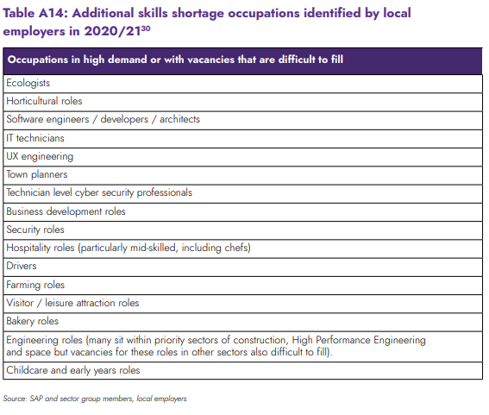
What other occupations have been identified by employers locally as being in particularly high demand or being difficult to recruit into?
The occupations listed in this table are those identified by local employers as being in particularly high demand at present and / or being difficult to roles to recruit into.
It is by no means an exhaustive list and will be continually added to when new intelligence is acquired.

Slide 72
What specific skills have been reported by Buckinghamshire employers as being difficult to source or requiring focus due to anticipated future demand? (1 of 2)
General | Management and leadership skills (including skills required to take advantage of digital, data and AI opportunities, and managing remote workforces)
 | Self-employment skills (including interpersonal and networking skills, risk analysis, functional business skills, business knowledge)
 | Entrepreneurial skills
 | Hybrid skills (combing technical and business development skills)
 | Digital skills at all levels
 | Work-readiness of young people
 | Analytical skills
 | Sales and business development skills
 | Automation skills
 | Staff welfare and wellbeing skills
Creative industries | Fundraising
 | Social media
 | Technological change
 | Advanced IT
High Performance Engineering | Science, technology, engineering and mathematics (STEM) skills), cutting edge R&D and prototyping skills
Source: Buckinghamshire Skills Advisory Panel and sector sub-group members, 2019 - 2020

Slide 73
What specific skills have been reported by Buckinghamshire employers as being difficult to source or requiring focus due to anticipated future demand? (2 of 2)
MedTech | High level digital, advanced data analytics and machine learning
 | Skills to deploy Internet of Medical Things (IoMT) solutions e.g. network management
 | Data scientists with advanced degrees and training in maths, statistics and/or computer science and experience in data mining and data visualisation
 | Multidisciplinary talent technical, science and business
 | Business skills to manage the path from R&D to market
 | Applied knowledge of ISO
 | Design skills
 | Testing skills (including clinicians)
 | Partnership skills - to develop partnerships across relevant technological spheres and grow the products and business areas that develop.
Space | Science, technology, engineering and mathematics (STEM) skills)
 | Cryogenics
 | Skills associated with 5G, drones and space capabilities.
Construction | Analytical skills
 | Skills associated with new construction methods
Digital | Social and language skills, incl. composition, sentence structure, fluency in second languages to enable successful provision of support to global customers.
 | Problem navigation and solution skills (incl. applied technical knowledge e.g. networking, operation systems).
Source: Buckinghamshire Skills Advisory Panel and sector sub-group members, 2019 - 2021

Slide 74
What training do Buckinghamshire employers find most valuable?
In 2020, Buckinghamshire Skills Advisory Panel members reported that local employers find the following training most valuable:
Leadership (including managing remote teams)
Diversity and inclusion
Critical strategic skills (e.g. business planning)
Mental health awareness
Apprenticeships
Courses that help develop soft skills (e.g. personal responsibility, self-management, positive attitude and personal presentation)

Slide 75
Section 5: The extent of skills mismatches within Buckinghamshire

Slide 76
To what extent do Buckinghamshire employers struggle to fill vacancies, and why?
Pre-Covid 19, just over a quarter (28%) of vacancies in Buckinghamshire were skills shortage vacancies. This is slightly higher than the national average (25%). In addition, a quarter of vacancies were hard-to-fill, which is more than double the national average at 12%.
Further evidence from the 2019 Employer Skills Survey shows that, of the hard-to-fill vacancies in Buckinghamshire, 45.5% of them are associate professional roles. This is the highest of any LEP area by a significant margin. Likewise, Buckinghamshire has the highest proportion of all 38 LEP areas of high-skill roles identified as hard-to-fill.
Further analysis of the 2019 Employer Skills Survey suggests that the quantity of applicants rather than the quality of applicants is a key issue in Buckinghamshire. It shows that 58% of hard-to-fill vacancies are caused by ‘not enough people interested in doing this type of job’. In addition, 46% are caused by the ‘low numbers of applicants generally’. Both causes in Buckinghamshire are the highest of all 38 LEP areas.
Source: Employer Skills Survey, 2019 (published 2020)

Slide 77
To what extent are there skills mismatches within the existing workforce?
Whilst Buckinghamshire employers find it more difficult to recruit than average, they appear to have fewer skills mismatches (on aggregate) within their existing workforce.
According to the 2019 Employer Skills Survey (ESS), 3.9% of staff are not fully proficient in Buckinghamshire, which is lower than the national average at 4.6%. Whilst 31% of employers in Buckinghamshire reported overqualified staff, which is also lower than the national average at 34%.
Whilst Buckinghamshire performs better than the national average, the data does still suggest some mismatch. Will greater exploration needed to understand how staff could be better utilised by their employers.
Source: Employer Skills Survey, 2019 (published 2020)

Slide 78
Annex

Slide 79
How is this analysis being used?
The analysis presented within this slide deck has been used to inform the development of the Buckinghamshire Skills Action Plan.
The Action Plan is published within Buckinghamshire’s Local Skills Report. The 2022 Buckinghamshire Local Skills Report was published in January 2022, and can be accessed via the Buckinghamshire LEP and Buckinghamshire Skills Hub websites.

Slide 80
Definitions
Foundational economy
The element of the economy that provides goods and services to the local population
Tradable economy
The element of the economy that produces goods and services that are, or could be, traded outside of the local area, including internationally
Creative industries
Include:
Film, TV, video, animation, VFX/SFX, radio and photography
Music, performing and visual arts
Museums, galleries, libraries and heritage
IT, video games, software and computer services (‘creative tech’)
Publishing
Design (product, graphic, fashion)
Crafts
Architecture
Advertising and marketing
Back to contents

Slide 81
Standard Industrial Classification codes
Broad industry group | Sometimes shortened to… | Includes…
1: Agriculture, forestry & fishing (A) | Farming | Farming, forestry, fishery, aquaculture
2: Mining, quarrying & utilities (B, D and E) | Utilities | Mining, quarrying, electricity, gas supply, air conditioning, sewerage, water and waste
3 : Manufacturing (C) |  | All types of manufacturing
4 : Construction (F) |  | All types of construction
5 : Motor trades (Part G) |  | Wholesale, retail and repair of motor vehicles
6 : Wholesale (Part G) |  | Wholesale of goods, from food to pharmaceuticals
7 : Retail (Part G) |  | All types of retail (including online)
8 : Transport & storage (inc postal) (H) |  | Land, water and air transport, warehousing, postal and courier activities
9 : Accommodation & food services (I) | Hospitality | Hotels, restaurants and pubs
10 : Information & communication (J) | Digital technologies | Computer consultancy, programming, film and TV, publishing, telecommunications
11 : Financial & insurance (K) |  | Banks, insurance, pensions
Back to contents

Slide 82
Standard Industrial Classification codes
Broad industry group | Sometimes shortened to… | Includes…
12 : Property (L) |  | Real estate, renting, buying and selling of own property
13 : Professional, scientific & technical (M) |  | Business consultancy, management consultancy, head offices, accountancy, veterinary, legal, architectural, design, R&D, advertising, PR, market research, translation
14 : Business administration & support services (N) | Business admin and support | Employment agencies, cleaning of building, landscape, security, renting and leasing activity, travel agencies, HR support
15 : Public administration & defence (O) |  | Local government, police, fire, prisons, defence
16 : Education (P) |  | All types of education
17 : Health (Q) |  | Hospitals, care homes, GPs, social work, dental practices
18 : Arts, entertainment, recreation & other services (R,S,T and U) | Arts, entertainment and recreation | Sport facilities, sports clubs, gyms, gambling, libraries, performing arts, historic sites, museums, visitor attractions
Back to contents

