Slide 1

Helping individuals claiming ‘out-of-work’ benefits into new employment in Buckinghamshire Analysis to further our understanding of the nature of the challenge in Buckinghamshire’s wards with the highest claimant count rates

Slide 2
Questions from LEP Board members
Why do we have high claimant count rates in some areas of the County?
What more could be done to understand the profile of those on the claimant count, in particularly what their transferrable skills might be, to help DWP / other agencies match individuals with available and appropriate job vacancies?

Slide 3
Is this new news? Or have some wards in Buckinghamshire always had high claimant count rates?
Ward | (former) District | February 2019 | February 2020 (immediately pre-pandemic) | October 2021 | % point increase Feb 2020 to Oct 2021
Oakridge and Castlefield | Wycombe | 2.9 | 4.4 | 9.7 | 5.3
Bowerdean | Wycombe | 2.2 | 3.5 | 7.3 | 3.8
Micklefield | Wycombe | 2.8 | 3.8 | 6.9 | 3.1
Disraeli | Wycombe | 2.4 | 3.0 | 6.7 | 3.7
Booker and Cressex | Wycombe | 3.3 | 4.7 | 6.4 | 1.7
Ridgeway | Chiltern | 2.3 | 2.8 | 6.4 | 3.6
Southcourt | Aylesbury Vale | 2.1 | 3.0 | 5.9 | 2.9
Vale | Chiltern | 2.2 | 2.6 | 5.9 | 3.3
Sands | Wycombe | 1.8 | 2.5 | 5.7 | 3.2
Elmhurst | Aylesbury Vale | 2.1 | 3.0 | 5.6 | 2.6
Totteridge | Wycombe | 2.4 | 2.6 | 5.6 | 3.0
Abbey | Wycombe | 2.0 | 2.7 | 5.5 | 2.8
Ryemead | Wycombe | 1.7 | 2.5 | 5.0 | 2.5
Gatehouse | Aylesbury Vale | 2.1 | 3.1 | 4.9 | 1.8
England |  | 2.5 | 3.0 | 4.9 | 1.9
It is new news
The number of wards with higher than national average claimant count rates did increase between 2019 and 2020, but has shot up since the start of the pandemic
Feb 2019 – 3 out of 196 wards
Feb 2020 – 5 out of 196 wards
Oct 2021 – 13 out of 196 wards
9 of the 13 wards with higher than national average claimant count rates are in Wycombe (approximately a third of all Wycombe wards).
Note 1: Cells shaded in light blue have higher than national average claimant count rates
Note 2: Claimant count rate = number of ‘out of work’ benefit claimants as a proportion of the working age population
Source: DWP, 2021 (via www.nomisweb.co.uk)

Slide 4
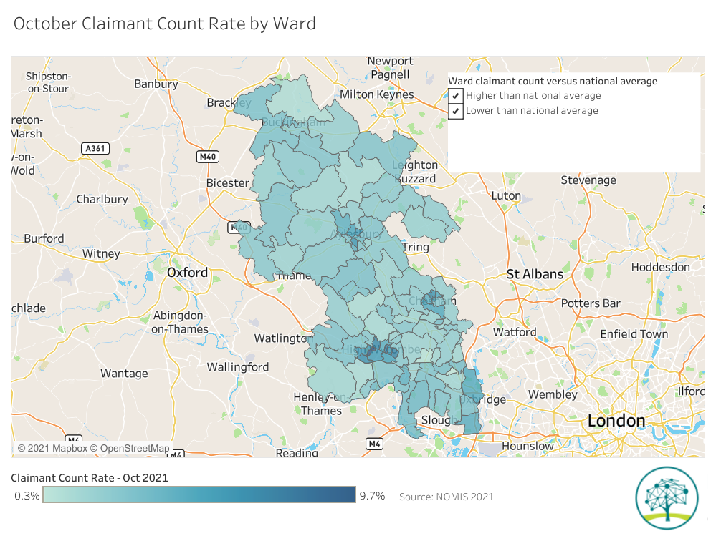
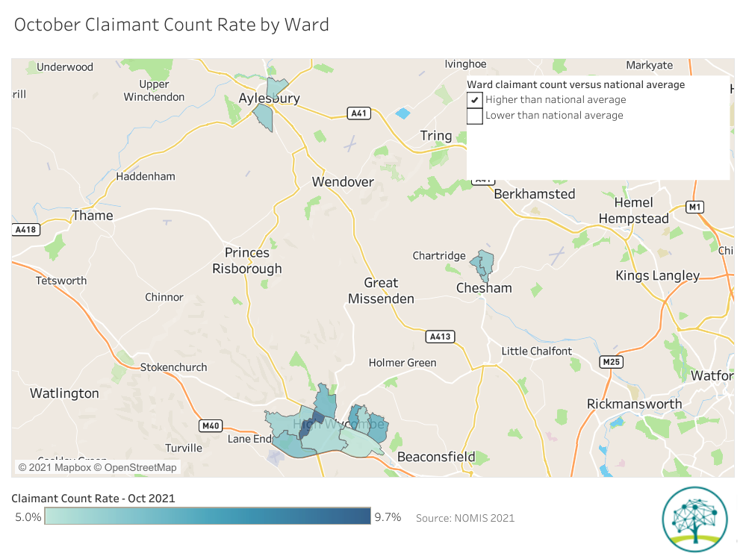
There are three clusters of areas with high claimant count rates. All are in urban areas. The largest geographic cluster is in High Wycombe.
Source: DWP, 2021 (via www.nomisweb.co.uk)
Click here for interactive version of map - October Claimant Count Rate by Ward | Tableau Public

Slide 5
Age profile of claimants in wards with highest rates
There is little difference between the age profile of claimants in the 13 wards with the highest claimant count rates and Buckinghamshire as a whole.
In Oakridge and Castlefield, the ward with the highest claimant count rate, a higher proportion of claimants are aged 30 to 49 than the County average.
Source: DWP, 2021 (via www.nomisweb.co.uk) – Data for October 2021

Slide 6
Sex of claimants in wards with highest rates
Claimants in Buckinghamshire’s wards with the highest claimant count rates are slightly more likely to be male than the County average (59% versus 56%).
Even more so in Oakridge and Castlefield where 63% of claimants are male.
Source: DWP, 2021 (via www.nomisweb.co.uk) – Data for October 2021

Slide 7
What are the ‘usual’ sectors and occupations of those claiming ‘out-of-work’ related benefits in Buckinghamshire? Particularly those in areas with higher than national average claimant count rates?
In short, we don’t know.
This data is not published, and we have been unable to glean qualitative insight from local DWP contacts.
We do have some old data however that provides some potential clues.
At the time of the 2011 Census, a higher proportion of residents in the 13 high claimant count wards worked in the ‘wholesale and retail’, ‘transport and storage’ and ‘hospitality’ than the Buckinghamshire average, and fewer residents worked in professional and public sectors.
All three of these sectors were hard-hit by the pandemic.
In Oakridge and Castlefield (the Buckinghamshire ward with the highest claimant count in October 2021), 25% of residents worked in the ‘wholesale and retail’ sector in 2011, compared to 16% of all Buckinghamshire residents.
Those previously employed in retail and hospitality roles are likely to have transferable customer service skills.

Slide 8
Industry residents living in high claimant count wards are employed in (Census 2011), versus the County average
Industry | Oakridge and Castlefield (ward with highest claimant count rate - Oct 2021) | All 13 high claimant count rate wards | Buckinghamshire
A Agriculture, forestry and fishing | 0% | 0% | 1%
B Mining and quarrying | 0% | 0% | 0%
C Manufacturing | 9% | 9% | 8%
D Electricity, gas, steam and air conditioning supply | 0% | 0% | 0%
E Water supply; sewerage, waste management and remediation activities | 1% | 1% | 1%
F Construction | 5% | 7% | 7%
G Wholesale and retail trade; repair of motor vehicles and motorcycles | 25% | 19% | 16%
H Transport and storage | 9% | 6% | 4%
I Accommodation and food service activities | 9% | 6% | 4%
J Information and communication | 4% | 6% | 7%
K Financial and insurance activities | 2% | 3% | 4%
L Real estate activities | 1% | 1% | 2%
M Professional, scientific and technical activities | 4% | 6% | 9%
N Administrative and support service activities | 6% | 6% | 5%
O Public administration and defence; compulsory social security | 3% | 5% | 5%
P Education | 7% | 9% | 10%
Q Human health and social work activities | 9% | 11% | 10%
R, S, T, U Other | 5% | 5% | 5%

Slide 9
Occupations | Oakridge and Castlefield | All 13 high claimant count rate wards | Buckinghamshire
11. Corporate managers and directors | 4% | 7% | 11%
12. Other managers and proprietors | 3% | 3% | 5%
21. Science research, engineering and technology professionals | 4% | 5% | 6%
22. Health professionals | 2% | 3% | 4%
23. Teaching and educational professionals | 3% | 4% | 5%
24. Business, media and public service professionals | 2% | 4% | 6%
31. Science, engineering and technology associate professionals | 2% | 2% | 2%
32. Health and social care associate professionals | 1% | 1% | 1%
33. Protective Service Occupations | 1% | 1% | 2%
34. Culture, media and sports occupations | 2% | 2% | 3%
35. Business and public service associate professionals | 4% | 7% | 8%
41. Administrative occupations | 7% | 8% | 8%
42. Secretarial and related occupations | 2% | 2% | 3%
51. Skilled agricultural and related trades | 1% | 1% | 1%
52. Skilled metal, electrical and electronic trades | 3% | 4% | 3%
53. Skilled construction and building trades | 3% | 4% | 4%
54. Textiles, printing and other skilled trades | 4% | 3% | 2%
61. Caring personal service occupations | 7% | 7% | 6%
62. Leisure, travel and related personal service occupations | 2% | 2% | 2%
71. Sales occupations | 13% | 8% | 6%
72. Customer service occupations | 2% | 2% | 1%
81. Process, plant and machine operatives | 4% | 3% | 2%
82. Transport and mobile machine drivers and operatives | 9% | 5% | 3%
91. Elementary trades and related occupations | 2% | 1% | 1%
92. Elementary administration and service occupations | 14% | 10% | 7%
Occupations residents living in high claimant count wards are employed in (Census 2011), versus the County average
Many of whom work as retail assistants

Slide 10
Which major employers are (or were) located in, or near to, wards with high claimant count rates? Have any recently moved, closed or made redundancies?
All three areas with higher than national average claimant count rates are urban areas, in which there tends to be higher levels of employment in retail and hospitality.
A number of retailers have closed their High Wycombe stores since the onset of the pandemic, including Pret a Manger and Two Seasons.
Oasis Foods in the Sands ward has reportedly made redundancies over the last 18 months.
Hyundai moved its headquarters out of High Wycombe to Leatherhead in the Autumn of 2020.

Slide 11
What are the demographic and social characteristics of those living in Buckinghamshire’s high claimant count wards? 1) Age structure
Buckinghamshire’s high claimant count wards have a younger age profile than the County average.
Oakridge and Castlefield (the ward with the highest claimant count rate in October 2021) has a younger age profile still.
Claimant Count rates have risen most sharply across Buckinghamshire since February 2020 amongst those aged 25 to 34. The 13 high claimant count wards have a higher proportion of residents in this age bracket than the County average.
For the group of high claimant count wards, rates have risen most sharply amongst those aged 30 to 39.
Source: Mid-Year Population Estimates 2020, ONS

Slide 12
What are the demographic and social characteristics of those living in Buckinghamshire’s high claimant count wards? 2) Ethnicity
Those living in Buckinghamshire’s 13 high claimant count rate wards are more likely to be of black, Asian or mixed ethnicity than the County average (35% compared to 14%).
In Oakridge and Castleford, 64% of residents are of black, Asian or mixed ethnicity. The highest proportion of all wards in Buckinghamshire.
Source: Census 2011, ONS

Slide 13
What are the demographic and social characteristics of those living in Buckinghamshire’s high claimant count wards? 3) Cannot speak English well
Those living in Buckinghamshire’s 13 high claimant count rate wards are more likely to be unable to speak English well than the County average (4% compared to 1%).
In Oakridge and Castleford, this figure is much higher at 10%.
Source: Census 2011, ONS

Slide 14
What are the demographic and social characteristics of those living in Buckinghamshire’s high claimant count wards? 4) No cars or vans in household
Those living in Buckinghamshire’s 13 high claimant count rate wards are less likely to have access to a car or van than across the County as a whole.
In Oakridge and Castleford, 28% of residents do not have access to a car or van, compared to the County average of 13%. Similarly. 29% of Southcourt ward (Aylesbury) residents do not have access to a car or van.
Source: Census 2011, ONS

Slide 15
Summary (1)
A handful of wards in Buckinghamshire have historically had higher than national average claimant count rates.
Whilst still small numbers, the number of wards in Buckinghamshire with higher than national average claimant count rates has more than doubled (from 5 to 13) since the onset of the Covid-19 pandemic.
9 out of the 13 wards with higher than national average claimant count rates are in High Wycombe. The remaining four are in Aylesbury and Chesham.
Despite a very buoyant job market, 1 in 10 working age residents living in the Oakridge and Castlefield ward in High Wycombe were claiming ‘out-of-work’ related benefits in October 2021.
There is little difference in the age profile and sex of claimants in the 13 high claimant count wards and the rest of the County. Claimants in Oakridge and Castlefield are however more likely to be male and in their 30s and 40s than in the rest of the County.

Slide 16
Summary (2)
Whilst we do not have data or local insight regarding the previous jobs held by those currently claiming ‘out-of-work’ related benefits, we know that historically, those living in the wards with high claimant count rates in October 2021 were more likely to be employed in the following sectors than the County average:
Wholesales and retail
Transport and storage
Hospitality
They were also more likely to work in ‘low skilled’ roles, such as
‘Elementary’ admin and service occupations
Retail assistants
Transport and mobile machine drivers and operatives
Those living in high claimant count wards tend to be younger than the County’s population as a whole, are more likely to be of black, Asian or mixed heritage, are more likely not to speak English well and are less likely to have access to a car or van than the County average.

Slide 17
What more could be done to help those claiming ‘out-of-work’ related benefits find new employment?
Short-term
Actions set out in the Buckinghamshire Local Skills Report
DWP initiatives - Restart etc
Buckinghamshire Council Employability and Skills Taskforce
Debt Prevent and Advice Workstream High Wycombe Pilot underway
A new jobcentre is opening on High Wycombe high street.
Medium to long-term
County Deal asks including:-
Freedom & flexibility in delivering skills brokerage services beyond the DWP Framework
Pinewood Global Screen Hub – serving local outreach as well national needs
College ambitions to deliver new FE Campus in High Wycombe Town Centre

Slide 18


All the latest local labour market analysis is available on the Buckinghamshire Economic Intelligence Observatory website
www.buckseconomy.co.uk or via www.buckstvlep.co.uk
#buckseconobservatory
@BucksLEP
@Caroline_BLEP
research@buckslep.co.uk

