Slide 2
Job Vacancies within Buckinghamshire
August 2021

Slide 3
Background
This slide deck provides a monthly summary of recruitment trends within Buckinghamshire.
Data is sourced from Burning Glass Technologies via the Labour Insight platform. Data is generated by scraping information from job adverts posted on-line Further details can be found here.
To monitor the impact of Covid-19 on the labour market, and track the speed of economic recovery, data within this report is either benchmarked against Quarter 1 (January to March) 2020, or is benchmarked against the corresponding month in 2019.
Further details, including some caveats to be aware are, can be found at the end of this slide deck.

Slide 4
Headlines – July 2021
The recent rise in job postings in Buckinghamshire has slowed, with a 8% fall in job postings in July 2021 compared to the previous month. This decline is higher than the 5% fall nationally.
This follows on from an 9% rise in job postings in Buckinghamshire between May 2021 and June 2021.
Within Buckinghamshire, the largest fall between June 2021 and July 2021 was in the South Bucks area (-30%).
Roles with the most job postings for July 2021 in Buckinghamshire included office/admin assistant, customer service rep, account manager/rep, registered general nurse, project manager, software developer/engineer and accountant.
Compared to previous quarters, demand for health and social care roles is now lower whilst business-related roles have featured prominently in job postings data throughout.
Demand for teamwork, collaboration, customer service, KPIs and customer contact skills was greater in Q2 2021 than Q2 2020. This compares to reduced demand for skills in teaching, budgeting, accounting, cleaning, staff management and working with patient and/or carer.
‘Visible’ employers with the most job openings include Buckinghamshire Council, the NHS, Danaher Corporation, the Buckinghamshire Healthcare Trust and Johnson & Johnson.

Slide 5
Monthly Job Postings: 2020-21

Slide 6
Monthly Job Postings: 2020-21
As with the national picture, job postings in Buckinghamshire declined significantly at the start of the first Covid-19 lockdown.
From May 2020 to October 2020, the number of job postings (nationally and in Buckinghamshire) rose month on month.
In October 2020, the number of job postings returned to pre-pandemic levels.
The second national lockdown initiated in early November 2020 brought a return to falling job posting numbers, however they remained at pre-pandemic levels in Buckinghamshire.
December 2020 saw a drop in job posting numbers in Buckinghamshire, whereas numbers for England remained relatively level. This is to be expected as recruitment activity tends to be lower in December.
Job postings increased at the start of 2021 in Buckinghamshire, with numbers for March 2021 onwards surpassing those from the previous year.

Slide 7
Recruitment activity tends to vary across the year, so how does 2021 & 2020 compare with 2019 on a month-by-month basis?
Number of job postings
Data for Buckinghamshire

Slide 8
Variation within Buckinghamshire
Job postings in Buckinghamshire during May 2021 to July 2021 are higher overall compared to the same period pre-Covid.
Within Buckinghamshire, South Bucks has had the largest rise in the number of job postings.
Job postings in Buckinghamshire increased more significantly compared to the South East region and England as a whole.
Note – some job postings state the job location as being ‘Buckinghamshire’ only. These cannot therefore be coded to sub-areas. Hence why the data for Buckinghamshire is higher than the data for the four former districts combined.
 | Number of job postings
 | May 19-Jul 19 (pre-Covid benchmark) | May 21-Jul 21 (latest 3 months) | Change | Change (%)
Wycombe | 4,320 | 5,540 | +1,220 | +28%
Aylesbury Vale | 2,710 | 3,730 | +1,020 | +38%
South Bucks | 780 | 1,360 | +580 | +74%
Chiltern | 900 | 1,440 | +540 | +60%
Buckinghamshire | 12,530 | 19,060 | +6,530 | +52%
South East England | 259,200 | 358,620 | +99,420 | +38%
England | 1,295,560 | 1,735,500 | +439,940 | +34%

Slide 9
Top occupational groups by number of job postings – July 2021
Data for Buckinghamshire

Slide 10
Job creation: occupations with more job postings in Bucks in Q2 2021 than Q2 2020
Admin, sales and customer service roles
Legal and finance roles
Construction and engineering roles
Chefs
Roles linked to increase in online retail (warehouse and driver roles)
Early-years teaching roles
Source: Labour Insight

Slide 11
Reduced demand: occupations with fewer job postings in Bucks in Q2 2021 than Q2 2020
Nursing and social care
Product manager
Computer programmer
Vocational and secondary education
Source: Labour Insight

Slide 12
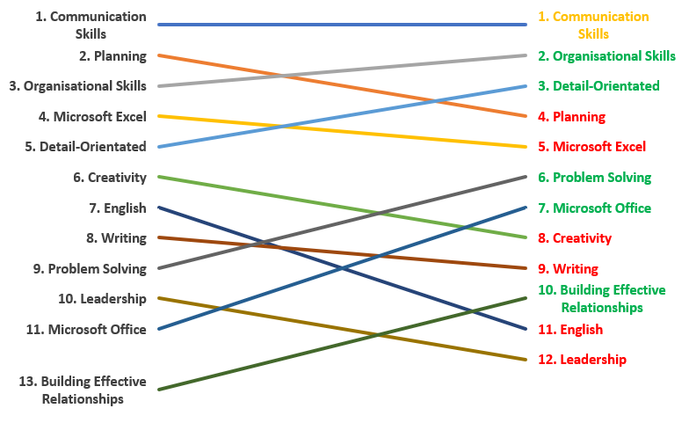
Changing demand for skills – baseline skills
The chart shows the change in demand for the top baseline skills (as cited within job postings) between Quarter 2 (Apr-Jun) 2020 and Quarter 2 (Apr-Jun) 2021.
Overall, there hasn’t been a significant deal of change.
There has been a relative increase in demand for
‘organisational’ skills (3rd to 2nd)
‘detail-orientated’ skills (5th to 3rd)
‘problem solving’ skills (9th to 6th)
‘Microsoft Office’ skills (11th to 7th)
skills in ‘building effective relationships’ (13th to 10th)
And a relative decrease in demand for:
‘planning’ skills (2nd to 4th),
‘Microsoft Excel’ skills (4th to 5th)
‘creativity’ skills (6th to 8th)
‘writing skills (8th to 9th).
‘English’ skills (7th to 11th)
‘leadership’ skills (10th to 12th)
Q2 2020
Q2 2021

Slide 13
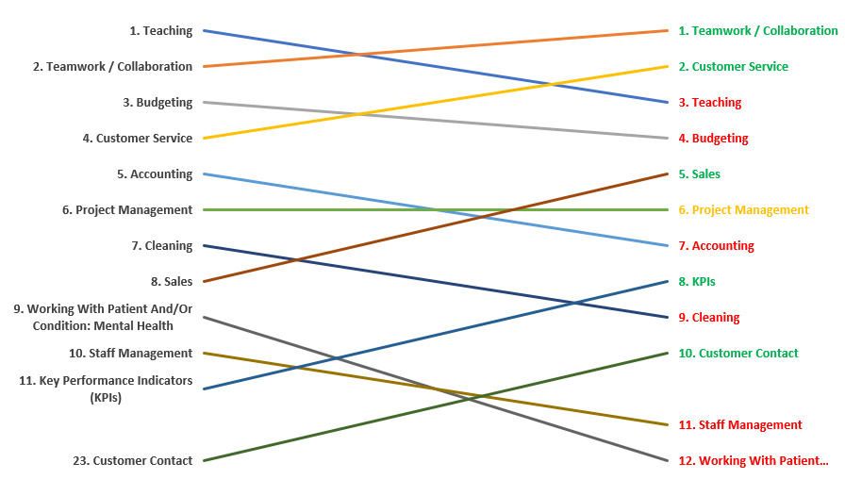
Changing demand for skills – specialist skills
Q2 2020
Q2 2021
The chart shows the change in demand for the top specialised skills demand (as cited within job postings) between Quarter 2 (Apr-Jun) 2020 and Quarter 2 (Apr-Jun) 2021.
There was a relatively large increase in demand for ‘customer contact’ skills (23rd to 10th), ‘sales’ skills (8th to 5th) and ‘KPIs’ (11th to 8th).
Demand also increased for ‘teamwork / collaboration skills (2nd to 1st), and ‘customer service’ skills (4th to 2nd).
There were declines in demand for:
‘teaching’ (1st to 3rd)
‘budgeting’ (3rd to 4th)
‘accounting’ (5th to 7th)
‘cleaning’ (7th to 9th)
‘staff management’ (10th to 11th)
‘working with patient and/or condition’ skills (9th to 12th).

Slide 14
Demand for computer and programming skills
This table shows the top computer and programming skills featured in job postings for Buckinghamshire for the month of July 2021.
Four Microsoft Office suite programmes feature in the top five.
Demand for Customer Relationship Management skills is growing globally.
Growth categories are stable for all other computer and programming skills.
Most sought computer and programming skills by Bucks employers | National Growth Category | Global Growth Category
Microsoft Excel | Stable | Stable
Microsoft Office | Stable | Stable
Microsoft Word | Stable | Stable
SAP | Stable | Stable
Microsoft PowerPoint | Stable | Stable
SQL | Stable | Stable
Software Development | Stable | Stable
Customer Relationship Management (CRM) | Stable | Growing
Enterprise Resource Planning | Stable | Stable
Microsoft C# | Stable | Stable

Slide 15
Some employers with the most job openings in Buckinghamshire – May 2021 to July 2021
Around 45% of job postings in Buckinghamshire can be linked to a specific employer. Many employers chose not to provide their name when recruiting via a recruitment agency or job site.
This table is therefore based on the 45% of job postings which can be linked to an employer (‘visible’ employers)
‘Visible’ employers with the most job openings for the last full quarter (Q2 Apr-Jun 2021) are primarily in the Human Health and Social Work sector.
This corresponds with the high proportionate number of job postings for the sector.
Source: Burning Glass Technologies
Note: 55% of records have been excluded because they do not include an employer. As a result, the chart above may not be representative of the full sample.

Slide 16
About the data
Online job postings provide a useful, real-time indication of the characteristics and health of local labour markets.
However, limitations of online job posting data include:
Some jobs not commonly advertised online (e.g. those often filled through word-of-mouth or adverts in windows)
The employer’s name often not being included in the job posting, which makes it difficult to glean a complete picture of the top recruiting employers in an area, and makes it difficult to assign jobs to industries.
The location not being provided in the job posting, in part due to the increased prevalence of remote working.
Burning Glass Technologies’ classifications of skills are:
Specialised skills - covers skills that are specific to an occupation, such as ‘lesson planning’ for teachers, or ‘Primary Care’ for nurses.
Baseline skills - are sometimes also called “soft skills” or “transferable skills”. They include skills that are useful across a variety of occupations, such as ‘research’ or ‘staff coordination’.
Computer and programming skills - are IT skills ranging from widely applicable (e.g. ‘Microsoft Word’) to highly specialised (e.g. ‘PERL’).

